Slide 1

CS 0445
Data Structures
Fall 2017
Sorting II
Sherif Khattab
ksm73@pitt.edu
6307 Sennott Square

Slide 2
Administrivia
Assignment 3 due on 11/14 @11:59pm
Quiz in recitation of next week
open-book open-notes
same format as Quiz 1:
design and implement a solution to a problem

Slide 3
Earlier in the course
InsertionSort and SelectionSort

Slide 4
Today’s Topics
Sorting
O(n²)
InsertionSort on linked chains
Shell Sort
O(n log n)
MergeSort
QuickSort
O(1) Sorting
Radix Sort

Slide 5
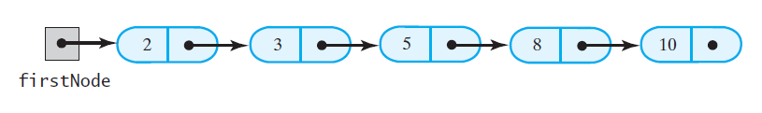
Insertion Sort of a Chain of Linked Nodes
FIGURE 8-8 A chain of integers sorted into ascending order

Slide 6
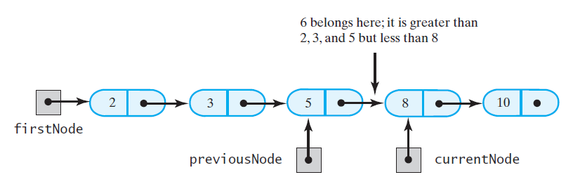
Insertion Sort of a Chain of Linked Nodes
FIGURE 8-9 During the traversal of a chain to locate the insertion point, save a reference to the node before the current one

Slide 7
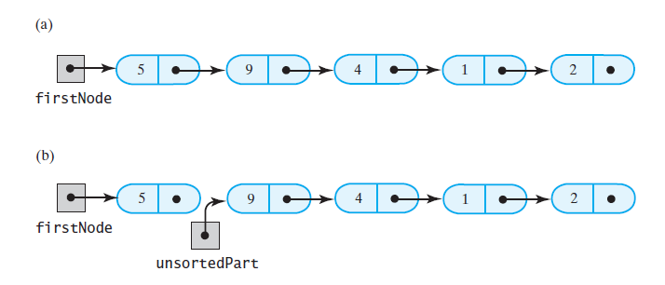
Insertion Sort of a Chain of Linked Nodes
FIGURE 8-10 Breaking a chain of nodes into two pieces as the first step in an insertion sort: (a) the original chain; (b) the two pieces

Slide 8
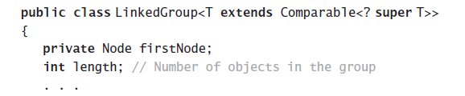
Insertion Sort of a Chain of Linked Nodes
Add a sort method to a class LinkedGroup
that uses a linked chain to represent a certain collection

Slide 9
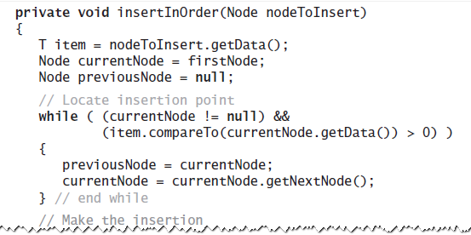
Insertion Sort of a Chain of Linked Nodes
This class has an inner class Node that has set and get methods

Slide 10
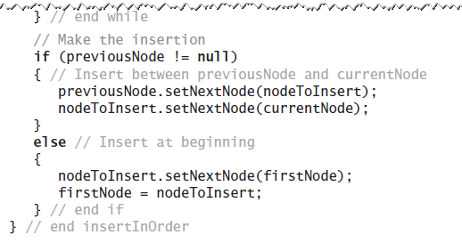
Insertion Sort of a Chain of Linked Nodes
This class has an inner class Node that has set and get methods

Slide 11
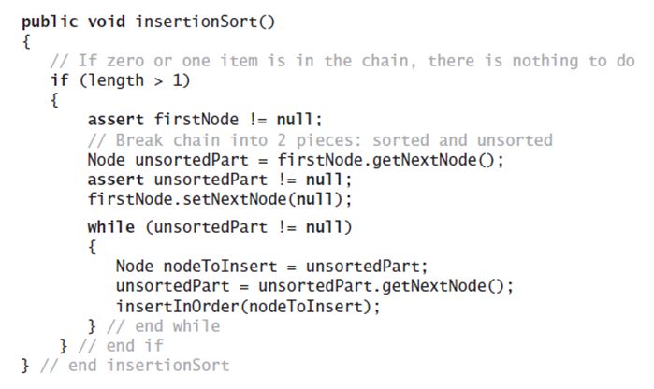
Insertion Sort of a Chain of Linked Nodes
The method to perform the insertion sort.

Slide 12
Shell Sort
Algorithms seen so far are simple but inefficient for large arrays at O(n²)
Note, the more sorted an array is, the less work insertInOrder must do
Improved insertion sort developed by Donald Shell

Slide 13
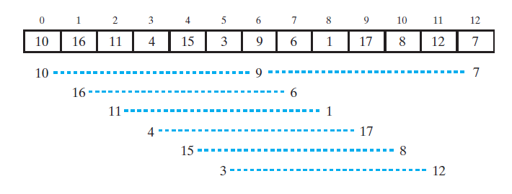
Shell Sort
FIGURE 8-11 An array and the subarrays formed by grouping entries whose indices are 6 apart.

Slide 14
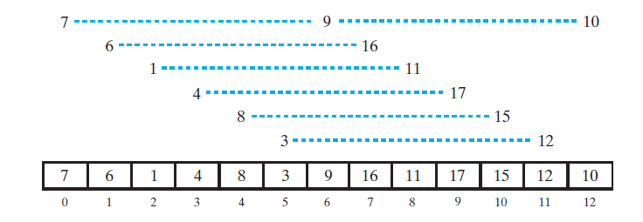
Shell Sort
FIGURE 8-12 The subarrays of Figure 8-11 after each is sorted, and the array that contains them

Slide 15
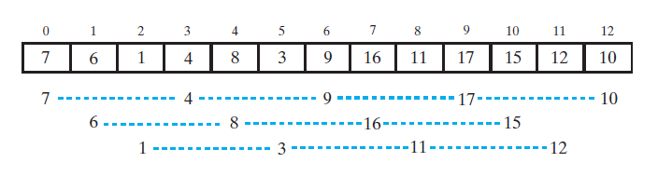
Shell Sort
FIGURE 8-13 The subarrays of the array in Figure 8-12 formed by grouping entries whose indices are 3 apart

Slide 16
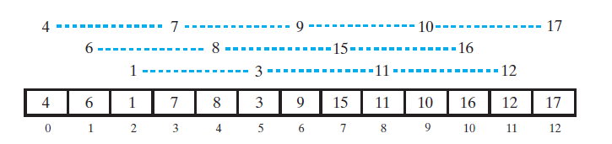
Shell Sort
FIGURE 8-14 The subarrays of Figure 8-13 after each is sorted, and the array that contains them

Slide 17
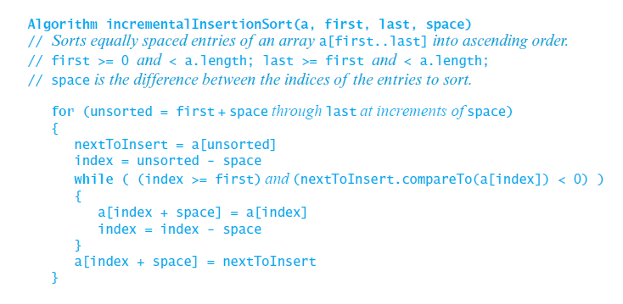
Shell Sort
Algorithm that sorts array entries whose indices are separated by an increment of space.

Slide 18
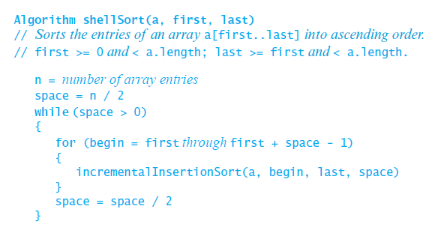
Shell Sort
Algorithm to perform a Shell sort will invoke incrementalInsertionSort and supply any sequence of spacing factors. Efficiency (worst) can be O(n^{1.5})

Slide 19
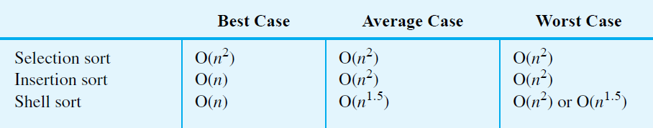
Comparing the Algorithms
FIGURE 8-16 The time efficiencies of three sorting algorithms, expressed in Big Oh notation

Slide 20
Merge Sort
Divides an array into halves
Sorts the two halves,
Then merges them into one sorted array.
The algorithm for merge sort is usually stated recursively.
Major programming effort is in the merge process

Slide 21
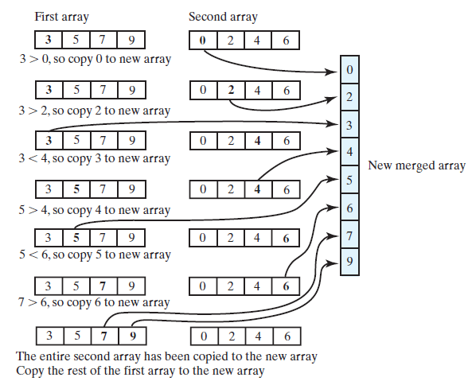
Merging Arrays
FIGURE 9-1 Merging two sorted arrays into one sorted array

Slide 22
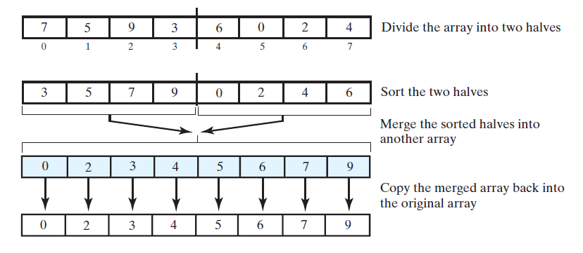
Recursive Merge Sort
FIGURE 9-2 The major steps in a merge sort

Slide 23
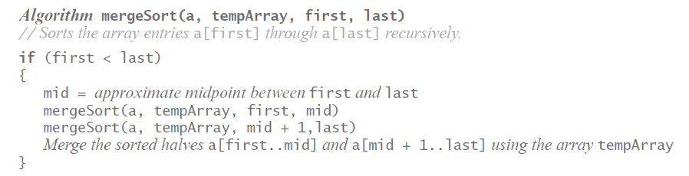
Recursive Merge Sort
Recursive algorithm for merge sort.

