Slide 1

CS 0445
Data Structures
Fall 2017
Sorting III
Sherif Khattab
ksm73@pitt.edu
6307 Sennott Square

Slide 2
Administrivia
Assignment 3 due on 11/14 @11:59pm
Quiz in recitation of next week
open-book open-notes
same format as Quiz 1:
design and implement a solution to a problem

Slide 3
Earlier in the course
InsertionSort and SelectionSort, Shell’s Sort, MergeSort

Slide 4
Today’s Topics
Sorting
O(n log n)
MergeSort
QuickSort
O(1) Sorting
Radix Sort

Slide 5
Merge Sort
Divides an array into halves
Sorts the two halves,
Then merges them into one sorted array.
The algorithm for merge sort is usually stated recursively.
Major programming effort is in the merge process

Slide 6
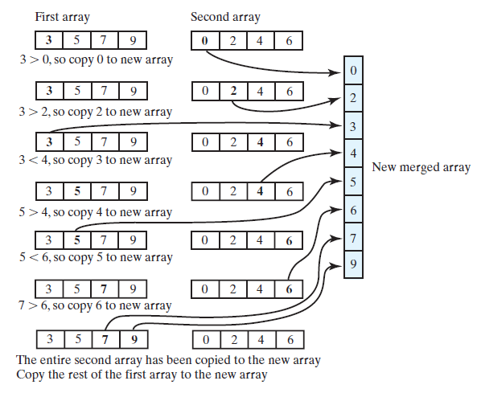
Merging Arrays
FIGURE 9-1 Merging two sorted arrays into one sorted array

Slide 7
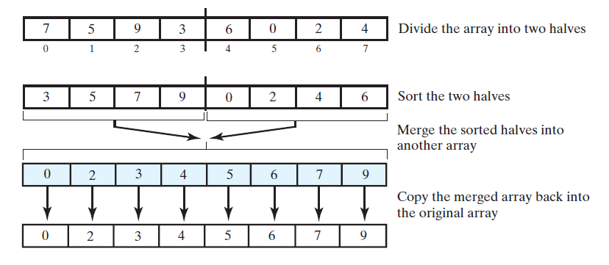
Recursive Merge Sort
FIGURE 9-2 The major steps in a merge sort

Slide 8
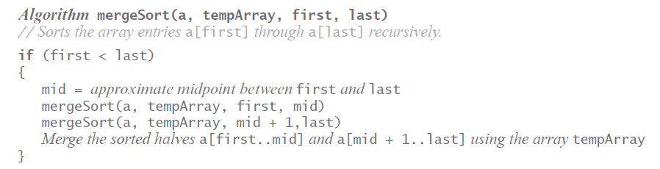
Recursive Merge Sort
Recursive algorithm for merge sort.

Slide 9
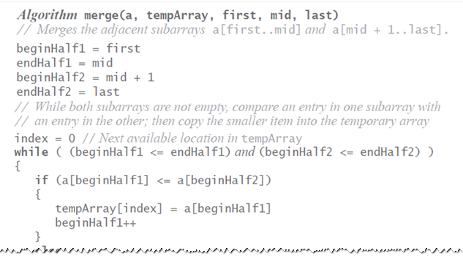
Recursive Merge Sort
Pseudocode which describes the merge step.

Slide 10
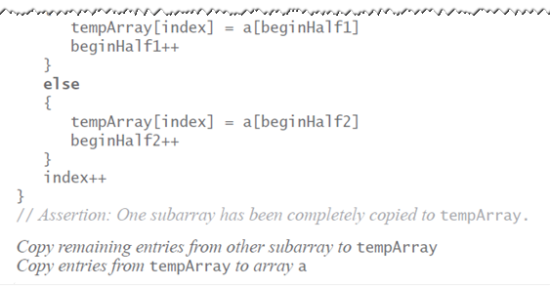
Recursive Merge Sort
Pseudocode which describes the merge step.

Slide 11
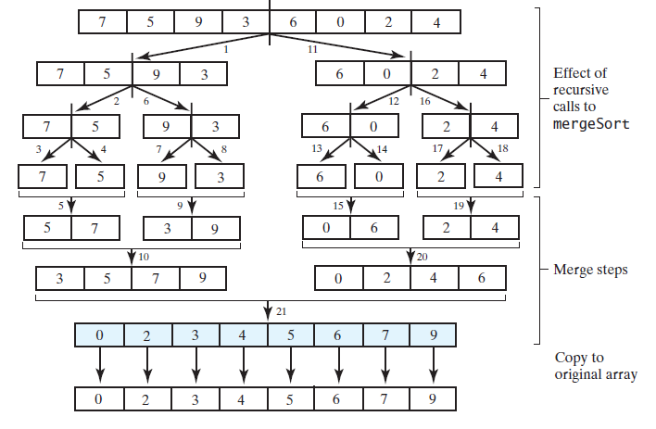
Recursive Merge Sort
FIGURE 9-3 The effect of the recursive calls and the merges during a merge sort

Slide 12
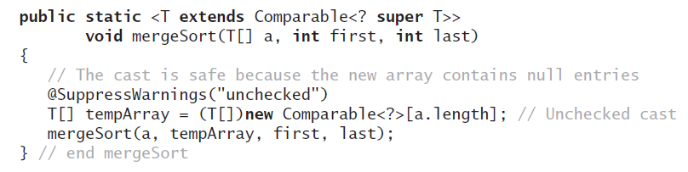
Recursive Merge Sort
Be careful to allocate the temporary array only once.

Slide 13
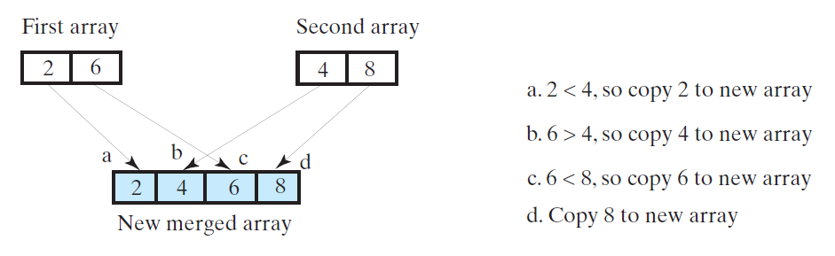
Efficiency of Merge Sort
FIGURE 9-4 A worst-case merge of two sorted arrays.
Efficiency is O(n log n).

Slide 14
Iterative Merge Sort
Less simple than recursive version.
Need to control the merges.
Will be more efficient of both time and space.
But, trickier to code without error.

Slide 15
Iterative Merge Sort
Starts at beginning of array
Merges pairs of individual entries to form two-entry subarrays
Returns to the beginning of array and merges pairs of the two-entry subarrays to form four-entry subarrays
And so on
After merging all pairs of subarrays of a particular length, might have entries left over.

Slide 16
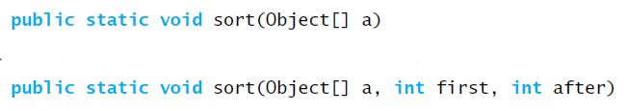
Merge Sort in the Java Class Library
Class Arrays in the package java.util defines versions of a static method sort

Slide 17
Quick Sort
Divides an array into two pieces
Pieces are not necessarily halves of the array
Chooses one entry in the array—called the pivot
Partitions the array

Slide 18
Quick Sort
When pivot chosen, array rearranged such that:
Pivot is in position that it will occupy in final sorted array
Entries in positions before pivot are less than or equal to pivot
Entries in positions after pivot are greater than or equal to pivot

Slide 19
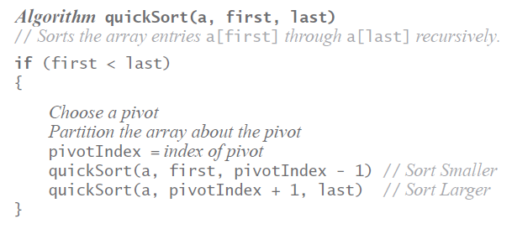
Quick Sort
Algorithm that describes our sorting strategy:

Slide 20
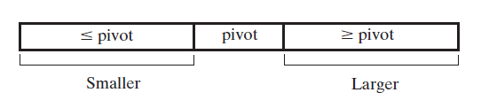
Quick Sort
FIGURE 9-5 A partition of an array during a quick sort
Quick sort is O(n log n) in average case, O(n²) in worst case.
Choice of pivots affects behavior

Slide 21
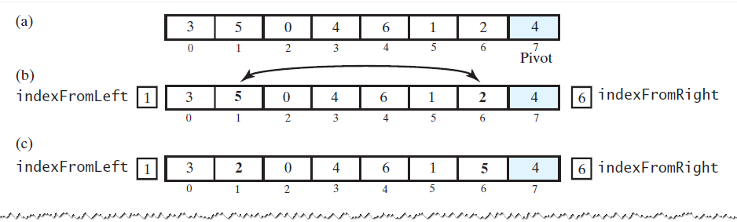
Creating the Partition
FIGURE 9-6 A partitioning strategy for quick sort

Slide 22
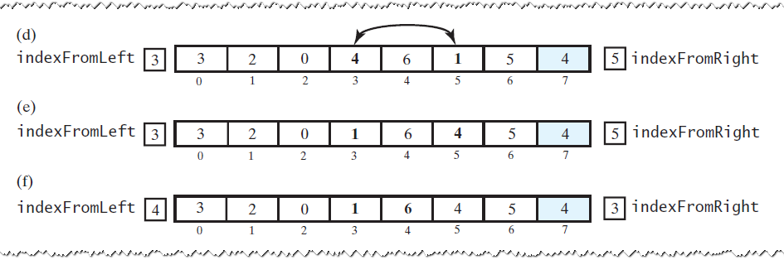
Creating the Partition
FIGURE 9-6 A partitioning strategy for quick sort

Slide 23
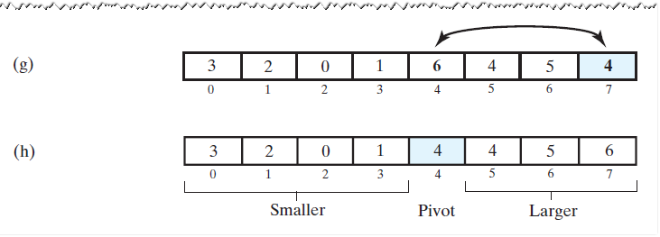
Creating the Partition
FIGURE 9-6 A partitioning strategy for quick sort

Slide 24
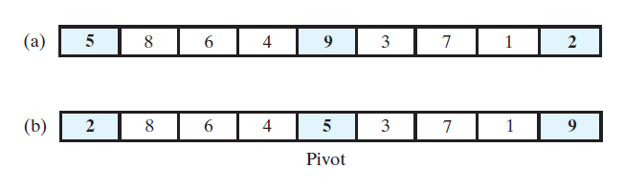
Creating the Partition
FIGURE 9-7 Median-of-three pivot selection: (a) The original array; (b) the array with its first, middle, and last entries sorted

Slide 25
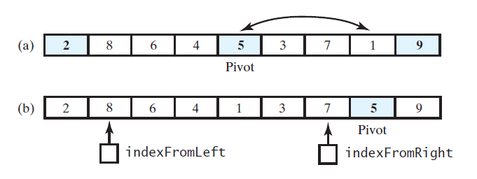
Adjusting the Partition Algorithm
FIGURE 9-8 (a) The array with its first, middle, and last entries sorted; (b) the array after positioning the pivot and just before partitioning

Slide 26
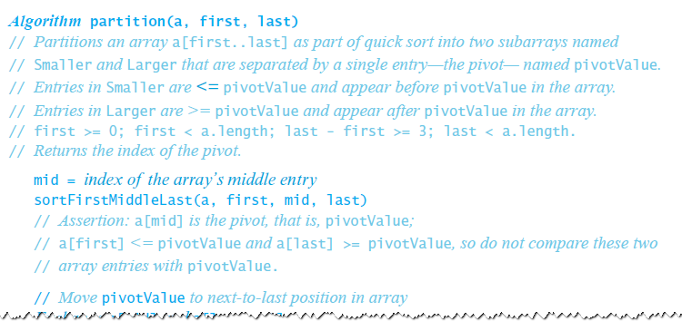
Adjusting the Partition Algorithm

Slide 27
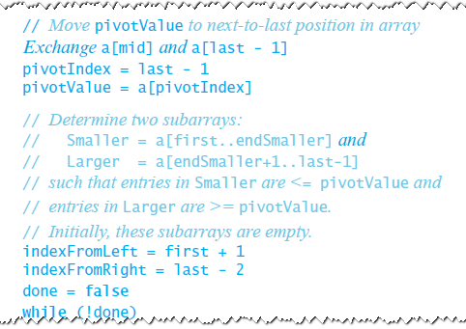
Adjusting the Partition Algorithm

Slide 28
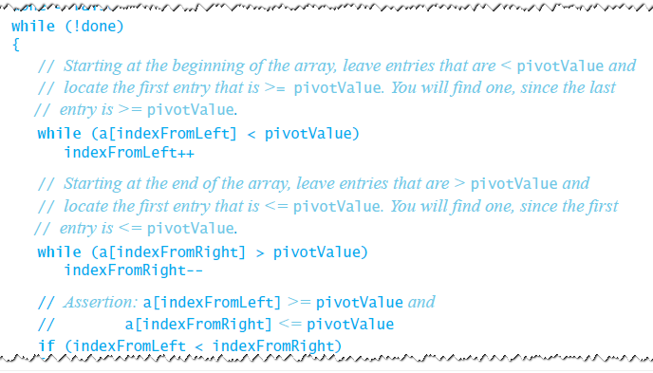
Adjusting the Partition Algorithm

Slide 29
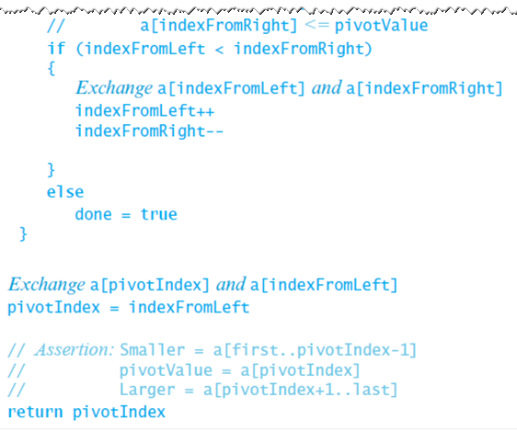
Adjusting the Partition Algorithm

Slide 30
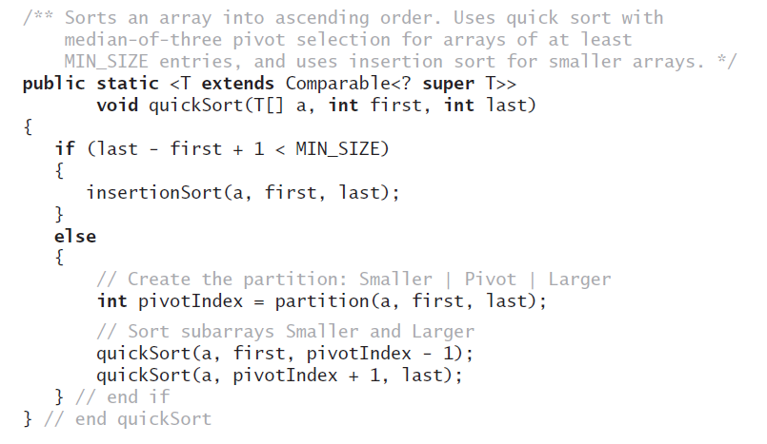
The Quick Sort Method
Above method implements quick sort.

Slide 31
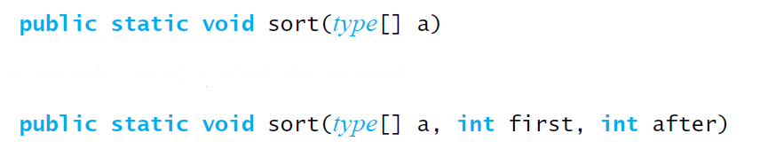
Quick Sort in the Java Class Library
Class Arrays in the package java.util uses a quick sort to sort arrays of primitive types into ascending order

