Slide 1

CS 0445
Data Structures
Fall 2017
Sorting IV + List ADT
Sherif Khattab
ksm73@pitt.edu
6307 Sennott Square

Slide 2
Administrivia
Assignment 3 due on 11/17 @11:59pm
Quiz 2 in recitations of this week
open-book open-notes
same format as Quiz 1:
design and implement a solution to a problem

Slide 3
Earlier in the course
InsertionSort, SelectionSort, Shell’s Sort, MergeSort, QuickSort

Slide 4
Today’s Topics
Sorting
O(1) Sorting
Radix Sort

Slide 5
Radix Sort
Does not use comparison
Treats array entries as if they were strings that have the same length.
Group integers according to their rightmost character (digit) into “buckets”
Repeat with next character (digit), etc.

Slide 6
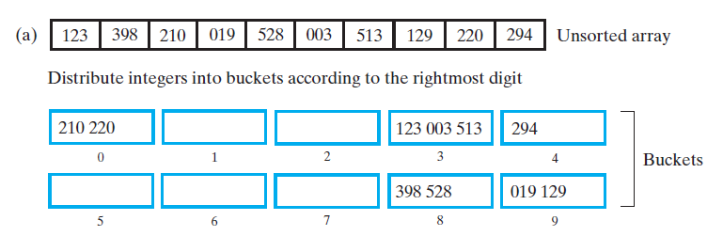
Radix Sort
FIGURE 9-9 Radix sort: (a) Original array and buckets after first distribution;

Slide 7
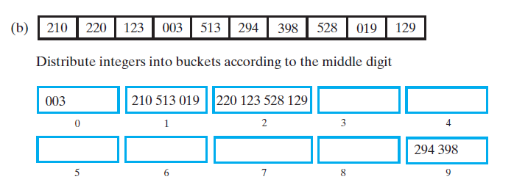
Radix Sort
FIGURE 9-9 Radix sort: (b) reordered array and buckets after second distribution;

Slide 8
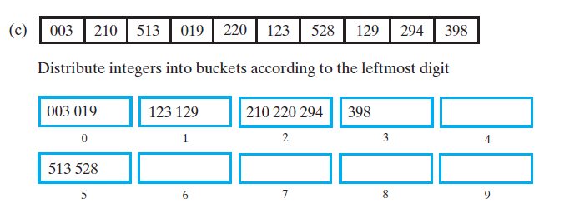

Radix Sort
FIGURE 9-9 Radix sort: (c) reordered array and buckets after third distribution; (d) sorted array

Slide 9
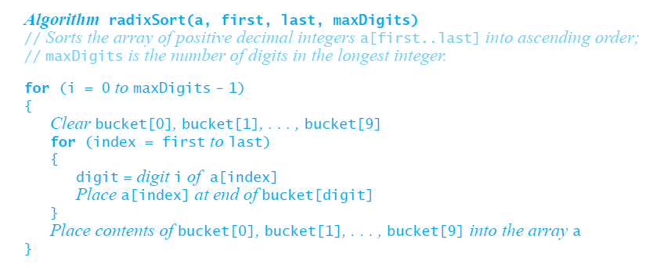
Pseudocode for Radix Sort
Radix sort is an O(n) algorithm for certain data, it is not appropriate for all data

Slide 10
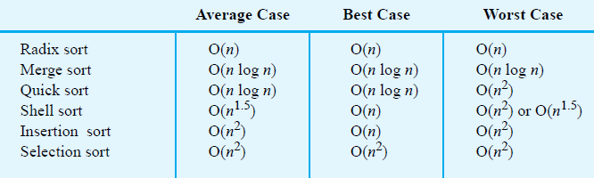
Comparing the Algorithms
FIGURE 9-10 The time efficiency of various sorting algorithms, expressed in Big Oh notation

Slide 11
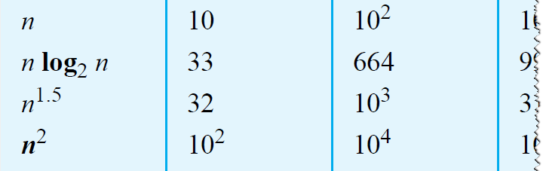
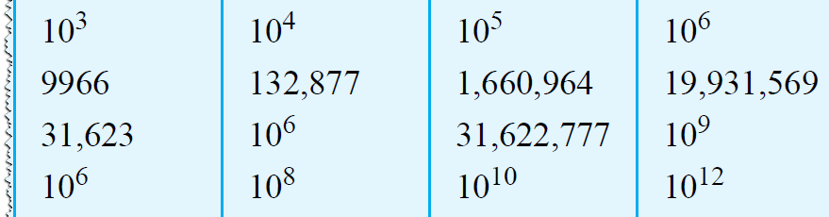
Comparing the Algorithms
FIGURE 9-11 A comparison of growth-rate functions as n increases

Slide 12
Lists
A way to organize data
Examples
To-do list
Gift lists
Grocery Lists
Items in list have position
May or may not be important
Items may be added anywhere

Slide 13

Lists
FIGURE 12-1 A to-do list

Slide 14
Specifications for the ADT List
add (newEntry)
add (newPosition, newEntry)
remove(givenPosition)
clear()
replace( givenPosition, newEntry)
getEntry( givenPosition)
toArray()
contains(anEntry)
getLength()
isEmpty()

Slide 15
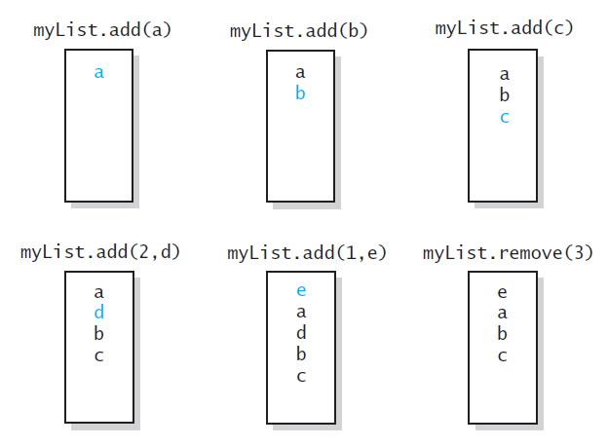
Specifications for the ADT List
FIGURE 12-2 The effect of ADT list operations on an initially empty list

Slide 16
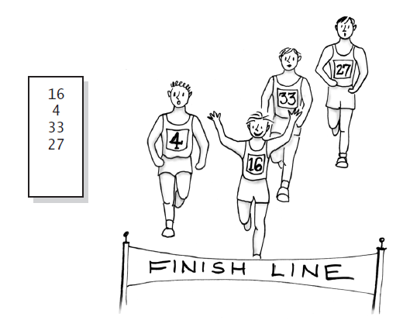
Using the ADT List
FIGURE 12-3 A list of numbers that identify runners in the order in which they finished a race

Slide 17
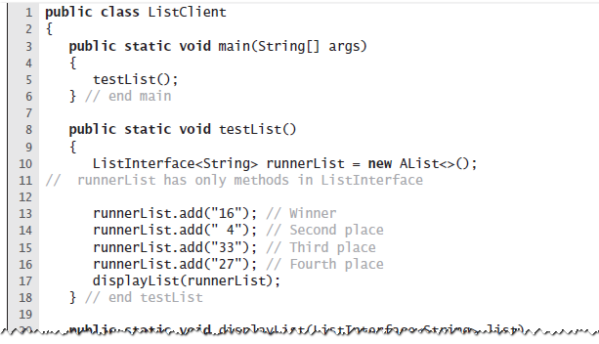
Using the ADT List
LISTING 12-2 A client of a class that implements ListInterface

Slide 18
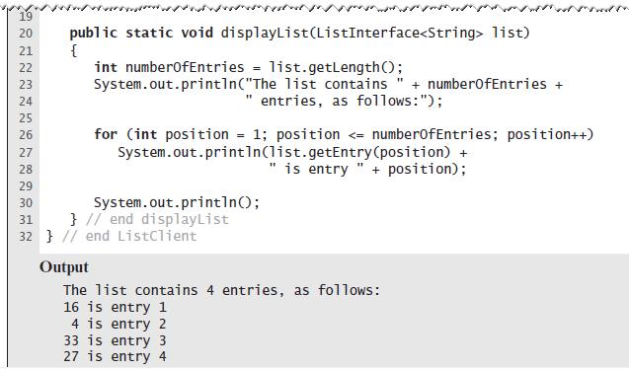
Using the ADT List
LISTING 12-2 A client of a class that implements ListInterface

Slide 19
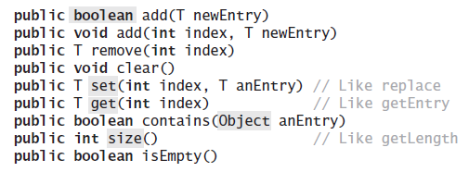
Java Class Library: The Interface List
Method headers from the interface List

Slide 20
Java Class Library: The Class ArrayList
Available constructors
public ArrayList()
public ArrayList(int initialCapacity)
Similar to java.util.vector
Can use either ArrayList or Vector as an implementation of the interface List.

Slide 21
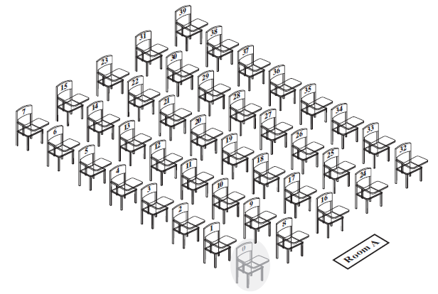
Array to Implement the ADT List
FIGURE 13-1 A classroom that contains desks in fixed positions

Slide 22
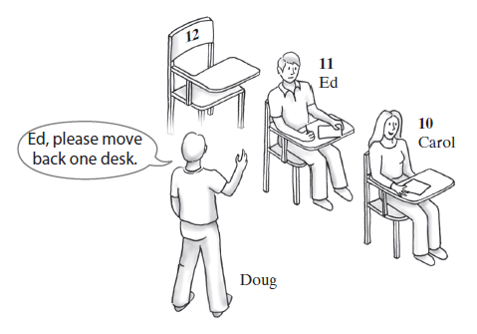
Array to Implement the ADT List
FIGURE 13-2 Seating a new student between two existing students: At least one other student must move

Slide 23
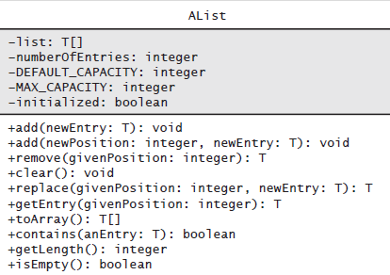
Array to Implement the ADT List
FIGURE 13-3 UML notation for the class AList

Slide 24
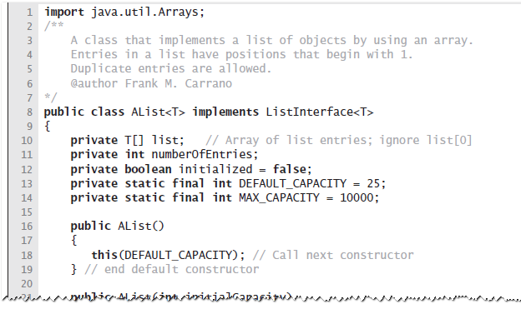
Array to Implement the ADT List
LISTING 13-1 The class AList

Slide 25
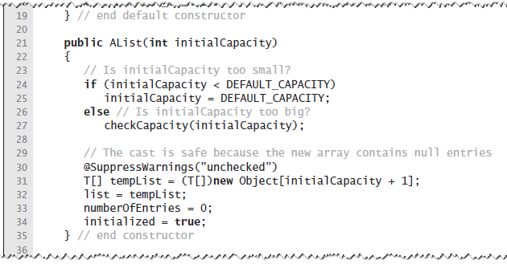
Array to Implement the ADT List
LISTING 13-1 The class AList

Slide 26
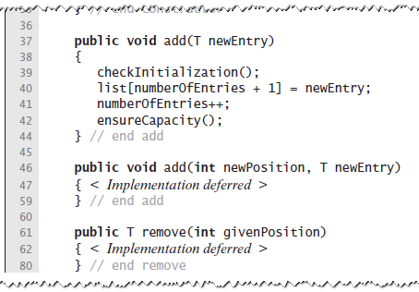
Array to Implement the ADT List
LISTING 13-1 The class AList

Slide 27
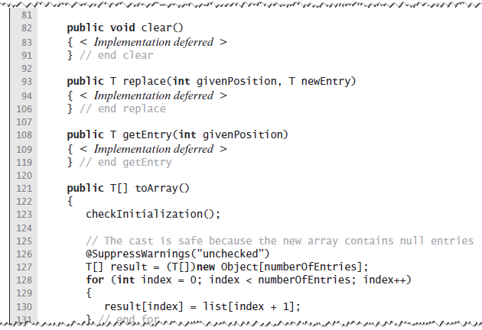
Array to Implement the ADT List
LISTING 13-1 The class AList

Slide 28
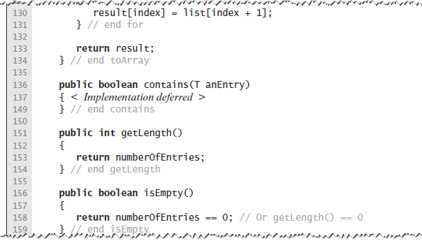
Array to Implement the ADT List
LISTING 13-1 The class AList

Slide 29
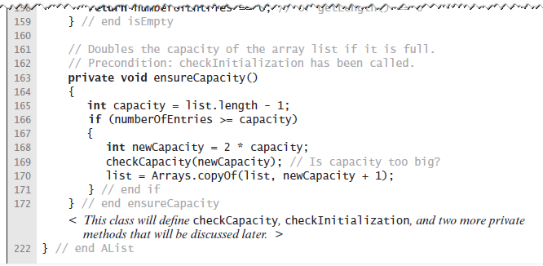
Array to Implement the ADT List
LISTING 13-1 The class AList

Slide 30
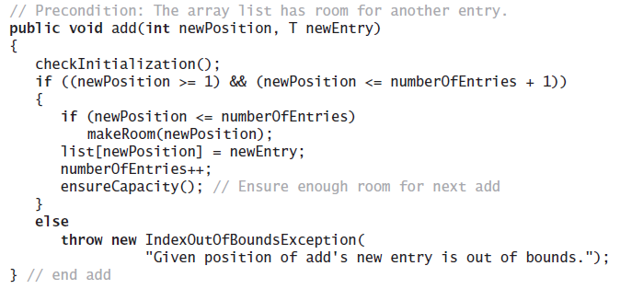
Array to Implement the ADT List
Implementation of add uses a private method makeRoom to handle the details of moving data within the array

Slide 31
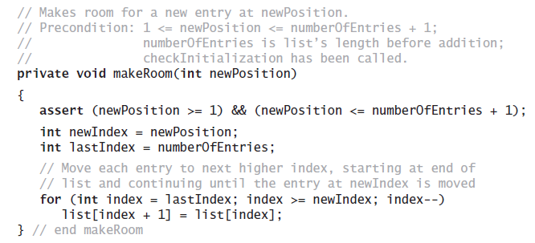
Array to Implement the ADT List
Implement the private method makeRoom

Slide 32
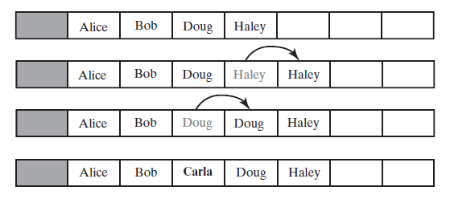
Array to Implement the ADT List
FIGURE 13-4 Making room to insert Carla as the third entry in an array

Slide 33
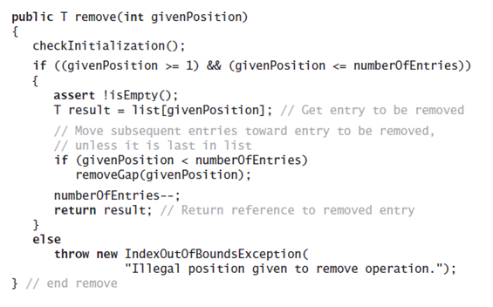
Array to Implement the ADT List
Implementation uses a private method removeGap to handle the details of moving data within the array.

Slide 34
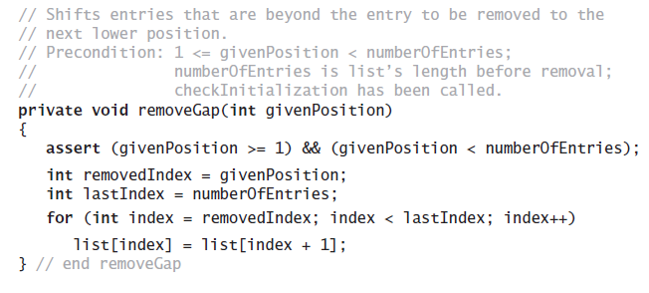
Array to Implement the ADT List
Method removeGap shifts list entries within the array

Slide 35
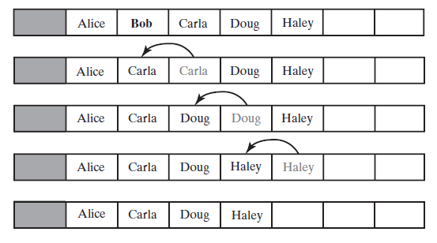
Array to Implement the ADT List
FIGURE 13-5 Removing Bob by shifting array entries

Slide 36
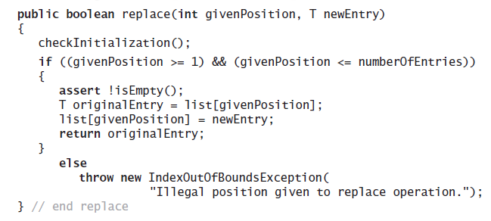
Array to Implement the ADT List
Method replace

Slide 37
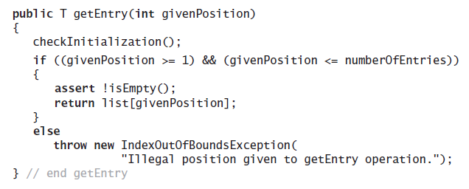
Array to Implement the ADT List
Method getEntry

Slide 38
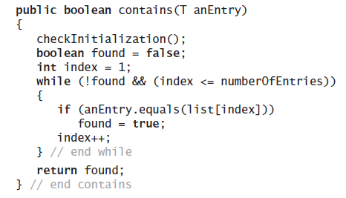
Array to Implement the ADT List
Method contains uses a local boolean variable to terminate the loop when we find the desired entry.

Slide 39
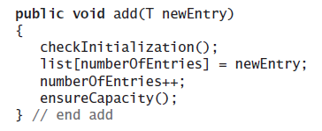
Array to Implement the ADT List
Operation that adds a new entry to the end of a list.
Efficiency O(1) if new if array is not resized.

Slide 40
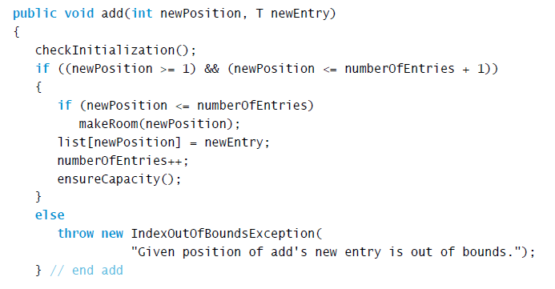
Array to Implement the ADT List
Add a new entry to a list at a client-specified position.

Slide 41
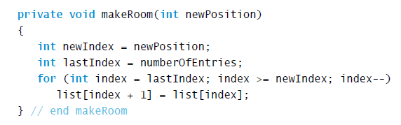
Array to Implement the ADT List
Method add uses method makeRoom.

Slide 42
Linked Implementation
Uses memory only as needed
When entry removed, unneeded memory returned to system
Avoids moving data when adding or removing entries

