Slide 1

CS 0445
Data Structures
Fall 2017
Linked Implementation of the List ADT
Searching
Sherif Khattab
ksm73@pitt.edu
6307 Sennott Square

Slide 2
Administrivia
Assignment 3 due on 11/17 @11:59pm
Quiz 2 in recitations of this week
open-book open-notes
same format as Quiz 1:
design and implement a solution to a problem

Slide 3
Earlier in the course
ADTs
Bag
Stack
Algorithms
Recursive algorithms
Sorting

Slide 4
Today’s Topics
Linked implementation of the List ADT
Searching algorithms

Slide 5
Linked Implementation
Uses memory only as needed
When entry removed, unneeded memory returned to system
Avoids moving data when adding or removing entries

Slide 6
Adding a Node at Various Positions
Possible cases:
Chain is empty
Adding node at chain’s beginning
Adding node between adjacent nodes
Adding node to chain’s end

Slide 7

Adding a Node to an empty chain
This pseudocode establishes a new node for the given data

Slide 8
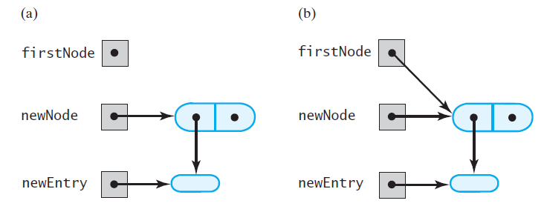
Adding a Node
FIGURE 14-1 (a) An empty chain and a new node; (b) after adding the new node to a chain that was empty

Slide 9
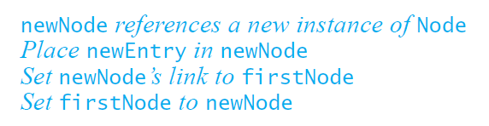
Adding a Node
This pseudocode describes the steps needed to add a node to the beginning of a chain.

Slide 10
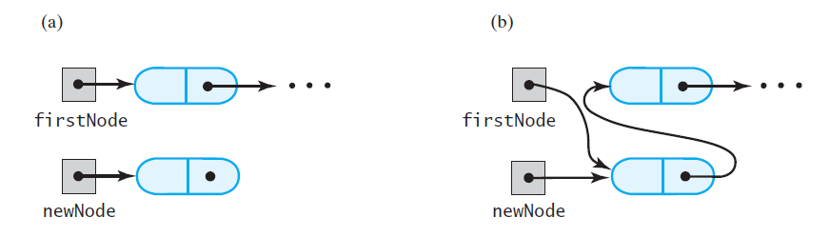
Adding a Node
FIGURE 14-2 A chain of nodes (a) just prior to adding a node at the beginning; (b) just after adding a node at the beginning

Slide 11
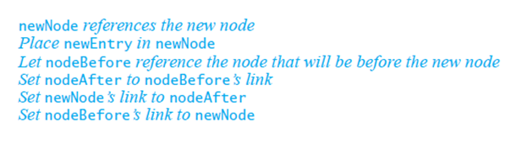
Adding a Node
Pseudocode to add a node to a chain between two existing, consecutive nodes

Slide 12
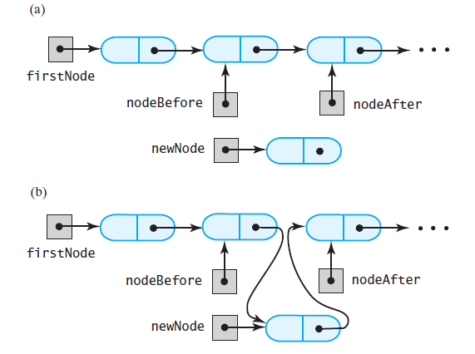
Adding a Node
FIGURE 14-3 A chain of nodes (a) just prior to adding a node between two adjacent nodes; (b) just after adding a node between two adjacent nodes

Slide 13
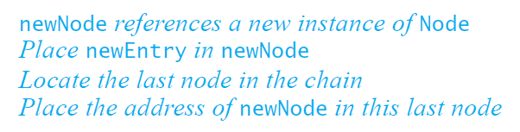
Adding a Node
Steps to add a node at the end of a chain.

Slide 14
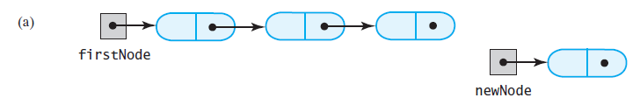
Adding a Node
FIGURE 14-4 A chain of nodes (a) prior to adding a node at the end

Slide 15
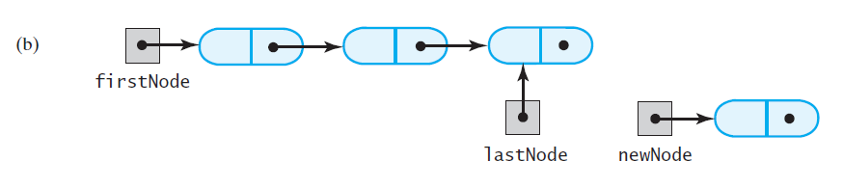
Adding a Node
FIGURE 14-4 A chain of nodes (b) after locating its last node;

Slide 16
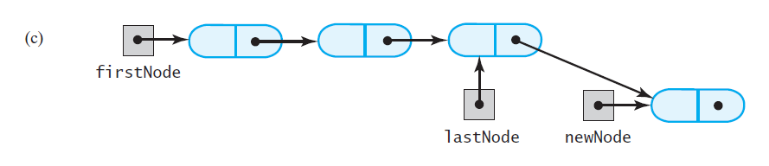
Adding a Node
FIGURE 14-4 A chain of nodes (c) after adding a node at the end

Slide 17
Removing a Node from Various Positions
Possible cases
Removing the first node
Removing a node other than first one

Slide 18
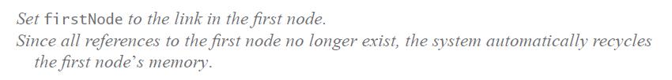
Removing a Node
Steps for removing the first node.

Slide 19
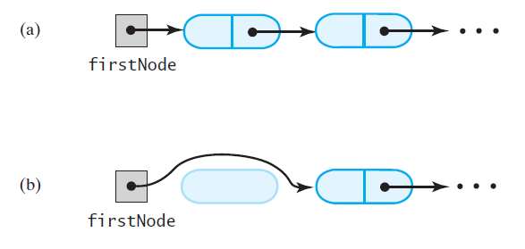
Removing a Node
FIGURE 14-5 A chain of nodes (a) just prior to removing the first node; (b) just after removing the first node

Slide 20
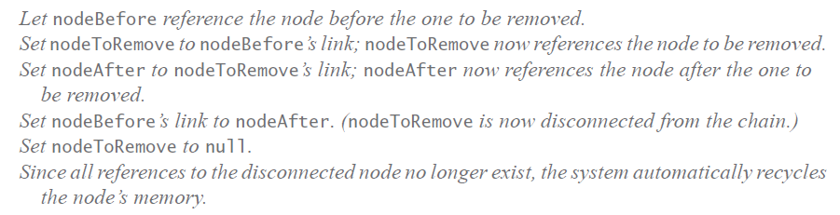
Removing a Node
Removing a node other than the first one.

Slide 21
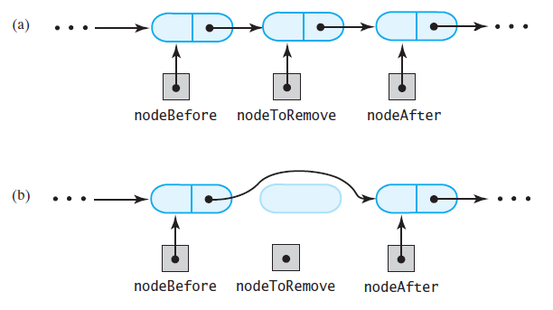
Removing a Node
FIGURE 14-6 A chain of nodes (a) just prior to removing an interior node; (b) just after removing an interior node

Slide 22
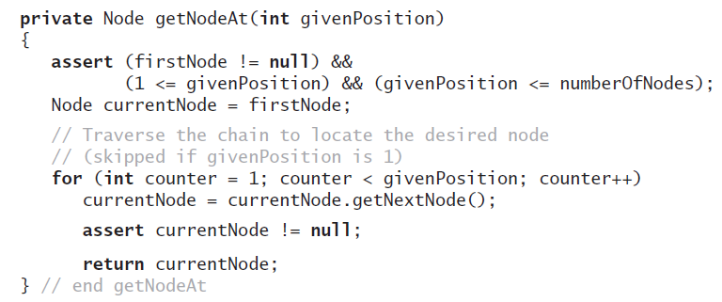
Removing a Node
Operations on a chain depended on the method getNodeAt

Slide 23
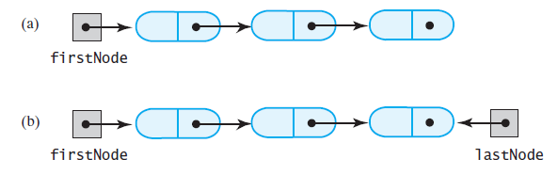
Design Decision A Link to Last Node
FIGURE 14-7 A linked chain with (a) a head reference; (b) both a head reference and a tail reference

Slide 24
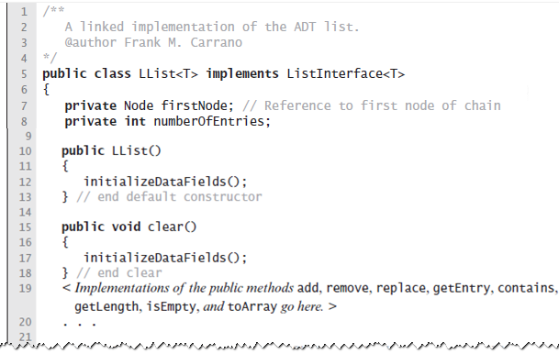
Data Fields and Constructor
LISTING 14-1 An outline of the class LList

Slide 25
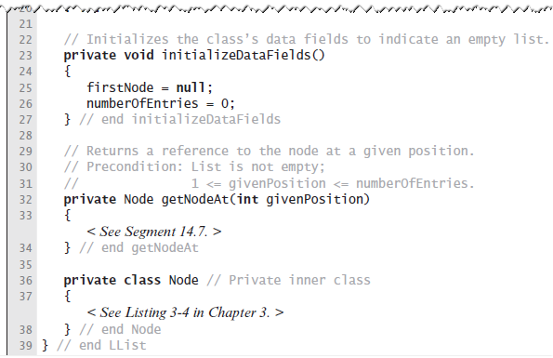
Data Fields and Constructor
LISTING 14-1 An outline of the class LList

Slide 26
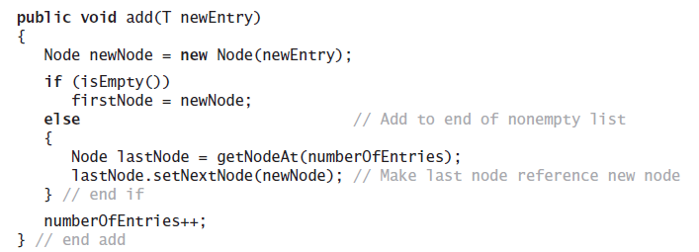
Adding to the End of the List
The method add assumes method getNodeAt

Slide 27
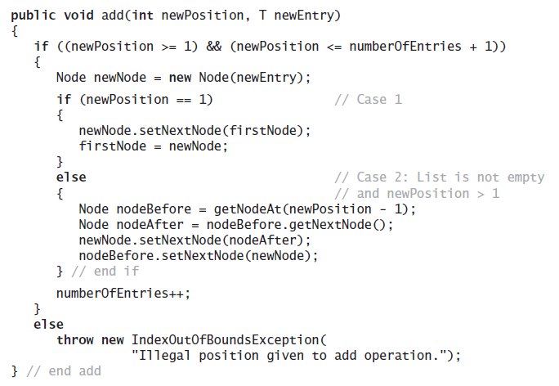
Adding at a Given Position
Java method.

Slide 28
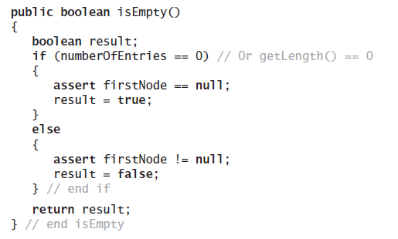
Method isEmpty
Note use of assert statement.

Slide 29
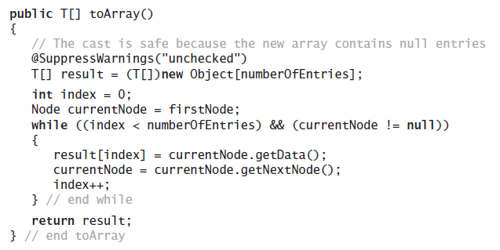
Method toArray
Traverses chain, loads an array.

Slide 30
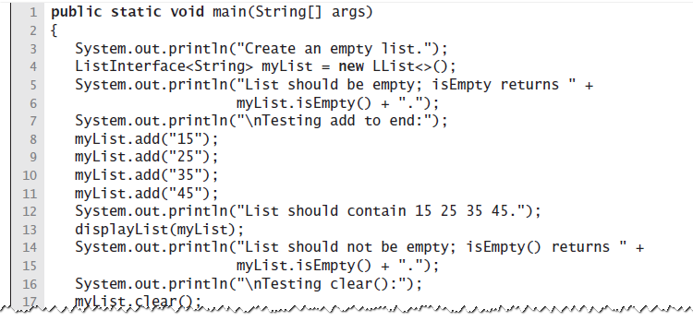
Testing Core Methods
LISTING 14-2 A main method that tests part of the implementation of the ADT list

Slide 31
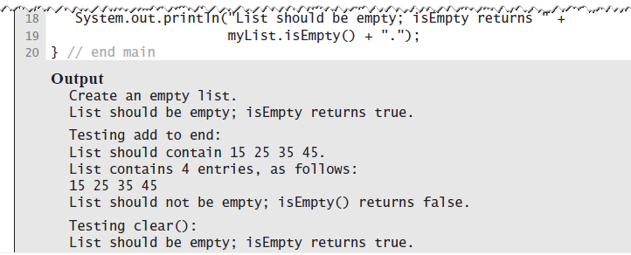
Testing Core Methods
LISTING 14-2 A main method that tests part of the implementation of the ADT list

Slide 32
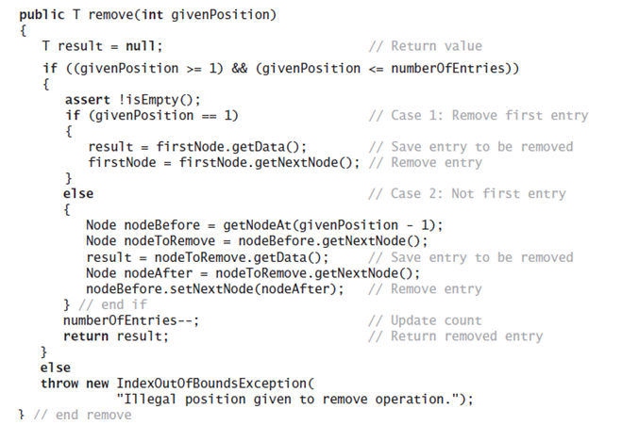
Continuing the Implementation
The remove method returns the entry that it deletes from the list

Slide 33
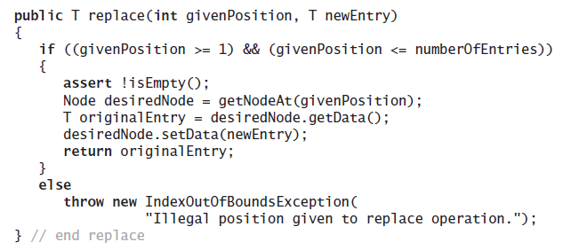
Continuing the Implementation
Replacing a list entry requires us to replace the data portion of a node with other data.

Slide 34
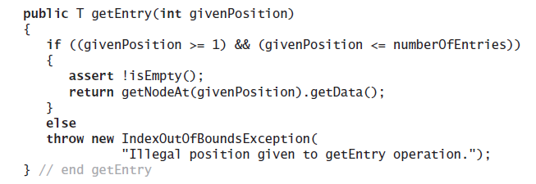
Continuing the Implementation
Retrieving a list entry is straightforward.

Slide 35
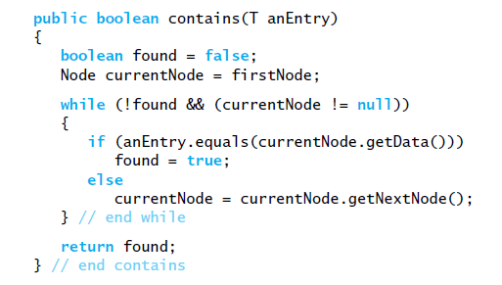
Continuing the Implementation
Checking to see if an entry is in the list, the method contains.

Slide 36
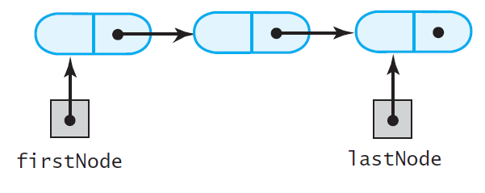
A Refined Implementation
FIGURE 14-8 A linked chain with both a head reference and a tail reference

Slide 37
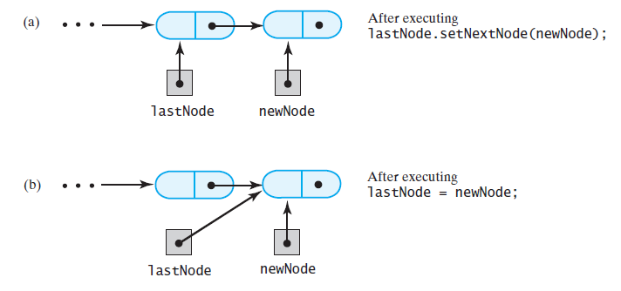
A Refined Implementation
FIGURE 14-9 Adding a node to the end of a nonempty chain that has a tail reference

Slide 38
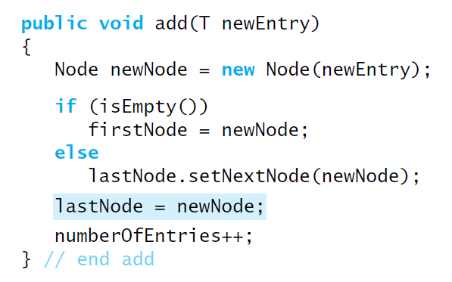
A Refined Implementation
Revision of the first add method

Slide 39
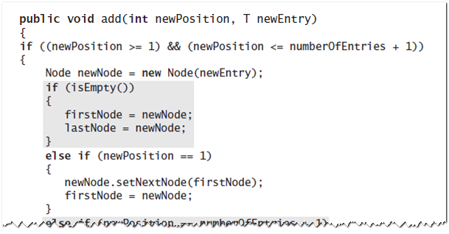
A Refined Implementation
Implementation of the method that adds by position.

Slide 40
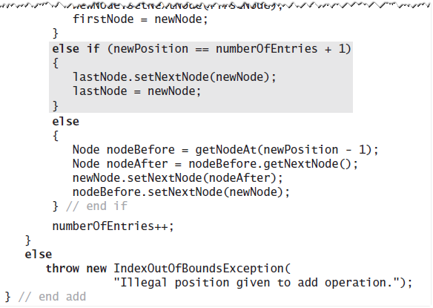
A Refined Implementation
Implementation of the method that adds by position.

Slide 41
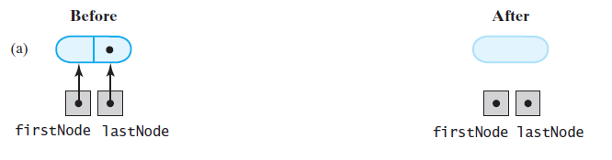
A Refined Implementation
FIGURE 14-10 Removing the last node from a chain that has both head and tail references when the chain contains (a) one node

Slide 42
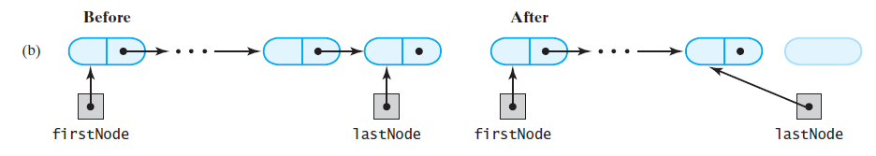
A Refined Implementation
FIGURE 14-10 Removing the last node from a chain that has both head and tail references when the chain contains (b) more than one node

Slide 43
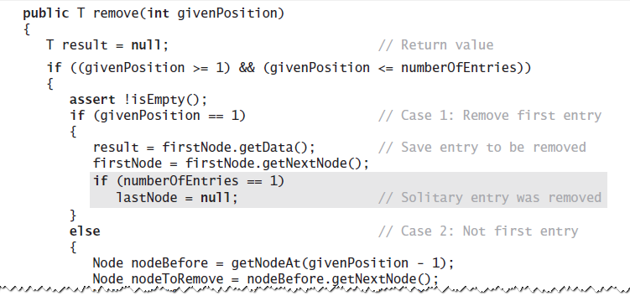
A Refined Implementation
Implementation of the remove operation:

Slide 44
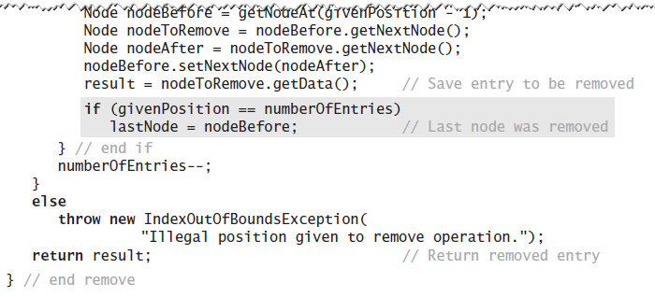
A Refined Implementation
Implementation of the remove operation:

Slide 45
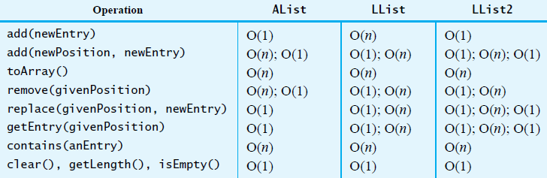
Efficiency of Using a Chain
FIGURE 14-11 The time efficiencies of the ADT list operations for three implementations, expressed in Big Oh notation

Slide 46
Java Class Library: The Class LinkedList
Implements the interface List
LinkedList defines more methods than are in the interface List
You can use the class LinkedList as implementation of ADT
queue
deque
or list.

Slide 47
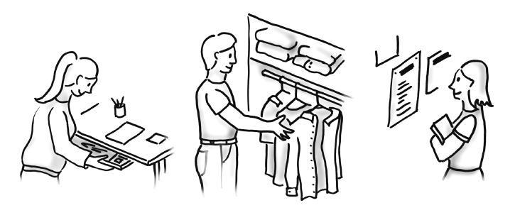
Searching
FIGURE 18-1 Searching is an everyday occurrence

Slide 48
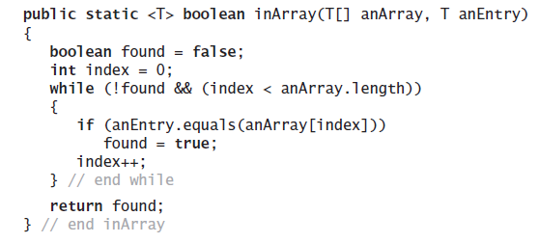
Iterative Sequential Search of an Unsorted Array
Using a loop to search for a specific valued entry.

Slide 49
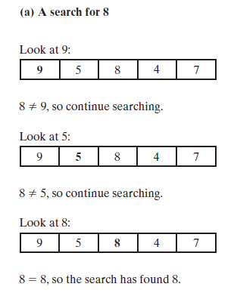
Iterative Sequential Search of an Unsorted Array
FIGURE 18-2 An iterative sequential search of an array that (a) finds its target

Slide 50
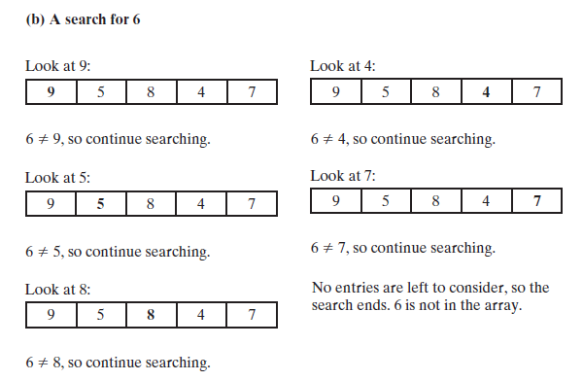
Iterative Sequential Search of an Unsorted Array
FIGURE 18-2 An iterative sequential search of an array that (b) does not find its target

