Slide 1

CS 0445
Data Structures
Fall 2017
Searching
Tree ADT
Sherif Khattab
ksm73@pitt.edu
6307 Sennott Square

Slide 2
Administrivia
Assignment 4 due on 12/01 @11:59pm
Next week’s recitation is for credit

Slide 3
Earlier in the course
ADTs
Bag
Stack
List
Algorithms
Recursive algorithms
Sorting

Slide 4
Today’s Topics
Searching algorithms
Java Iterators
Tree ADT

Slide 5
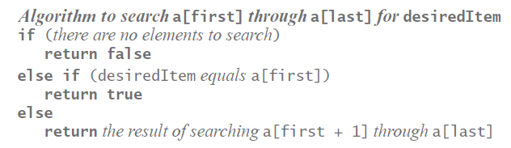
Recursive Sequential Search of an Unsorted Array
Pseudocode of the logic of our recursive algorithm.

Slide 6
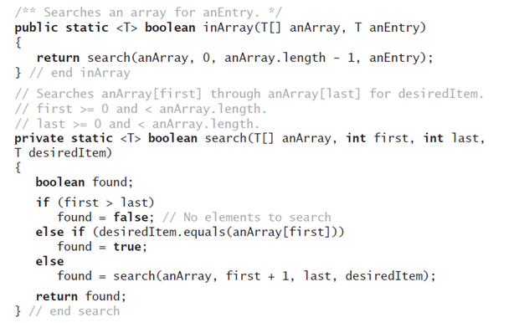
Recursive Sequential Search of an Unsorted Array
Method that implements this algorithm will need parameters first and last.

Slide 7
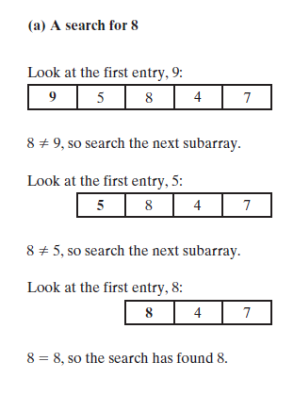
Recursive Sequential Search of an Unsorted Array
FIGURE 18-3 A recursive sequential search of an array that (a) finds its target;

Slide 8
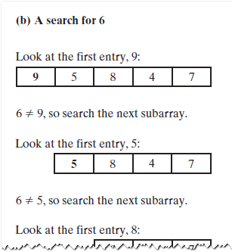
Recursive Sequential Search of an Unsorted Array
FIGURE 18-3 A recursive sequential search of an array that (b) does not find its target

Slide 9
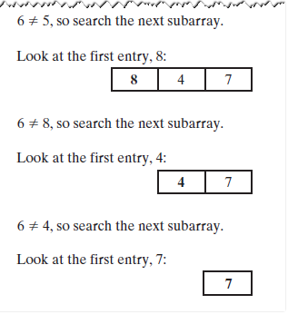
Recursive Sequential Search of an Unsorted Array
FIGURE 18-3 A recursive sequential search of an array that (b) does not find its target

Slide 10
Efficiency of a Sequential Search of an Array
The time efficiency of a sequential search of an array.
Best case O(1)
Worst case: O(n)
Average case: O(n)

Slide 11
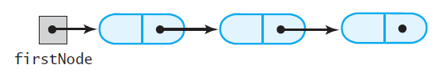
Iterative Sequential Search of an Unsorted Chain
FIGURE 18-7 A chain of linked nodes that contain the entries in a list

Slide 12
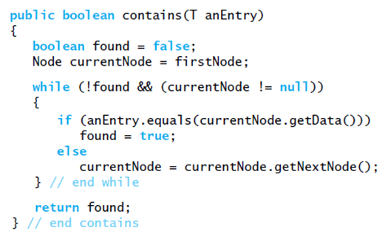
Iterative Sequential Search of an Unsorted Chain
Implementation of iterative search

Slide 13
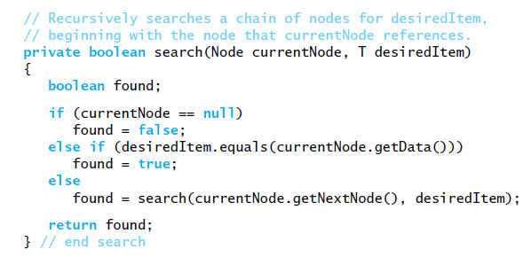
Recursive Sequential Search of an Unsorted Chain
Implementation of the method search

Slide 14
Efficiency of a Sequential Search of a Chain
The time efficiency of a sequential search of a chain of linked nodes
Best case: O(1)
Worst case: O(n)
Average case: O(n)

Slide 15

Sequential Search of a Sorted Array
FIGURE 18-4 Coins sorted by their mint dates
Note: sequential search can be
more efficient if the data is sorted

Slide 16
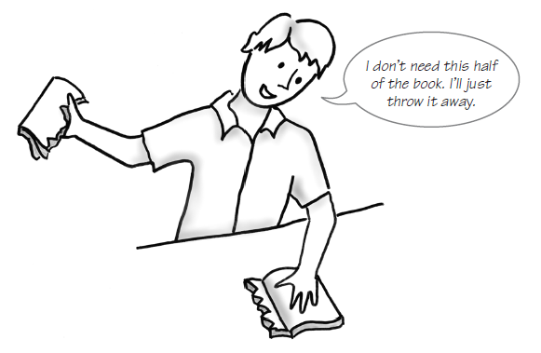
Binary Search of a Sorted Array
FIGURE 18-5 Ignoring one half of the data when the data is sorted

Slide 17
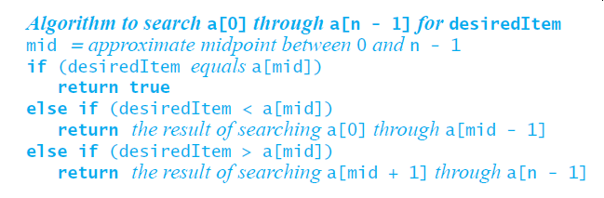
Binary Search of a Sorted Array
First draft of an algorithm for a binary search of an array

Slide 18
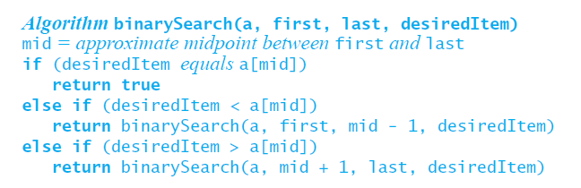
Binary Search of a Sorted Array
Use parameters and make recursive calls look more like Java

Slide 19
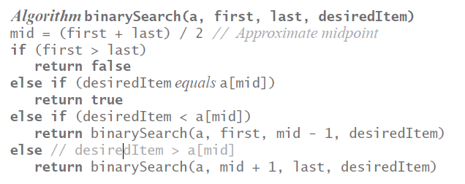
Binary Search of a Sorted Array
Refine the logic a bit, get a more complete algorithm

Slide 20
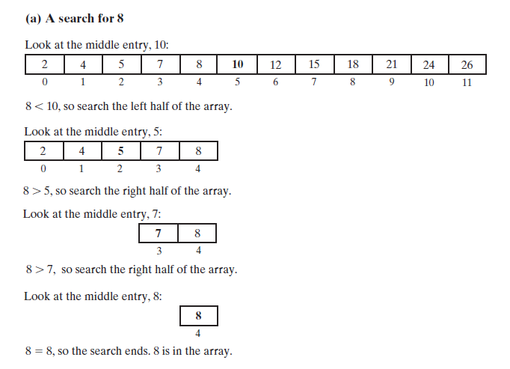
Binary Search of a Sorted Array
FIGURE 18-6 A recursive binary search of a sorted array that (a) finds its target;

Slide 21
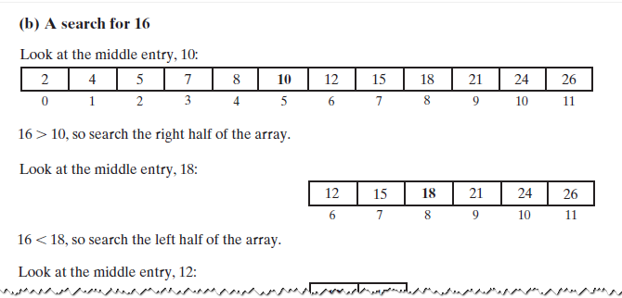
Binary Search of a Sorted Array
FIGURE 18-6 A recursive binary search of a sorted array that (b) does not find its target

Slide 22
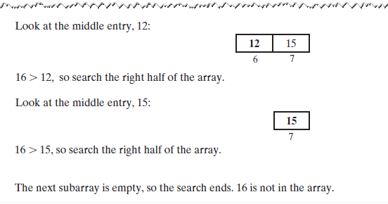
Binary Search of a Sorted Array
FIGURE 18-6 A recursive binary search of a sorted array that (b) does not find its target

Slide 23
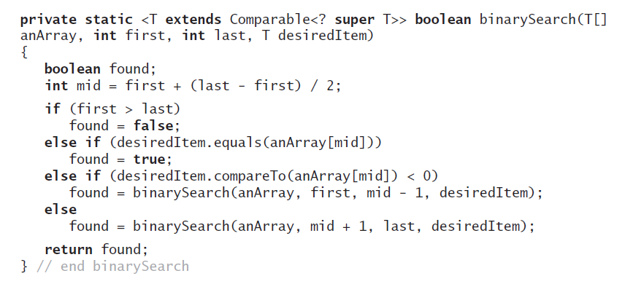
Binary Search of a Sorted Array
Implementation of the method binarySearch

Slide 24
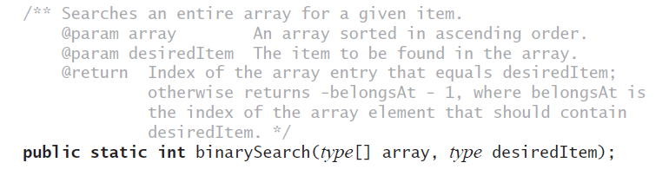
Java Class Library: The Method binarySearch
Static method binarySearch
with the above specification:

Slide 25
Efficiency of a Binary Search of an Array
The time efficiency of a binary search of an array
Best case: O(1)
Worst case: O(log n)
Average case: O(log n)

Slide 26
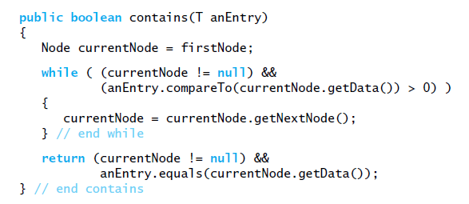
Searching a Sorted Chain
Similar to sequentially searching a sorted array.
Implementation of contains.

Slide 27
Binary Search of a Sorted Chain
To find the middle of the chain you must traverse the whole chain
Then must traverse one of the halves to find the middle of that half
Conclusion
Hard to implement
Less efficient than sequential search

Slide 28
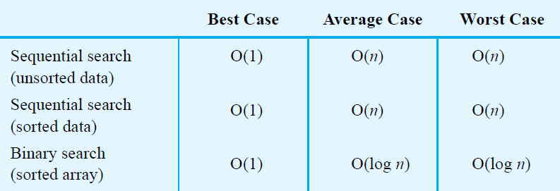
Choosing between Sequential Search and Binary Search
FIGURE 18-8 The time efficiency of searching, expressed in Big Oh notation

Slide 29
Choosing between Iterative Search and Recursive Search
Can save some time and space by using iterative version of a search
Using recursion will not require much additional space for the recursive calls
Coding binary search recursively is somewhat easier

Slide 30
Tree ADT

Slide 31
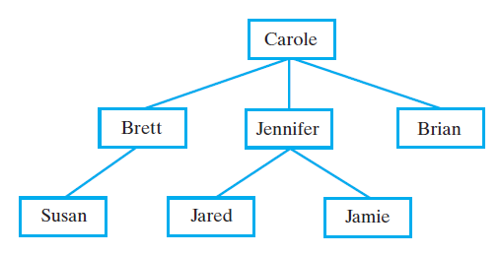
Hierarchical Organizations Example: Family Trees
FIGURE 23-1 Carole’s children and grandchildren

Slide 32
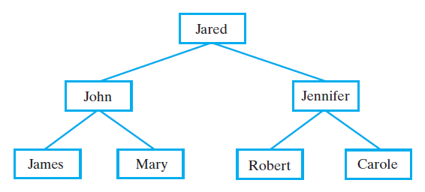
Hierarchical Organizations Example: Family Trees
FIGURE 23-2 Jared’s parents and grandparents

Slide 33
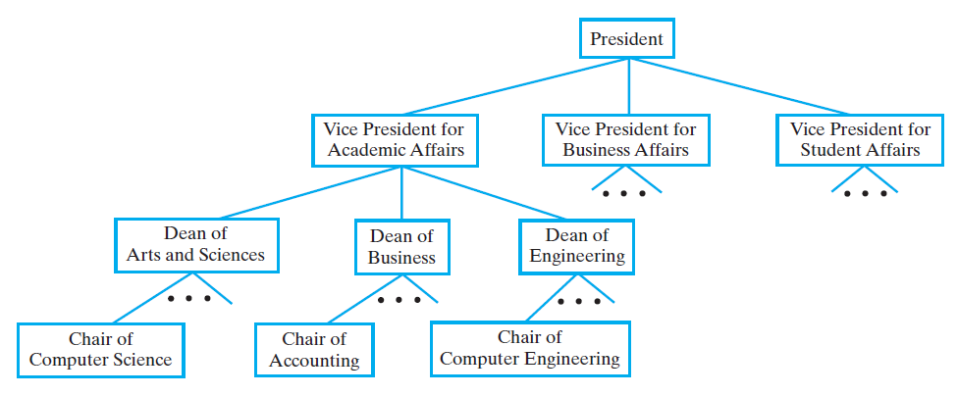
Hierarchical Organizations
FIGURE 23-3 A portion of a university’s administrative structure

Slide 34
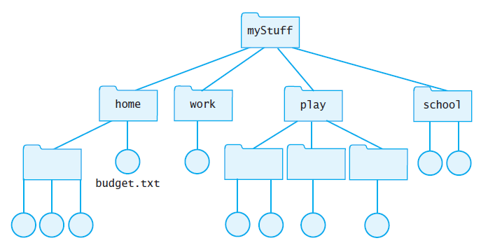
Hierarchical Organizations
FIGURE 23-4 Computer files organized into folders

Slide 35
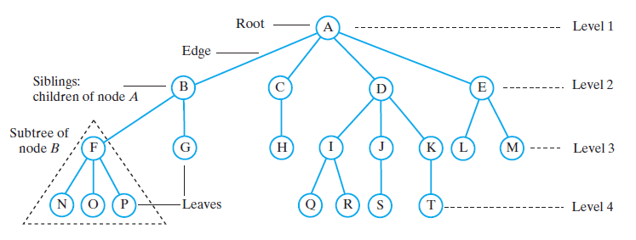
Tree Terminology
FIGURE 23-5 A tree equivalent to the tree in Figure 23-4

Slide 36
Tree Terminology
Contrast plants with root at bottom
ADT tree with root at top
Root is only node with no parent
A tree can be empty
Any node and its descendants form a subtree of the original tree
The height of a tree is the number of levels in the tree

Slide 37
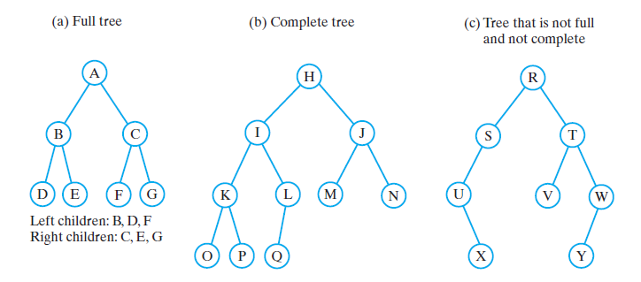
Binary Trees
FIGURE 23-6 Three binary trees

Slide 38
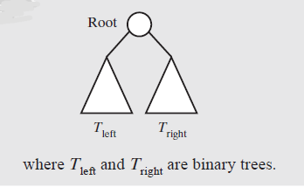
Binary Trees
A binary tree is empty or has the above form

Slide 39
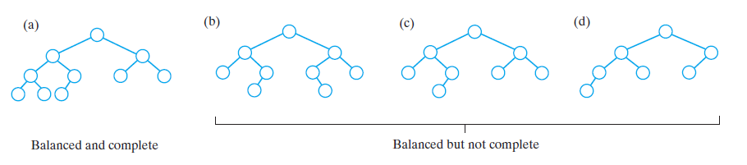
Binary Trees
FIGURE 23-7 Some binary trees that are height balanced

Slide 40
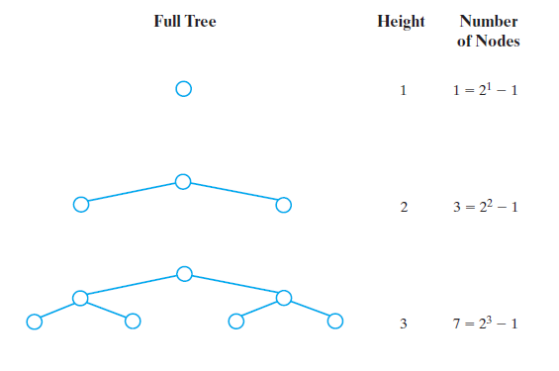
Binary Trees
FIGURE 23-8 The number of nodes in a full binary tree as a function of the tree’s height

Slide 41
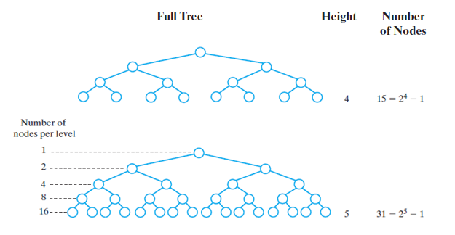
Binary Trees
FIGURE 23-8 The number of nodes in a full binary tree as a function of the tree’s height

Slide 42
Traversals of A Tree
Definition: visit, or process, each data item exactly once
We will say that traversal can pass through a node without visiting it at that moment.
Order in which we visit items is not unique
Traversals of a binary tree are somewhat easier to understand
We consider these first

Slide 43
Traversals of a Binary Tree
We use recursion
To visit all the nodes in a binary tree, we must
Visit the root
Visit all the nodes in the root’s left subtree
Visit all the nodes in the root’s right subtree

Slide 44
Traversals of a Binary Tree
Preorder traversal
Visit root before we visit root’s subtrees
Inorder traversal
Visit root of a binary tree between visiting nodes in root’s subtrees.
Postorder traversal
Visit root of a binary tree after visiting nodes in root’s subtrees
Level-order traversal
Begin at root and visit nodes one level at a time

Slide 45
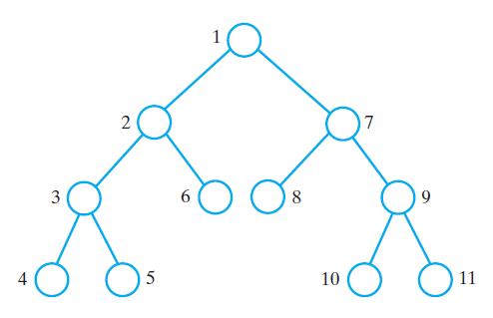
Traversals of a Binary Tree
FIGURE 23-9 The visitation order of a preorder traversal

Slide 46
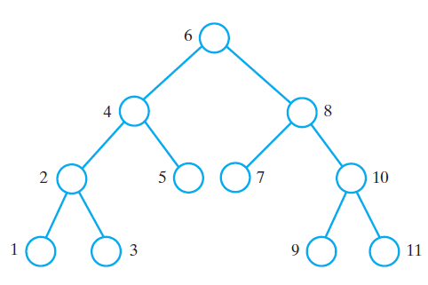
Traversals of a Binary Tree
FIGURE 23-10 The visitation order of an inorder traversal

Slide 47
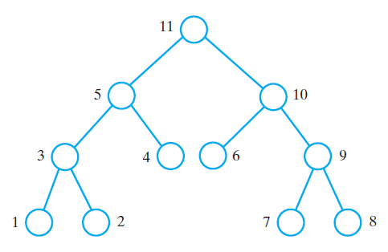
Traversals of a Binary Tree
FIGURE 23-11 The visitation order of a postorder traversal

Slide 48
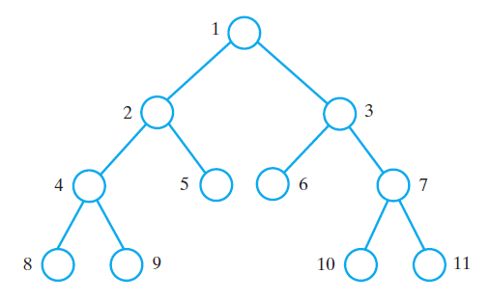
Traversals of a Binary Tree
FIGURE 23-12 The visitation order of a level-order traversal

Slide 49
Traversals of a General Tree
Types of traversals for general tree
Level order
Preorder
Postorder
Not suited for general tree traversal
Inorder

Slide 50
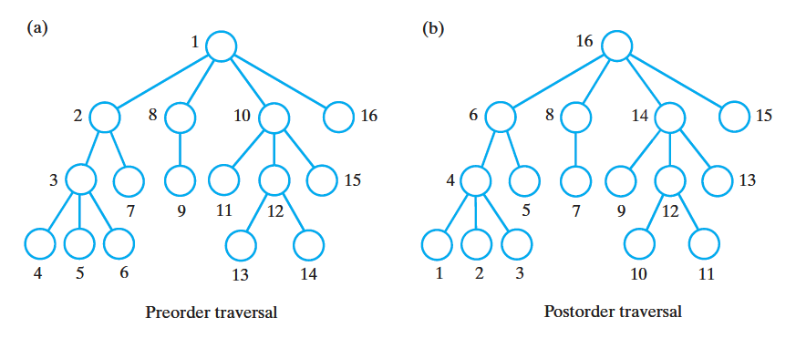
Traversals of a General Tree
FIGURE 23-13 The visitation order of two traversals of a general tree: (a) preorder; (b) postorder

