Slide 1

CS 0445
Data Structures
Fall 2017
Tree ADT
Sherif Khattab
ksm73@pitt.edu
6307 Sennott Square

Slide 2
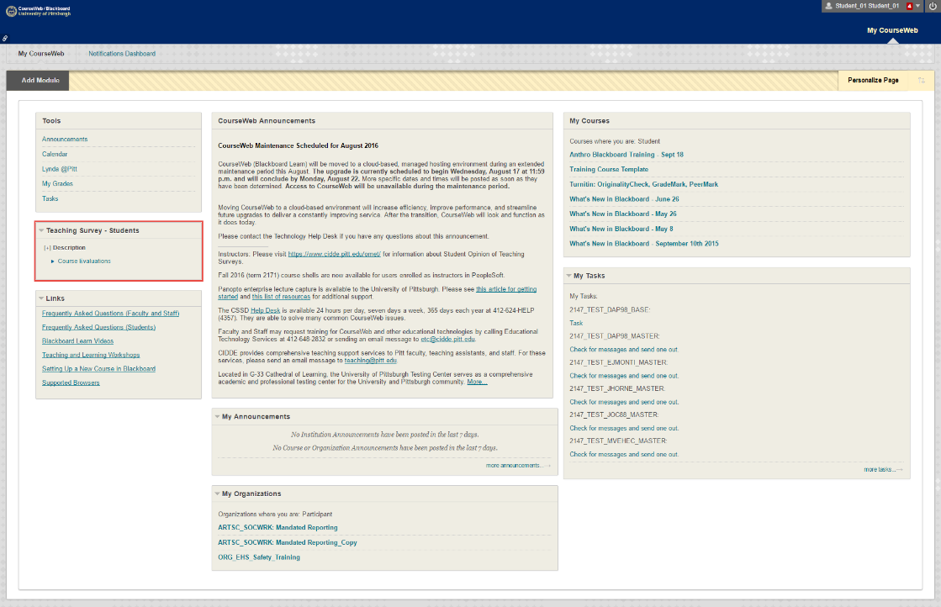
Administrivia
Assignment 4 due on 12/01 @11:59pm
This week’s recitation is for credit
OMET Teaching Survey
Email with subject Teaching Survey
My Pitt
CourseWeb

Slide 3
Earlier in the course
ADTs
Bag
Stack
List
Tree
Algorithms
Recursive algorithms
Sorting
Searching

Slide 4
Today’s Topics
Java Iterators
More on Tree ADT and its implementation

Slide 5
What Is an Iterator?
An object that traverses a collection of data
During iteration, each data item is considered once
Possible to modify item as accessed
Should implement as a distinct class that interacts with the ADT

Slide 6
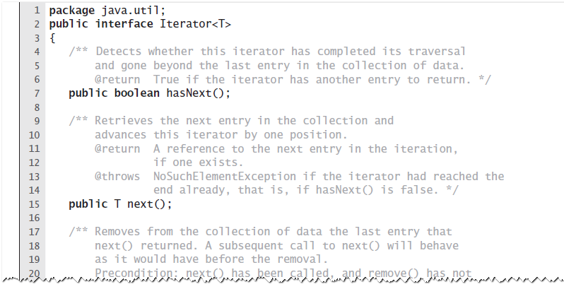
The Interface Iterator
LISTING JI5 -1 Java’s interface java.util.Iterator

Slide 7
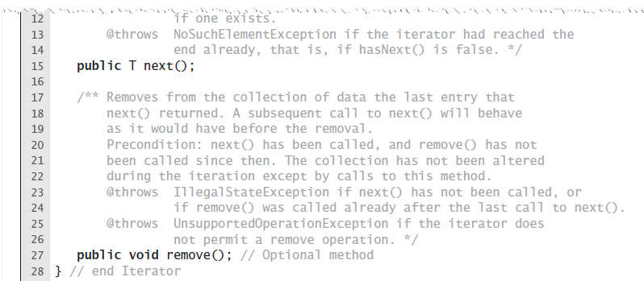
The Interface Iterator
LISTING JI5 -1 Java’s interface java.util.Iterator

Slide 8
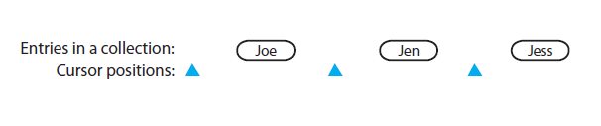
The Interface Iterator
Figure JI5 -1 Possible positions of an iterator’s cursor within a collection

Slide 9
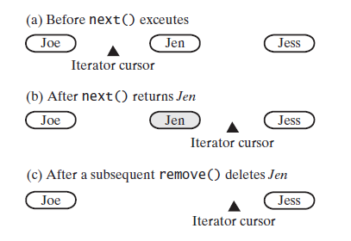
The Interface Iterator
Figure JI5 -2 The effect on a collections iterator by a call to next and a subsequent call to remove

Slide 10
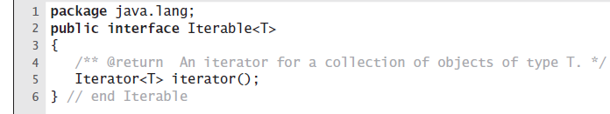
The Interface Iterable
LISTING JI5-2 The interface java.lang.Iterable

Slide 11
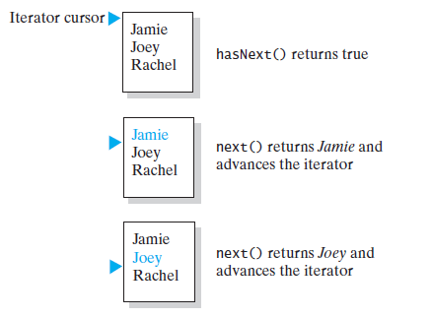
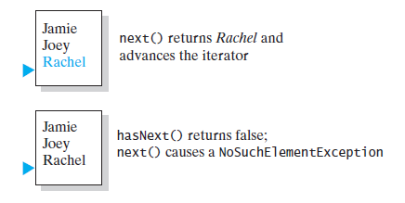
Using the Interface Iterator
FIGURE JI5 -2 The effect of the iterator methods hasNext and next on a list

Slide 12
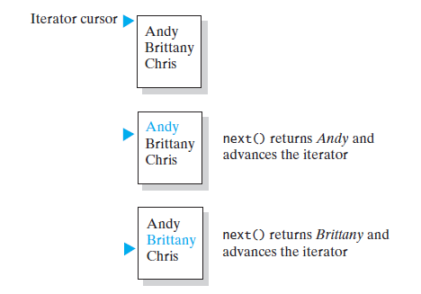
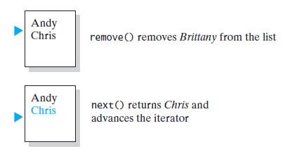
Using the Interface Iterator
FIGURE JI5 -3 The effect of the iterator methods next and remove on a list

Slide 13
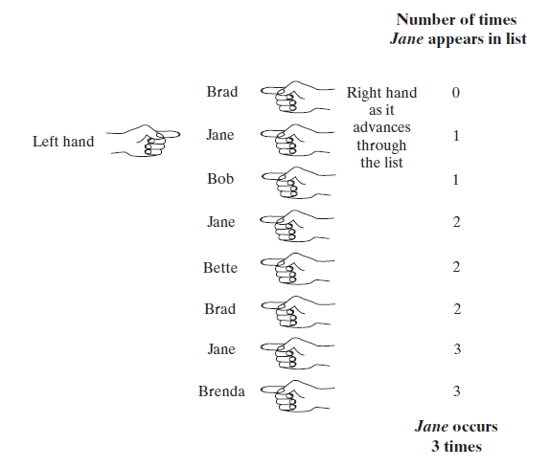
Multiple Iterators
FIGURE JI5 -4 Counting the number of times that Jane appears in a list of names

Slide 14
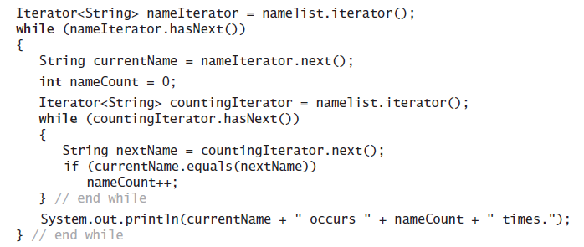
Multiple Iterators
Code that counts the occurrences of each name

Slide 15
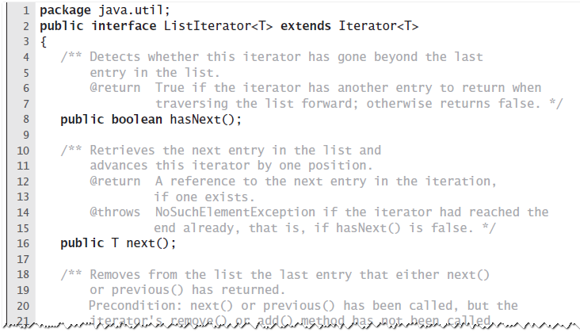
The Interface ListIterator
LISTING JI5-3 Java’s interface java.util.ListIterator

Slide 16
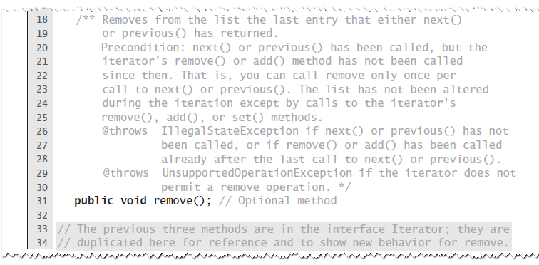
The Interface ListIterator
LISTING JI5-3 Java’s interface java.util.ListIterator

Slide 17
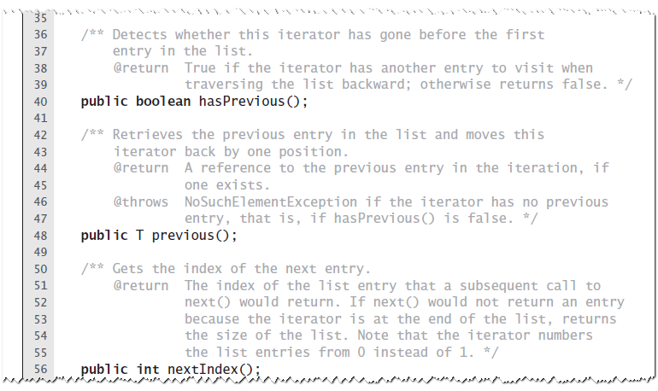
The Interface ListIterator
LISTING JI5-3 Java’s interface java.util.ListIterator

Slide 18
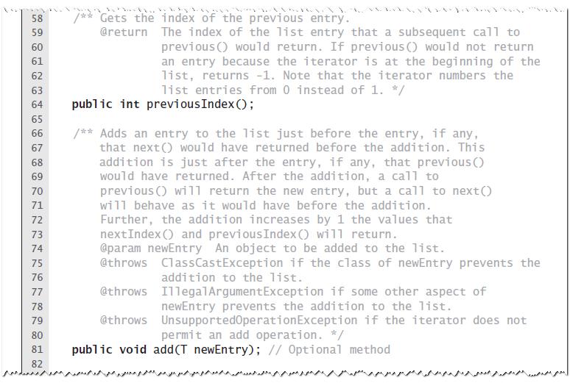
The Interface ListIterator
LISTING JI5-3 Java’s interface java.util.ListIterator

Slide 19
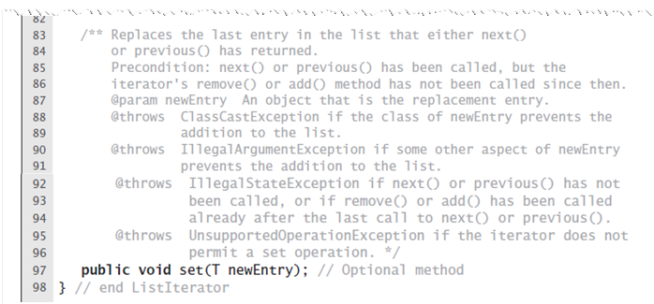
The Interface ListIterator
LISTING JI5-3 Java’s interface java.util.ListIterator

Slide 20
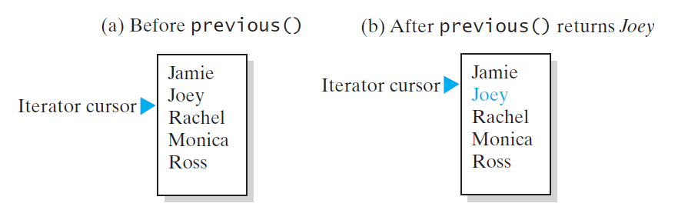
The Interface ListIterator
FIGURE JI5-9 The effect of a call to previous on a list

Slide 21
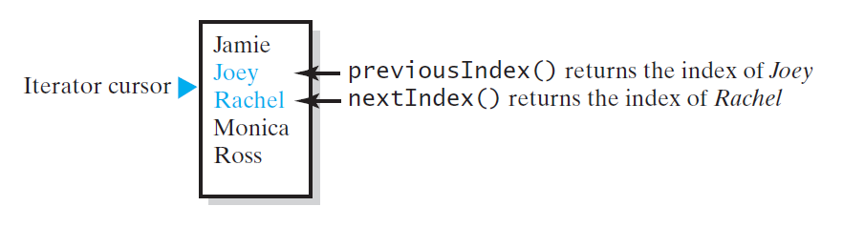
The Interface ListIterator
FIGURE JI5-10 The indices returned by the methods nextIndex and previousIndex

Slide 22
The Interface List Revisited
Method set replaces entry that either next or previous just returned.
Method add inserts an entry into list just before iterator’s current position
Method remove removes list entry that last call to either next or previous returned

Slide 23
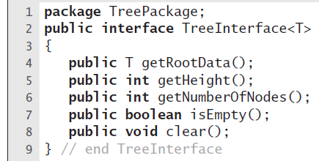
Interfaces for All Trees
LISTING 23-1 An interface of methods common to all trees

Slide 24
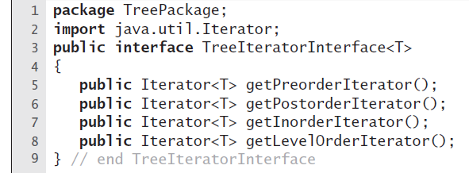
Traversals
LISTING 23-2 An interface of traversal methods for a tree

Slide 25
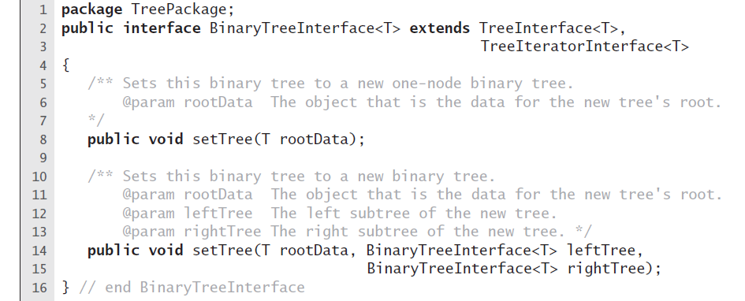
Interface for Binary Trees
LISTING 23-3 An interface for a binary tree

Slide 26
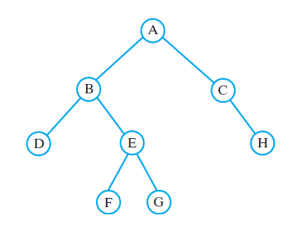
Example
FIGURE 23-14 A binary tree whose nodes
contain one-letter strings

Slide 27
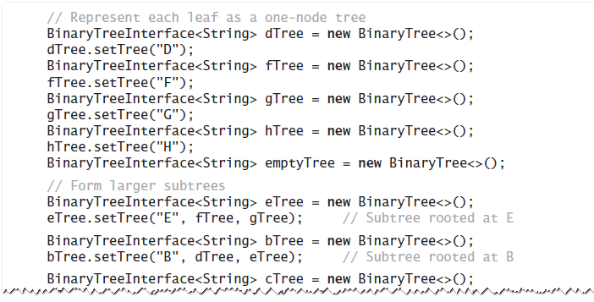
Example
Java statements that build a tree and then display some of its characteristics:

Slide 28
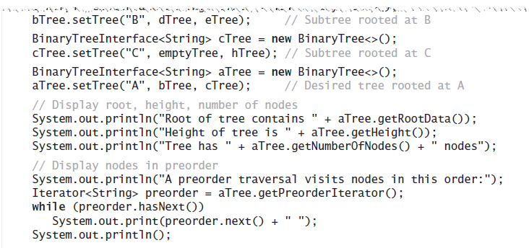
Example
Java statements that build a tree and then display some of its characteristics:

Slide 29
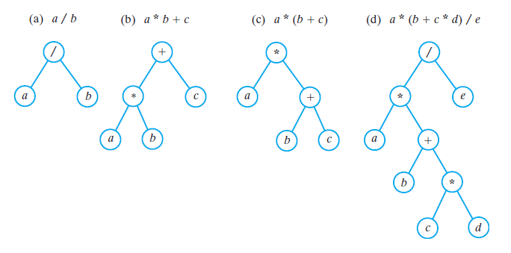
Expression Trees
FIGURE 23-15 Expression trees for four algebraic expressions

Slide 30
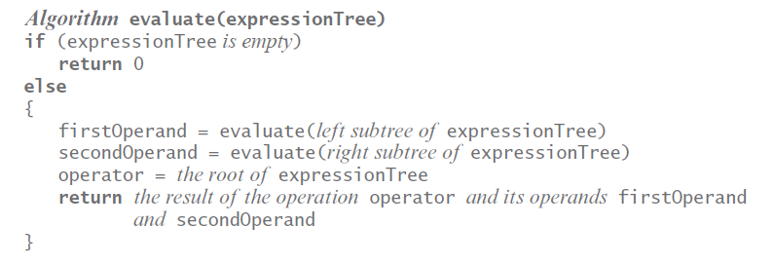
Expression Trees
Algorithm for postorder traversal of an expression tree.

Slide 31
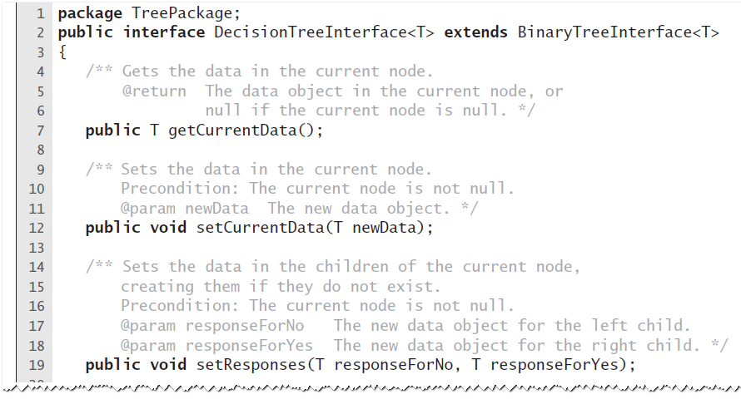
Expert System Uses A Decision Tree
LISTING 23-4 An interface for a binary decision tree

Slide 32
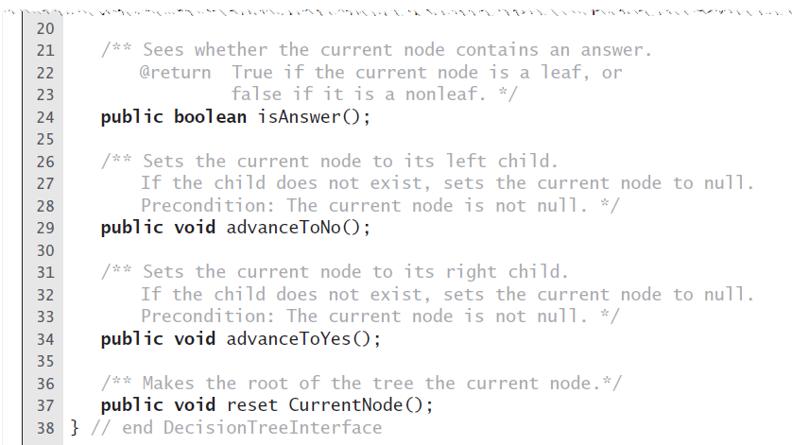
Expert System Uses A Decision Tree
LISTING 23-4 An interface for a binary decision tree

Slide 33
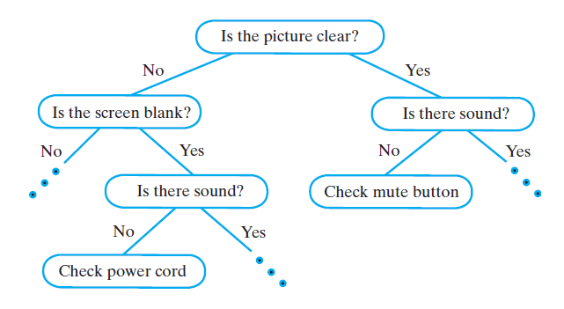
Expert System Uses A Decision Tree
FIGURE 23-16 A portion of a binary decision tree

Slide 34
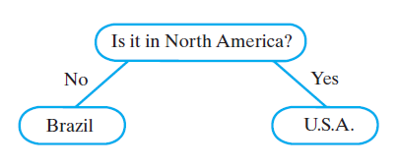
Expert System Uses A Decision Tree
FIGURE 23-17 An initial decision tree for a guessing game

Slide 35
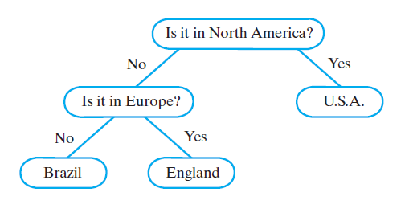
Expert System Uses A Decision Tree
FIGURE 23-18 The decision tree for a guessing game after acquiring another fact

Slide 36
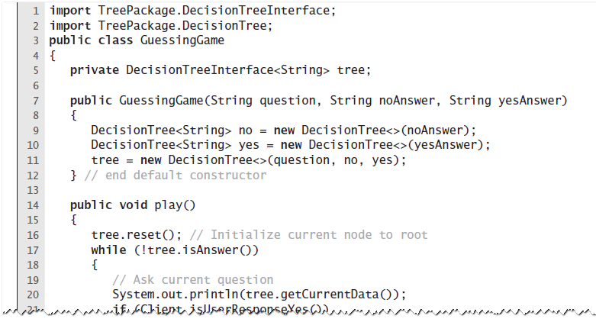
Expert System Uses A Decision Tree
LISTING 23-5 The class GuessingGame

Slide 37
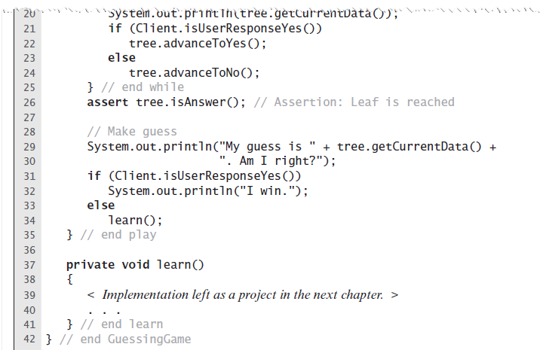
Expert System Uses A Decision Tree
LISTING 23-5 The class GuessingGame

Slide 38
Binary Search Tree
For each node in a binary search tree
Node’s data is greater than all data in node’s left subtree
Node’s data is less than all data in node’s right subtree
Every node in a binary search tree is the root of a binary search tree

Slide 39
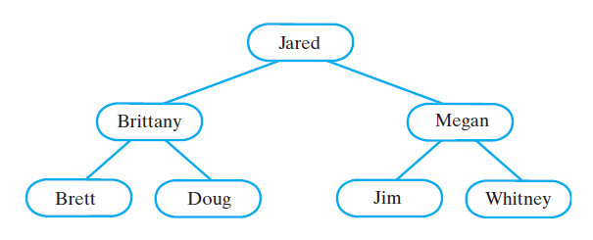
Binary Search Tree
FIGURE 23-19 A binary search tree of names

Slide 40
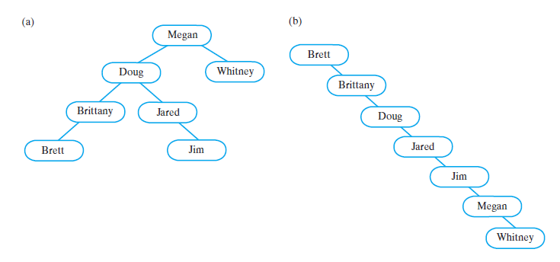
Binary Search Tree
FIGURE 23-20 Two binary search trees containing the same data as the tree in Figure 23-19

Slide 41
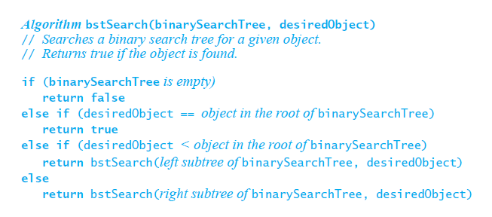
Binary Search Tree
Pseudocode for recursive search algorithm

Slide 42
Binary Search Tree
Efficiency of a search
Searching a binary search tree of height h is O(h)
To make searching a binary search tree as efficient as possible …
Tree must be as short as possible.

Slide 43
Heaps
Definition: Complete binary tree whose nodes contain Comparable objects and are organized as follows.
Each node contains an object no smaller/larger than objects in its descendants
Maxheap: object in node greater than or equal to its descendant objects
Minheap: object in node less than or equal to its descendant objects

Slide 44
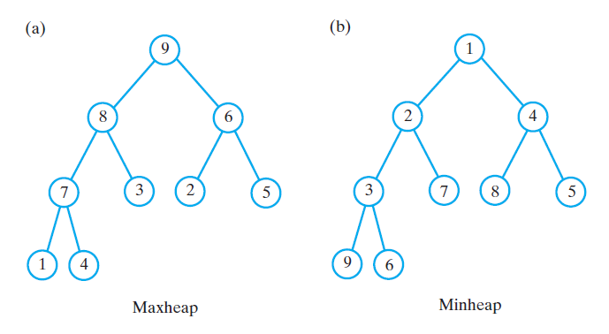
Heaps
FIGURE 23-21 (a) A maxheap and (b) a minheap that contain the same values

Slide 45
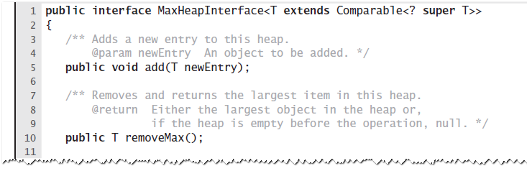
Heaps
LISTING 23-6 An interface for a maxheap

Slide 46
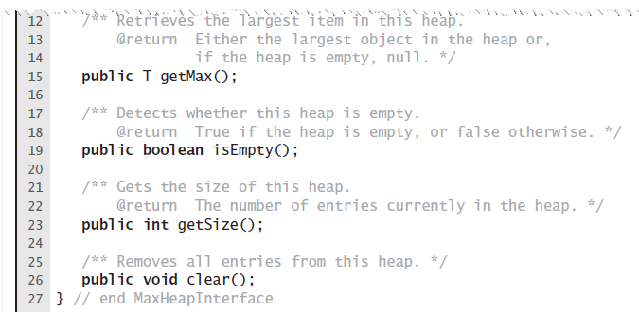
Heaps
LISTING 23-6 An interface for a maxheap

