Slide 1

CS 0445
Data Structures
Fall 2017
Implementation of the Tree ADT
Sherif Khattab
ksm73@pitt.edu
6307 Sennott Square

Slide 2

Administrivia
Assignment 4 due on 12/01 @11:59pm
This week’s recitation is for credit
OMET Teaching Survey
Email with subject Teaching Survey
My Pitt
CourseWeb

Slide 3
Earlier in the course
ADTs
Bag
Stack
List
Tree
Algorithms
Recursive algorithms
Sorting
Searching

Slide 4
Today’s Topics
Tree ADT implementation

Slide 5
Examples of General Trees
Parse tree
Check syntax of a string for valid algebraic expression
If valid can be expressed as a parse tree
Parse tree must be a general tree
So it can accommodate any expression
Compilers use parse trees
Check syntax, produce code

Slide 6
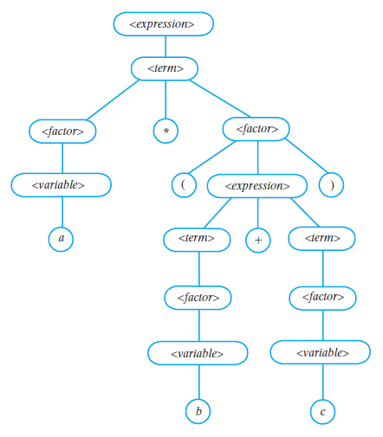
Examples of General Trees
FIGURE 23-22 A parse tree for the algebraic expression a * (b + c)

Slide 7
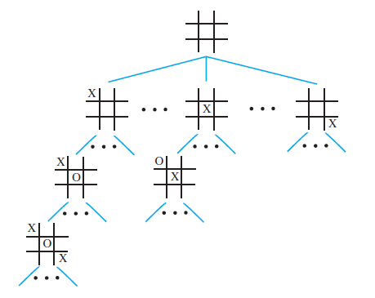
Examples of General Trees
FIGURE 23-23 A portion of a game tree for tic-tac-toe

Slide 8
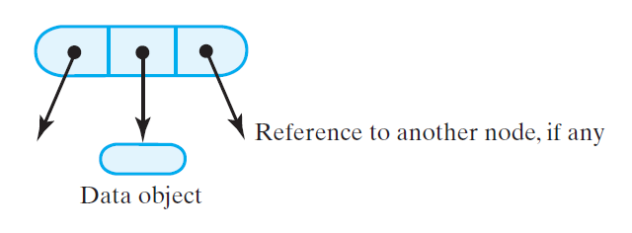
Nodes in a Binary Tree
FIGURE 24-1 A node in a binary tree

Slide 9
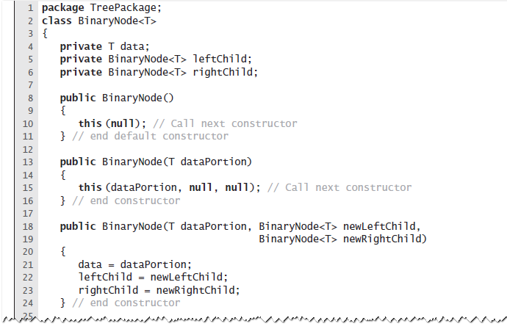
Nodes in a Binary Tree
LISTING 24-1 The class BinaryNode

Slide 10
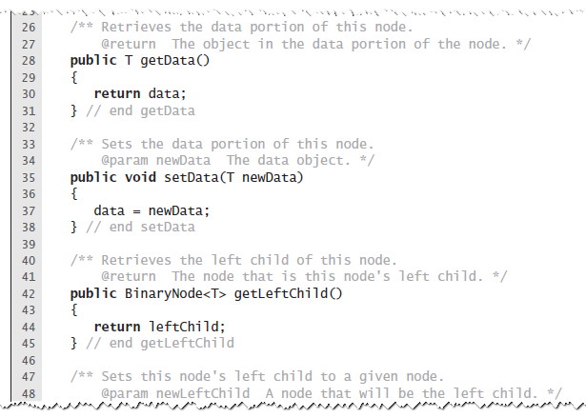
Nodes in a Binary Tree
LISTING 24-1 The class BinaryNode

Slide 11
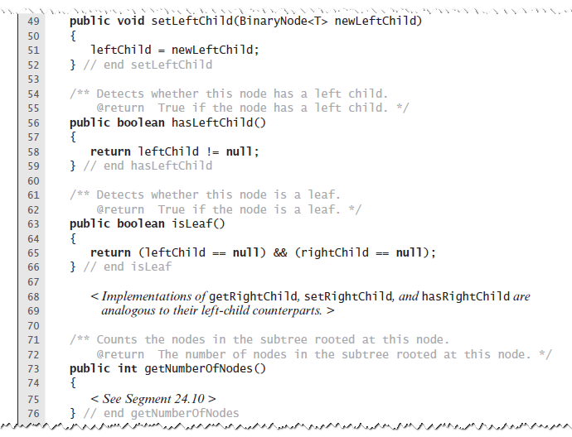
Nodes in a Binary Tree
LISTING 24-1 The class BinaryNode

Slide 12
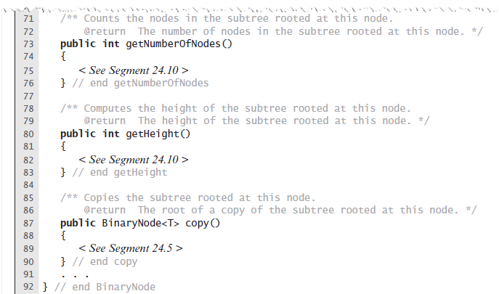
Nodes in a Binary Tree
LISTING 24-1 The class BinaryNode

Slide 13
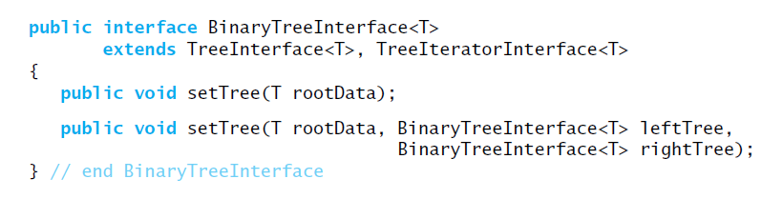
Creating a Basic Binary Tree
Interface for a class of binary trees

Slide 14
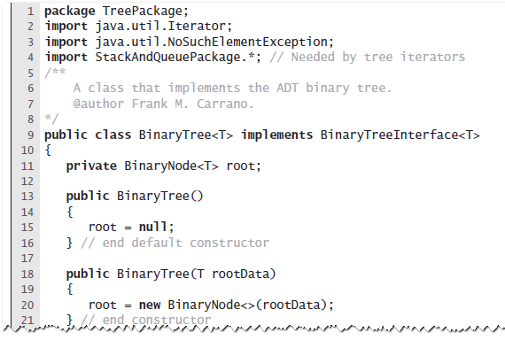
Creating a Basic Binary Tree
LISTING 24-2 A first draft of the class BinaryTree

Slide 15
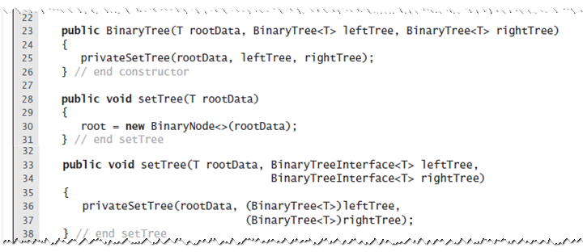
Creating a Basic Binary Tree
LISTING 24-2 A first draft of the class BinaryTree

Slide 16
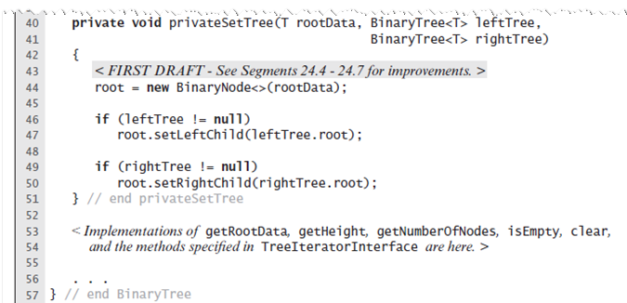
Creating a Basic Binary Tree
LISTING 24-2 A first draft of the class BinaryTree

Slide 17
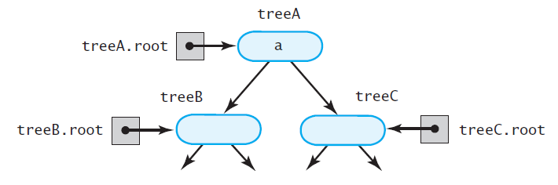
The Method privateSetTree
FIGURE 24-2 The binary tree treeA shares nodes with treeB and treeC

Slide 18
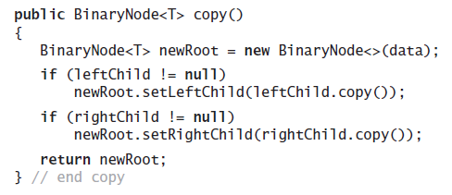
The Method privateSetTree
Definition of the method copy in the class BinaryNode

Slide 19
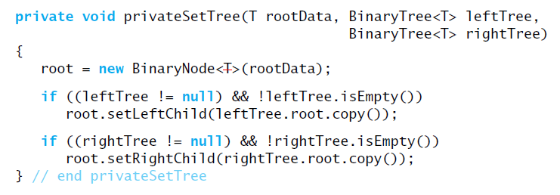
The Method privateSetTree
Method privateSetTree can invoke copy to copy the nodes from the two given subtrees

Slide 20
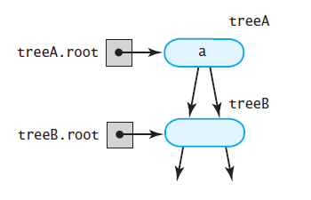
The Method privateSetTree
Another approach, more problems
FIGURE 24-3 treeA has identical subtrees

Slide 21
The Method privateSetTree
The second solution:
Create root node r containing given data.
If left subtree exists and not empty, attach root node to r as left child.
If right subtree exists, not empty, and distinct from left subtree, attach root node to r as a right child. But if right and left subtrees are same, attach copy of right subtree to r instead.

Slide 22
The Method privateSetTree
If the left subtree exists and differs from the tree object used to call privateSetTree, set the subtree’s data field root to null.
If right subtree exists and differs from the tree object used to call privateSetTree, set subtree’s data field root to null.

Slide 23
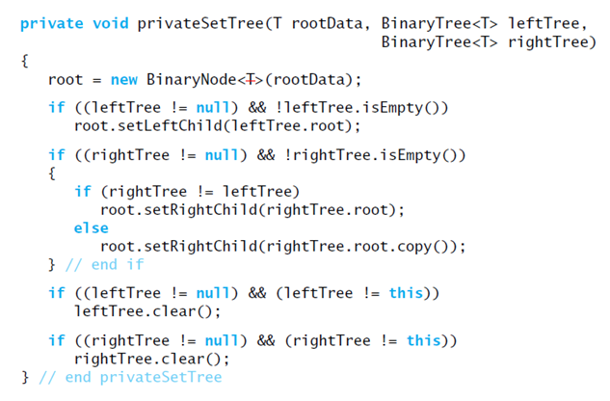
The Method privateSetTree
An implementation of privateSetTree

Slide 24
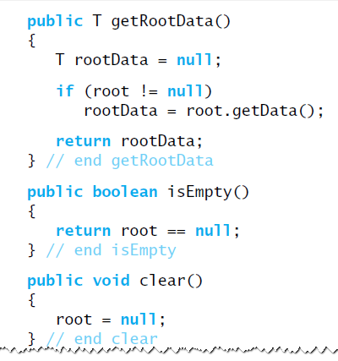
Accessor and Mutator Methods

Slide 25
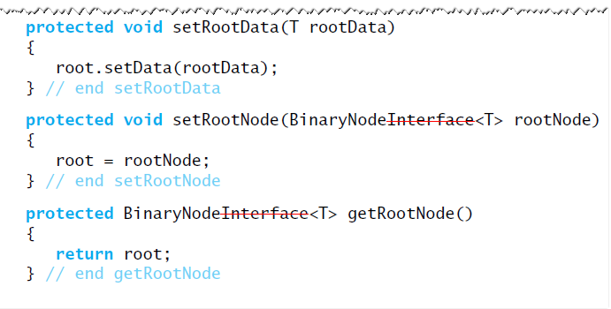
Accessor and Mutator Methods

Slide 26
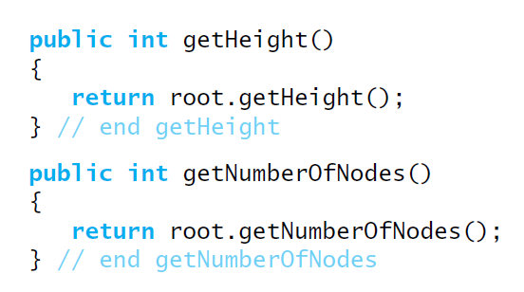
Computing the Height and Counting Nodes

Slide 27
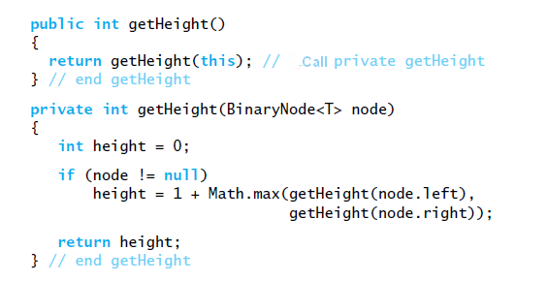
Methods within BinaryNode.

Slide 28
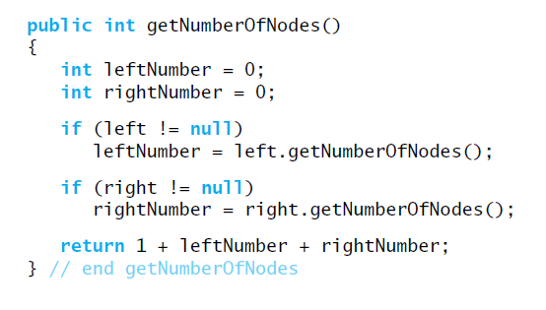
Methods within BinaryNode.

Slide 29
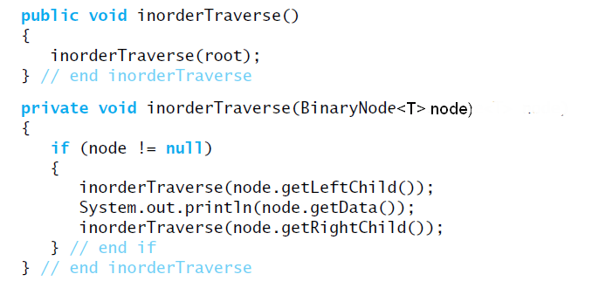
Traversals
Traversing a binary tree recursively

Slide 30
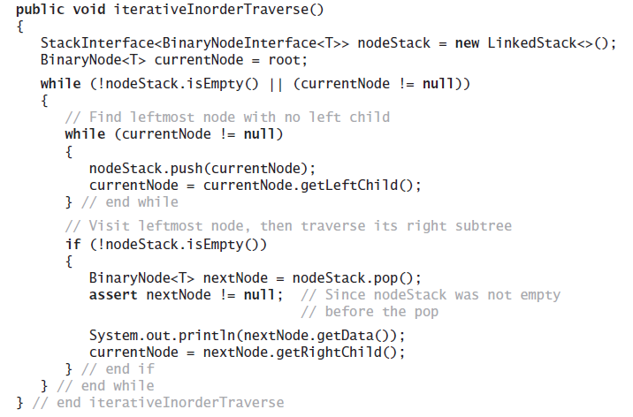
Traversals That Use An Iterator
Iterative version …

Slide 31
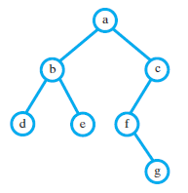
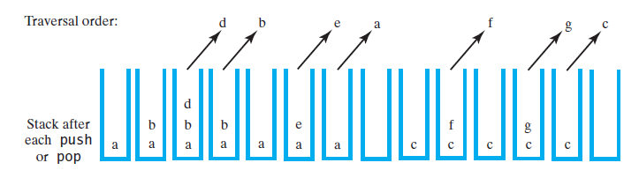
Traversals That Use An Iterator
FIGURE 24-5 Using a stack to perform an inorder traversal of a binary tree

Slide 32
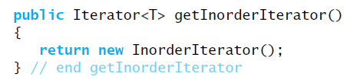
Traversals That Use An Iterator
Method getInorderIterator can be implemented within BinaryTree

Slide 33
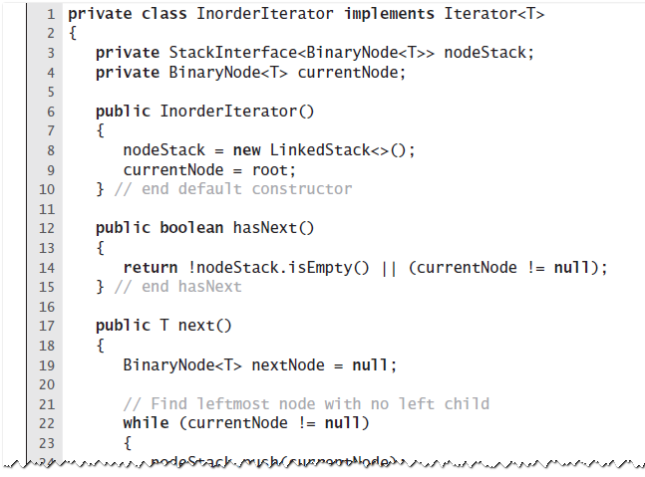
Private Class InorderIterator
LISTING 24-3 The private inner class InorderIterator

Slide 34
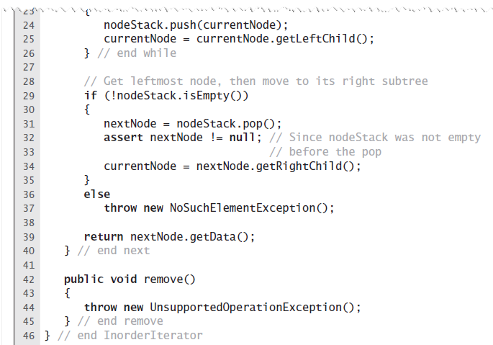
Private Class InorderIterator
LISTING 24-3 The private inner class InorderIterator

Slide 35
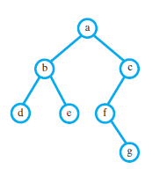
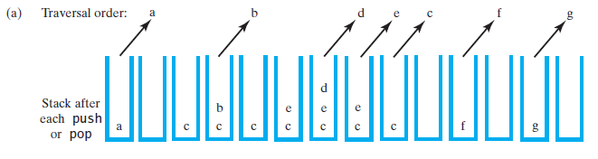
Postorder, and Level-order Traversals
FIGURE 24-6 Using a stack to traverse a binary tree in (a) preorder

Slide 36
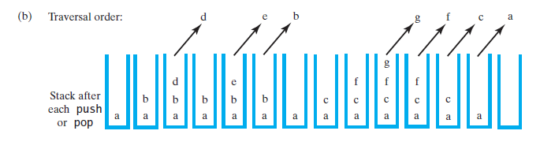
Postorder, and Level-order Traversals
FIGURE 24-6 Using a stack to traverse a binary tree in (b) postorder

Slide 37
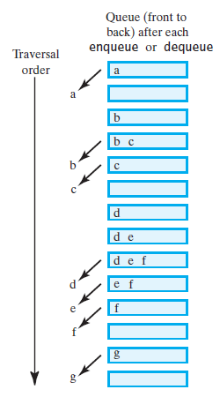
Postorder, and Level-order Traversals
FIGURE 24-7 Using a queue to traverse a binary tree in level order

Slide 38
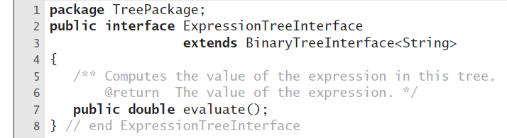
Implementation of an Expression Tree
LISTING 24-4 An interface for an expression tree

Slide 39
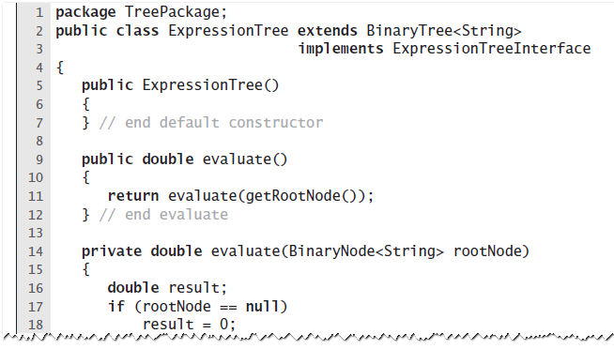
Implementation of an Expression Tree
LISTING 24-5 The class ExpressionTree

Slide 40
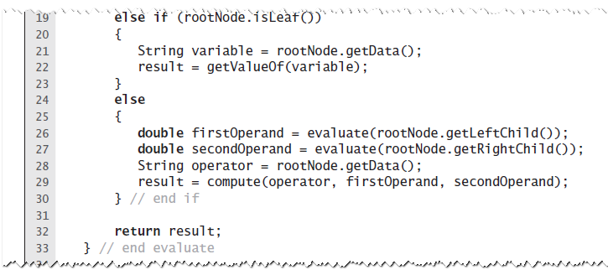
Implementation of an Expression Tree
LISTING 24-5 The class ExpressionTree

Slide 41
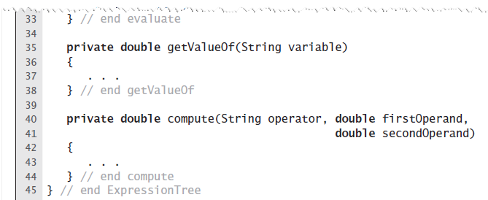
Implementation of an Expression Tree
LISTING 24-5 The class ExpressionTree

Slide 42
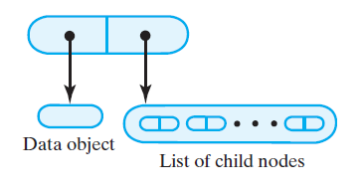
A Node for a General Tree
FIGURE 24-8 A node for a general tree

Slide 43
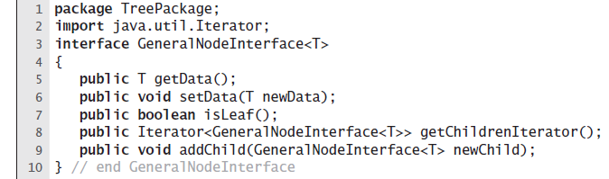
A Node for a General Tree
LISTING 24-6 An interface for a node in a general tree

Slide 44
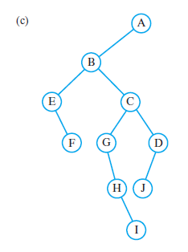
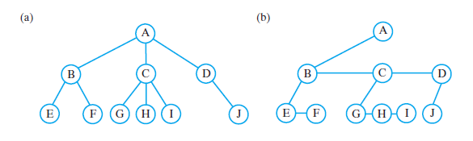
Using a Binary Tree to Represent a General Tree
FIGURE 24-9 (a) A general tree; (b) an equivalent binary tree; (c) a more conventional view of the same binary tree

Slide 45
Binary Search Tree
For each node in a binary search tree
Node’s data is greater than all data in node’s left subtree
Node’s data is less than all data in node’s right subtree
Every node in a binary search tree is the root of a binary search tree

Slide 46
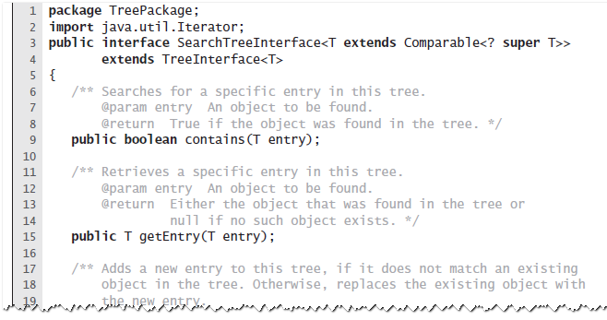
Interface for the Binary Search Tree
LISTING 25-1 An interface for a search tree

Slide 47
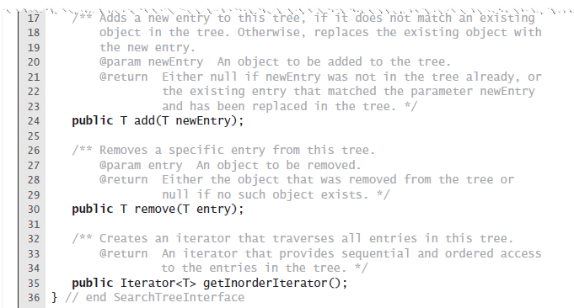
Interface for the Binary Search Tree
LISTING 25-1 An interface for a search tree

