Slide 1

CS 0445
Data Structures
Fall 2017
Queue and Heap
(Slides from Dr. John Ramirez’s CS 445 course)
Sherif Khattab
ksm73@pitt.edu
6307 Sennott Square

Slide 2
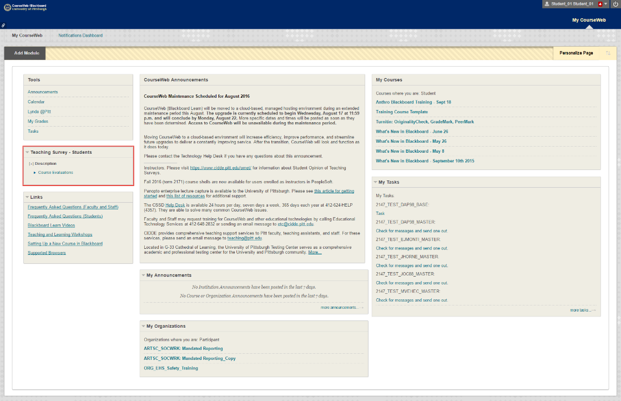
Administrivia
Assignment 5 due on 12/12 @11:59pm
Final on 12/15 12:00-1:50pm
OMET Teaching Survey
Email with subject Teaching Survey
My Pitt
CourseWeb

Slide 3
Earlier in the course
ADTs
Bag
Stack
List
Tree
BST
Algorithms
Recursive algorithms
Sorting
Searching

Slide 4
Today’s Topics
Queue and Heaps

Slide 5
BST Run-times
So how long will getEntry() (and contains()), add() and remove() take to run?
It is clear that they are all proportional in run-time to the height of the tree
So if the BST is balanced
getEntry(), add() and remove() will all be O(log₂N)
If the BST is very unbalanced
getEntry(), add() and remove() will all be O(N)
Given normal use, the tree tends to stay balanced
However, it could be unbalanced if the data is inserted in a particular way
Ex: If we do add()s of sorted data from a file

Slide 6
BST Run-times
Thus, in the AVERAGE CASE, BST give us O(log₂N) for Find, Insert and Delete
In the WORST CASE, BST gives us O(N) for Find, Insert and Delete
So how does a BST compare to a Sorted array or ArrayList?
Recall that a sorted array gives us (average)
O(log₂N) to find an item using binary search
O(N) to add or remove an item (due to shifting)
Thus, in the average case, BST is better for Insert and Delete and about the same for Find

Slide 7
Balanced BSTs
"On average", a BST will remain balanced
But it is possible for it to become unbalanced, yielding worst case run-times
Can we guarantee that the tree remains balanced?
Yes, for example the AVL Tree (Chapter 27)
When Inserts or Deletes are done, nodes may be "rotated" to ensure that the tree remains balanced
However, these rotations add overhead to the operations
If we time the operations, on average it is actually slower than the regular BST

Slide 8
Queues
Queue
Data is added to the end and removed from the front
Logically the items other than the front item cannot be accessed
Think of a bowling ball return lane
Balls are put in at the end and removed from the front, and you can only see / remove the front ball
Fundamental Operations
enqueue an item to the end of the queue
dequeue an item from the front of the queue
front – look at the top item without disturbing it

Slide 9
Queues
A Queue organizes data by First In First Out, or FIFO (or LILO – Last In Last Out)
Like a Stack, a Queue is a simple but powerful data structure
Used extensively for simulations
Many real life situations are organized in FIFO, and Queues can be used to simulate these
Allows problems to be modeled and analyzed on the computer, saving time and money

Slide 10
Queues
Ex: A bank wants to determine how best to set up its lines to the tellers:
Option 1: Have a separate line for each teller
Option 2: Have a single line, with the customer at the front going to the next available teller
How can we determine which will have better results?
We can try each one for a while and measure
Obviously this will take time and may create some upset customers
We can simulate each one using reasonable data and compare the results
Other (often more complex) problems can also be solved through simulation

Slide 11
Queues
Queue Implementation?
We need a structure that has access to both the front and the rear
We'd like both enqueue and dequeue to be O(1) operations
We have two basic approaches:
Use a linked-list based implementation
Use an array based implementation
Let's consider each one

Slide 12
Queues
Queue using a Linked List
This implementation is fairly straightforward as long as we have a doubly linked list or access to the front and rear of the list
enqueue simply adds a new object to the end of the list
dequeue simply removes an object from the front of the list
Other operations are also simple
We can build our Queue from a LinkedList object, making the implementation even simpler
This is more or less done in the JDK
See QueueInterface.java, LList.java

Slide 13
Queues
Note that Queue is an interface
The LList class implements Queue (among other things)
Note that in one way this is a good use of interfaces as ADTs
Even though LinkedList can do a lot more than just the Queue operations, if we use a QueueInterface reference to the object, we restrict it to the Queue operations
The text author also uses an interface, but implements the Queue from scratch
See LinkedQueue.java from text
Linked list with front and rear references is used

Slide 14
Queues
Are there other linked options?
a circular linked list
The extra link gives us all the functionality we need for a Queue
enqueue?
newNode = new Node(newEntry, lastNode.next);
lastNode.next = newNode;
lastNode = newNode;
dequeue?
frontNode = lastNode.next;
lastNode.next = frontNode.next;
frontNode.next = null;
return frontNode;
lastNode

Slide 15
Queues
Take this notion one step further:
Logic enqueue and dequeue are as we expect
However, when we dequeue, rather than removing the node (and allowing it to be garbage collected), we instead just "deallocate it" ourselves
This way we save some overhead of creating new nodes all the time
We keep two references: queueNode and freeNode
queueNode is the front of the queue
This will be the next node dequeued
freeNode is the rear of the queue
This will be the next node enqueued – if none left we will then create a new node

Slide 16
Queues
Queue using an array
Arrays that we have seen so far can easily add at the end, so enqueue is not a problem
Can clearly be done in O(1) time
We may have to resize, but we know how to do that too
However, removing from the front is trickier
In ArrayList, removing from the front causes the remaining objects to be shifted forward
This gives a run-time of O(N), not O(1) as we want
So we will not use an ArrayList
Instead we will work directly with an array to implement our Queue

Slide 17
Queues
How can we make dequeue an O(1) operation?
What if the front of the Queue could "move" – not necessarily be at index 0?
We would then keep a head index to tell us where the front is (and a tail index to tell where the end is)
Ok…so now we can enqueue at the rear by incrementing the tail index and putting the new object in that location and we can dequeue in the front by simply returning the head value and incrementing the head index
 | H |  |  |  | T
 | 30 | 80 | 60 | 40 | 70

Slide 18
Queues
This implementation will definitely work, but it has an important drawback:
Both enqueue and dequeue increment index values
Once we increment front past a location, we never use that location again
Thus, as the queue is used the data migrates toward the end of the array
Clearly this is wasteful in terms of memory
What can we do to fix this problem?
We need a way to reclaim the locations at the front of the array without spending too much time
So shifting is not a good idea
Any ideas?

Slide 19
Queues
How about proceeding down the array as we did before, but when we get to the end, we wrap around back to the beginning
We call this a circular queue, since we use the array locations in a circular way
Circular queue before enqueue of 80
Circular queue after enqueue of 80
 |  |  | H |  |  |  | T
 |  |  | 60 | 40 | 70 | 50 | 90
T |  |  | H
80 |  |  | 60 | 40 | 70 | 50 | 90

Slide 20
Queues
How can this be done?
Actually it is quite simple
When we increment the front and rear index values we do so mod the array length, or
backIndex = (backIndex + 1) % queue.length;
queue[backIndex] = newEntry;
As long as backIndex+1 is less than queue.length, the result is a normal increment
However, once backIndex+1 == queue.length, taking the mod will result in 0, returning us to the beginning of the array
One remaining question: how do we know if the queue is empty or full?

Slide 21
Queues
Both indexes move throughout the array
Show example on board
front == (back+1) % queue.length when array is full or empty
One easy solution is to keep track of the size with an extra instance variable
Text doesn't want to do that (even though the size of a queue is often needed)
Rather, they keep one location in the array empty, even if the queue is full
Array is full when front == (back + 2) % queue.length
Empty when front == (back + 1) % queue.length
Let's look at some more code
See ArrayQueue.java

Slide 22
Array vs. Linked List Implementations
So far we have discussed both array and linked list based data structures:
For List interface we have ArrayList (and Vector) and LinkedList
For Stack we have subclass of Vector (as we discussed) or of LinkedList
For Queue we have linked list version in text (LinkedQueue.java) and also the circular array-based version (ArrayQueue.java)
So which do we prefer?
It depends!

Slide 23
Array vs. Linked List Implementations
Consider Stack and Queue
As long as resizing is done in an intelligent way, the array versions of these tend to be a bit faster than the linked list versions
Stack: push(), pop() are O(1) amortized time for both implementations, but they are a constant factor faster in normal use with the array version
Queue: enqueue(), dequeue() are O(1) amortized time for both implementations, but they are a constant factor faster in normal use with the array version
But notice that the Vector does not automatically "downward" size when items are deleted, so that Vector-based Stack will not either
It could waste memory if it previously had many items and now has few

Slide 24
Array vs. Linked List Implementations
In general, you need to decide for a given application which implementation is more appropriate
In real life, however (especially now)
Most of these data structures are predefined in a library
Java Collections Framework
Stack is array-based, Queue is LL-based
C++ Standard Template Library
It's still good to understand how they are implemented, but more often than not we just use the standard version, due to convenience

Slide 25
Priority Queues
Queues organize data FIFO
Sometimes we want to remove data by other rules
"Those traveling with small children may board"
Tip the maitre d' to get a table
Your Java program is running out of memory so the garbage collector needs to run
This is the idea of a Priority Queue
Data is removed by priority order, rather than FIFO.

Slide 26
Priority Queues
Methods:
Similar in nature to Queue
add() an item to the PQ
Similar to enqueue
remove() and return the highest priority item
Similar to dequeue
peek() at the highest priority item
Similar to getFront
The difference is the order of the removals
See PriorityQueueInterface.java

Slide 27
Priority Queues
Implementation?
Consider unsorted array:
add()?
peek()?
remove()?
Run-times?
Consider sorted array:
add()?
peek()?
remove()?
Run-times?
[see notes on bottom of slide]
Notes:
unsorted array:
add at the end O(1)
peek: search for smallest O(n)
remove: search for smallest then delete it O(n)
sorted array:
add in correct spot O(lgn) to find spot, O(n) to shift
peek: front or rear item: which is better?
remove: simply remove that item [from end]

Slide 28
Priority Queues
How about a linked-list?
Unsorted will be similar to unsorted array
Sorted does not buy us anything
Why?
For any of the above implementations, consider a sequence of N adds followed by N removes
Let's figure out the total run-time and the amortized time per operation
Do on board
[Also see Notes on the bottom of this slide]
Can we do better?
Yes, with a HEAP
Notes:
In all cases with a simple array or linked list, one of the operations (either add or remove) is linear. Thus, if we consider N adds followed by N removes, the total run-time will be N^2 by the following logic [we consider the case of the unsorted array – other cases are similar]
Each add() will be O(1) for a total of O(N)
First remove will require N comparisons to find the highest priority item
Second remove will require N-1 comparisons
Third remove will require N-2 comparisons
…
Adding we get the sum: 1 + 2 + … + N which we know evaluates to N(N+1)/2 which is O(N^2)
In the amortized case we have O(N^2)/N = O(N) per operation, which is more time than we want to spend

Slide 29
Heaps
Idea of a heap:
Partial ordering of data in a logical complete binary tree
For each node, T, in the tree:
T.data has a higher priority than T.lchild.data
T.data has a higher priority than T.rchild.data
Note that NOTHING IS SAID about how T.lchild.data and T.rchild.data compare to each other
We do not care – could be either way
This is why it is a partial ordering
Compare to BST, which is a complete ordering
In that case, we define a specific relationship between siblings

Slide 30
Heaps
Higher priority here can mean either greater than or less than in terms of value
Min Heap: Highest priority value is the smallest
Ex: Seedings in an event, rankings, etc.
Max Heap: Highest priority value is the largest
Ex: Salary, batting average, goals per game, etc.
The logic is the same for both
Text uses Max Heap
Look at PriorityQueue.java and MaxHeapInterface.java
We could very easily switch this to a Min Heap if needed
Look at simple example on the board

Slide 31
Heaps
Ok, how do we do our PQ / MaxHeap operations:
peek() / getMax() is easy – ROOT of tree
How about add and remove?
add() / add() is not as simple
remove() / removeMax() is even trickier
For both we are altering the tree, so we must ensure that the HEAP PROPERTY is reestablished
We need to carefully consider where / how to add and remove to keep the tree valid but also not cost too much work

Slide 32
Heaps
Idea of add():
Add new node at next available leaf
Push the node "up" the tree until it reaches its appropriate spot
We'll call this upHeap
See example on board
Idea of removeMax():
We must be careful since root may have two children
Similar problem exists when deleting from BST
To delete that node will require a major reworking of the tree
Instead of deleting root node, we overwrite its value with that of the last leaf

Slide 33
Heaps
Then we delete the last leaf -- easy to delete a leaf
And we guarantee that the tree is still complete
But now root value may not be the max
Push the node "down" the tree until it reaches its appropriate spot
We'll call this downHeap
See example on board

Slide 34
Heaps
Run-time?
Complete Binary Tree has height ≈ lgN
upHeap or downHeap at most traverse height of the tree
Thus add() and removeMax are always O(lgN) worst case
For N add + removeMax operations:
N x lgN = O(NlgN)
Amortized the operations are (clearly) O(lgN) each
This is definitely superior to either the array or linked list implementation

Slide 35
Implementing a Heap
How to Implement a Heap?
We could use a linked binary tree, similar to that used for BST
Will work, but we have overhead associated with dynamic memory allocation and access
To go up and down we need child and parent references
Must keep track of "last leaf in tree" reference
But note that we are maintaining a complete binary tree for our heap
It turns out that we can easily represent a complete binary tree using an array

Slide 36
Implementing a Heap
Idea:
Number nodes row-wise starting at 1
Use these numbers as index values in the array
Now, for node at index i
See example on board
Now we have the benefit of a tree structure with the speed of an array implementation
See MaxHeap.java
Parent(i) = i/2
LChild(i) = 2i
RChild(i) = 2i+1

Slide 37
Mutable and Immutable Objects
Many classes that we build contain mutator methods
Methods that allow us to change the content of an object
Objects that can be changed via mutators are said to be mutable
Ex: StringBuilder
append() method adds characters to the current StringBuilder
Ex: Rectangle2D.Double
setFrame() method changes size and location

Slide 38
Mutable and Immutable Objects
Ex: ArrayList
add(), remove() for example
Some classes do not contain mutator methods
Objects from these classes are said to be immutable
Ex: String
Cannot alter the string once the object is created
Ex: wrapper objects (Integer, Float, etc)
Allow accessors but no mutators

Slide 39
Mutable and Immutable Objects
Implications of Mutable vs. Immutable Objects
Complications of being immutable
Actions that could be simple as a mutation require more work if a new object must be created
Ex: Concatenating Strings
String S1 = "Hello ";
S1 = S1 + "there";
We must create and assign a new object rather than just append the string to the existing object
If done repeatedly this can cause a lot of overhead
Show on board

Slide 40
Mutable and Immutable Objects
Complications of being mutable
Consider collections of objects
When we add an object to a collection, it doesn't mean we give up outside access to the object
If we subsequently alter the object "external" to the collection, we could destroy a property of the collection
Ex: Consider a BST or a MaxHeap
In either of these cases the data must meet a certain requirement based on its value
Altering an object within the BST or MaxHeap could cause the collection to no longer satisfy the BST property or the Heap property

Slide 41
Cloning
What to do?
We can make objects immutable
We can put clones of our original objects into the collection
However, we still must be careful not to mutate the objects within the collection
Since some access methods return references to the objects within the collection
To be very safe our accessors should themselves return clones of the objects rather than references to the originals
What is cloning?

Slide 42
Copying and Deep vs. Shallow Copy
Java objects can be copied using the clone() method
clone() is defined in class Object, so it will work for all Java classes
However, you must override it for new classes to work properly
It needs to know what data in the new class to copy
This is somewhat tricky to do, especially for subclasses – see Employee.java for syntax
clone() is already defined for Java arrays (and some other classes), so we can use it for them without overriding

Slide 43
Copying and Deep vs. Shallow Copy
clone() is typically defined to do a shallow copy of the data in an object
This means that when the object is copied, objects that it refers to are NOT copied
Ex: If cloning an array of StringBuilders, we get a new array but NOT new StringBuilders
Show on board
This can cause data sharing/aliasing that you must be aware of
See Example15.java and Employee.java for example

Slide 44
Copying and Deep vs. Shallow Copy
Generally speaking, (true) deep copying is more difficult than shallow copying
We need to follow all references in the original and make copies for the clone()
This could be several levels deep
Ex: A Binary Search Tree
The BST object has only one instance variable – a reference to the root node
A shallow copy would only copy this single reference
A deep copy would have to traverse the entire tree, copying each node AND copying the data in each node AND …
For a deep-er copy we can use the copyNodes() which calls the copy() method that we discussed previously

