Slide 1

CS 0445
Data Structures
Fall 2017
Comparing Bag Implementations
Sherif Khattab
ksm73@pitt.edu
6307 Sennott Square

Slide 2
Administrivia
Assignment 2 will be posted this Friday
Deadline Mon 10/16

Slide 3
Earlier in the course
Array-based and linked implementations of the Bag ADT
How to measure algorithm complexity
The Big-O notation

Slide 4
Today’s Topic
Measuring Time Complexity
Exceptions
The Stack ADT

Slide 5
How to measure the time complexity of an algorithm
Count the number of executed steps (basic operations or just lines)
sum = 0
for i = 1 to n
sum = sum + i
Number of executed lines is 2n + 2
Let f(n) = the number of executed steps
n is the problem size
Usually it is the input size (very roughly, the number of keyboard presses needed to enter the input)
f(n) may depend only on n or on the actual values of the input
In the latter, need to find f(n) for best, average, worst cases

Slide 6
How to measure the time complexity of an algorithm
Convert the function f into the Big-O notation
Ignore lower order terms
e.g., constant < log log n < log n < log²n < n < n log n < n² < n³ < 2^{n} < n!
e.g., n² + log n = O(n²)
Ignore constant factors
cn => O(n), where c is a constant (doesn’t depend on n)
2^{cn} is not O(2^{n})
f(n) = 2n + 2 = O(2n) = O(n)

Slide 7
The Big-O Family
Big Omicron: O ≈ <=
n = O(n)
n = O(n!)
Little Omicron: o ≈ <
n ≠ o(n)
n = o(n²)
Big Omega: Ω ≈ >=
n = Ω(n)
2^{n} = Ω(n)
Little Omega: ω ≈ >
n ≠ ω(n)
n = ω(1)
Theta: θ ≈ =
5n = θ(n) (has to be O and Ω)

Slide 8
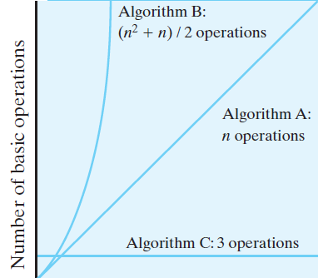
Riding Moore’s law
Writing an efficient algorithm (with less time complexity) is important
Such algorithm rides the exponentially-growing curve of hardware-speed ``better”
Problem size solvable by machine M using Algorithm B in T second
Problem size solvable by machine M using Algorithm A in T second
Number of operations that machine M can do in time T seconds

Slide 9
Exceptions

Slide 10
The Basics
Method creates an exception object
We say “throws an exception”
Signal to program
Unexpected has happened
Handle the exception
Detect and react

Slide 11
The Basics
Checked exceptions in the Java Class Library
ClassNotFoundException
FileNotFoundException
IOException
NoSuchMethodException
WriteAbortedException

Slide 12
The Basics
Runtime exceptions in the Java Class Library
ArithmeticException
ArrayIndexOutOfBoundsException
ClassCastException
IllegalArgumentException
IllegalStateException
IndexOutOfBoundsException
NoSuchElementException
NullPointerException
StringIndexOutOfBoundsException
UnsupportedOperationException

Slide 13
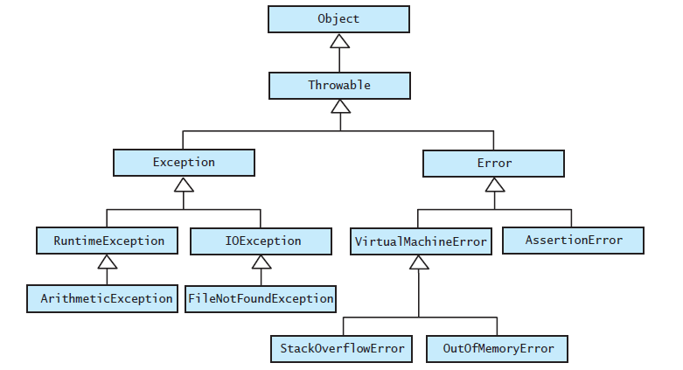
The Basics
FIGURE JI2-1 The hierarchy of some standard exception and error classes

Slide 14

Handling an Exception
Postpone handling: The throws clause
If programmer not sure what action is best for a client when an exception occurs
Leave the handling of the exception to the method’s client
Method that can cause but does not handle checked exception must declare in its header

Slide 15
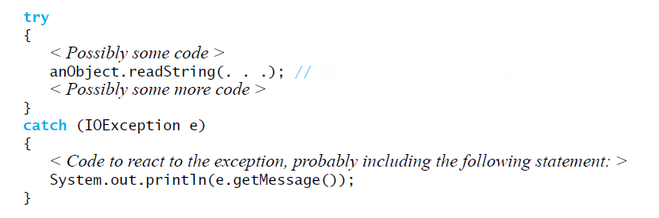
Handle It Now: The try-catch Blocks
Might throw an IOException
Code to handle an IOException as a result of invoking the method readString

Slide 16
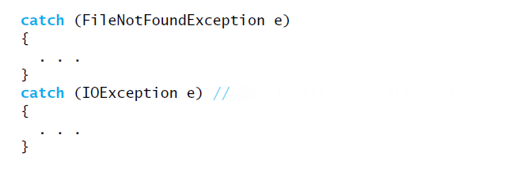
Multiple catch Blocks
Handle all other IOExceptions
Good order for catch blocks

Slide 17

Throwing an Exception
A method intentionally throws an exception by executing a throw statement.
Programmers usually create the object within the throw statement

Slide 18
Throwing an Exception
If you can resolve unusual situation in a reasonable manner
likely can use a decision statement instead of throwing an exception
If several resolutions to abnormal occurrence possible, and you want client to choose
Throw a checked exception
If a programmer makes a coding mistake by using your method incorrectly
Throw a runtime exception

Slide 19
The Stack ADT

Slide 20
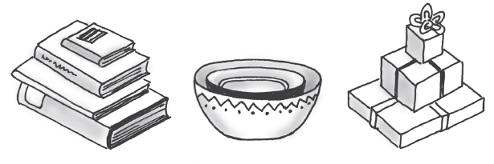
Stacks
FIGURE 5-1 Some familiar stacks
Add item on top of stack
Remove item that is topmost
Last In, First Out … LIFO

Slide 21
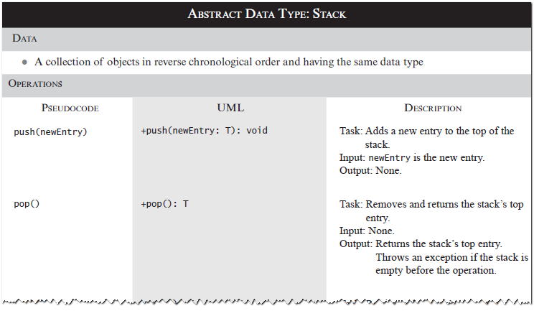
Specifications of the ADT Stack

Slide 22
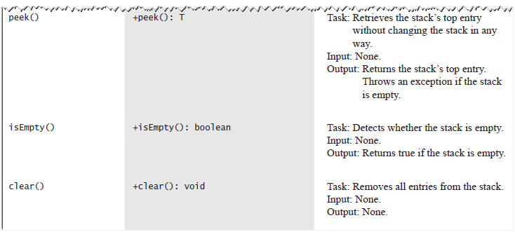
Specifications of the ADT Stack

Slide 23
Design Decision
When stack is empty
What to do with pop and peek?
Possible actions
Assume that the ADT is not empty;
Return null.
Throw an exception (which type?).

Slide 24
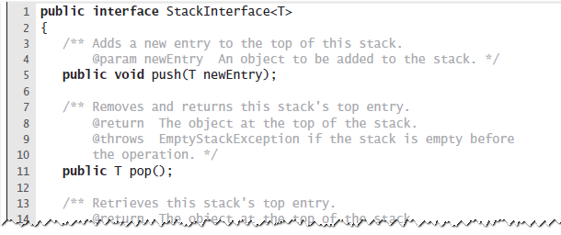
Interface
LISTING 5-1 An interface for the ADT stack

Slide 25
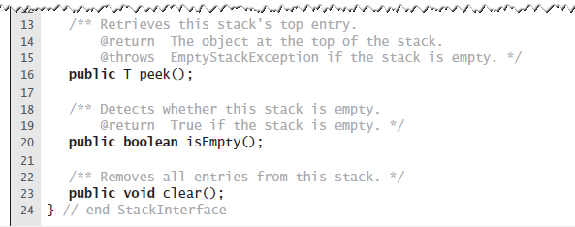
Interface
LISTING 5-1 An interface for the ADT stack

Slide 26
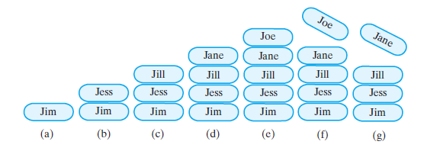
Example
FIGURE 5-2 A stack of strings after (a) push adds Jim; (b) push adds Jess; (c) push adds Jill; (d) push adds Jane; (e) push adds Joe; (f ) pop retrieves and removes Joe; (g) pop retrieves and removes Jane

Slide 27
Security Note
Design guidelines
Use preconditions and postconditions to document assumptions.
Do not trust client to use public methods correctly.
Avoid ambiguous return values.
Prefer throwing exceptions instead of returning values to signal problem.

Slide 28
Processing Algebraic Expressions
Infix: each binary operator appears between its operands a + b
Prefix: each binary operator appears before its operands + a b
Postfix: each binary operator appears after its operands a b +
Balanced expressions: delimiters paired correctly

Slide 29
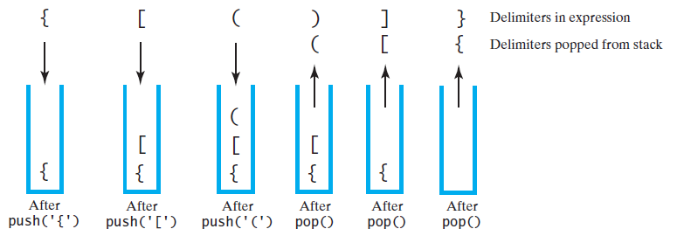
Processing Algebraic Expressions
FIGURE 5-3 The contents of a stack during the scan of an expression that contains the balanced delimiters { [ ( ) ] }

Slide 30
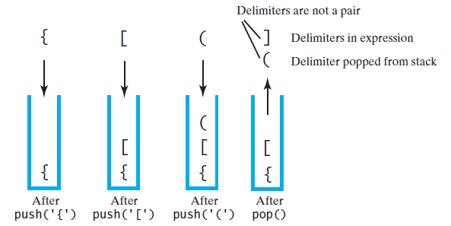
Processing Algebraic Expressions
FIGURE 5-4 The contents of a stack during the scan of an expression that contains the unbalanced delimiters { [ ( ] ) }

Slide 31
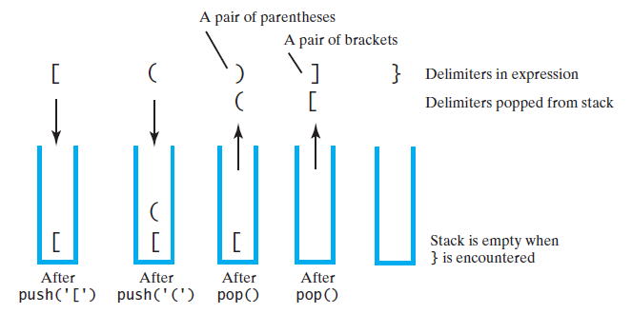
Processing Algebraic Expressions
FIGURE 5-5 The contents of a stack during the scan of an expression that contains the unbalanced delimiters [ ( ) ] }

Slide 32
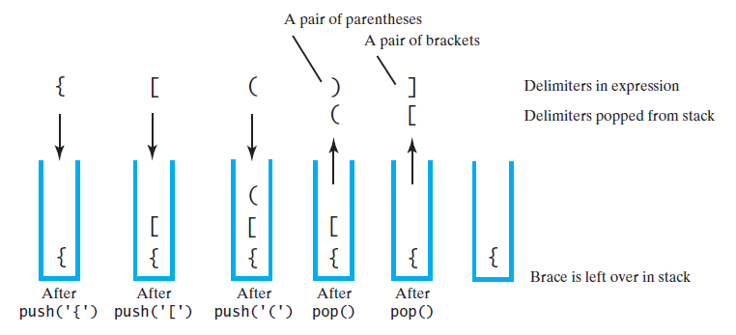
Processing Algebraic Expressions
FIGURE 5-6 The contents of a stack during the scan of an expression that contains the unbalanced delimiters { [ ( ) ]

Slide 33
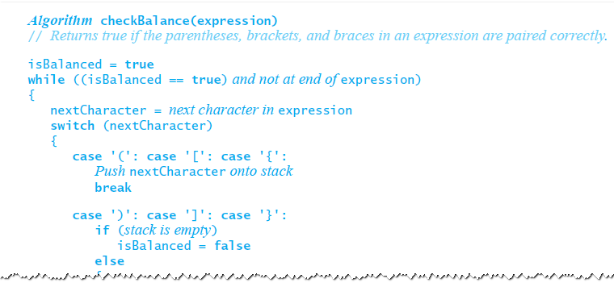
Processing Algebraic Expressions
Algorithm to process for balanced expression.

Slide 34
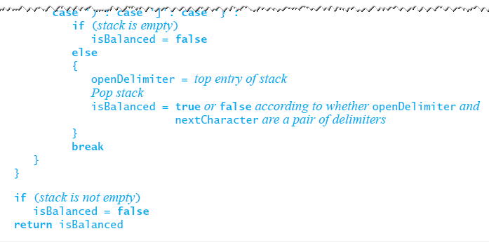
Processing Algebraic Expressions
Algorithm to process for balanced expression.

Slide 35
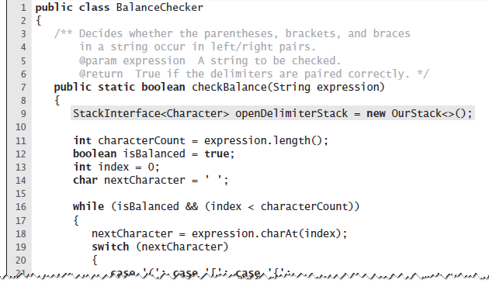
Java Implementation
LISTING 5-2 The class BalanceChecker

Slide 36
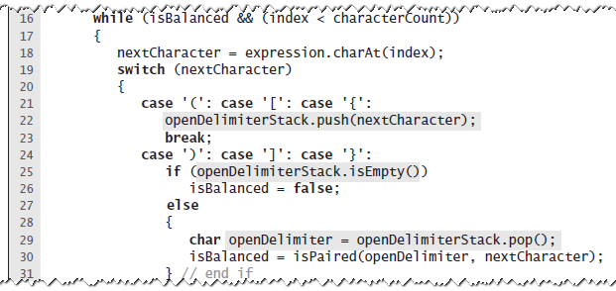
Java Implementation
LISTING 5-2 The class BalanceChecker

Slide 37
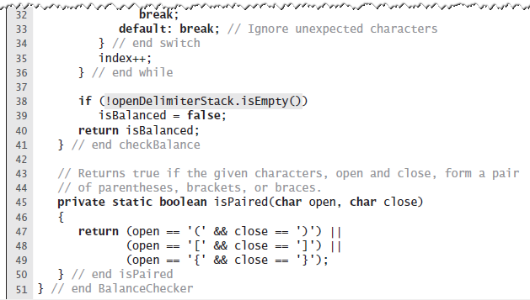
Java Implementation
LISTING 5-2 The class BalanceChecker

Slide 38
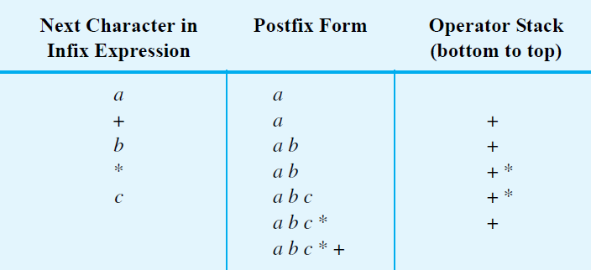
Infix to Postfix
FIGURE 5-7 Converting the infix expression a + b * c to postfix form

Slide 39
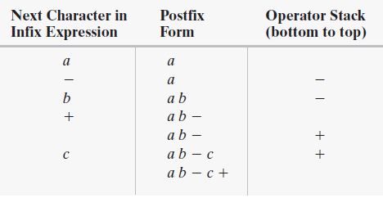
Successive Operators with Same Precedence
FIGURE 5-8 Converting an infix expression to postfix form: (a) a - b + c;

Slide 40
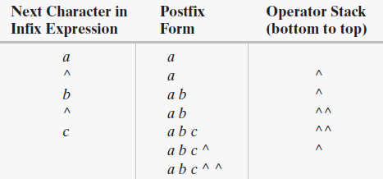
Successive Operators with Same Precedence
FIGURE 5-8 Converting an infix expression to postfix form: a ^ b ^ c

Slide 41
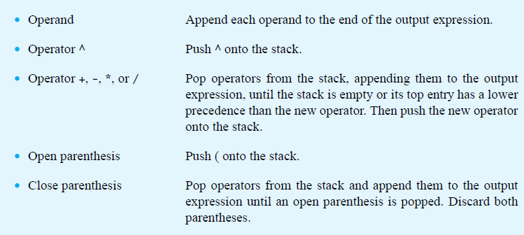
Infix-to-postfix Conversion

