Slide 1

CS 0445
Data Structures
Fall 2017
The Stack ADT
Sherif Khattab
ksm73@pitt.edu
6307 Sennott Square

Slide 2
Administrivia
For Tuesday recitation ONLY
Lab 7 is for credit instead of Lab 5 or
Lab 5 is for credit but send by email? (Majority opted for second option)
Assignment 2 is up
Deadline Tuesday 10/17 @11:59

Slide 3
Earlier in the course
Bag ADT
The Big-O notation

Slide 4
Today’s Topic
The Stack ADT

Slide 5
Pop Quiz 1
password: stack

Slide 6
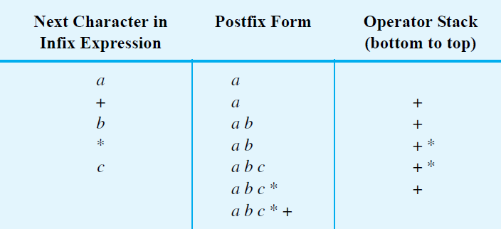
Infix to Postfix
FIGURE 5-7 Converting the infix expression a + b * c to postfix form

Slide 7
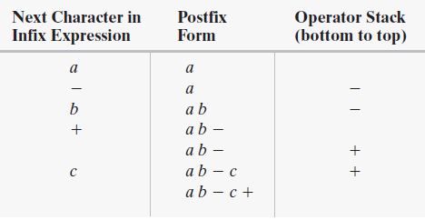
Successive Operators with Same Precedence
FIGURE 5-8 Converting an infix expression to postfix form: (a) a - b + c;

Slide 8
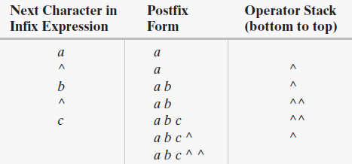
Successive Operators with Same Precedence
FIGURE 5-8 Converting an infix expression to postfix form: a ^ b ^ c

Slide 9
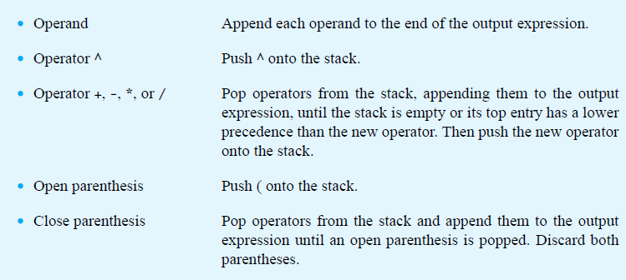
Infix-to-postfix Conversion

Slide 10
Pop Quiz 2
password: postfix

Slide 11
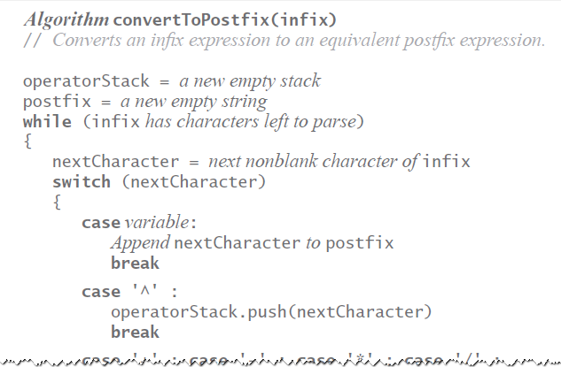
Infix-to-postfix Algorithm

Slide 12
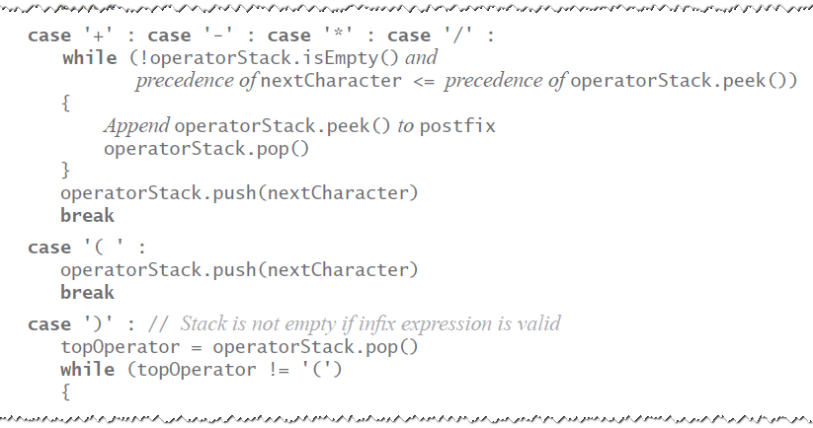
Infix-to-postfix Algorithm

Slide 13
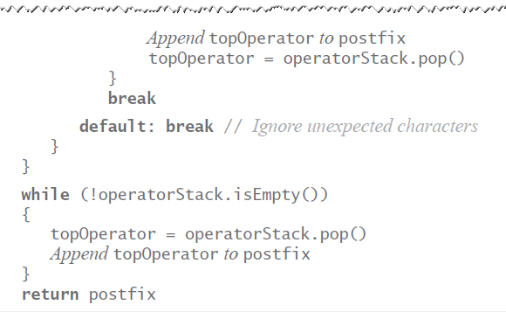
Infix-to-postfix Algorithm

Slide 14
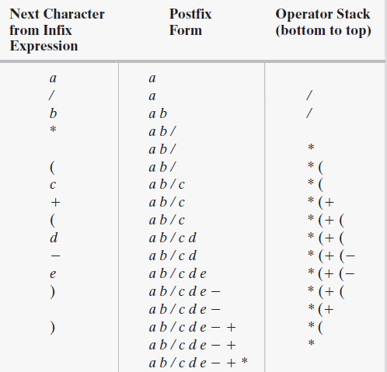
Infix to Postfix
FIGURE 5-9 The steps in converting the infix expression a / b * (c + (d - e)) to postfix form

Slide 15
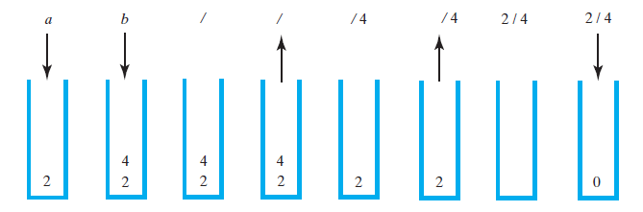
Evaluating Postfix Expressions
FIGURE 5-10 The stack during the evaluation of the postfix expression a b / when a is 2 and b is 4

Slide 16
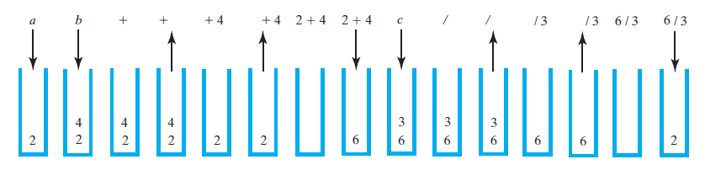
Evaluating Postfix Expressions
FIGURE 5-11 The stack during the evaluation of the postfix expression a b + c / when a is 2, b is 4, and c is 3

Slide 17
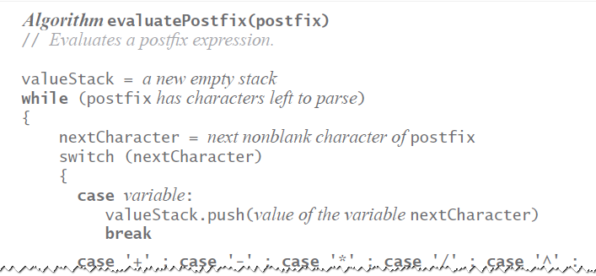
Evaluating Postfix Expressions
Algorithm for evaluating postfix expressions.

Slide 18
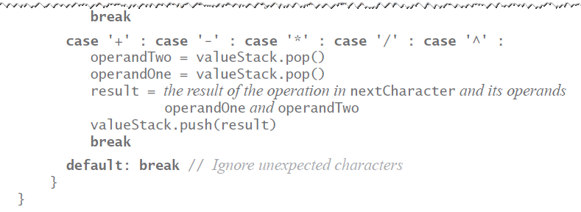
Evaluating Postfix Expressions
Algorithm for evaluating postfix expressions.

Slide 19
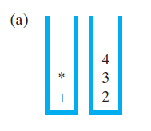
Evaluating Infix Expressions
FIGURE 5-12 Two stacks during the evaluation of a + b * c when a is 2, b is 3, and c is 4:
(a) after reaching the end of the expression;

Slide 20
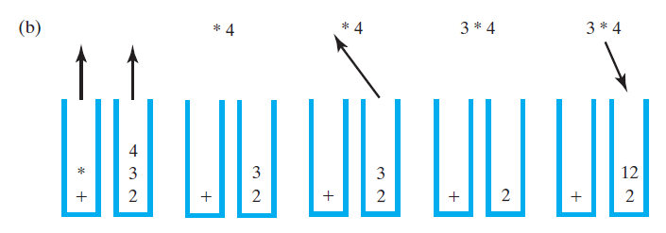
Evaluating Infix Expressions
FIGURE 5-12 Two stacks during the evaluation of a + b * c when a is 2, b is 3, and c is 4: (b) while performing the multiplication;

Slide 21
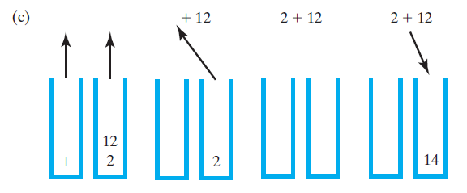
Evaluating Infix Expressions
FIGURE 5-12 Two stacks during the evaluation of a + b * c when a is 2, b is 3, and c is 4: (c) while performing the addition

Slide 22
Pop Quiz 3
password: infix

Slide 23
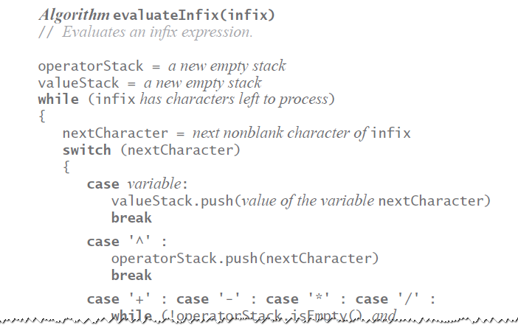
Evaluating Infix Expressions
Algorithm to evaluate infix expression.

Slide 24
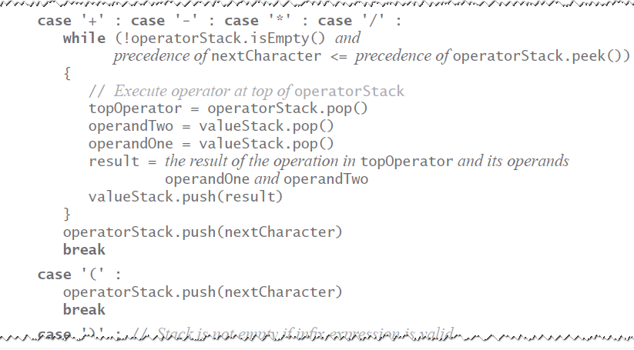
Evaluating Infix Expressions
Algorithm to evaluate infix expression.

Slide 25
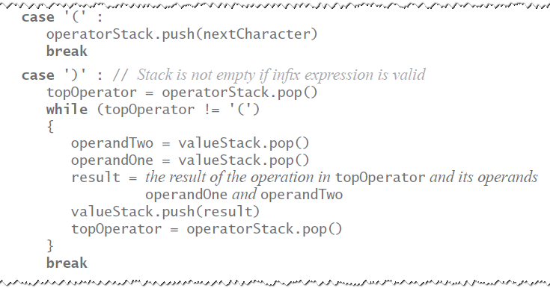
Evaluating Infix Expressions
Algorithm to evaluate infix expression.

Slide 26
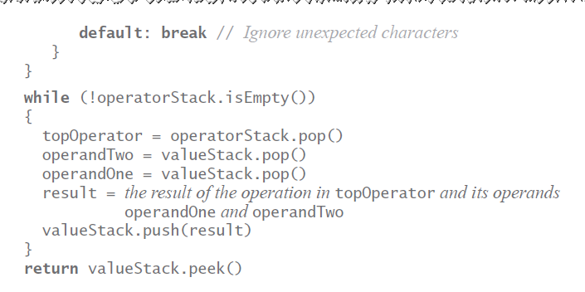
Evaluating Infix Expressions
Algorithm to evaluate infix expression.

Slide 27
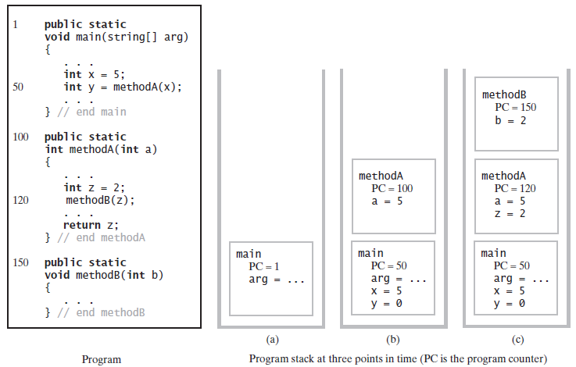
The Program Stack
FIGURE 5-13 The program stack at three points in time: (a) when main begins execution; (b) when methodA begins execution; (c) when methodB begins execution

Slide 28
Pop Quiz 4
password: activation

