Slide 1

CS 0445
Data Structures
Fall 2017
Implementations of the Stack ADT
Sherif Khattab
ksm73@pitt.edu
6307 Sennott Square

Slide 2
Administrivia
Next Lab is for credit
For Tuesday recitation, email your solution to your TA

Slide 3
Earlier in the course
Bag ADT
The Big-O notation
Stack ADT and three applications
balanced brackets
evaluation of infix arithmetic expressions
the program stack

Slide 4
Today’s Topic
Stack implementations

Slide 5
Java Class Library: The Class Stack
Found in java.util
Methods
A constructor – creates an empty stack
public T push(T item);
public T pop();
public T peek();
public boolean empty();

Slide 6
Pop Quiz 5
password: linked

Slide 7
Linked Implementation
Each operation involves top of stack
push
pop
peek
Head of linked list easiest, fastest to access
Let this be the top of the stack

Slide 8
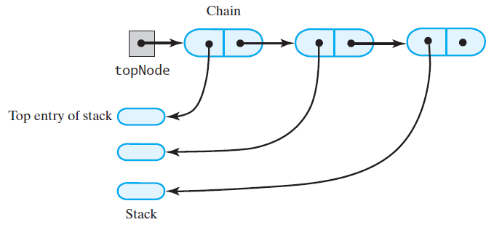
Linked Implementation
FIGURE 6-1 A chain of linked nodes that implements a stack

Slide 9
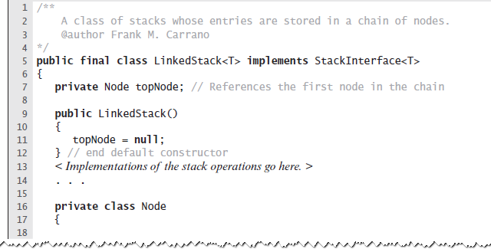
Linked Implementation
LISTING 6-1 An outline of a linked implementation of the ADT stack

Slide 10
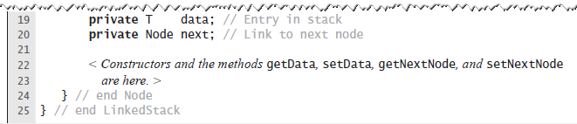
Linked Implementation
LISTING 6-1 An outline of a linked implementation of the ADT stack

Slide 11
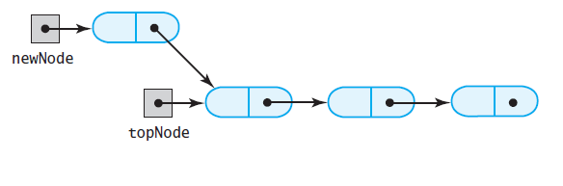
Linked Implementation
(a)
FIGURE 6-2 (a) A new node that references the node at the top of the stack;

Slide 12
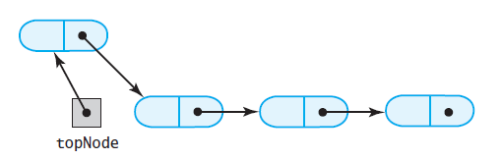
Linked Implementation
(b)
FIGURE 6-2 (b) the new node is now at the top of the stack

Slide 13
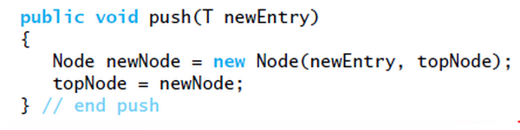
Linked Implementation
Definition of push

Slide 14
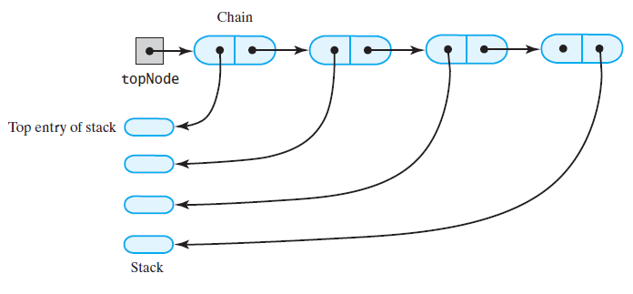
Linked Implementation
(a)
FIGURE 6-3 The stack (a) before the first node in the chain is deleted

Slide 15
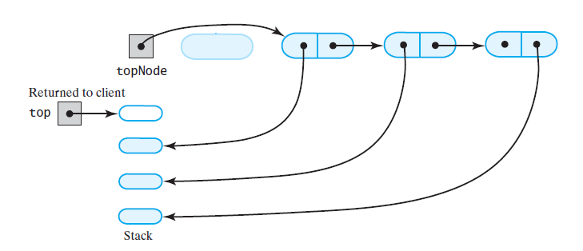
Linked Implementation
(b)
FIGURE 6-3 The stack (b) after the first node in the chain is deleted

Slide 16
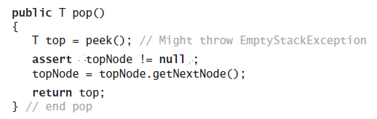
Linked Implementation
Definition of pop

Slide 17
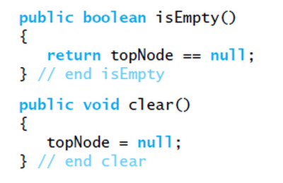
Linked Implementation
Definition of rest of class.

Slide 18
Array-Based Implementation
Each operation involves top of stack
push
pop
peek
End of the array easiest to access
Let this be top of stack
Let first entry be bottom of stack

Slide 19
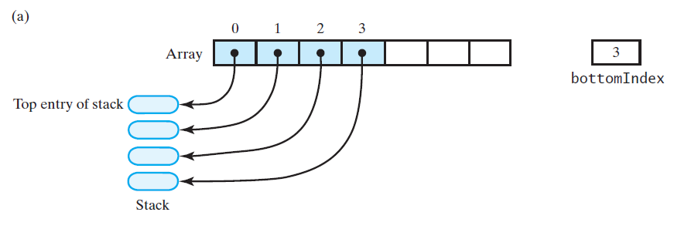
Array-Based Implementation
FIGURE 6-4 An array that implements a stack; its first location references (a) the top entry in the stack;

Slide 20
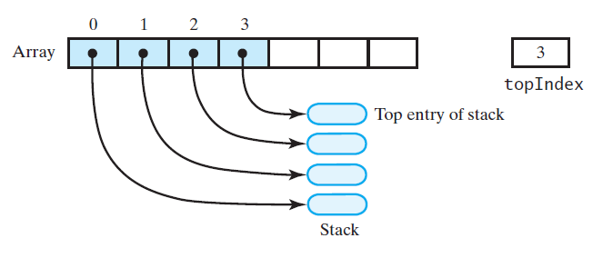
Array-Based Implementation
(b)
FIGURE 6-4 An array that implements a stack; its first location references (b) the bottom entry in the stack

Slide 21
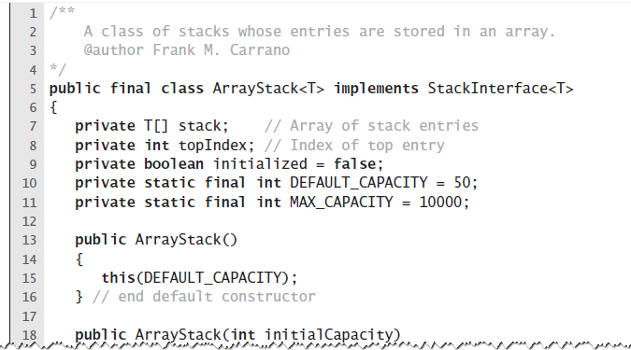
Array-Based Implementation
LISTING 6-2 An outline of an array-based implementation of the ADT stack

Slide 22
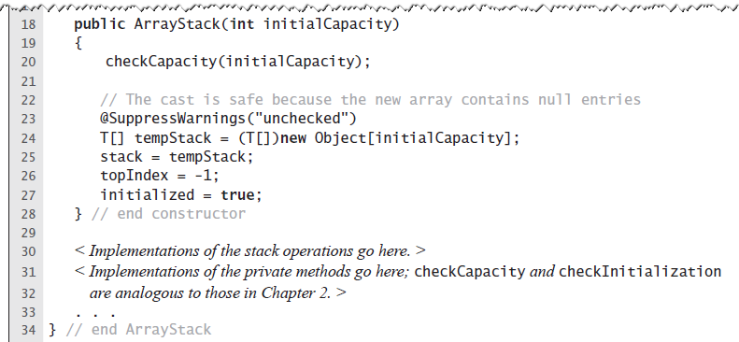
Array-Based Implementation
LISTING 6-2 An outline of an array-based implementation of the ADT stack

Slide 23
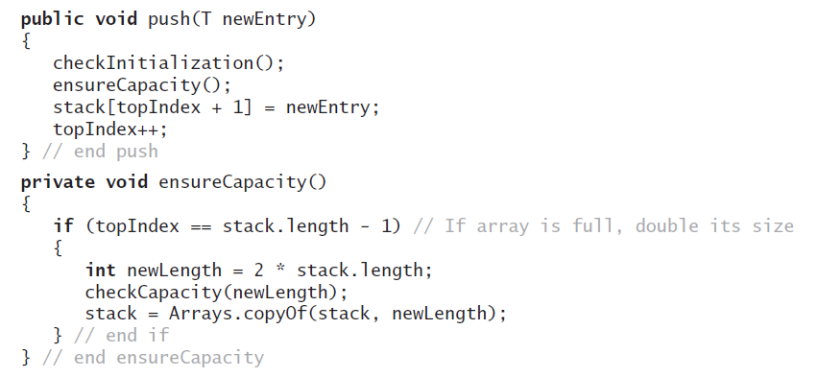
Array-Based Implementation
Adding to the top.

Slide 24
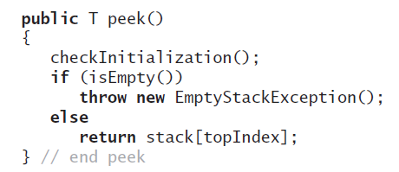
Array-Based Implementation
Retrieving the top, operation is O(1)

Slide 25
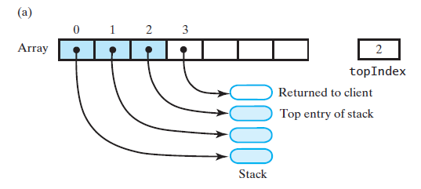
Array-Based Implementation
FIGURE 6-5 An array-based stack after its top entry is removed by (a) decrementing topIndex;

Slide 26
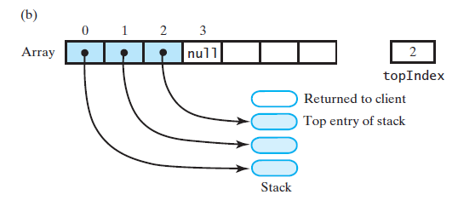
Array-Based Implementation
FIGURE 6-5 An array-based stack after its top entry is removed by (b) setting stack[topIndex] to null and then decrementing topIndex

Slide 27
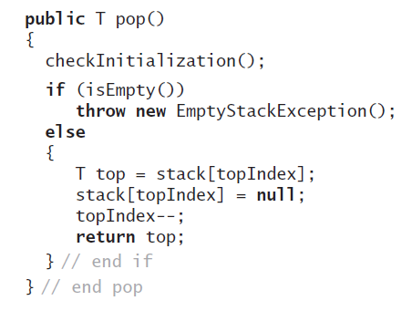
Array-Based Implementation
Removing the top

Slide 28
Vector Based Implementation
Vector: an object that behaves like a high-level array
Index begins with 0
Methods to access or set entries
Size will grow as needed
Use vector’s methods to manipulate stack

Slide 29
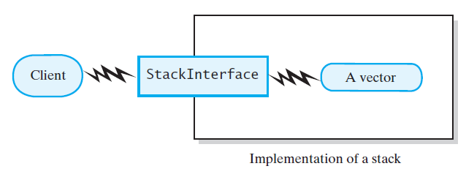
Vector Based Implementation
FIGURE 6-6 A client using the methods given in StackInterface; these methods interact with a vector’s methods to perform stack operations

Slide 30
The Class Vector
Constructors
Has methods to add, remove, clear
Also methods to determine
Last element
Is the vector empty
Number of entries

Slide 31
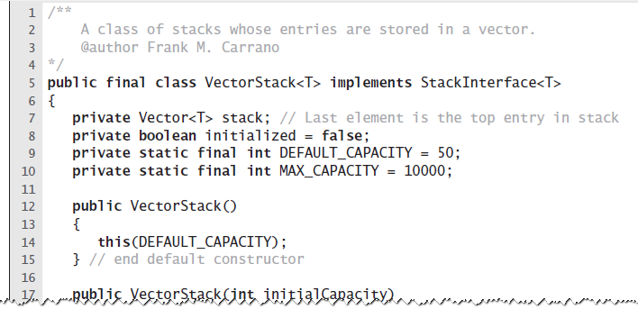
Vector Based Implementation
LISTING 6-3 An outline of a vector-based implementation of the ADT stack

Slide 32
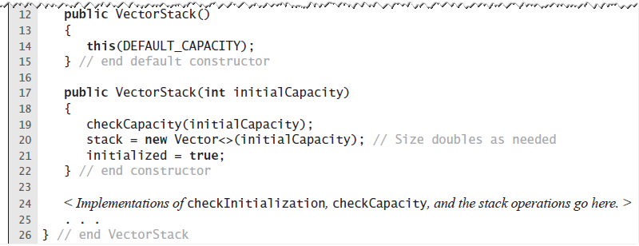
Vector Based Implementation
LISTING 6-3 An outline of a vector-based implementation of the ADT stack

Slide 33
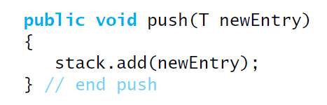
Vector Based Implementation
Adding to the top

Slide 34
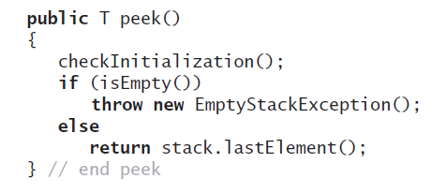
Vector Based Implementation
Retrieving the top

Slide 35
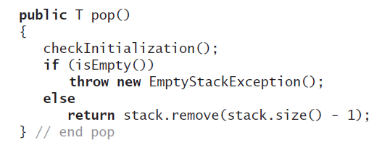
Vector Based Implementation
Removing the top

Slide 36
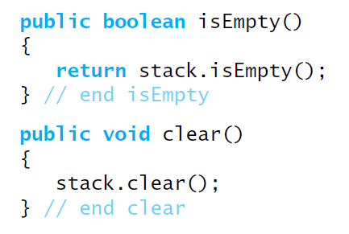
Vector Based Implementation
The rest of the class.

