Slide 1

CS 0445
Data Structures
Fall 2017
Recursion
Sherif Khattab
ksm73@pitt.edu
6307 Sennott Square

Slide 2
Administrivia
For last week’s recitation, please email your solution to your TA until next week
Midterm exam next Tuesday

Slide 3
Earlier in the course
Bag ADT
The Big-O notation
Stack ADT

Slide 4
Today’s Topic
Recursion

Slide 5
What Is Recursion?
Consider hiring a contractor to build
He hires a subcontractor for a portion of the job
That subcontractor hires a sub-subcontractor to do a smaller portion of job
The last sub-sub- … subcontractor finishes
Each one finishes and reports “done” up the line

Slide 6
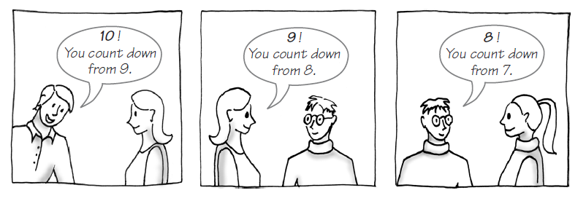
Example: The Countdown
FIGURE 7-1 Counting down from 10

Slide 7
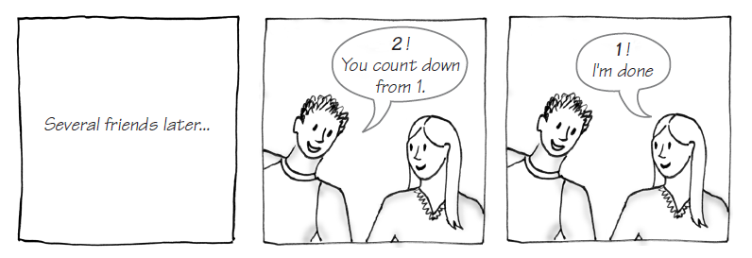
Example: The Countdown
FIGURE 7-1 Counting down from 10

Slide 8
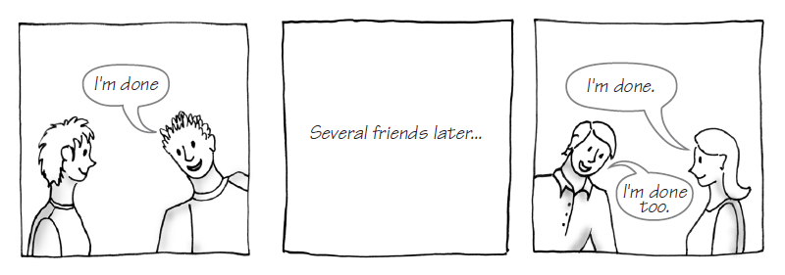
Example: The Countdown
FIGURE 7-1 Counting down from 10

Slide 9
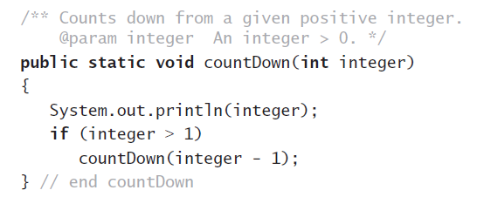
Example: The Countdown
Recursive Java method to do countdown.

Slide 10
Definition
Recursion is a problem-solving process
Breaks a problem into identical but smaller problems.
A method that calls itself is a recursive method.
The invocation is a recursive call or recursive invocation.

Slide 11
Design Guidelines
Method must be given an input value
Method definition must contain logic that involves this input, leads to different cases
One or more cases should provide solution that does not require recursion
Else infinite recursion
One or more cases must include a recursive invocation

Slide 12
Programming Tip
Iterative method contains a loop
Recursive method calls itself
Some recursive methods contain a loop and call themselves
If the recursive method with loop uses while, make sure you did not mean to use an if statement

Slide 13
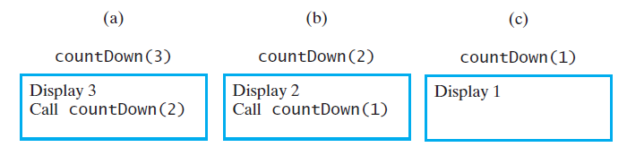
Tracing a Recursive Method
FIGURE 7-2 The effect of the method call countDown(3)

Slide 14
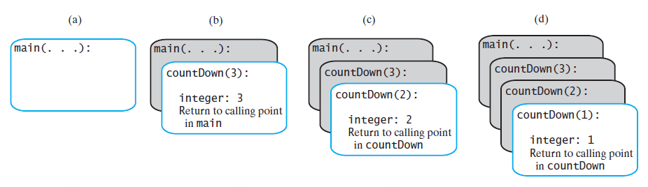
Tracing a Recursive Method
FIGURE 7-4 The stack of activation records during the execution of the call countDown(3)

Slide 15
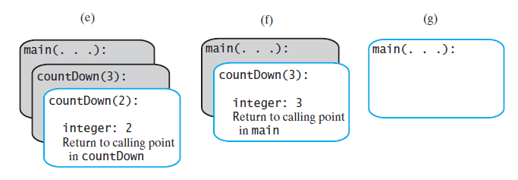
Tracing a Recursive Method
FIGURE 7-4 The stack of activation records during the execution of the call countDown(3)

Slide 16
Stack of Activation Records
Each call to a method generates an activation record
Recursive method uses more memory than an iterative method
Each recursive call generates an activation record
If recursive call generates too many activation records, could cause stack overflow

Slide 17
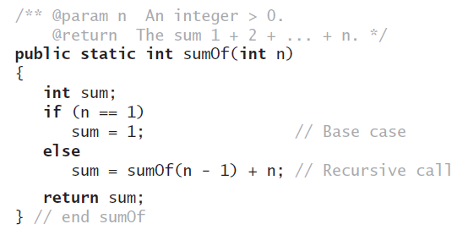

Recursive Methods That Return a Value
Recursive method to calculate

Slide 18
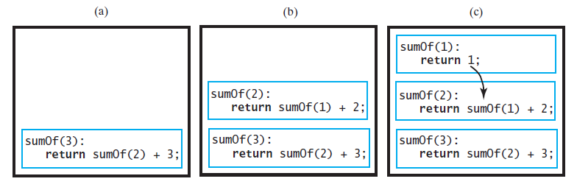
Tracing a Recursive Method
FIGURE 7-5 Tracing the execution of sumOf(3)

Slide 19
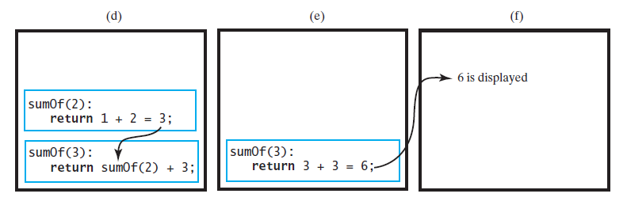
Tracing a Recursive Method
FIGURE 7-5 Tracing the execution of sumOf(3)

Slide 20
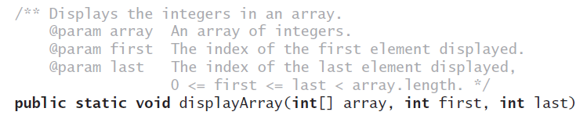
Recursively Processing an Array
Given definition of a recursive method to display array.

Slide 21
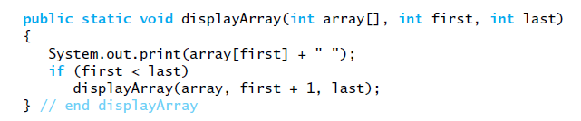
Recursively Processing an Array
Starting with array[first]

Slide 22
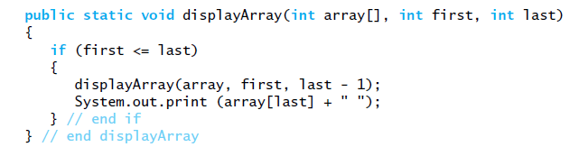
Recursively Processing an Array
Starting with array[last]

Slide 23

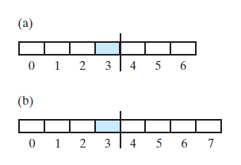
Recursively Processing an Array
FIGURE 7-6 Two arrays with their middle elements within their left halves

Slide 24
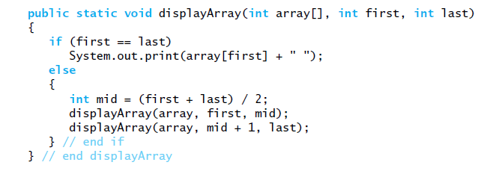
Recursively Processing an Array
Consider first + (last – first) / 2 Why?
Processing array from middle.

