Slide 1

CS 0445
Data Structures
Fall 2017
Recursion II
Sherif Khattab
ksm73@pitt.edu
6307 Sennott Square

Slide 2
Administrivia
For last week’s recitation, please email your solution to your TA until next week
Midterm exam next Tuesday
Assignment 2 late submission is due tonight @11:59pm

Slide 3
Earlier in the course
Bag ADT
The Big-O notation
Stack ADT
Recursion

Slide 4
Today’s Topic
More on recursion

Slide 5
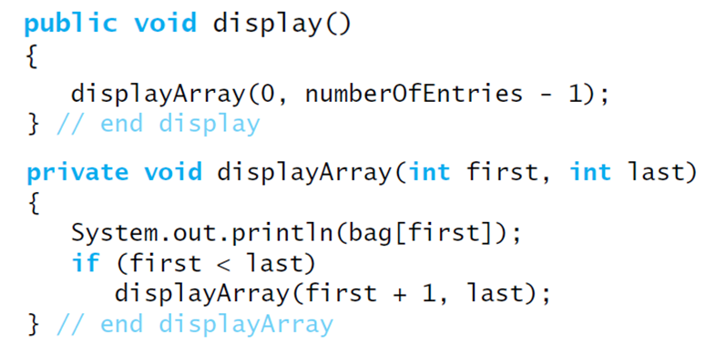
Displaying a Bag
Recursive method that is part of an implementation of an ADT often is private.

Slide 6
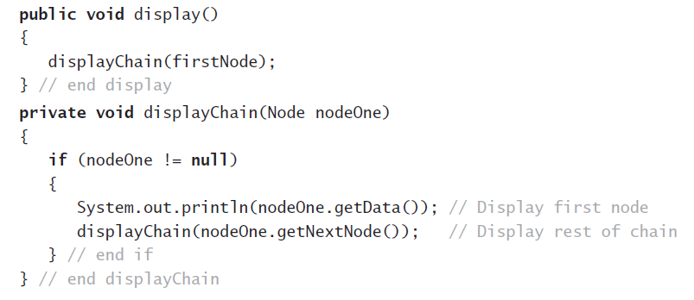
Recursively Processing a Linked Chain
Display data in first node and recursively display data in rest of chain.

Slide 7
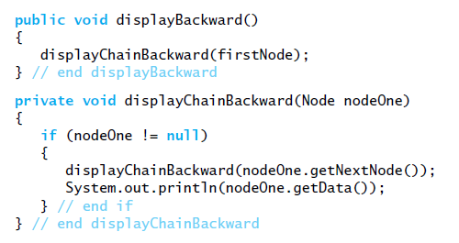
Recursively Processing a Linked Chain
Displaying a chain backwards. Traversing chain of linked nodes in reverse order easier when done recursively.

Slide 8
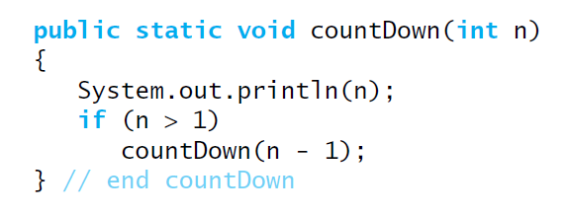
Time Efficiency of Recursive Methods
Using proof by induction, we conclude method is O(n).

Slide 9
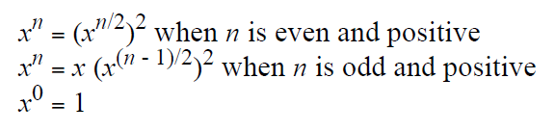
Time Efficiency of Computing x^{n}
Efficiency of algorithm is O(log n)

Slide 10
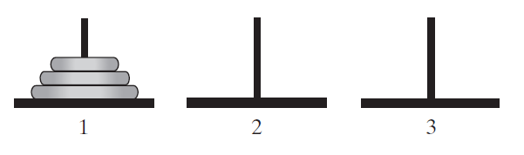
Simple Solution to a Difficult Problem
FIGURE 7-7 The initial configuration of the Towers of Hanoi for three disks.

Slide 11
Simple Solution to a Difficult Problem
Rules:
Move one disk at a time. Each disk moved must be topmost disk.
No disk may rest on top of a disk smaller than itself.
You can store disks on the second pole temporarily, as long as you observe the previous two rules.

Slide 12
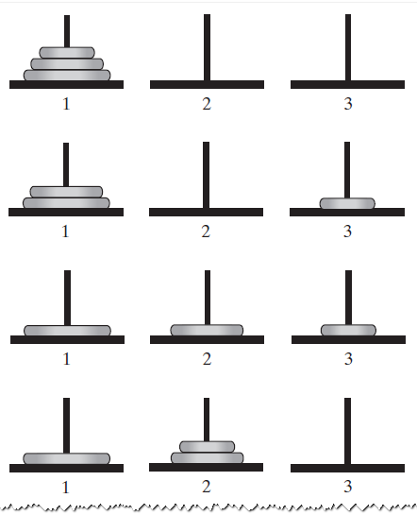
Solutions
FIGURE 7-8 The sequence of moves for solving the Towers of Hanoi problem with three disks

Slide 13
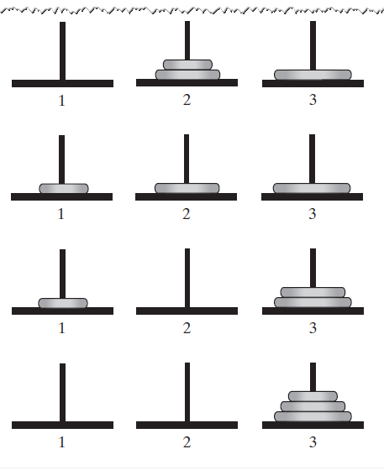
Solutions
FIGURE 7-8 The sequence of moves for solving the Towers of Hanoi problem with three disks

Slide 14
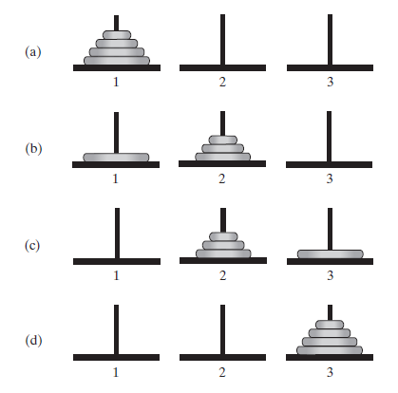
Solutions
FIGURE 7-9 The smaller problems in a recursive solution for four disks

Slide 15
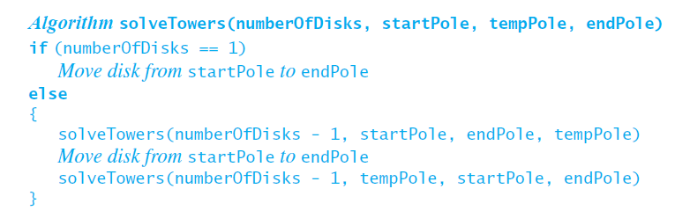
Solutions
Recursive algorithm to solve any number of disks. Note: for n disks, solution will be 2^{n} – 1 moves

Slide 16
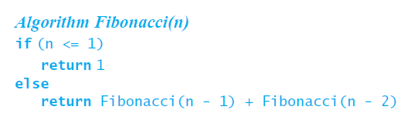
Poor Solution to a Simple Problem
Algorithm to generate Fibonacci numbers.
Why is this inefficient?

Slide 17
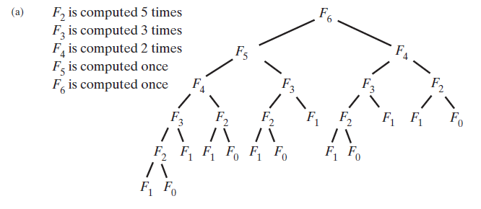
Poor Solution to a Simple Problem
FIGURE 7-10 The computation of the Fibonacci number F₆ using (a) recursion … F_{n} = Ω(a^{n})

Slide 18
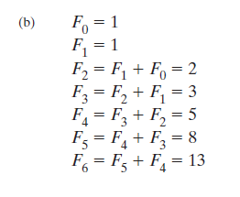
Poor Solution to a Simple Problem
FIGURE 7-10 The computation of the Fibonacci number F₆ using (b) iteration.

Slide 19
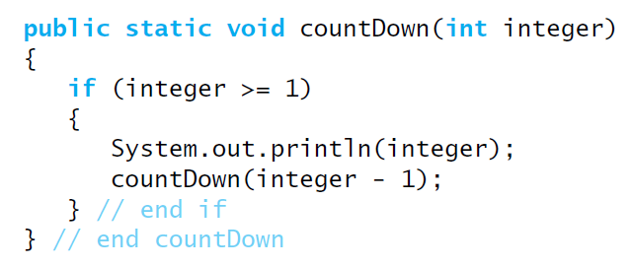
Tail Recursion
When the last action performed by a recursive method is a recursive call.

Slide 20
Tail Recursion
In a tail-recursive method, the last action is a recursive call
This call performs a repetition that can be done by using iteration.
Converting a tail-recursive method to an iterative one is usually a straightforward process.

Slide 21
Indirect Recursion
Example
Method A calls Method B
Method B calls Method C
Method C calls Method A
Difficult to understand and trace
But does happen occasionally

Slide 22
Indirect Recursion
Consider evaluation of validity of an algebraic expression
Algebraic expression is either a term or two terms separated by a + or – operator
Term is either a factor or two factors separated by a * or / operator
Factor is either a variable or an algebraic expression enclosed in parentheses
Variable is a single letter

Slide 23
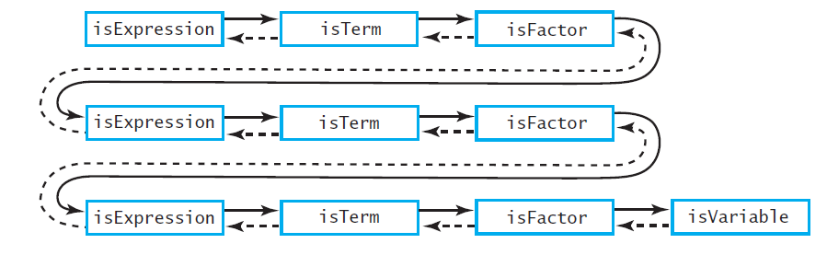
Indirect Recursion
FIGURE 7-11 An example of indirect recursion

Slide 24
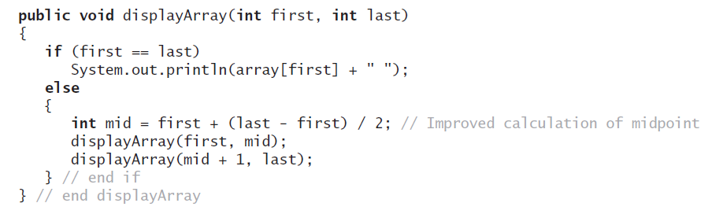
Using a Stack Instead of Recursion
An example of converting a recursive method to an iterative one

Slide 25
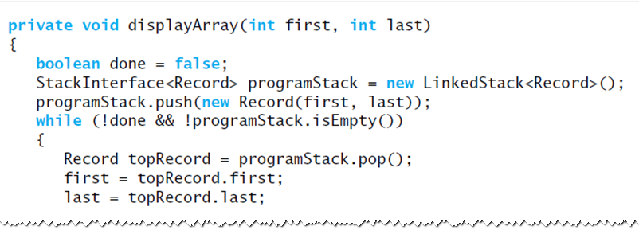
Using a Stack Instead of Recursion
An iterative displayArray to maintain its own stack

Slide 26
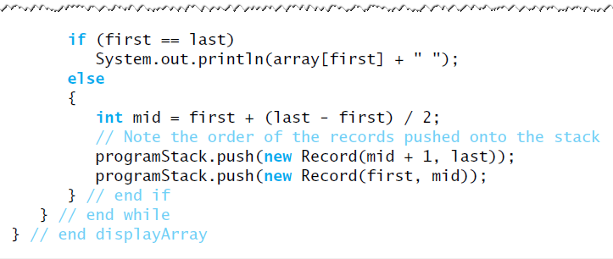
Using a Stack Instead of Recursion
An iterative displayArray to maintain its own stack

