Slide 1

CS 0445
Data Structures
Fall 2017
Abstract Data Types (ADTs)
Sherif Khattab
ksm73@pitt.edu
6307 Sennott Square

Slide 2
Abstract Data Types (ADTs)
ADTs are data types defined by the operations they can provide
Algorithms use ADTs.
ADTs are implemented using data structures
Learn ADTs to select the most suitable data type for your algorithm
For each ADT that follows learn:
its abstraction
operations that it provides
examples of algorithms that use it
how it is usually implemented

Slide 3
Container
value-based and reference-based
sequence and associative

Slide 4
Container Operations
create a new empty container (constructor),
report the number of objects it stores (size),
delete all the objects in the container (clear),
insert new objects into the container,
remove objects from it,
provide access to the stored objects

Slide 5
List (Sequence Container)
ordered; repeated items
element, entry, item
implementation:
linked list
array
binary search tree

Slide 6
List Operations
create an empty list
test whether or not a list is empty
prepend an entity to a list
append an entity to a list
determine the "head” of a list
determine the “tail” of a list: the list consisting of all the components of a list without the list head

Slide 7
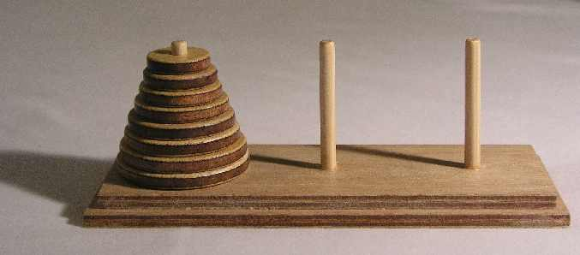
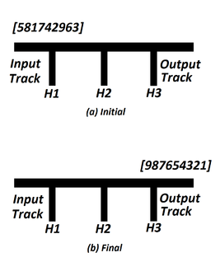
Stack
First-In Last-Out (FILO) or Last-In First-Out (LIFO)
Implementation:
arrays
linked-lists
Applications
Converting a decimal number into a
binary number
Towers of Hanoi
Expression evaluation
Rearranging railroad cars

Slide 8
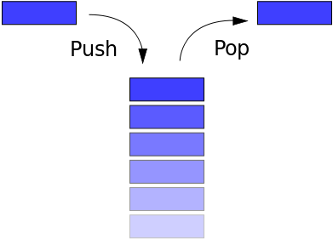
Stack Operations
init
push
pop
top
isempty

Slide 9
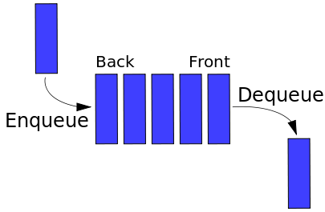
Queue
First-In First-Out (FIFO)
implementation:
linked list
array
applications
buffers

Slide 10
Queue Operations
add an element to the rear terminal position (enqueue)
remove an element from the front terminal position (dequeue)

Slide 11
Double-ended Queue (Deque)
enqueue and dequeue on either end
peek: returns the value at that end without dequeuing it.

Slide 12
Priority Queue
Each element has a priority
implementation:
array
linked list
heap
binary search tree
applications
simulation (discrete-event)
resource management
any algorithm that requires repetitive min OR max

Slide 13
Priority Queue Operations
insert_with_priority: add an element to the queue with an associated priority
pull_highest_priority_element: remove the element from the queue that has the highest priority, and return it

Slide 14
Map (Dictionary or Associative Array)
(key, value) pairs
keys are unique
implementation:
hash table
arrays
binary search trees
Applications:
library system (books and patrons)

Slide 15
Map Operations
Add or insert: the arguments to this operation are the key and the value.
Reassign: replace the value in one of the pairs that are already in the collection. The arguments to this operation are the key and the value.
Remove or delete: remove a pair from the collection. The argument to this operation is the key.
Lookup: find the value (if any) that is bound to a given key. The argument to this operation is the key.

Slide 16
Multimap
more than one value with one key
implementation:
a map of sets or a map of lists
multimap in C++ STL
applications
student registration
HTTP querystring
book index

