Slide 1

CS 0445
Data Structures
Fall 2017
Brush-up on Java
Sherif Khattab
ksm73@pitt.edu
6307 Sennott Square

Slide 2
Ea
Relationship between algorithms, abstract data types (ADTs), and data structures
Levels of "proficiency" in data structures
Golden rule for selecting a data structure
Browsing through some commonly used ADTs
Fall 2017 CS0445-Data Structures- Sherif Khattab

Slide 3
Today's topics
A few more ADTs
Revision on creating Java classes (Appendix C in the textbook)
Fall 2017 CS0445-Data Structures- Sherif Khattab

Slide 4
Set
No particular order; no repeated items
Fall 2017 CS0445-Data Structures- Sherif Khattab

Slide 5
Set Operations
union of two sets
intersection of two sets
difference of two sets
Fall 2017 CS0445-Data Structures- Sherif Khattab

Slide 6
Set Implementations
Array (bit array)
Hash table
Binary Search Tree
Bloom filter
union-find
Fall 2017 CS0445-Data Structures- Sherif Khattab

Slide 7
Multiset (Bag)
no particular order; repeated items
can be implemented by a binary search tree
Fall 2017 CS0445-Data Structures- Sherif Khattab

Slide 8
Multiset Operations
check whether an element is present (at least once) in the bag
check whether two bags have the same elements (including repeated items)
count the number of times that an element occurs
duplicate each element m times
combine (union) elements of two bags including repeated items
Fall 2017 CS0445-Data Structures- Sherif Khattab

Slide 9
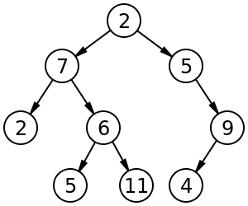
Tree
a tree has a value (root) and children (sub-trees), and the children are themselves trees
internal nodes vs. leaf nodes
Applications:
hierarchal data
searchable data
special variations for special key types: tries
Fall 2017 CS0445-Data Structures- Sherif Khattab

Slide 10
Tree Operations
Enumerating all the items
Enumerating a section of a tree
Searching for an item
Adding a new item at a certain position on the tree
Deleting an item
Pruning: Removing a whole section of a tree
Grafting: Adding a whole section to a tree
Finding the root for any node
Fall 2017 CS0445-Data Structures- Sherif Khattab

Slide 11
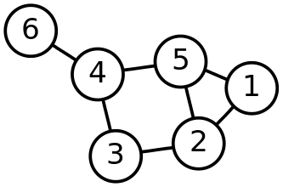
Graph
nodes and edges
node and edge values
Fall 2017 CS0445-Data Structures- Sherif Khattab

Slide 12
Graph Operations
adjacent(G, x, y): tests whether there is an edge from node x to node y.
neighbors(G, x): lists all nodes y such that there is an edge from x to y.
add(G, x, y): adds to G the edge from x to y, if it is not there.
delete(G, x, y): removes the edge from x to y, if it is there.
Minimum spanning tree
Shortest path with variations.
Fall 2017 CS0445-Data Structures- Sherif Khattab

Slide 13
Creating java classes

Slide 14
Three ways to create a Java class
Write it up from scratch
Compose it using other classes (has-a relationship)
Inherit it from another class (is-a relationship)

Slide 15
Composition
Ex: Construct a Student class from a Name class.
What if you want to change the existing class?
Use an adapter class

Slide 16
Inheritance
Ex: Create CollegeStudent class by inheriting from Student class

