Slide 1

CS 0445
Data Structures
Fall 2017
Array Implementation of the Bag ADT
Sherif Khattab
ksm73@pitt.edu
6307 Sennott Square

Slide 2
Administrivia
Assignment posting and due dates explicitly noted at http://www.cs.pitt.edu/~skhattab/cs0445/
Assignment 1 is up and due on Tuesday Sept. 26 @11:59pm.
Prepare for the lab by going over the Pre-lab part
Quiz in next week’s recitations
Write an algorithm in pseudo-code (in paper) and convert that up into Java code
CourseWeb for submission of code
TA collects your papers
Note the lab sessions that are for credit (marked with an asterisk in the weekly schedule)

Slide 3
Earlier in the course
The interface of the Bag ADT
A couple examples on how to use the interface

Slide 4
Today’s Topic
Array-based implementation of the Bag ADT

Slide 5
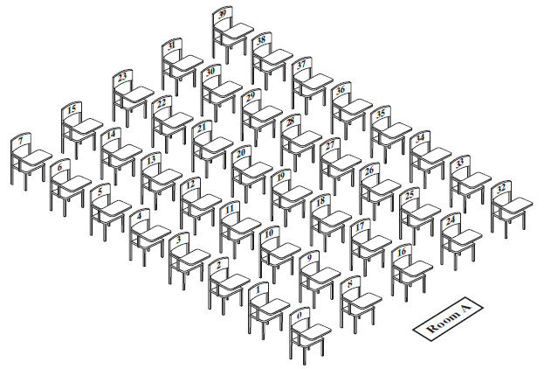
Fixed-Size Array to Implement the ADT Bag
A classroom that contains desks in fixed positions
© 2016 Pearson Education, Ltd. All rights reserved.

Slide 6
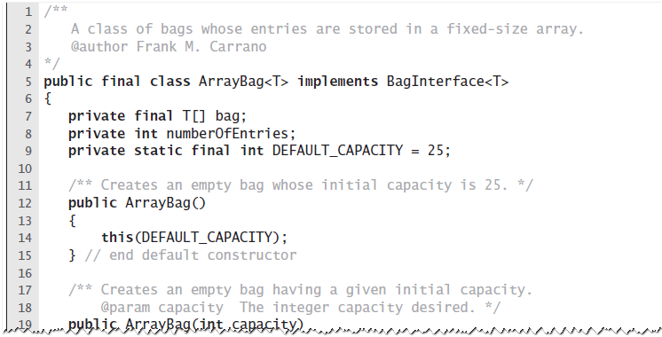
Fixed-Size Array
An outline of the class ArrayBag
© 2016 Pearson Education, Ltd. All rights reserved.

Slide 7
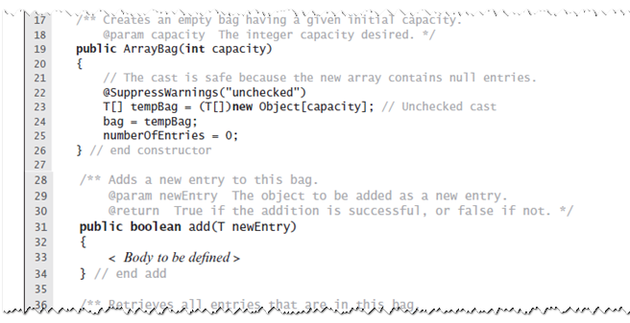
Fixed-Size Array
An outline of the class ArrayBag
© 2016 Pearson Education, Ltd. All rights reserved.

Slide 8
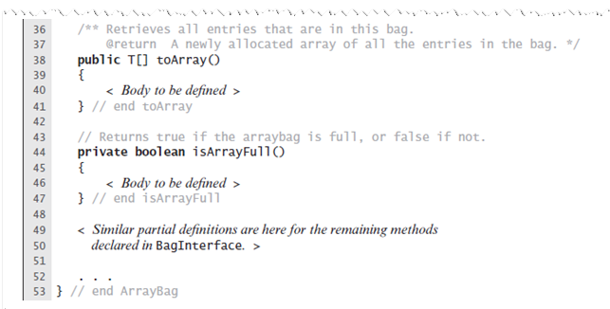
Fixed-Size Array
An outline of the class ArrayBag
© 2016 Pearson Education, Ltd. All rights reserved.

Slide 9
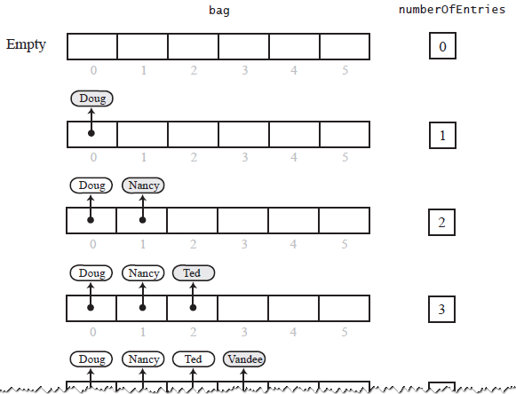
Fixed-Size Array
Adding entries to an array that represents a bag, whose capacity is six, until it becomes full
© 2016 Pearson Education, Ltd. All rights reserved.

Slide 10
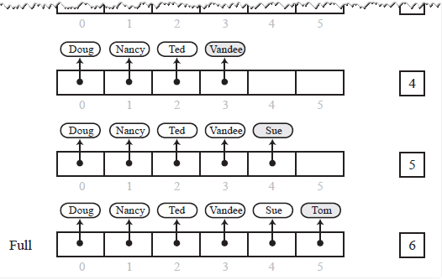
Fixed-Size Array
Adding entries to an array that represents a bag, whose capacity is six, until it becomes full
© 2016 Pearson Education, Ltd. All rights reserved.

Slide 11
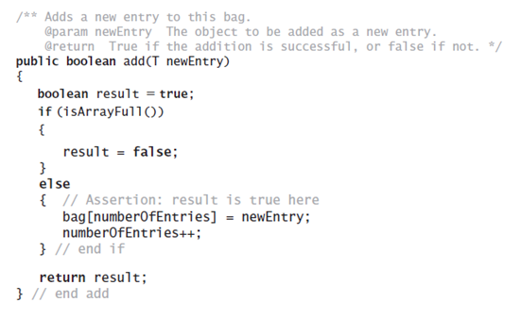
Fixed-Size Array
Method add
© 2016 Pearson Education, Ltd. All rights reserved.

Slide 12
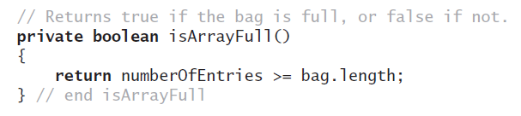
Fixed-Size Array
Method isFull
© 2016 Pearson Education, Ltd. All rights reserved.

Slide 13
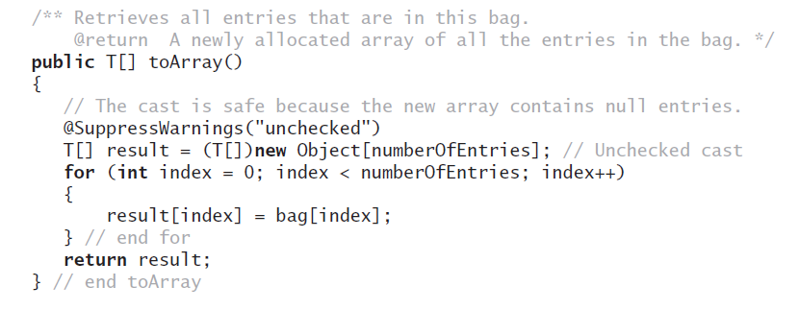
Fixed-Size Array
Method toArray
© 2016 Pearson Education, Ltd. All rights reserved.

