Slide 1

CS 0445
Data Structures
Fall 2017
Array Implementation of the Bag ADT
Sherif Khattab
ksm73@pitt.edu
6307 Sennott Square

Slide 2
Administrivia
Assignment 1 is up and due on Tuesday Sept. 26 @11:59pm.
Prepare for the lab by going over the Pre-lab part
Quiz in next week’s recitations
Write an algorithm in pseudo-code (in paper) and convert that up into Java code
CourseWeb for submission of code
TA collects your papers

Slide 3
Earlier in the course
Array-based implementation of the Bag ADT
“Core’’ methods

Slide 4
Today’s Topic
The remaining methods of ArrayBag
An implementation with a dynamically-expandable array

Slide 5

Making the Implementation Secure
Practice fail-safe programming by including checks for anticipated errors
Validate input data and arguments to a method
refine incomplete implementation of ArrayBag to make code more secure by adding the following two data fields
© 2016 Pearson Education, Ltd. All rights reserved.

Slide 6
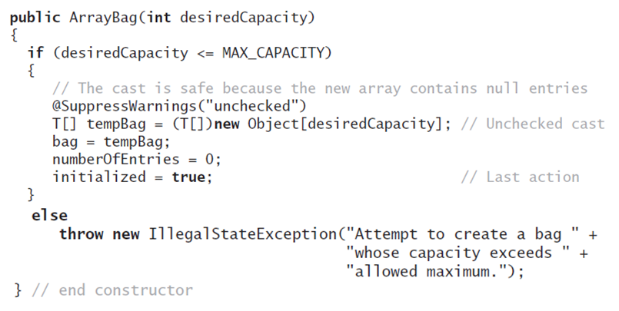
Making the Implementation Secure
Revised constructor
© 2016 Pearson Education, Ltd. All rights reserved.

Slide 7
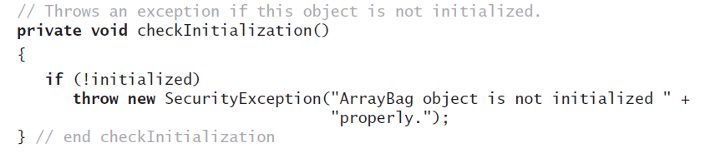
Making the Implementation Secure
Method to check initialization
© 2016 Pearson Education, Ltd. All rights reserved.

Slide 8
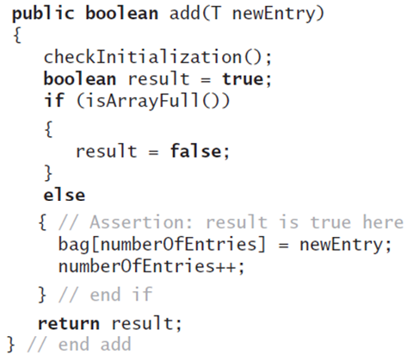
Making the Implementation Secure
Revise the method add
© 2016 Pearson Education, Ltd. All rights reserved.

Slide 9
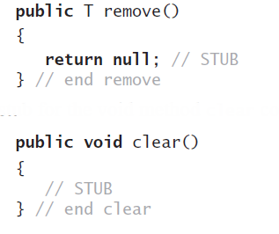
Testing the Core Methods
Stubs for remove and clear
© 2016 Pearson Education, Ltd. All rights reserved.

Slide 10
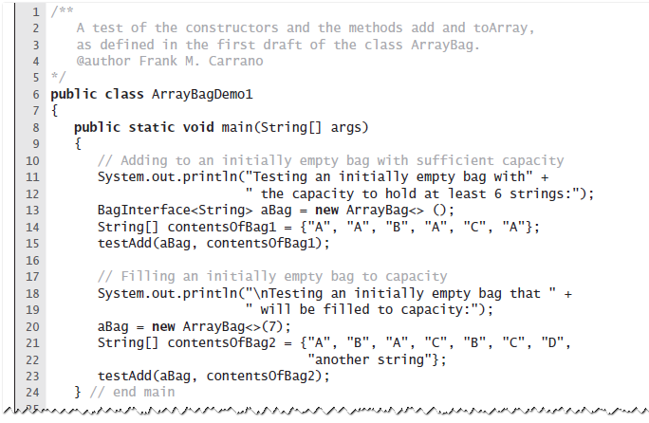
Testing the Core Methods
A program that tests core methods of the class ArrayBag
© 2016 Pearson Education, Ltd. All rights reserved.

Slide 11
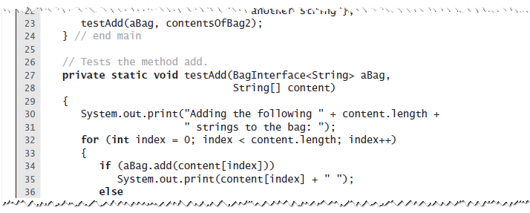
Testing the Core Methods
A program that tests core methods of the class ArrayBag
© 2016 Pearson Education, Ltd. All rights reserved.

Slide 12
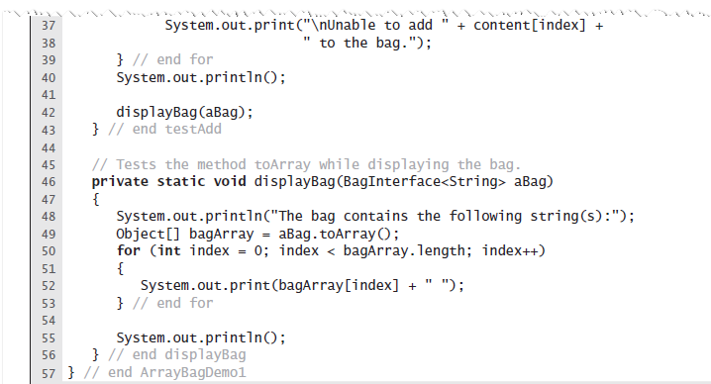
Testing the Core Methods
A program that tests core methods of the class ArrayBag
© 2016 Pearson Education, Ltd. All rights reserved.

Slide 13
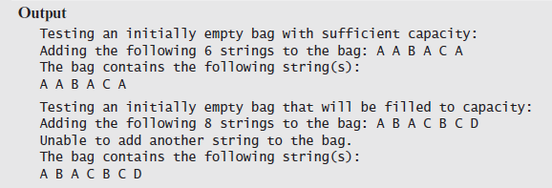
Testing the Core Methods
A program that tests core methods of the class ArrayBag
© 2016 Pearson Education, Ltd. All rights reserved.

Slide 14
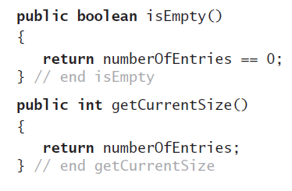
Implementing More Methods
Methods isEmpty and getCurrentSize
© 2016 Pearson Education, Ltd. All rights reserved.

Slide 15
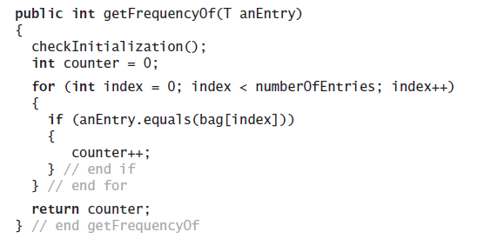
Implementing More Methods
Method getFrequencyOf
© 2016 Pearson Education, Ltd. All rights reserved.

Slide 16
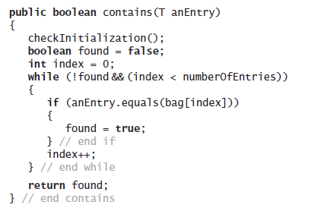
Implementing More Methods
Method contains
© 2016 Pearson Education, Ltd. All rights reserved.

Slide 17
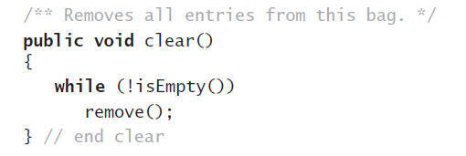
Methods That Remove Entries
The method clear
© 2016 Pearson Education, Ltd. All rights reserved.

Slide 18
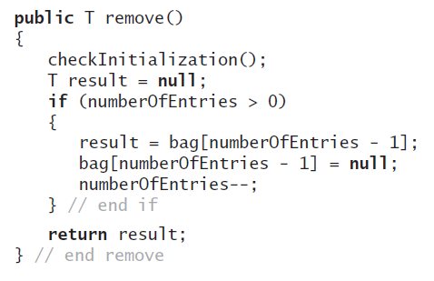
Methods That Remove Entries
The method remove
© 2016 Pearson Education, Ltd. All rights reserved.

Slide 19
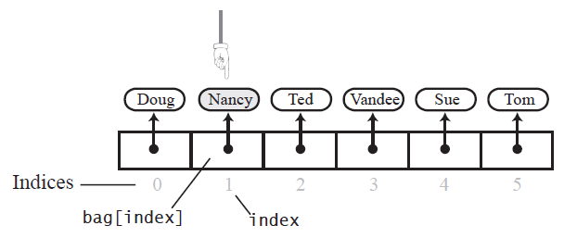
Methods That Remove Entries
The array bag after a successful search for the string “Nancy"
© 2016 Pearson Education, Ltd. All rights reserved.

Slide 20
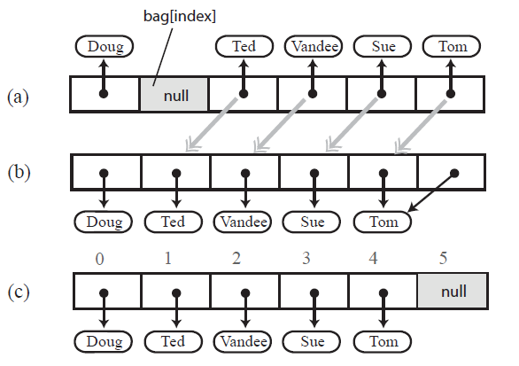
Methods That Remove Entries
(a) A gap in the array bag after setting the entry in bag[index] to null
(b-c) the array after shifting subsequent entries to avoid a gap
© 2016 Pearson Education, Ltd. All rights reserved.

Slide 21
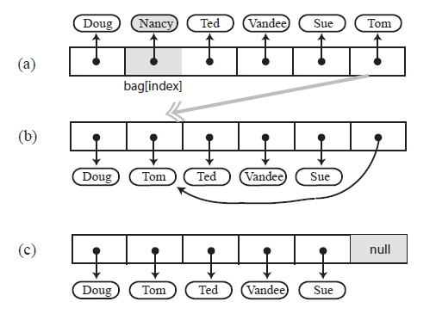
Methods That Remove Entries
Avoiding a gap in the array while removing an entry
© 2016 Pearson Education, Ltd. All rights reserved.

Slide 22
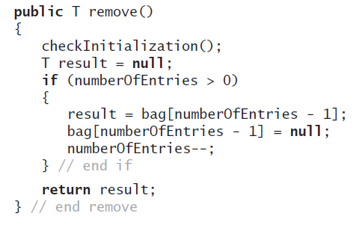
Methods That Remove Entries
New definition of remove
© 2016 Pearson Education, Ltd. All rights reserved.

Slide 23
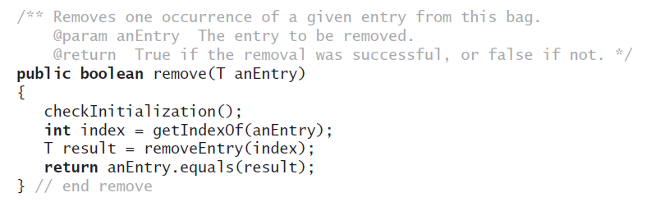
Methods That Remove Entries
The second remove method
© 2016 Pearson Education, Ltd. All rights reserved.

Slide 24
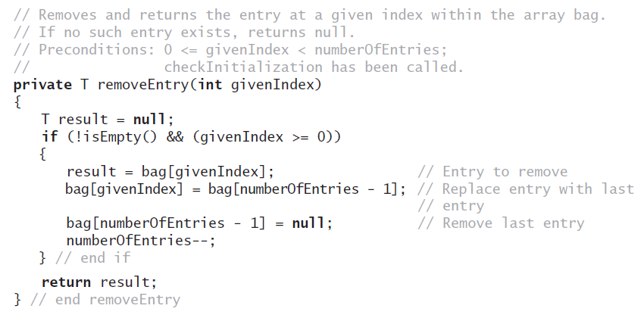
Methods That Remove Entries
The removeEntry method
© 2016 Pearson Education, Ltd. All rights reserved.

Slide 25
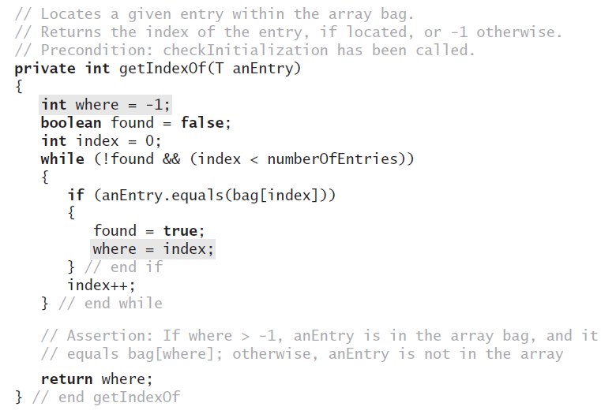
Methods That Remove Entries
Definition for the method getIndexOf
© 2016 Pearson Education, Ltd. All rights reserved.

Slide 26
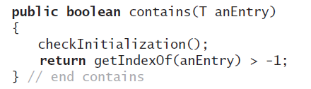
Methods That Remove Entries
Revised definition for the method contains
© 2016 Pearson Education, Ltd. All rights reserved.

Slide 27
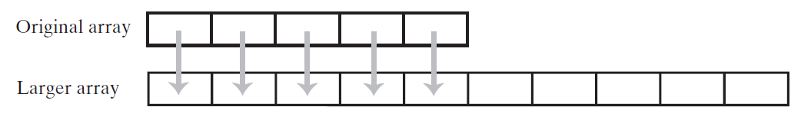
Using Array Resizing
Resizing an array copies its contents to a larger second array
© 2016 Pearson Education, Ltd. All rights reserved.

Slide 28
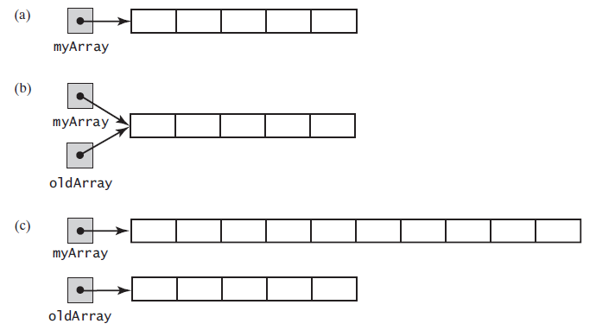
Using Array Resizing
(a) An array; (b) two references to the same array; (c) the original array variable now references a new, larger array;
© 2016 Pearson Education, Ltd. All rights reserved.

Slide 29
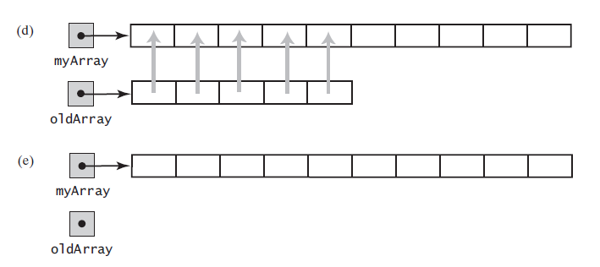
Using Array Resizing
(d) the entries in the original array are copied to the new array; (e) the original array is discarded
© 2016 Pearson Education, Ltd. All rights reserved.

Slide 30
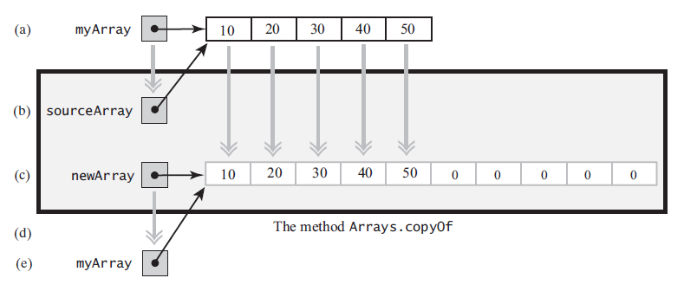
Using Array Resizing
The effect of the statement
myArray = Arrays.copyOf(myArray, 2 * myArray.length);
(a) The argument array; (b) the parameter that references the argument array; (c) a new, larger array that gets the contents of the argument array; (d) the return value that references the new array; (e) the argument variable is assigned the return value
© 2016 Pearson Education, Ltd. All rights reserved.

Slide 31
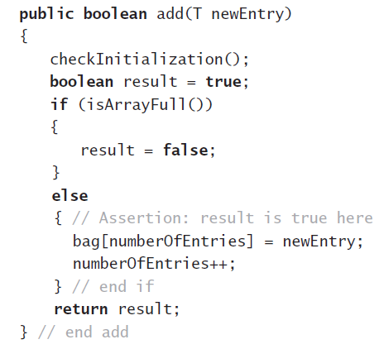
New Implementation of a Bag
Previous definition of method add
© 2016 Pearson Education, Ltd. All rights reserved.

Slide 32
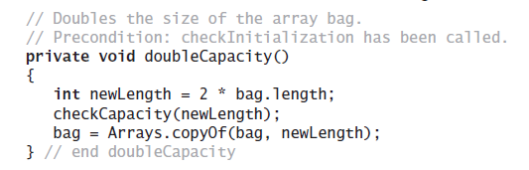
New Implementation of a Bag
The method doubleCapacity
© 2016 Pearson Education, Ltd. All rights reserved.

Slide 33
Pros and Cons of Using an Array
Adding an entry to the bag is fast
Removing an unspecified entry is fast
Removing a particular entry requires time to locate the entry
Increasing the size of the array requires time to copy its entries
© 2016 Pearson Education, Ltd. All rights reserved.

