Slide 1

CS 0445
Data Structures
Fall 2017
Linked Implementation of the Bag ADT
Sherif Khattab
ksm73@pitt.edu
6307 Sennott Square

Slide 2
Administrivia
Assignment 1 due next Tuesday
Small correction
Quiz in this week’s recitations
A discussion board is up

Slide 3
Earlier in the course
Array-based implementation of the Bag ADT

Slide 4
Today’s Topic
Linked implementation of the Bag ADT

Slide 5
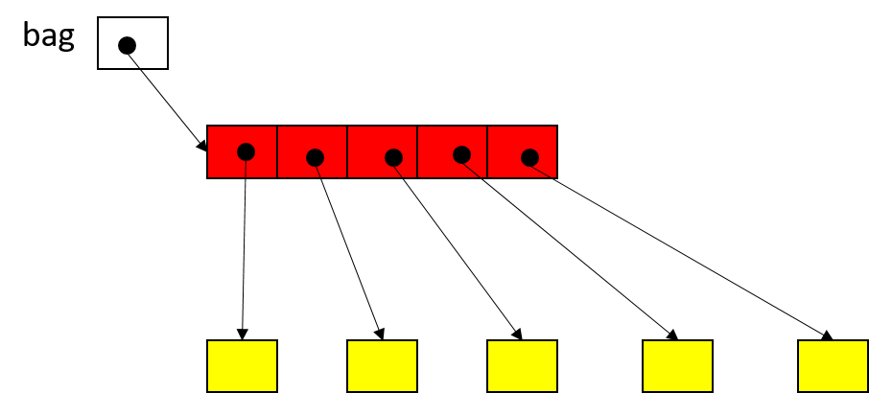
Garbage Collection in Java
bag = null
For(int i=0; i<bag.length; i++)
bag[i] = null

Slide 6
Problems with Array Implementation
Array has fixed size
May become full
Alternatively may have wasted space
Resizing is possible but requires overhead of time

Slide 7
Analogy
Empty classroom
Numbered desks stored in hallway
Number on back of desk is the “address”
Number on desktop references another desk in chain of desks
Desks are linked by the numbers

Slide 8
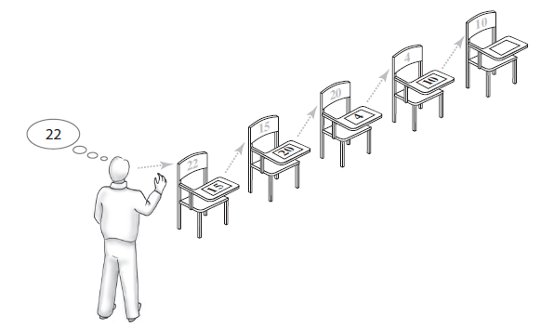
Analogy
FIGURE 3-1 A chain of five desks

Slide 9
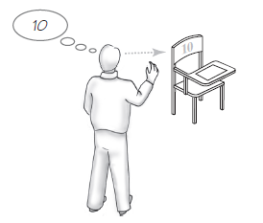
Forming a Chain by Adding to Its Beginning
FIGURE 3-2 One desk in the room

Slide 10
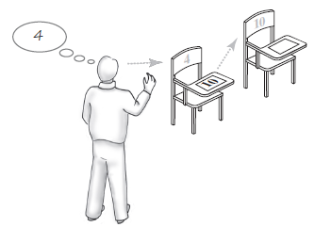
Forming a Chain by Adding to Its Beginning
FIGURE 3-3 Two linked desks, with the newest desk first

Slide 11
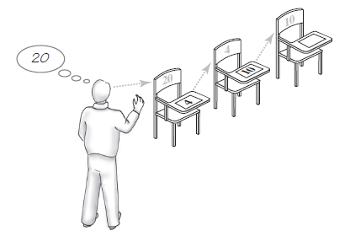
Forming a Chain by Adding to Its Beginning
FIGURE 3-4 Three linked desks, with the newest desk first.

Slide 12
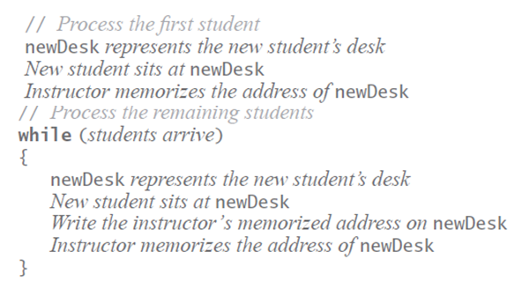
Forming a Chain by Adding to Its Beginning
Pseudocode details the steps taken to form a chain of desks

Slide 13
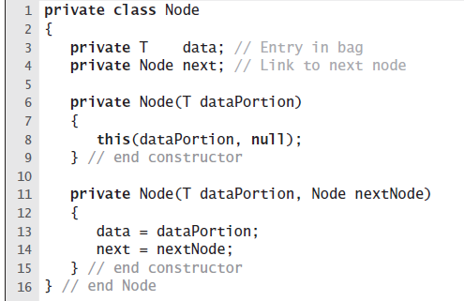
The Private Class Node
LISTING 3-1 The private inner class Node

Slide 14
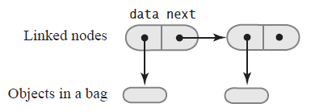
The Private Class Node
FIGURE 3-5 Two linked nodes that each reference object data

Slide 15
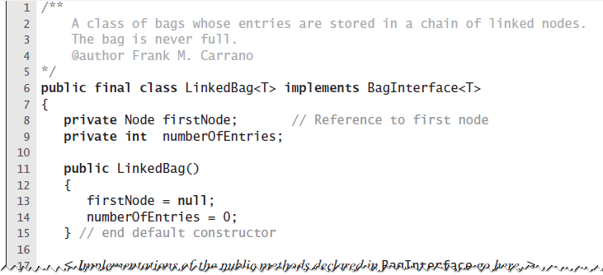
An Outline of the Class LinkedBag
LISTING 3-2 An outline of the class LinkedBag

Slide 16
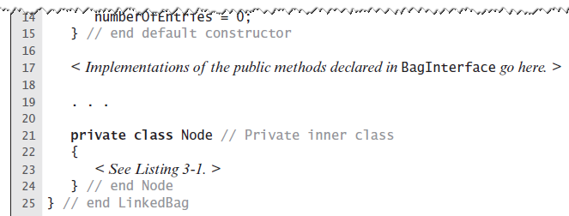
An Outline of the Class LinkedBag
LISTING 3-2 An outline of the class LinkedBag

Slide 17
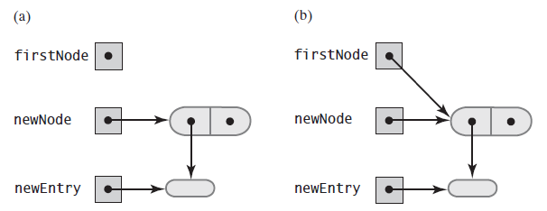
Beginning a Chain of Nodes
FIGURE 3-6 (a) An empty chain and a new node; (b) after adding a new node to a chain that was empty

Slide 18
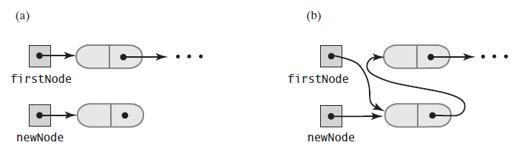
Beginning a Chain of Nodes
FIGURE 3-7 A chain of nodes (a) just prior to adding a node at the beginning; (b) just after adding a node at the beginning

Slide 19
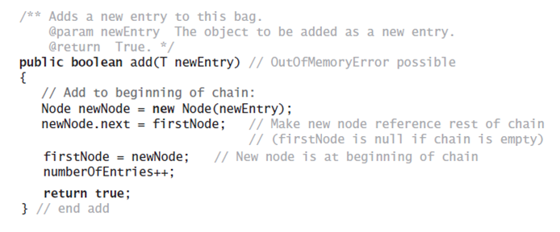
Beginning a Chain of Nodes
The method add

Slide 20
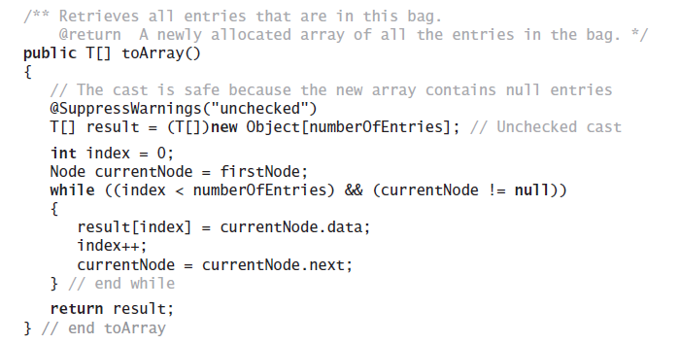
Method toArray
The method toArray returns an array of the entries currently in a bag

