Slide 1

CS 0445
Data Structures
Fall 2017
Linked Implementation of the Bag ADT
Sherif Khattab
ksm73@pitt.edu
6307 Sennott Square

Slide 2
Administrivia
Computer Science Resource Center (CRC)
https://cs.pitt.edu/degrees/bachelors/resources-opportunities/crc/
Assignment 1 due next Tuesday
A discussion board is up
Partially-initialized objects
Next lab is for credit
Start preparing early

Slide 3
Earlier in the course
Linked implementation of the Bag ADT

Slide 4
Today’s Topic
Linked implementation of the Bag ADT

Slide 5
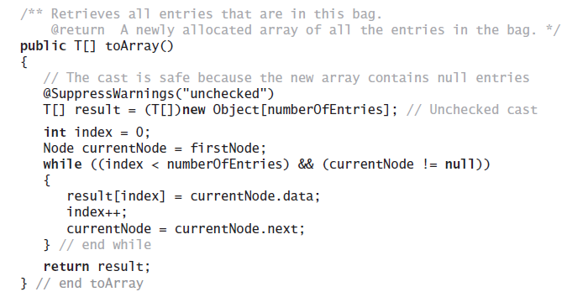
Method toArray
The method toArray returns an array of the entries currently in a bag

Slide 6
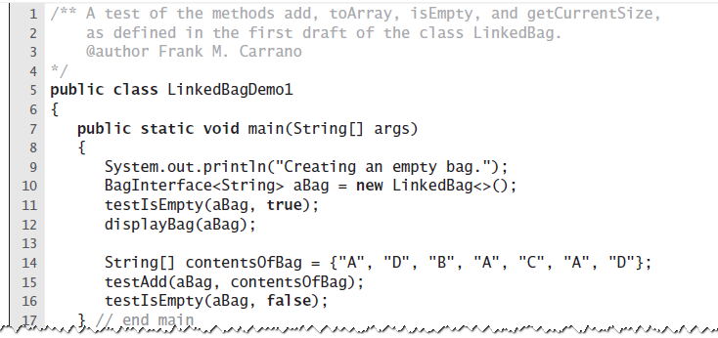
Test Program
LISTING 3-3 A sample program that tests some methods in the class LinkedBag

Slide 7
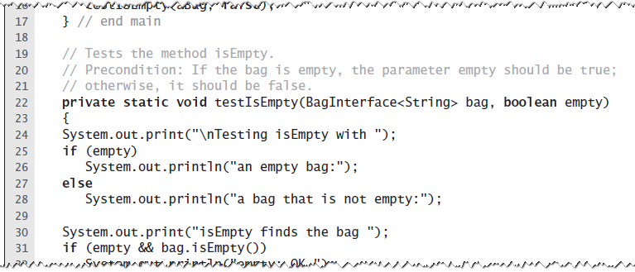
Test Program
LISTING 3-3 A sample program that tests some methods in the class LinkedBag

Slide 8
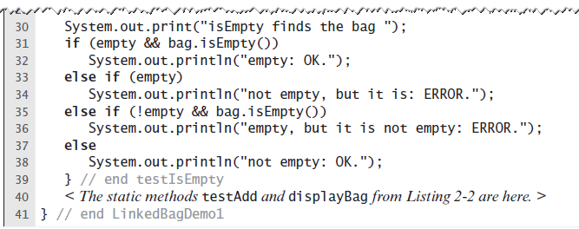
Test Program
LISTING 3-3 A sample program that tests some methods in the class LinkedBag

Slide 9
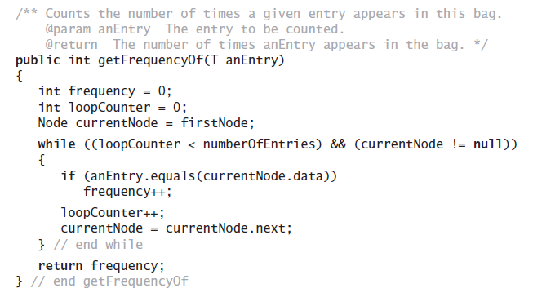
Method getFrequencyOf
Counts the number of times a given entry appears

Slide 10
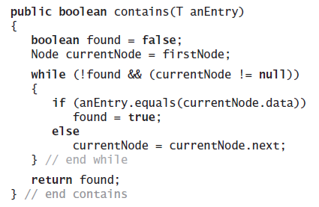
Method contains
Determine whether a bag contains a given entry

Slide 11
Removing an Item from a Linked Chain
Case 1: Your desk is first in the chain of desks.
Case 2: Your desk is not first in the chain of desks.

Slide 12
Removing an Item from a Linked Chain
Case 1
Locate first desk by asking instructor for its address.
Give address written on the first desk to instructor. This is address of second desk in chain.
Return first desk to hallway.

Slide 13
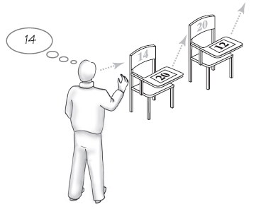
Removing an Item from a Linked Chain
FIGURE 3-8 A chain of desks just prior to removing its first desk

Slide 14
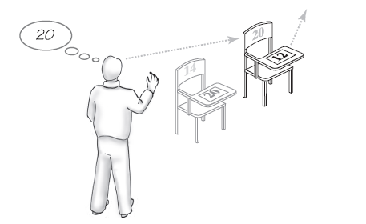
Removing an Item from a Linked Chain
FIGURE 3-9 A chain of desks just after removing its first desk

Slide 15
Removing an Item from a Linked Chain
Case 2
Move the student in the first desk to your former desk.
Remove the first desk using the steps described for Case 1.

Slide 16
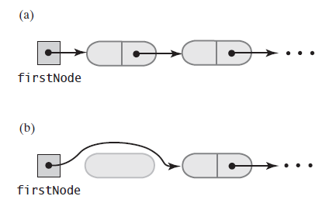
Removing an Item from a Linked Chain
FIGURE 3-10 A chain of nodes (a) just prior to removing the first node; (b) just after removing the first node

Slide 17
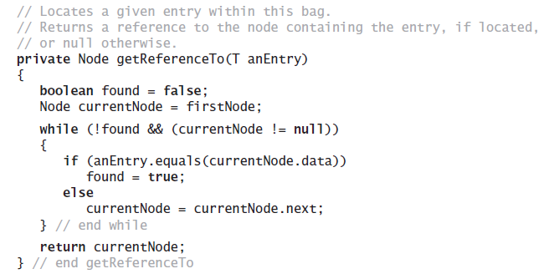
Method remove
Note need for private method getReferenceTo

Slide 18
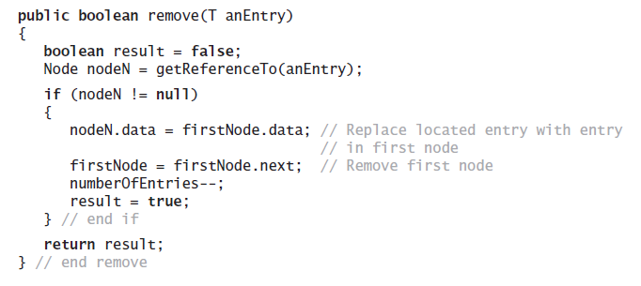
Method remove
Note use of method getReferenceTo

Slide 19
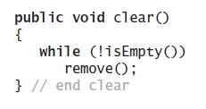
Method clear
As in previous implementation, uses isEmpty and remove

Slide 20
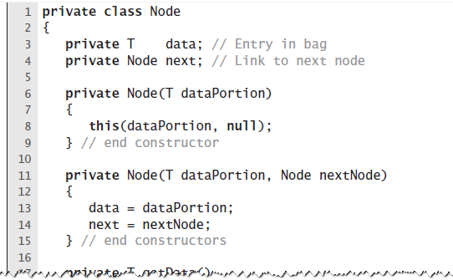
Class Node That Has Set and Get Methods
LISTING 3-4 The inner class Node with set and get methods

Slide 21
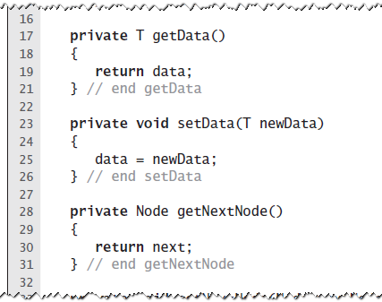
Class Node That Has Set and Get Methods
LISTING 3-4 The inner class Node with set and get methods

Slide 22
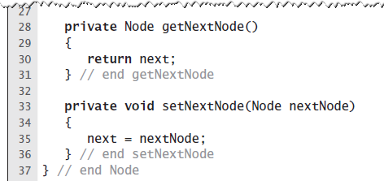
Class Node That Has Set and Get Methods
LISTING 3-4 The inner class Node with set and get methods

Slide 23
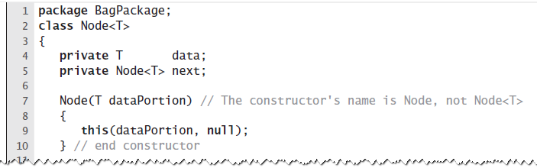
A Class within A Package
LISTING 3-5 The class Node with package access

Slide 24
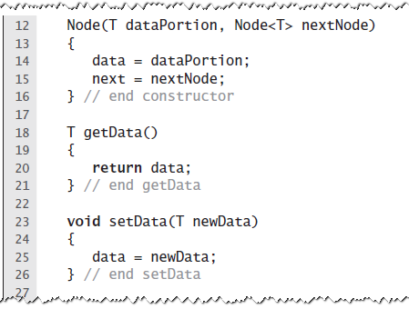
A Class within A Package
LISTING 3-5 The class Node with package access

Slide 25
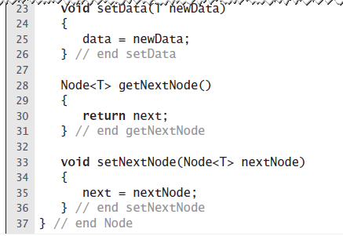
A Class within A Package
LISTING 3-5 The class Node with package access

Slide 26
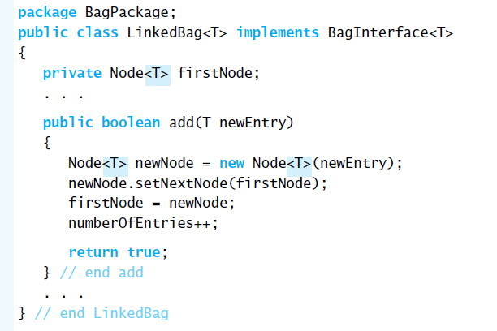
When Node Is in Same Package
This occurrence of T is optional
LISTING 3-6 The class LinkedBag when Node is in the same package

Slide 27
Pros of Using a Chain
Bag can grow and shrink in size as necessary.
Remove and recycle nodes that are no longer needed
Adding new entry to end of array or to beginning of chain both relatively simple
Similar for removal

Slide 28
Cons of Using a Chain
Removing specific entry requires search of array or chain
Chain requires more memory than array of same length

