Slide 1
React
By Athanasios Tsalkitzis & Panagiotis Zisis

Slide 2
What is React?
A JavaScript library for building user interfaces
Declarative
Component-Based
Learn Once, Write Anywhere

Slide 3
What is create-react-app?
It is a comfortable environment for learning React, and is the best way to start building a new single-page application in React
It sets up your development environment so that you can use the latest JavaScript features, provides a nice developer experience, and optimizes your app for production

Slide 4
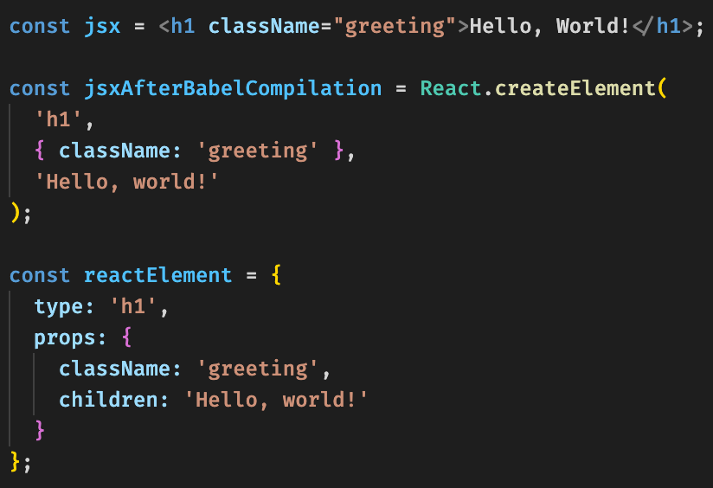
JSX

Slide 5
JSX
We can now delete all the files from the src folder.
Let’s create our index.js.
Let’s now create a hello world header.
Now display a paragraph with our name and our nationality.

Slide 6
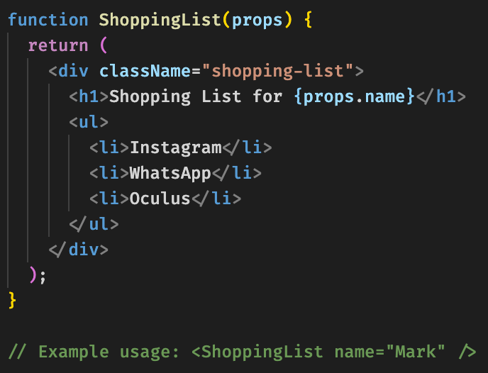
Components

Slide 7

Props

Slide 8
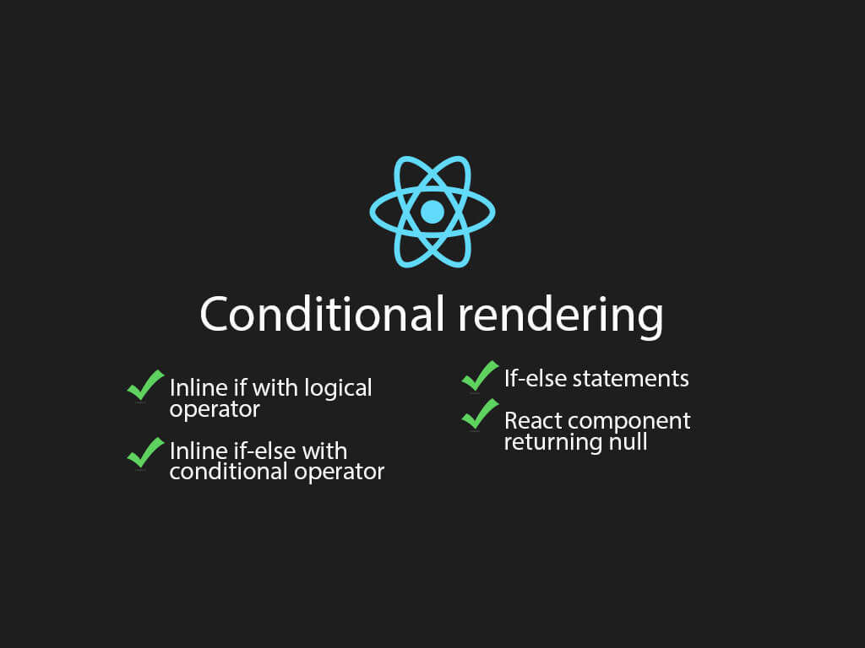
Conditional Rendering

