Slide 1
React
By Athanasios Tsalkitzis & Panagiotis Zisis

Slide 2

Event handlers

Slide 3



State

Slide 4
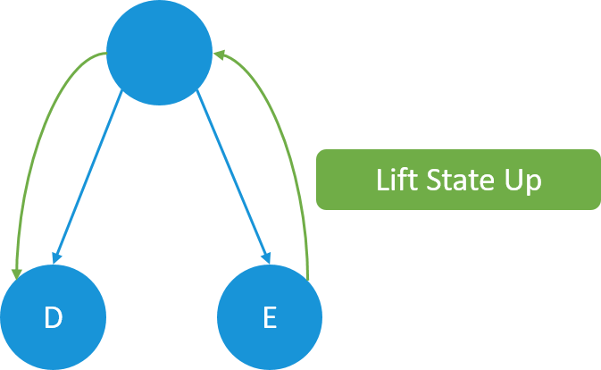
Lifting state up

