Slide 1
React
By Athanasios Tsalkitzis & Panagiotis Zisis

Slide 2

Loop over data

Slide 3
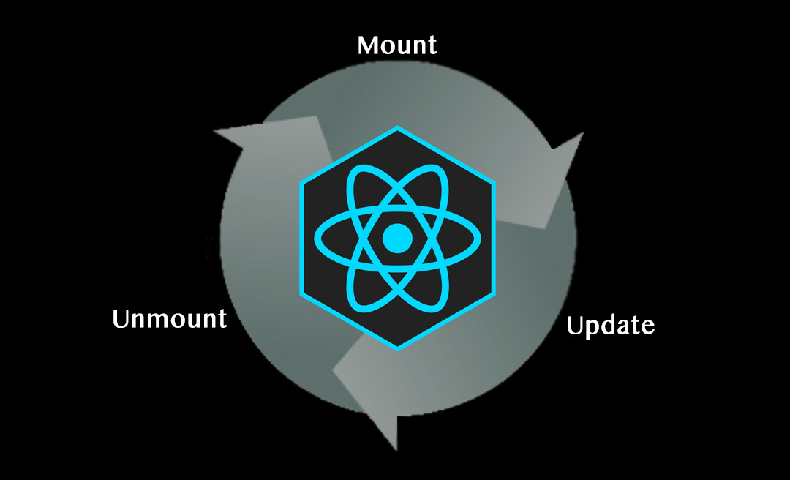
Component LifeCycle

Slide 4

Asynchronous operations

