Slide 1
My Portfolio Website
A quick walk through

Slide 2
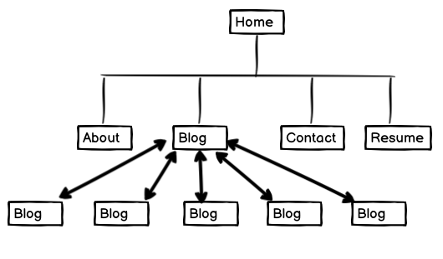
SiteMap
From the home page you can navigate the other four pages of my portfolio.

Slide 3
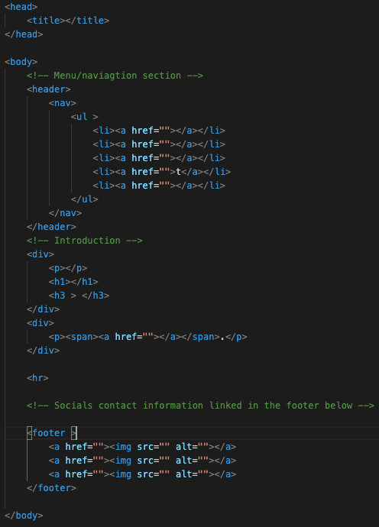
List of Components
<header><nav> for navigation to all the pages
<article> for the blog page and the <a> tag to link to the original blog site
<image> for about me
<footer> used on every page display my linkedin and github

Slide 4
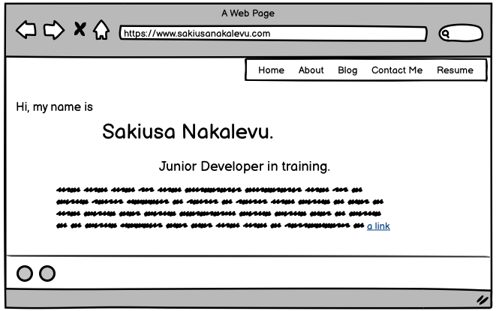
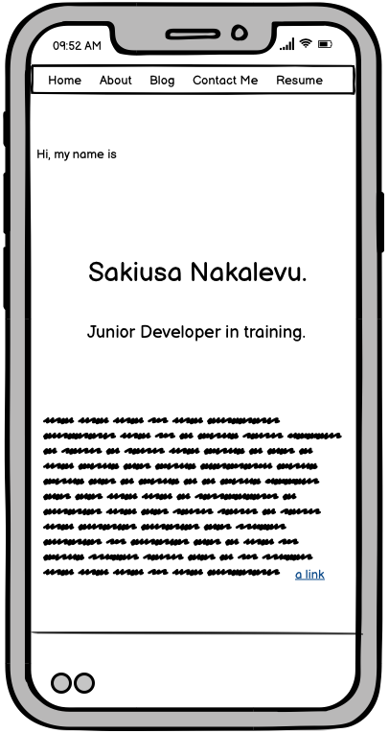
Landing Page

Slide 5
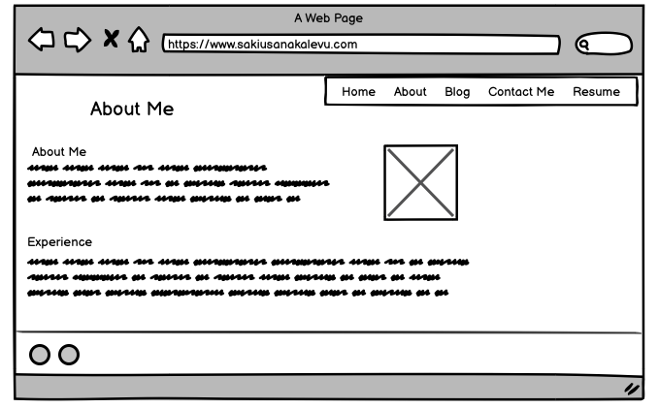
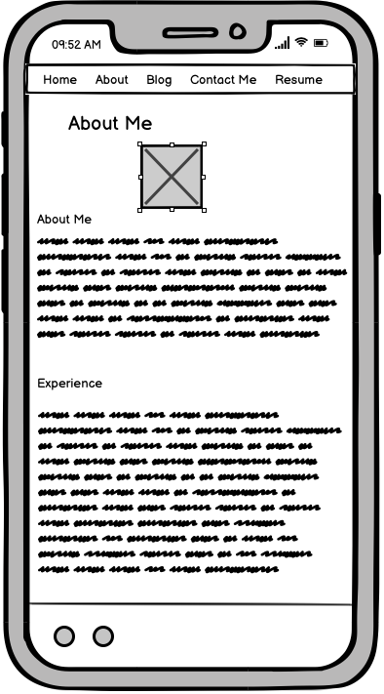
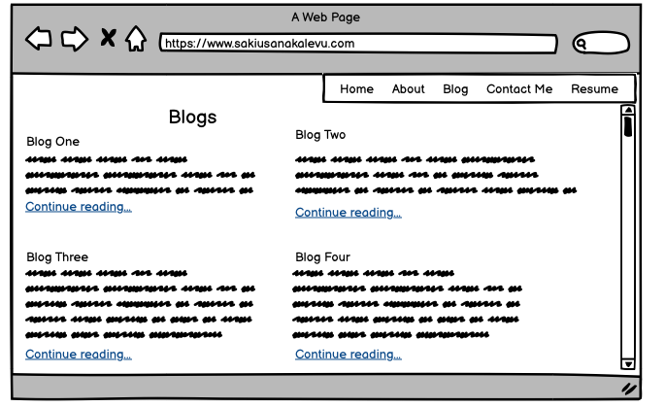
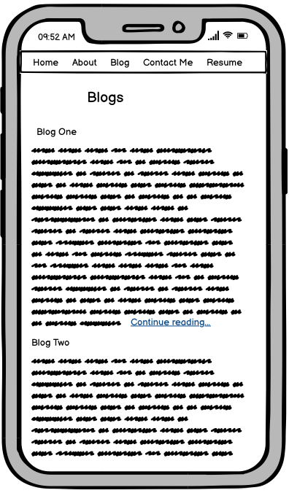
About & Blog

Slide 6
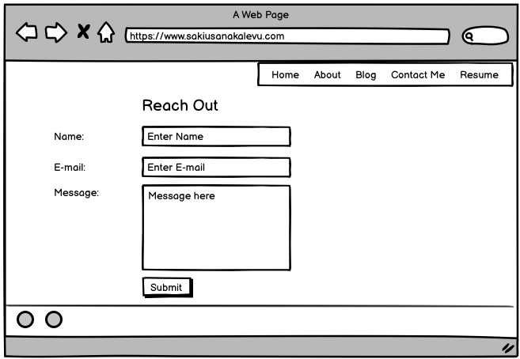
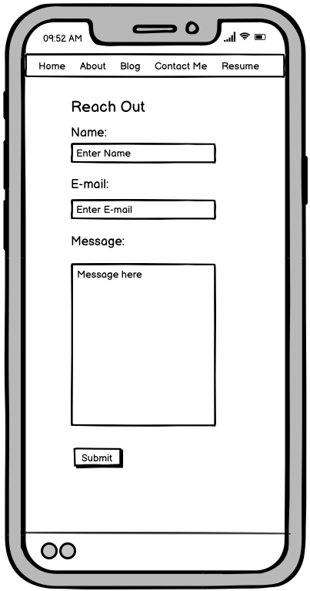
Contact

Slide 7
Challenges
I made the mistake of not going mobile first so it took me awhile to figure it out.
CSS – adding something new would break existing styling.
Responsiveness
Trying to figure out how to navigate back to the portfolio when someone has opened my resume – still havent figured it out yet.
Hambuger menu for mobile

Slide 8
Thank you

