Slide 1


Slide 2
Ansible Server:- The machine where Ansible is installed and from which all task and playbook will be run.
Host: Nodes, which are automated by Ansible
Module:- Basically, it is a command or set of similar commands meant to be executed on the client-side.
Role:- A way of organizing tasks and related files, to be later called playbook.
Fact:- Information fetched from the client system from the global variables with the gather-facts operation.
Inventory:- File containing data about the Ansible client servers.
Notifier:- Section attributed to a task which calls a handler if the output is changed.
Handler:- task which is called only if a notifier is present.
Playbook:- It consist code in YAML format, which describes task to be executed.

Slide 3
Installation of Ansible
Create 3 EC2 Instances on same availability zone, Ansible Server, Node 1and node 2.
sudo su
yum update-y
Go to inside Ansible server and download Ansible Package
sudo su
wget https://dl.fedoraproject.org/pub/epel/epel-release-latest-7.noarch.rpm
ls
epel-releas-latest-7.noarch.rpm
yum install epel-releas-latest-7.noarch.rpm
yum update –y *epel= extra package for enterprises Linux

Slide 4
Now we have install all the packages one by one
yum install git python python-level python-pip openssl ansible –y
ansible -–version
ansible 2.9.25

Slide 5
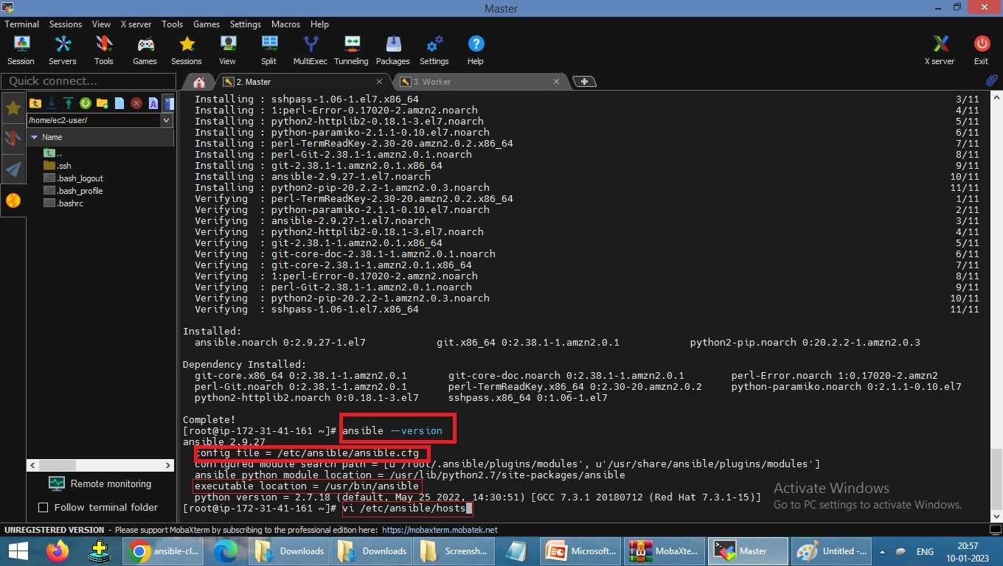

Slide 6
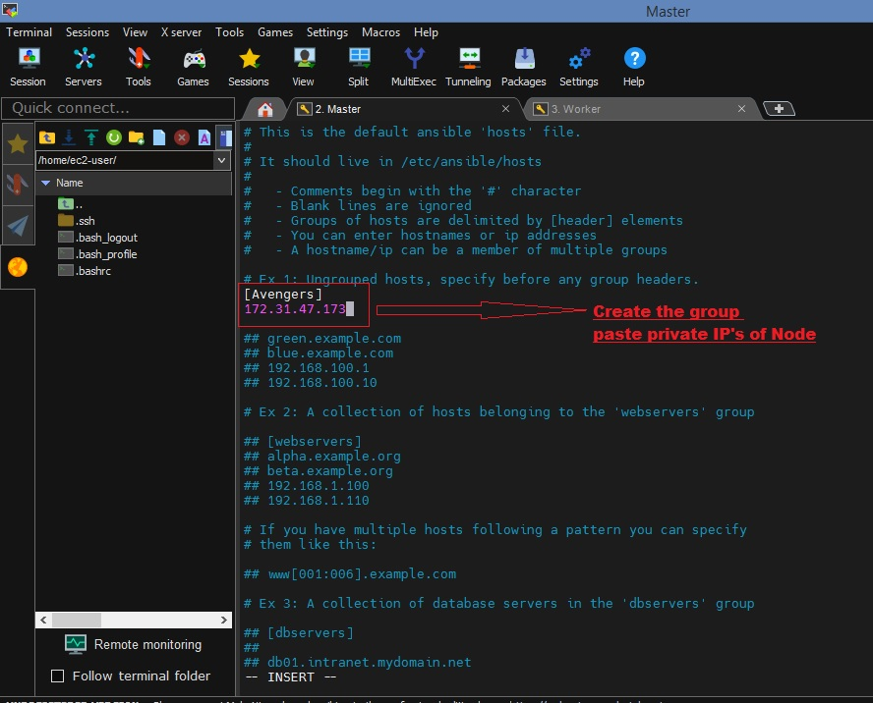
vi /etc/ansible/hosts
Go to… Ex 1: ungrouped hosts
Please create a group by name and paste the Pvt. IP address of Node 1 .
[Justice]
172.31.46.226 :wq

Slide 7
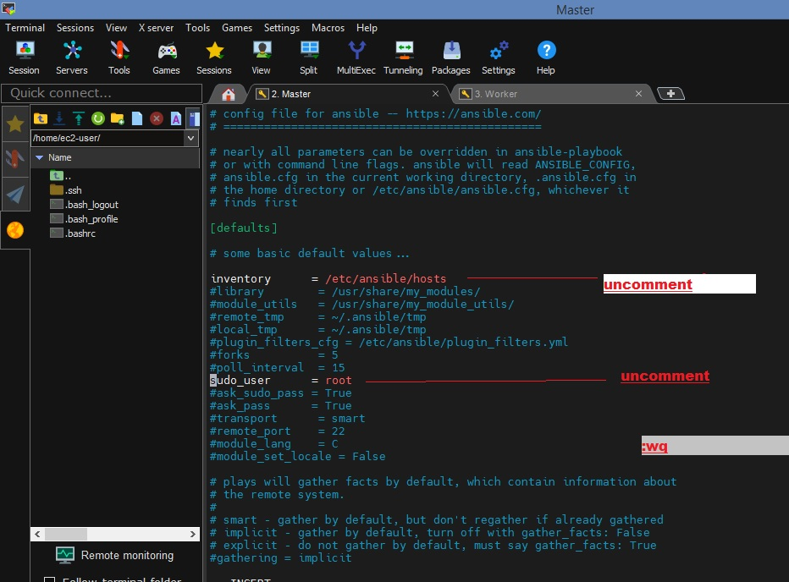
This will not work until we will do any change in configuration file. (Path is almost same)
vi /etc/ansible/ansible.cfg Press I to insert
Active the Inventory and sudo_user by removing #, means Uncommented them.
Inventory = /etc/ansible/hosts
sudo_user = root :wq

Slide 8
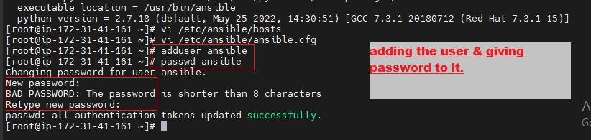
Create user for safe communication between nodes to server *(Do same for all machines)
adduser ansible
passwd ansible
TECHNICAL
New password: TECHNICAL

Slide 9
If wanted to login any Node through switch user (Ansible user), use this command (for all machines)
[] # su – ansible
Suppose this for Ansible server, check all commands of creating files and directory are working?
[] $ touch <filename>
[] $ ls
[] $ <filename>
[] $ yum install httpd –y you need to be root to perform this command
[] $ sudo yum install httpd –y Asking password for Ansible
[sudo] password for ansible: TECHNICAL
Ansible is not in the sudoers file. For this we have to give sudo privileges & rights.
[] # Exit get out from Ansible user and execute visudo
[] # visudo Edit inside the Allow root rights, give privileges (all machines)

Slide 10
##Allow root to run any commands anywhere
root ALL=(ALL) ALL
ansible ALL=(ALL) NOPASSWD: ALL :wq!
Here we are adding ansible, means giving it same permission as root have, and No password required
Again Check all commands of creating files and directory are working or not in Ansible server?
[] # su – ansible
[] $ yum install httpd –y you need to be root to perform this command
[] $ sudo yum install httpd –y after adding sudo this is executed* perfectly
*Ansible user got the privileges to work as SUDO USER by su – ansible
Check the communication has established between nodes and server by login ansible user (su-ansible) in machines, means- -
Check, if do something on node and push to the server and create something on server and update on node.

Slide 11
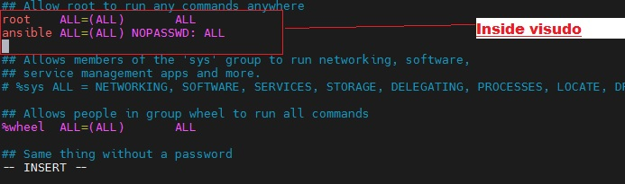

Slide 12
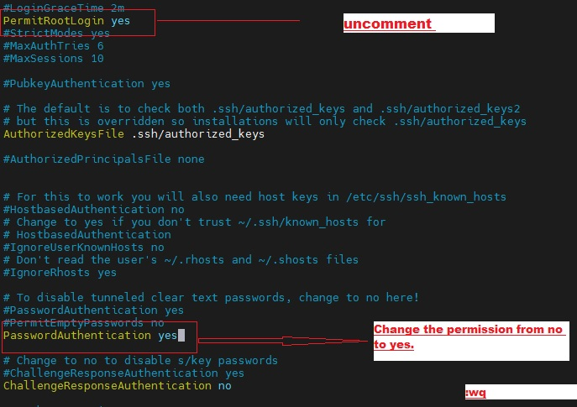
For connection establishment of ansible server + Node, execute SSH with Pvt IP of that Node.
[] # ssh 172.31.47.173 Permission denied because public key is not updated
[] # Exit
[] # vi /etc/ssh/sshd_config Go inside and do 3 important changes (all machines)
Uncommented PermitRootLogin yes
Uncommented PasswordAuthentication yes
Commented PasswordAuthentication no :wq

Slide 13
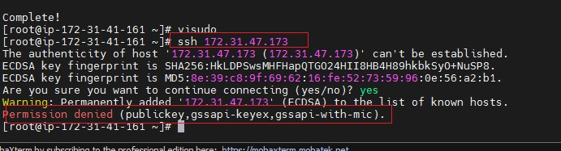
[] # service sshd restart for better Implementation
For checking the communication ‘su – ansible’ execute in All machines
Check server can access the node1
[] $ ssh 172.31.47.173 After execution you can access node 1 through server
Create files and directory on server accessing node1 and same files you will get inside node 1 means, communication between server and nodes is perfect.

Slide 14
For connection every time asked for the password this is not good for good performance & accuracy that’s why we created the TRUST RELATIONSHIP. This can be happen between root to root and user to user.
[ ] $ exit
[ansible] $ ssh-keygen Generation Pub/pvt rsa key pair… Press Enter Enter Enter,
[ansible] $ ls –a
.bas history .bash logout .bash profile .bashrc file1 .ssh
[ansible] $ cd .ssh/
[ .ssh] $ ls
>-------->id_rsa id_rsa.pub known hosts

Slide 15
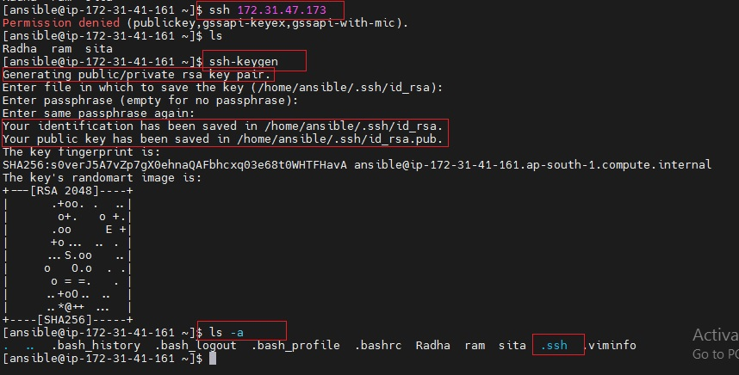

Slide 16
Copy servers’ public key (id_rsa.pub) in all the nodes to remind the nodes, not to ask for password all the time just give the permissions.
[ .ssh] $ ssh-copy-id ansible@172.31.47.173
ansible@172.31.41.226’s password: TECHNICAL Last time asked for Password
[ .ssh] $ ssh-copy-id ansible@172.31.47.173

Slide 17
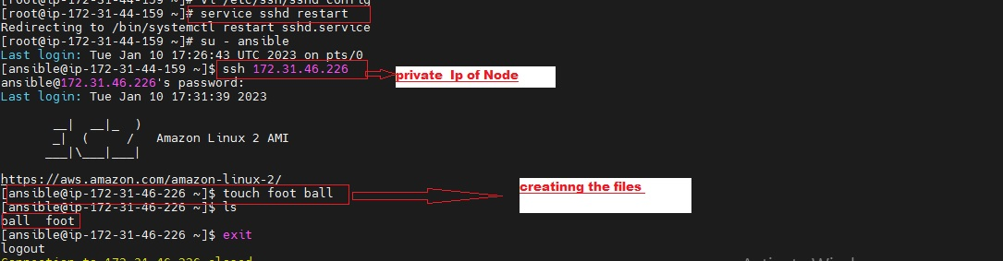
.

Slide 18
“All” pattern refer to all the machines in an inventory
[ .ssh] $ cd ..
[ansible] $ ansible all –-list-hosts check no of all nodes, hosts
hosts (2):
172.31.46.226
[ansible] $ ansible Zee –-list-hosts check nodes inside group=Justice
hosts (2):
172.31.46.226
172.31.41.248
[ansible] $ ansible Zeeman(0) –-list-hosts
hosts (1):
172.31.46.226
[ansible] $ ansible Zeeman(1) –-list-hosts
hosts (1):
172.31.41.248
[ansible] $ ansible Zeeman(-1) –-list-hosts
hosts (1):
172.31.41.248
[ansible] $ ansible Zeeman(3) –-list-host
[WARNING]: No host matched, nothing to do

Slide 19
Ad-hoc command:
It is individual running commands, which can be run individually to perform quick functions.
It’s not use for configuration management and deployment because the commands are of one time usage.
Ad-hoc commands uses the /user/bin/ansible command line tool to automate the signal task.
Important Ad-hoc commands:
[ansible@ip]$ ansible zeko –a “ls” zeko= group a=argument
[ansible@ip]$ ansible zeko[0] “touch filezz” update file to particular node
[ansible@ip]$ ansible all –a “touch filek” update file to all nodes
[ansible@ip]$ ansible zeko –a “ls-al” show total list with all details of groups
[ansible@ip]$ ansible zeko –a “sudo yum install httpd -y”
[ansible@ip]$ ansible zeko –ba “yum install httpd -y” b=become sudo
[ansible@ip]$ ansible zeko –ba “yum remove httpd -y”

Slide 20
Trying install httpd but Failed because need sudo privilege, add sudo / b for proper installation.
[@-ec2-user]# su - ansible
[ansible@ip]$ ansible zeko –a “yum install httpd -y” failed
[ansible@ip]$ ansible zeko –ba “yum install httpd -y” Installation done all nodes
[ansible@ip]$ which httpd ---→check Installed files in all nodes
[ansible@ip]$ /usr/sbin/httpd --------→output in all nodes
[ansible@ip]$ ansible zeko –a “sudo yum remove httpd -y” Uninstallation
[ansible@ip]$ which httpd No output all deleted

Slide 21
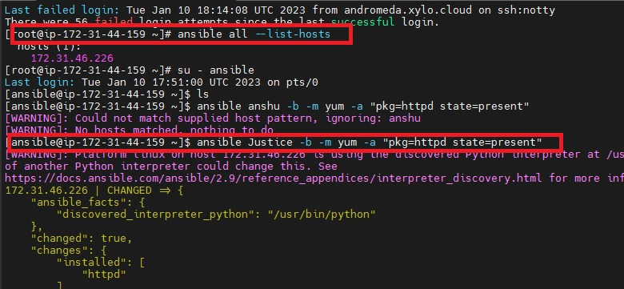

Slide 22
Ansible Module:
Ansible ships with a number of modules (called module library) that can be executed directory on remote host or through playbook. Your library of modules can reside on any machine and there are no servers, daemon or database required. (Idempotency is present).
Qn. Where ansible modules are stored?
Ans: the default location for the inventory file is /etc/ansible/hosts
Important Module Commands: Install >> present update >> latest uninstall >> remove
[ansible@ip]$ ansible zeko –b –m yum –a “pkg=httpd state=present”
[ansible@ip]$ ansible zeko –b –m service –a “name=httpd state=started”
[ansible@ip]$ ansible zeko –b –m user –a “name=shan”
[ansible@ip]$ ansible zeko –b –m copy –a “src=fileA dest=/tmp”

Slide 23
Update package of installed httpd:
[ansible@ip]$ ansible zeko –b –m yum –a “pkg=httpd state=latest”
[ansible@ip]$ which httpd
[ansible@ip]$ /usr/bin/httpd check in all nodes
Delete installed package: both nodes:
[ansible@ip]$ ansible zeko –b –m yum –a “pkg=httpd state=absent”
[ansible@ip]$ sudo service httpd status Inactive
To start a service execute this command:
[ansible@ip]$ ansible zeko –b –m service –a “name=httpd state=started”
[ansible@ip]$ sudo service httpd status Active = Running
To create the user:
[ansible@ip]$ ansible zeko –b –m user –a “name=shan”
To check the status of user:
[ansible@ip]$ cat /etc/passwd Check in all nodes you will get user shan at the bottem lines
To copy item from source to a Particular Node/destination: suppose only on last node [-1].
[ansible@ip]$ touch fileXYZ
[ansible@ip]$ ansible zeko[-1] –b –m copy –a “src=fileXYZ dest=/tmp”

Slide 24
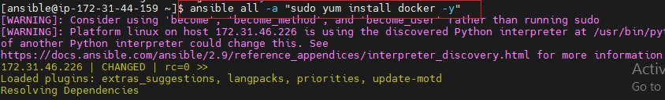
To copy item from source to destination: for all nodes:
[ansible@ip]$ ansible Justice –b –m copy –a “src=fileA dest=/tmp”

Slide 25
Ansible setup: It works like Ohai works in CHEF, avoids Noidempotency.
Useful commands: It will give all the details related to IP addresses of that particular node.
[ansible@ip]$ ansible zeko –m setup
[ansible@ip]$ ansible zeko –m setup –a “filter=*ipv4*”
Playbook:
Playbook is written in YAML. It is like a file where you write codes consist of vars, task, and handlers templates and roles.
Each playbook is composed of one or more module in a list, Module is a collection of configuration files
Playbook is divided into many sections:
Target section: It defines the host against which playbook’s task has to be executed.
Variable section: It defines variables
Task section: It defines list of all modules that we need to run an order.
YAML:
For Ansible, nearly every YAML file starts with a list.
Each item in the List is a list of key-value pair’s commonly called a Dictionary.
A Dictionary is represented in a simple Key: Volume form
All YAML files have to begin “---” and end with “…” and extension for playbook is .yml.
All members of a list lines must begin with same Indentation level starting with “-”.

Slide 26
Example-create a Task playbook:
[ansible@Ip]$ Vi task.yml
- - - #My Task Playbook
- hosts: zeko
user: ansible
become: yes
connection: ssh
tasks:
- name: install HTTPD on centos 7
action: yum name=httpd state=installed :wq
[ansible@Ip]$ ansible-playbook task.yml ←To execute this playbook

Slide 27
Variables:
Ansible uses variables which enable more flexibility in playbook and roles they can be uses to loop through a set of given values, access various information like the hostname of a system and replace strings in templates with specific values.
Put the variable section above the tasks so that we define it first and use it later.
Example create a variable playbook:
[ansible@Ip]$ Vi vars.yml
- - - #My variable Playbook
- hosts: zeko
user: ansible
become: yes
connection: ssh
vars:
pkgname: httpd
tasks:
- name: install HTTPD server on centos 7
action: yum name='{{pkgname}}'state=installed :wq
[ansible@Ip]$ ansible-playbook vars.yml ←execute this playbook

Slide 28
Dry run: It is the process to check errors before execute the playbook, it checks that Playboook is formatted correctly or not?
[ansible@Ip]$ ansible-playbook Handlers.yml –-check
[ansible@Ip]$ sudo service httpd status check the status of all nodes active or not?
Loops: Sometimes you repeat a task multiple time in programming it is called loop.
Common ansible loop include changing ownership on server files and/or directories with the file module, creating multiple user with the user module and repeating a polling step untill certain result is reached.

Slide 29
Example-create a Loops playbook:
[ansible@Ip]$ Vi loops.yml
- - - #My Loops Playbook
- hosts: zeko
user: ansible
become: yes
connection: ssh
tasks:
- name: add list of users in my nodes
user: name='{{item}}' state=present
with_items:
- zeeshan
- bhupinder
- hrithik roshan
- james bond
[ansible@Ip]$ ansible-playbook loops.yml

Slide 30
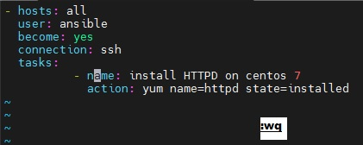
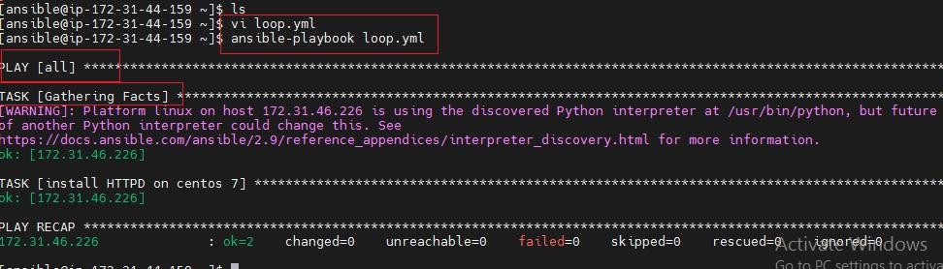

Slide 31
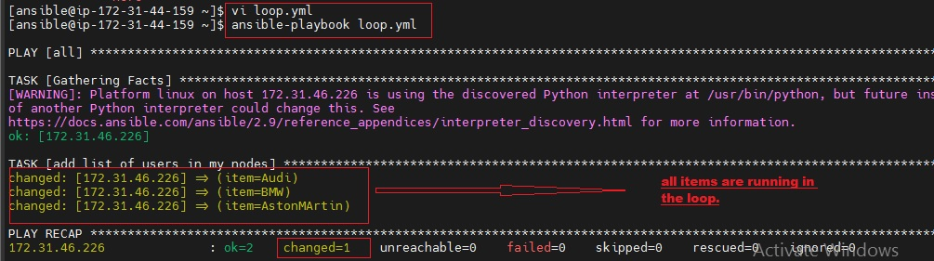
Condition: when we have different scenarios, then we put condition according to the scenario.
When statement: sometimes you want to skip a particular command on a particular node.

Slide 32
Example-conditional playbook:
[ansible@Ip]$ Vi condition.yml
- - - #My Conditional Playbook apt-get=debian yum=RedHat
-hosts: zeko
user: ansible
become: yes
connection: ssh
tasks:
- name: install apache server for Debian family
command: apt-get -y install apache2
when: ansible_os_family == ”Debian”
- name: install apache for RedHat
command: yum –y install httpd
when: ansible_os_family == ”RedHat”
[ansible@Ip]$ ansible-playbook condition.yml Before execution delete httpd from nodes

Slide 33
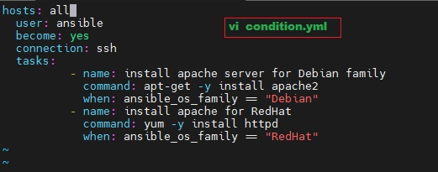
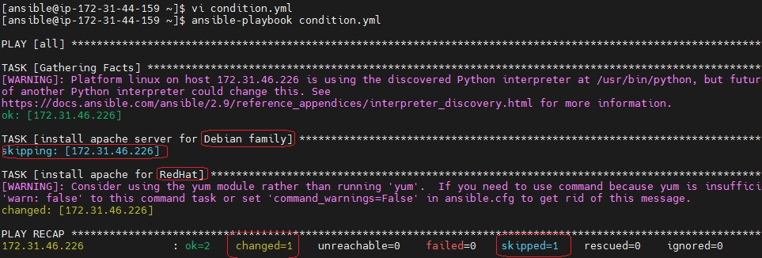

Slide 34
Vault: Ansible allows keeping sensitive data such as passwords or keys in encrypted files, rather than a plain text in your playbooks.
Create a new encrypted Playbook
[ansible]$ ansible-vault create Zeevault.yml
Edit the encrypted playbook
[ansible]$ ansible-vault edit Shanvault.yml
To change the password of Playbook
[ansible]$ ansible-vault rekey Shanvault.yml
It will ask for set up a password for Encryption and ask for same password before Decryption.
To encrypt

Slide 35
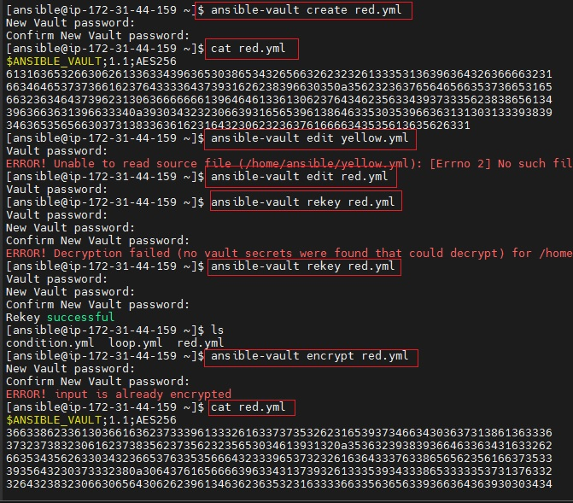

Slide 36
To encrypt an existing Playbook
[ansible]$ ansible-vault encrypt var.yml
To decrypt and encrypted Playbook
[ansible]$ ansible-vault decrypt task.yml
Roles: We can use 2 technologies for reusing a set of task: includes and roles.
Roles are good for organizing task and encapsulating data needed to accomplish those tasks.
We can organize playbook into a directory structure called Roles.
Adding more and more functionality to the playbooks will make it different to maintain in a single file.

Slide 37
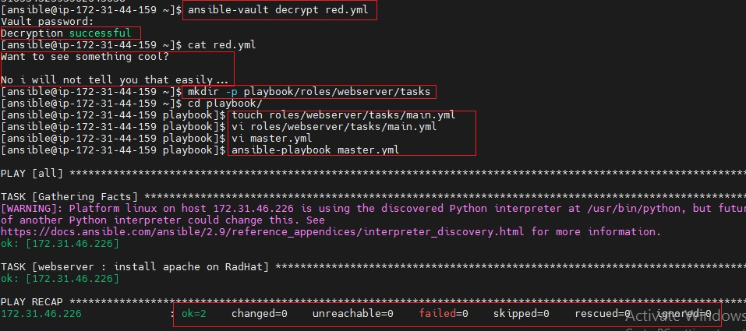

Slide 38
Thankyou

