Slide 1
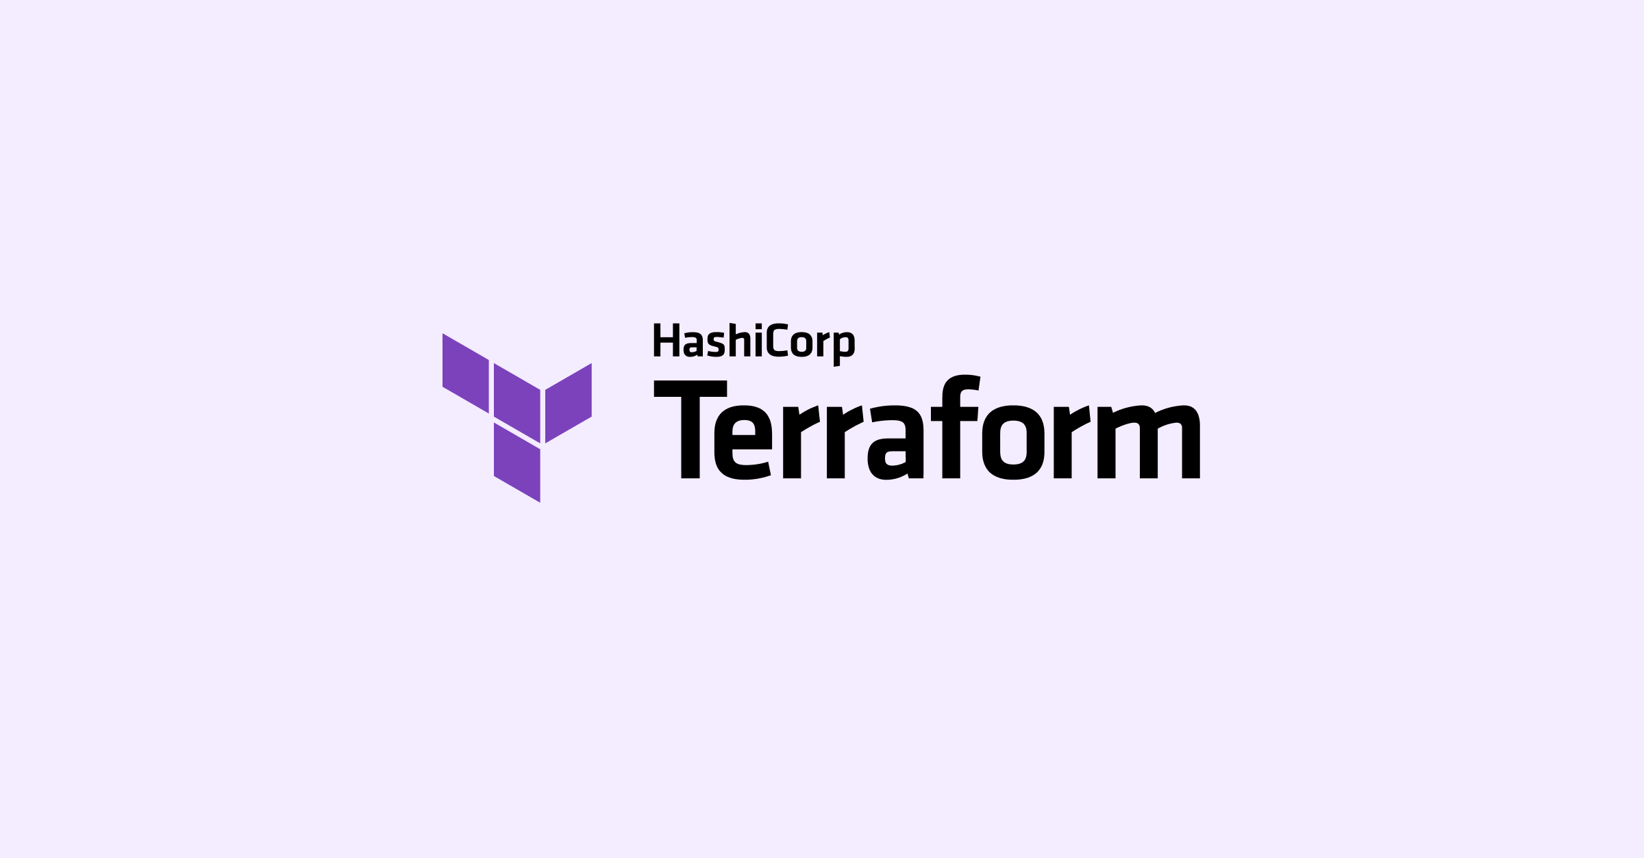

Slide 2
Infrastructure as Code
In the past, managing IT infrastructure was a hard job. System administrators had to manually manage and configure all of the hardware and software that was needed for the applications to run.
However, in recent years, things have changed dramatically. Trends like cloud computing revolutionized—and improved—the way organizations design, develop, and maintain their IT infrastructure.
One of the critical components of this trend is called “infrastructure as code,”
Infrastructure as code is the process of managing and provisioning computer data centers through machine-readable definition files, rather than physical hardware configuration or interactive configuration tools.
Infrastructure as code (IaC) means to manage your IT infrastructure using configuration files.

Slide 3
What Problem Does IaC Solve?
The Pain of Managing IT Infrastructure
Historically, managing IT infrastructure was a manual process. People would physically put servers in place and configure them. Only after the machines were configured to the correct setting required by the OS and applications would those people deploy the application. Unsurprisingly, this manual process would often result in several problems.
The first big problem is cost. You’d have to hire many professionals to perform the necessary tasks at each step of the process, from network engineers to hardware maintenance technicians. All of those people need to be paid, obviously, but they also need to be managed. That leads to more management overhead and adds more complexity to communication inside the organization. The result? Dollars go away. And we didn’t even mention building and maintaining your own data centers, which would increase the costs by orders of magnitude.

Slide 4
The next big problems are scalability and availability. But in the end, it all comes down to speed. Since manual configuration is so slow, applications would often struggle with spikes in access, while the system administrators would be desperately trying to set up servers to manage the load. This necessarily impacts availability. If the organization didn’t have backup servers or even data centers, then the application could be unavailable for long periods.
A third major problem is monitoring and performance visibility. Now that you have all of the infrastructure in place, how do you keep an eye on it to ensure it’s performing optimally? When you have an issue, how do you pinpoint exactly where in the infrastructure the issue is coming from? Is it the network, the server, or the application.

Slide 5
Infrastructure as Code Benefits
Speed
IaC benefits a company’s IT architecture and workflow as it uses automation to substantially increase the provisioning speed of the infrastructure’
s development, testing, and production.
Consistency
Since it is code, it generates the same result every time. It provisioned the same environment every time, enabling improved infrastructure
consistency at all times.
Cost
One of the main benefits of IaC is, without a doubt, lowering the costs of infrastructure management. With everything automated and organized,
engineers save up on time and cost which can be wisely invested in performing other manual tasks and higher-value jobs.
Minimum Risk
IaC allows server configuration that can be documented, logged, and tracked later for reference. Configuration files will be reviewed by a person or policy as a code (sentinel) for security leakages.

Slide 6
Everything Codified
The main benefit of IaC is explicit coding to configure files in use. You can share codes with the team, test them to ensure accuracy, maintain
uniformity and update your infrastructure into the same flow of IaC.
Version Controlled, Integrated
Since the infrastructure configurations are codified, we can check-in into version control like GitHub and start versioning it.
IaC allows you to track and give insight on what, who, when, and why anything changed in the process of deployment. This has more
transparency which we lack in traditional infrastructure management.

Slide 7
More IaC Tools
Every Cloud providers have their own native infrastructure as code solution.
Each comes with their own unique way of describing infrastructure in code.

Slide 8
What is Terraform?
Terraform is an open-source infrastructure as Code tool developed by HashiCorp. It is used to define and provision the complete infrastructure using an easy-to-learn declarative language. It is an infrastructure provisioning tool where you can store your cloud infrastructure setup as codes. It’s very similar to tools such as CloudFormation, which you would use to automate your AWS infrastructure, but you can only use that on AWS. With Terraform, you can use it on other cloud platforms as well.
Terraform is a tool for building, changing, and versioning infrastructure safely and
efficiently.
It is developed by Hashicorp & written in GoLang.

Slide 9
The benefits of using Terraform:-
Does orchestration, not just configuration management.
Supports multiple providers such as AWS, Azure, GCP, DigitalOcean and many more.
Provide immutable infrastructure where configuration changes smoothly.
Uses easy to understand language, HCL (HashiCorp configuration language).
Easily portable to any other provider.
Supports Client only architecture, so no need for additional configuration management on a server.

Slide 10
Install Terraform CLI
https://www.terraform.io/downloads.html
Terraform is distributed as a single binary Install
Terraform by unzipping it and moving it to a
directory included in your system's PATH
You can also install Terraform CLI with system
package managers such as
On Debian/Uubuntu APT Packages
https://www.terraform.io/docs/cli/install/apt.html
On RHEL/Fedora Yum Packages
https://www.terraform.io/docs/cli/install/yum.html

Slide 11
Install Terraform CLI on Linux
Below would install the terraform Version 1.0.1
cd /opt ; wget https://releases.hashicorp.com/terraform/1.1.9/terraform_1.1.9_linux_amd64.zip
apt update ; apt install –y unzip on Ubuntu / Debian Systems
yum update ; yum install –y unzip on RHEL/Centos/Fedora
unzip /opt/terraform_1.1.9_linux_amd64.zip
mv /opt/terraform /usr/local/bin/
terraform –version validate the version

Slide 12
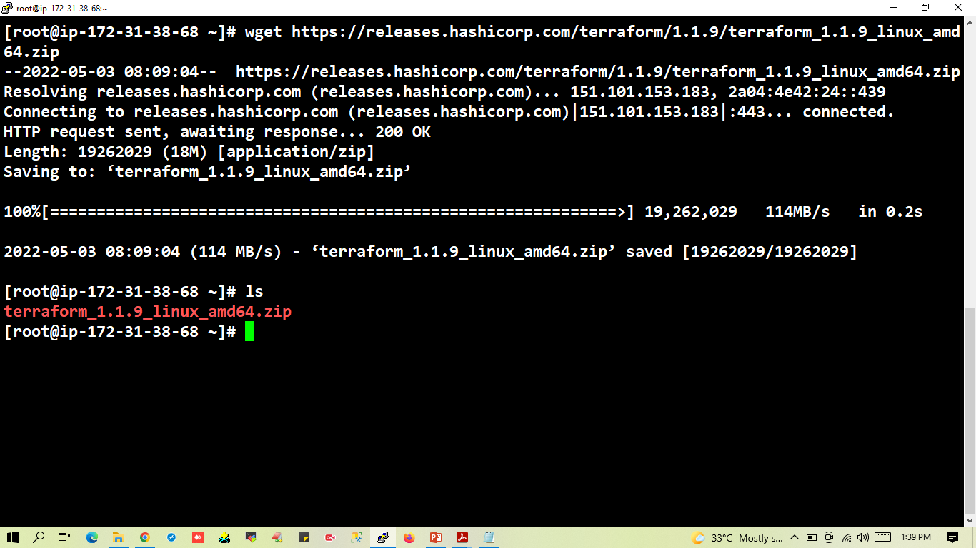

Slide 13
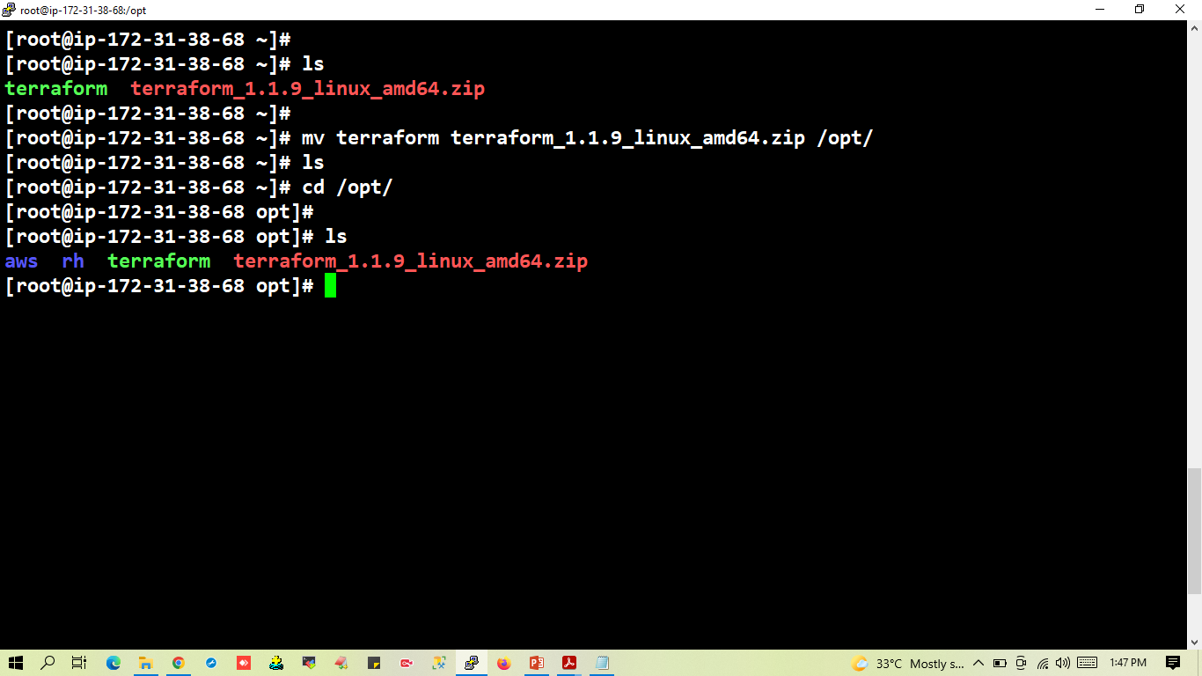
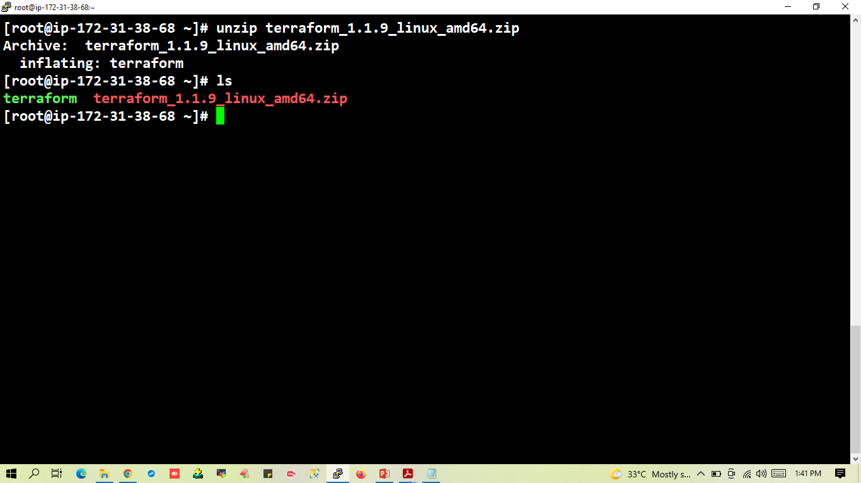

Slide 14
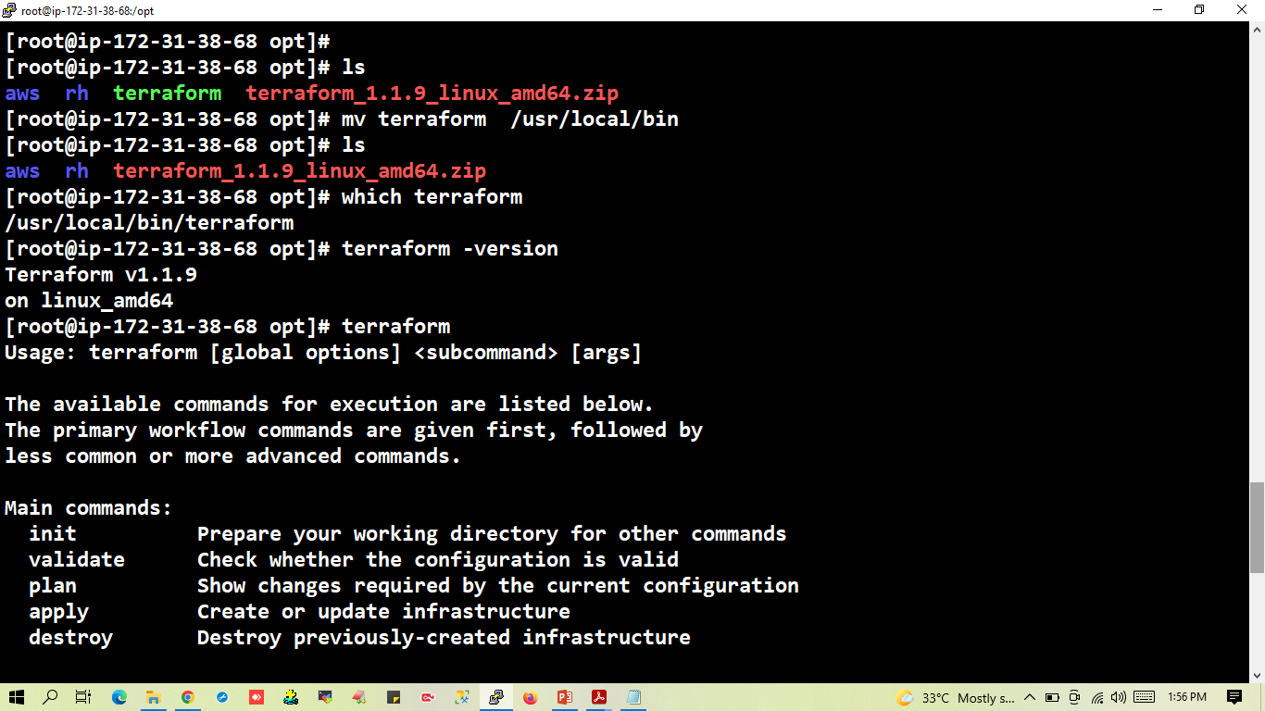

Slide 15
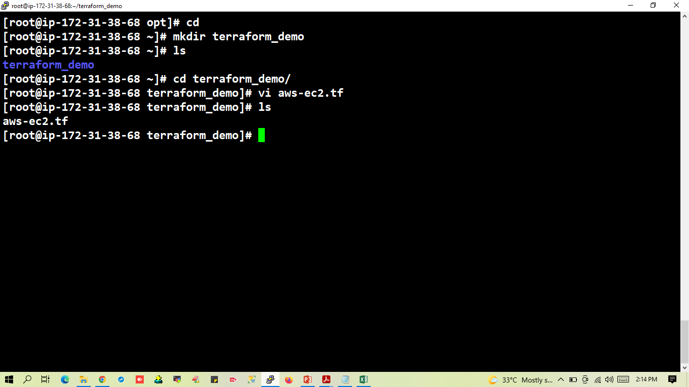

Slide 16
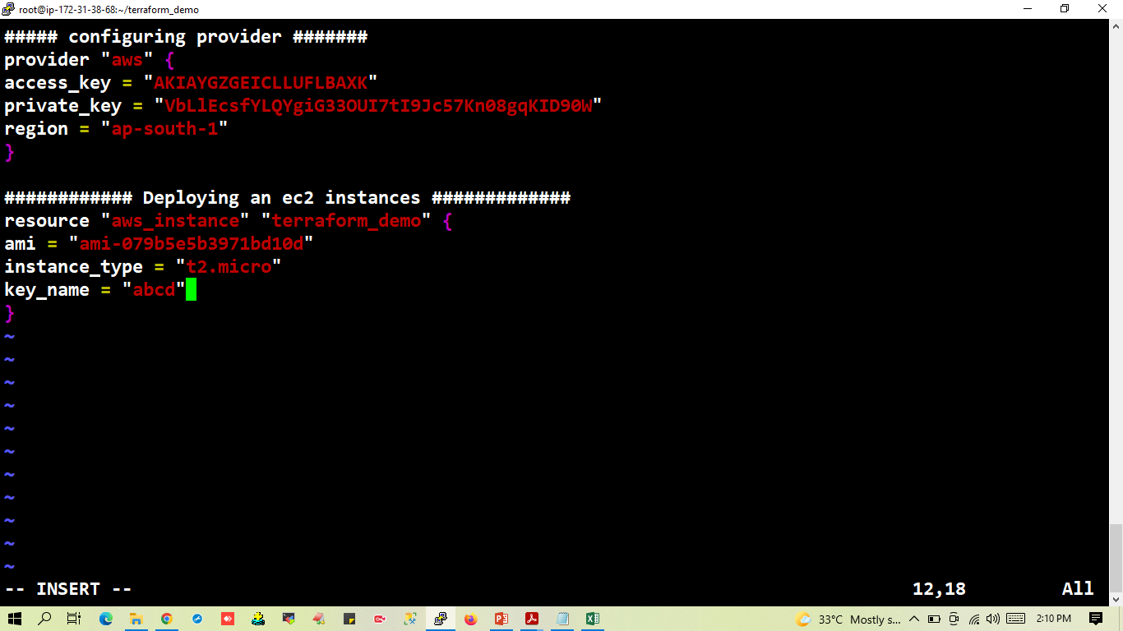

Slide 17
Provider
A provider is responsible for understanding API interactions and exposing resources.
Most of the available providers correspond to one cloud or on-premises infrastructure platform and offers resource types that correspond to each of the features of that platform.
In order to make a provider available on Terraform, we need to make a terraform init, these commands download any plugins we need for our providers. If for example, we need to copy the plugin directory manually, we can do it, moving the files to .terraform.d/plugins
provider "aws" {
region = "us-east-1"
}
If the plugin is already installed, terraform init will not download again unless to upgrade the version, run terraform init -upgrade.

Slide 18
Terraform Lifecycle
Terraform lifecycle consists of – init, plan, apply, and destroy.
Terraform Init
The terraform init command is used to initialise a working directory containing Terraform configuration files.
During init, the configuration is searched for module blocks, and the source code for referenced modules is retrieved from the locations given in their source arguments.
Terraform must initialize the provider before it can be used.
Initialization downloads and installs the provider’s plugin so that it can later be executed.
Initializes the backend configuration.

Slide 19
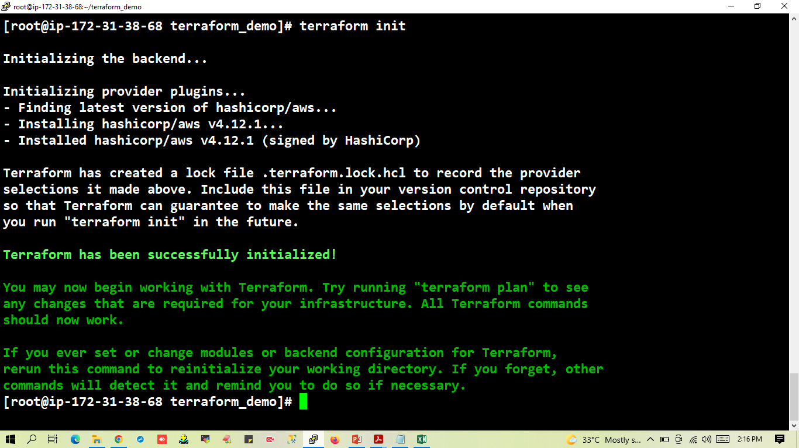

Slide 20
Terraform plan
The terraform plan command is used to create an execution plan.
It will not modify things in infrastructure.
Terraform performs a refresh, unless explicitly disabled, and then determines what actions are necessary to achieve the desired state specified in the configuration files.
This command is a convenient way to check whether the execution plan for a set of changes matches your expectations without making any changes to real resources or to the state.

Slide 21
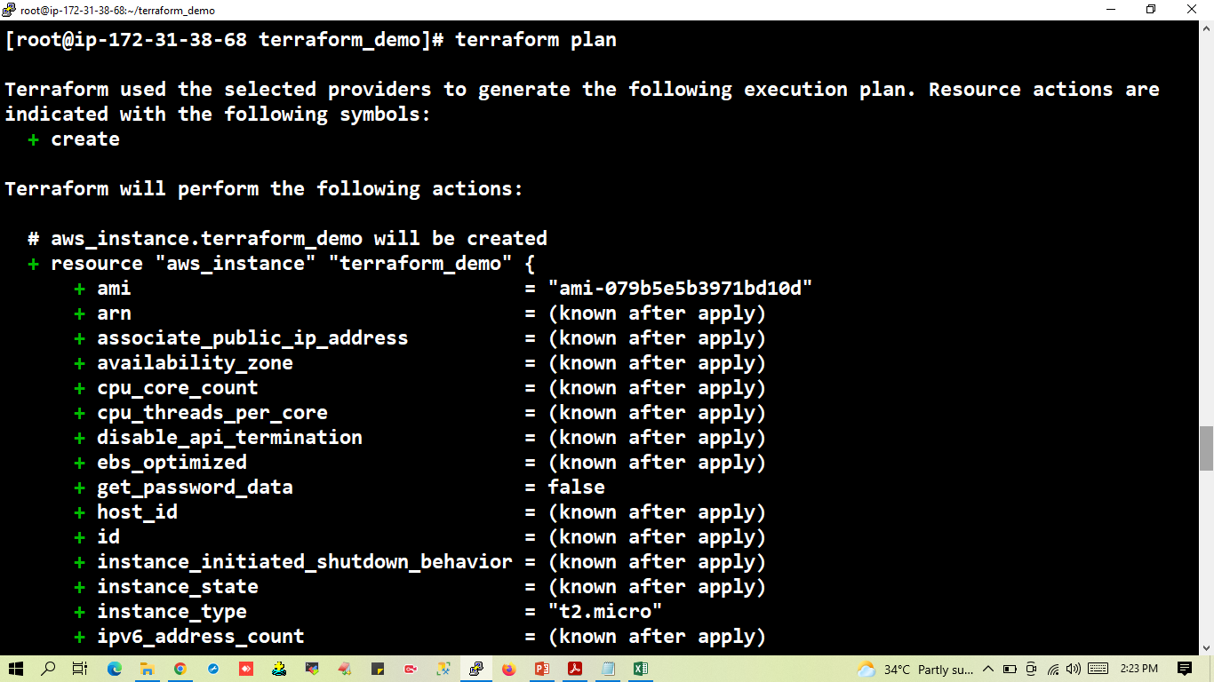

Slide 22
Terraform Apply
The terraform apply command is used to apply the changes required to reach the desired state of the configuration.
Terraform apply will also write data to the terraform.tf state file.
Once the application is completed, resources are immediately available.

Slide 23


Slide 24
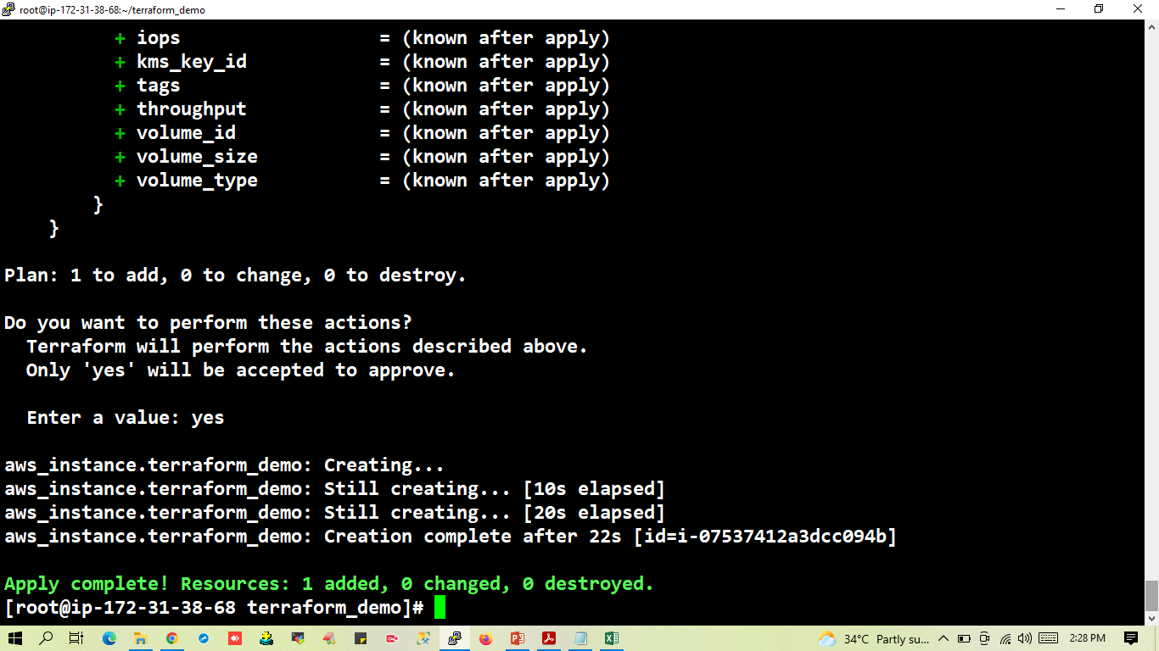

Slide 25
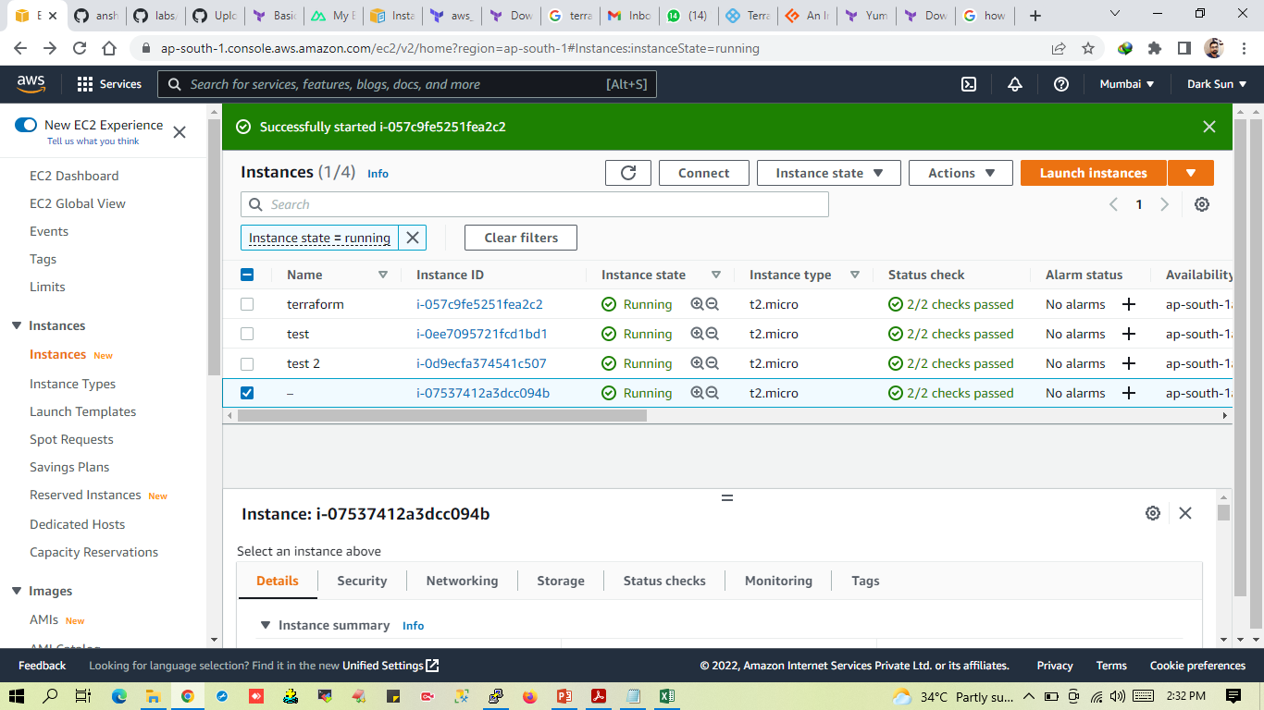

Slide 26
Terraform Refresh
The terraform refresh command is used to reconcile the state Terraform knows about (via its state file) with the real-world infrastructure.
This does not modify infrastructure but does modify the state file.
Terraform Destroy
The terraform destroy command is used to destroy the Terraform-managed infrastructure.
terraform destroy command is not the only command through which infrastructure can be destroyed.
You can remove the resource block from the configuration and run terraform apply this way you can destroy the infrastructure.

Slide 27
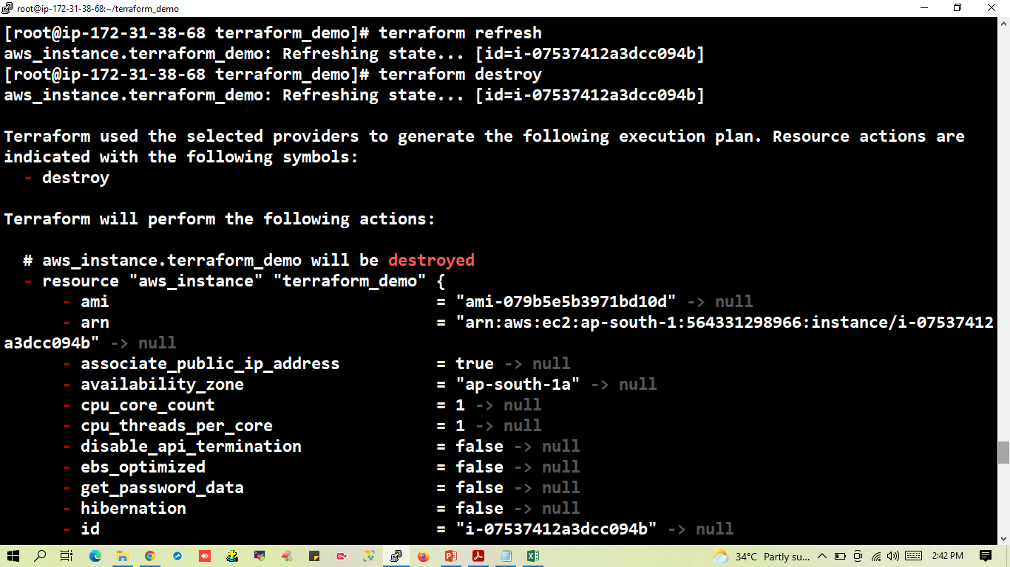

Slide 28
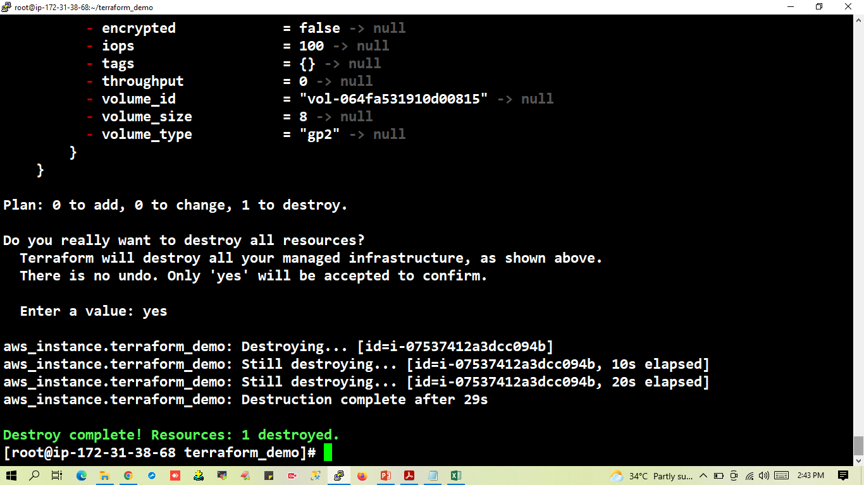

Slide 29
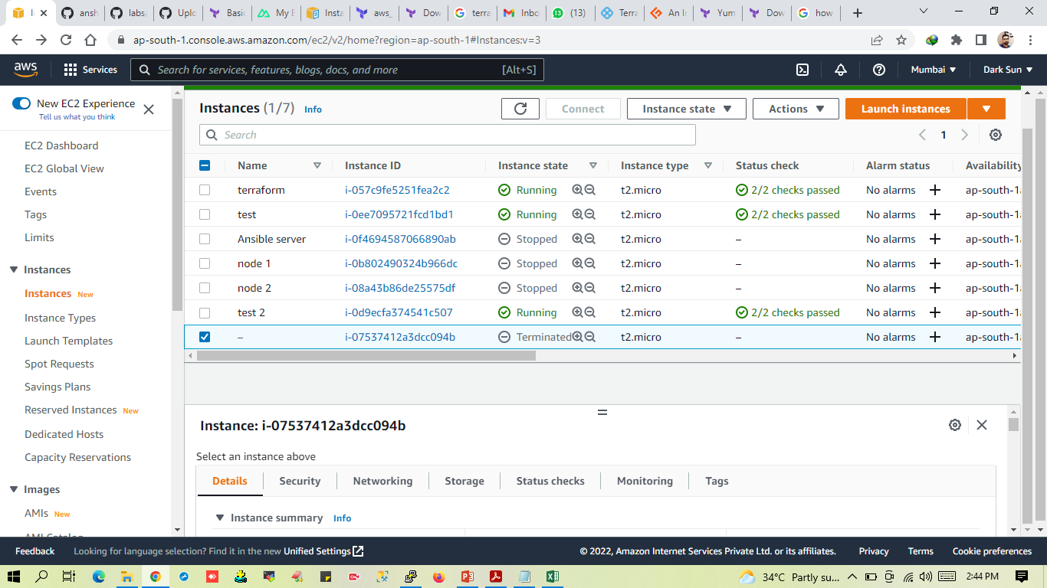

Slide 30
Some Best Practices of IaC:-
Make code your single source of truth. You should explicitly code all the infrastructure specifications in configuration files. Your configuration files should be the single source of truth for all your infrastructure management concerns.
Version control all of your configuration files. This probably should go without saying, but put all of your config files under source control.
Use little documentation (or none at all) for your infrastructure specifications. This point is the logical consequence of the first one. Since your config files should be your single source of truth, there should be no need for more documentation. External documentation can easily get out of sync with the real configurations, but that won’t happen with the config files.
Test and Monitor Your Configurations. IaC is code, and like all code, it can be tested. So test it you should! By employing testing and monitoring tools for IaC, you can check for errors and inconsistencies in your servers before you deploy them to production.

Slide 31
ThankYou …

