Slide 1
Housing Data Overview
A 2-page Power BI report on prices, sales, regions and sale types
Umesh Sakpal | Power BI Developer and Data Analyst

Slide 2
Project Overview
Goal: show how the housing market is doing in one place.
Where do sales happen?
Up or down?
Sales and price per SQM by region
Median price change and YOY growth
Offer vs paid?
What drives price?
How close the purchase price is to the offer
Sale type and house age

Slide 3
Data Preparation, Model and Security
Power Query
Data Model
Fixed data types
Conditional column
Merge queries
Housing Data (main table)
Measure Table-1 (8 measures)
Calculated columns: Age, Offer_Price

Slide 4
DAX Measures
Measure | What it shows
Average_Price_Per_Meter | Average price per SQM
Last_12_Month_Sale | Sales in the last 12 months
Median_Sales_Price_Change | Median price, latest vs previous year
Offer_To_SQM_Ration | Offer price per SQM
Sales_By_Region | Total sales by region
Total_YTD_Sales | Running sales total in the year
Units_Sold_Latest_Year_&_Quarter | Houses sold in latest quarter
YOY_Sales_Growth | Sales growth vs previous year

Slide 5
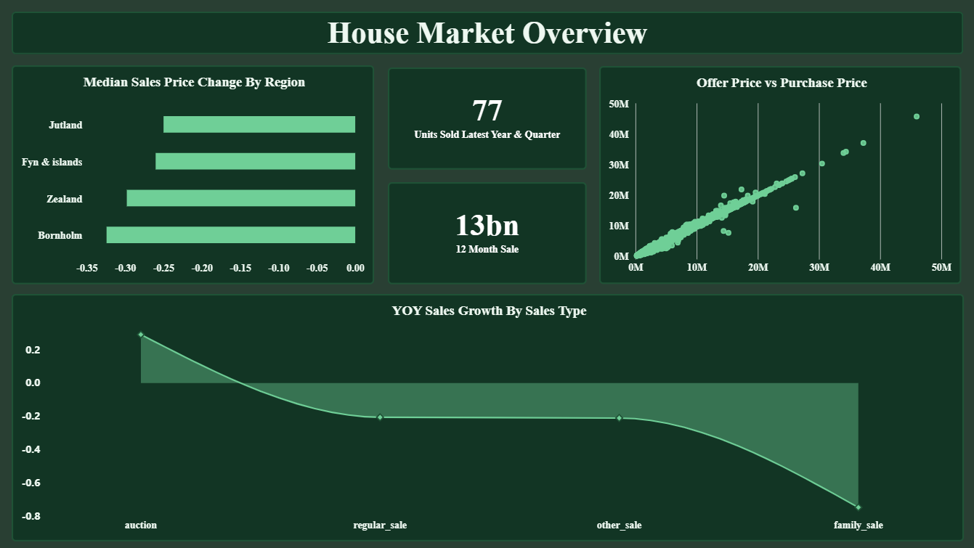
Page 1: House Market Overview
Median price is down in all 4 regions
77 units sold in the latest quarter
About 13bn sold in the last 12 months
Only auction sales grew YOY

Slide 6
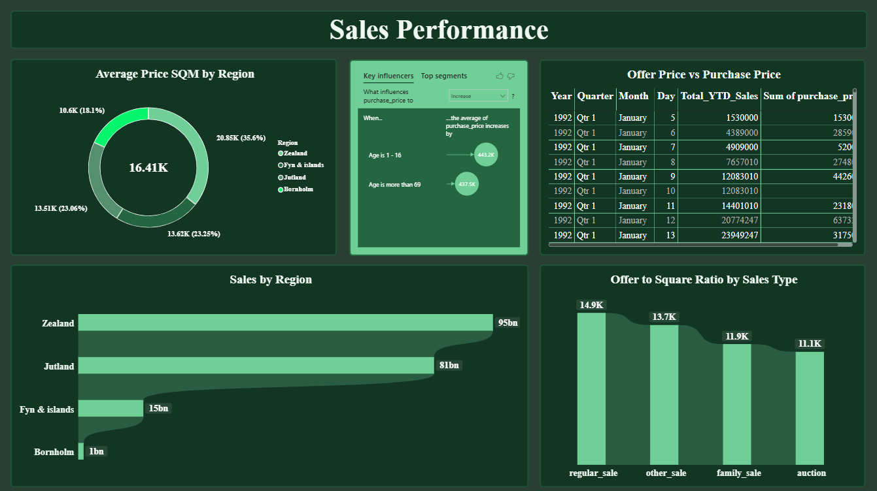
Page 2: Sales Performance
Zealand (95bn) and Jutland (81bn) lead sales
Zealand is the costliest per SQM
Regular sale has the top offer-to-SQM ratio
Very new and very old houses sell higher

Slide 7
Thank You
umeshsakpal14@gmail.com | github.com/Sakpal23

