Slide 1
Consumer Electronics: Sales Performance
Power BI dashboard | 3 report pages | Sales data 2018 to 2022
Shows managers which years, employees, products and states drive revenue.
26.9M
96
49
84
21
Total revenue
Employees
States served
Products
Product categories
Umesh Sakpal | Power BI Developer and Data Analyst

Slide 2
Data and Data Model
Sales_Employee_Data
Employee ID, name, gender, joining date
Sales Data holds one row per order line
5 years of orders, 2018 to 2022
96 employees, 84 products, 21 categories, 49 states
Star schema: 4 lookup tables, each one-to-many into Sales Data
1
*
Transaction Data
Order ID, Order Date, Month, Quarter, Year
Sales Data (fact)
Order ID, Customer ID, Employee ID, Product ID, Quantity, Discount, Unit_Price, Total_Revenue
Product Data
Product ID, Name, Category, Group, Unit Price
1
*
*
1
*
1
Customer_Profile_Data
Customer ID, name, city, state, zip
Rows in Sales Data: [add count]

Slide 3
DAX and Measures
CALCULATED COLUMN | Sales Data[Total_Revenue]
Measures (aggregations)
Sum of Total_Revenue
Sum of Quantity
Count of Employee ID, State, Product Name, Category
Customers per year
Total_Revenue =
[Quantity] * [Unit_Price]
- ([Quantity] * [Unit_Price] * [Discount] / 100)
Revenue after discount (Discount is a percentage).
CALCULATED COLUMN | Sales Data[Unit_Price]
Unit_Price = LOOKUPVALUE(
'Product Data'[Unit Price],
'Product Data'[Product ID],
'Sales Data'[Product_ID])
Also used
Top N filters (Top and Bottom 5)
AI visuals: key influencers, decomposition tree, smart narrative
Brings each product’s price into Sales Data.

Slide 4
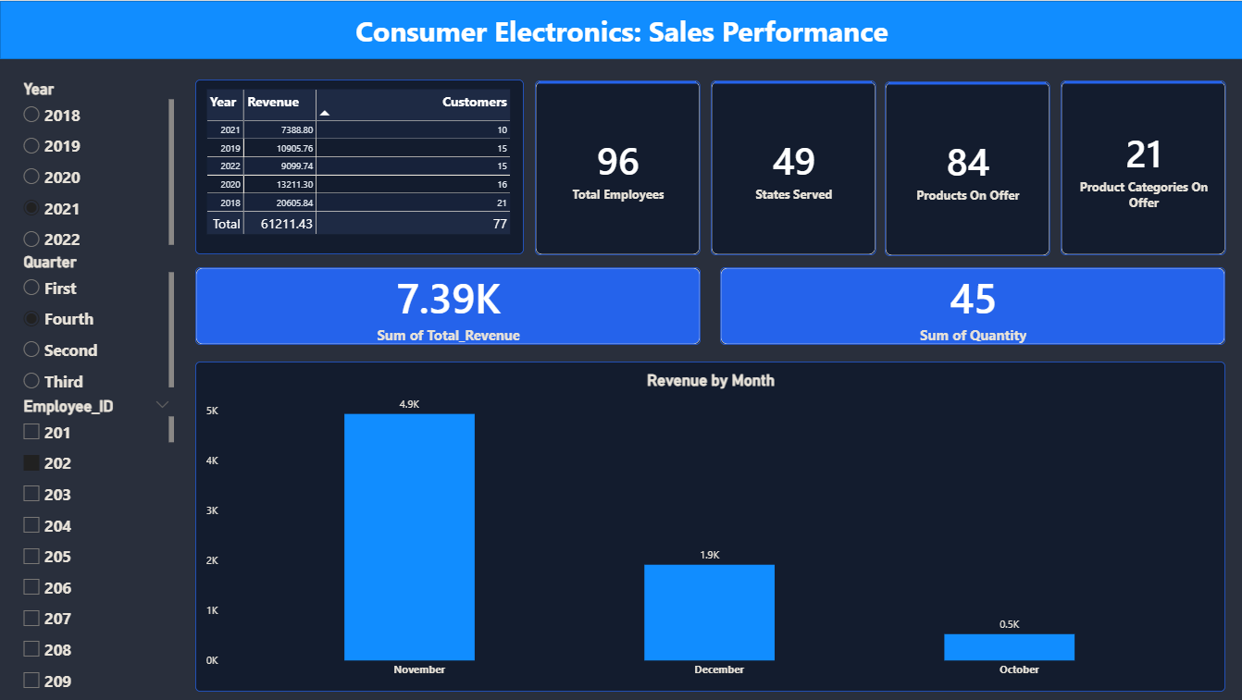
Sales Performance View
Key insights
Totals at a glance: 96 employees, 49 states, 84 products, 21 categories
Example: Employee 202 in Q4 2021 made 7.39K from 45 units
November was the best month (4.9K), October the weakest (0.5K)
Purpose: Pick a year, quarter and employee to see revenue, units and monthly trend.

Slide 5
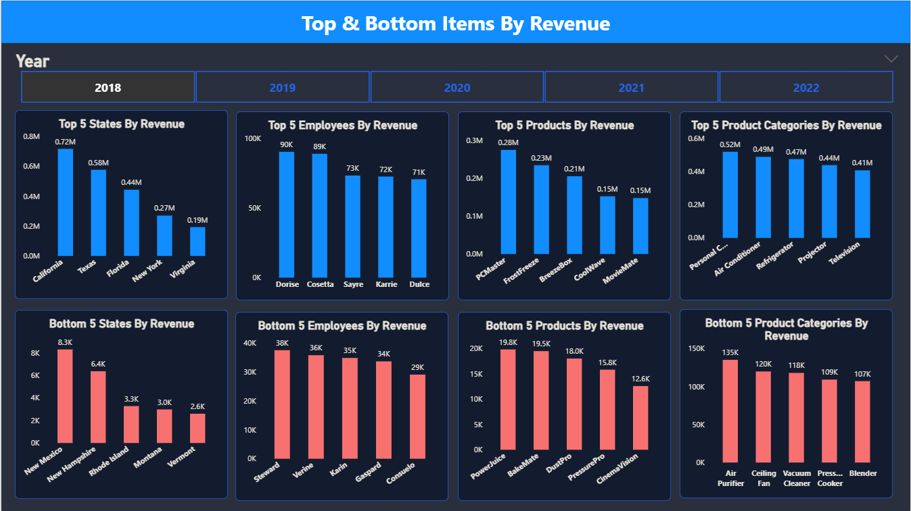
Top and Bottom Performers
Key insights
2018: California led states at 0.72M, Vermont was last at 2.6K
Top product PCMaster (0.28M); top category Personal Computers (0.52M)
Top employee Dorise (90K) vs weakest, Consuelo (29K)
Purpose: Shows the best and worst 5 states, employees, products and categories by year.

Slide 6
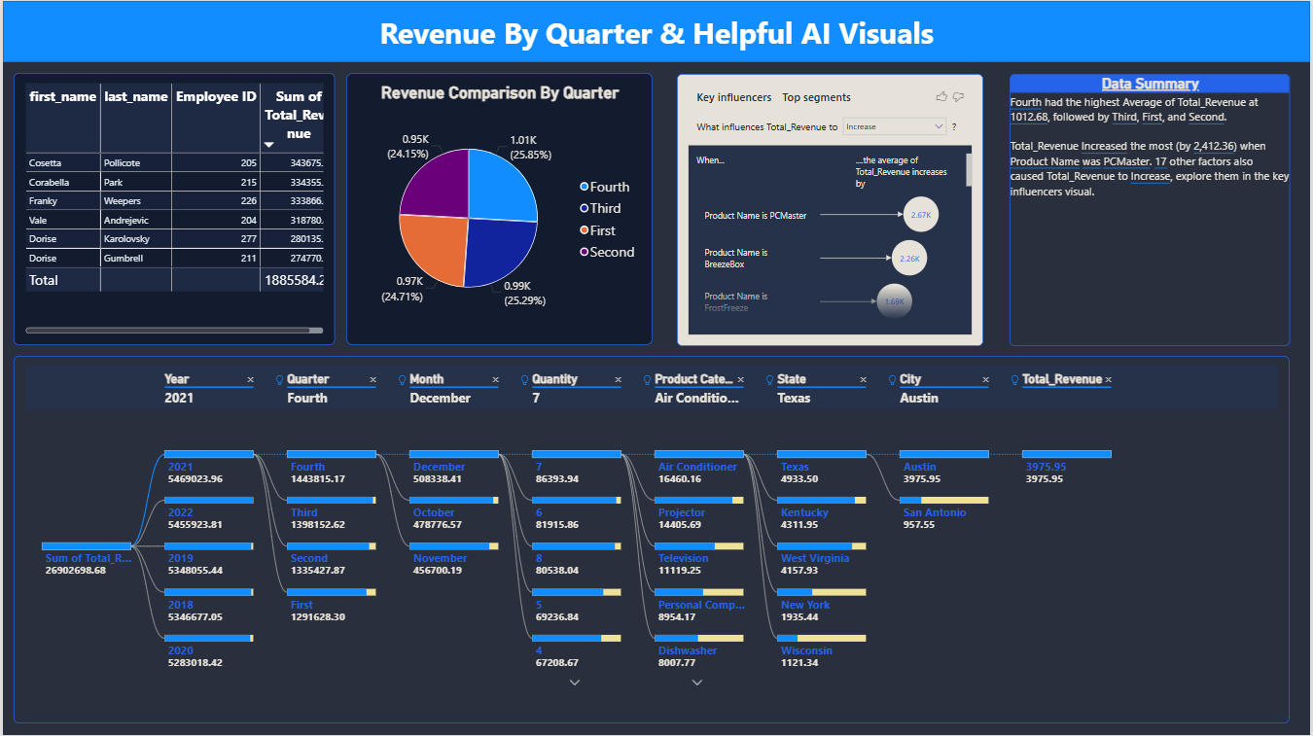
AI Visuals: What Drives Revenue?
Key insights
Total revenue 2018 to 2022: 26.9M, steady at 5.3M to 5.5M a year
Q4 had the highest average revenue per order line (1,012.68)
PCMaster lifts revenue the most (+2,412 per order line)
Drill path: 2021, Q4, December, Air Conditioner, Texas, Austin
Purpose: Explains why revenue moves, not just how much.

Slide 7
Thank You

