Slide 1
Insurance Data Analysis
Power BI report on policies, premiums and claims
Umesh Sakpal | Power BI Developer & Data Analyst

Slide 2
Project at a glance
Goal
Data
Show how premiums, coverage and claims move across policy types, age groups and claim status.
Policy, customer and claim records: policy number, age, gender, coverage, premium, start and end dates, policy type, claim status.
Report
Tools
2 pages. Slicers on policy, claim and customer. Role-based access with RLS.
Power BI Desktop, Power Query, DAX.

Slide 3
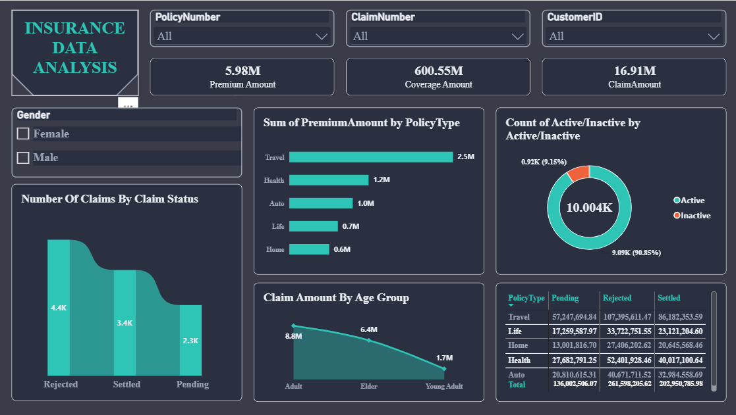
Main dashboard
5.98M
Premium
600.55M
Coverage
16.91M
Claims paid
Filters: policy number, claim number, customer ID, gender

Slide 4
How it was built
Power Query
Fixed data types. Conditional column for groups. Merged queries to join tables.
RLS
Roles limit the rows each user can see.
Visuals
Bar, donut, ribbon, area chart and matrix, with slicers.

Slide 5
What the data shows
Travel
Rejected
Biggest premium: 2.5M of 5.98M, about 42%.
4.4K claims, the largest group, ahead of Settled 3.4K and Pending 2.3K.
Active
Age
90.85% of policies are active. 9.15% are inactive.
Adults claim most: 8.8M. Elder 6.4M. Young Adult 1.7M.

Slide 6
Thank You
umeshsakpal14@gmail.com
github.com/Sakpal23

