Slide 1
Sales Data Analysis
A 5-page Power BI report on sales, profit, products, promotions and cities
Umesh Sakpal | Power BI Developer | github.com/Sakpal23
Notes:
Introduce yourself in one line, then say what the report answers: what sells, what earns profit, where, and how promotions work.

Slide 2
What this report does
Shows how sales, profit and units sold move over time
Ranks the best and worst products
Maps sales by city and checks how promotions affect discounts
Lets you compare two date ranges side by side
5
3.51K
report pages
orders
2020-2024
7
date range
tables in model
Built with Power BI, Power Query and DAX
Notes:
Keep this short. The point is: one report, five pages, each page answers one question.

Slide 3
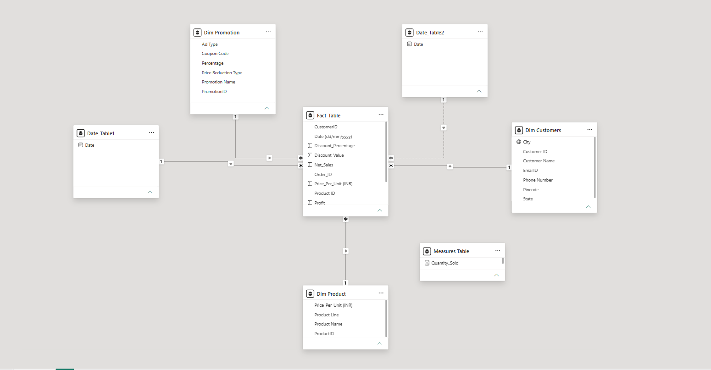
Data model
Star schema: one Fact_Table, three lookup tables (customer, product, promotion)
Two date tables: Date_Table1 is active, Date_Table2 is switched on only inside DAX for comparisons
Measures Table: keeps all DAX measures in one place
Notes:
Point at the dotted line: that is the inactive relationship to Date_Table2.

Slide 4
Data prep and DAX
Power Query
DAX measures
Removed null values
Merged queries to join data from different sources
Other cleaning and shaping steps to get the model ready
Sum_Dim: total net sales
Sum_Of_Net_Sales: net sales for the second date range
Total_Profit: profit for the second date range
Quantity_Sold: units for the second date range
The last three use ALL(Date_Table1) and USERELATIONSHIP so the second date filter works on its own.
Notes:
Be ready to explain USERELATIONSHIP in one sentence: it turns on the inactive link to Date_Table2 for that measure only.

Slide 5
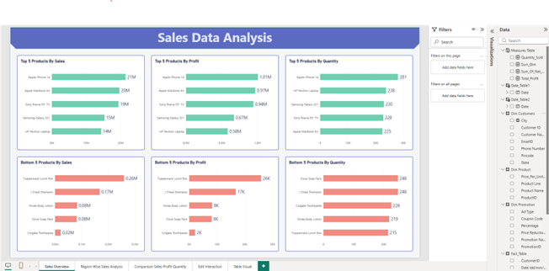
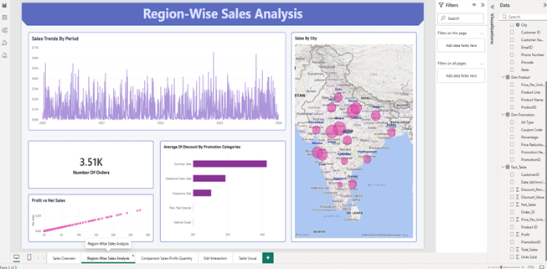
Pages 1 and 2: products and regions
Sales Overview: top and bottom 5 products by sales, profit and units
Region-Wise: sales trend, city map, order count and average discount by promotion
Notes:
Page 1: electronics lead sales and profit, personal-care items sit at the bottom. Page 2: bubbles show sales by city.

Slide 6
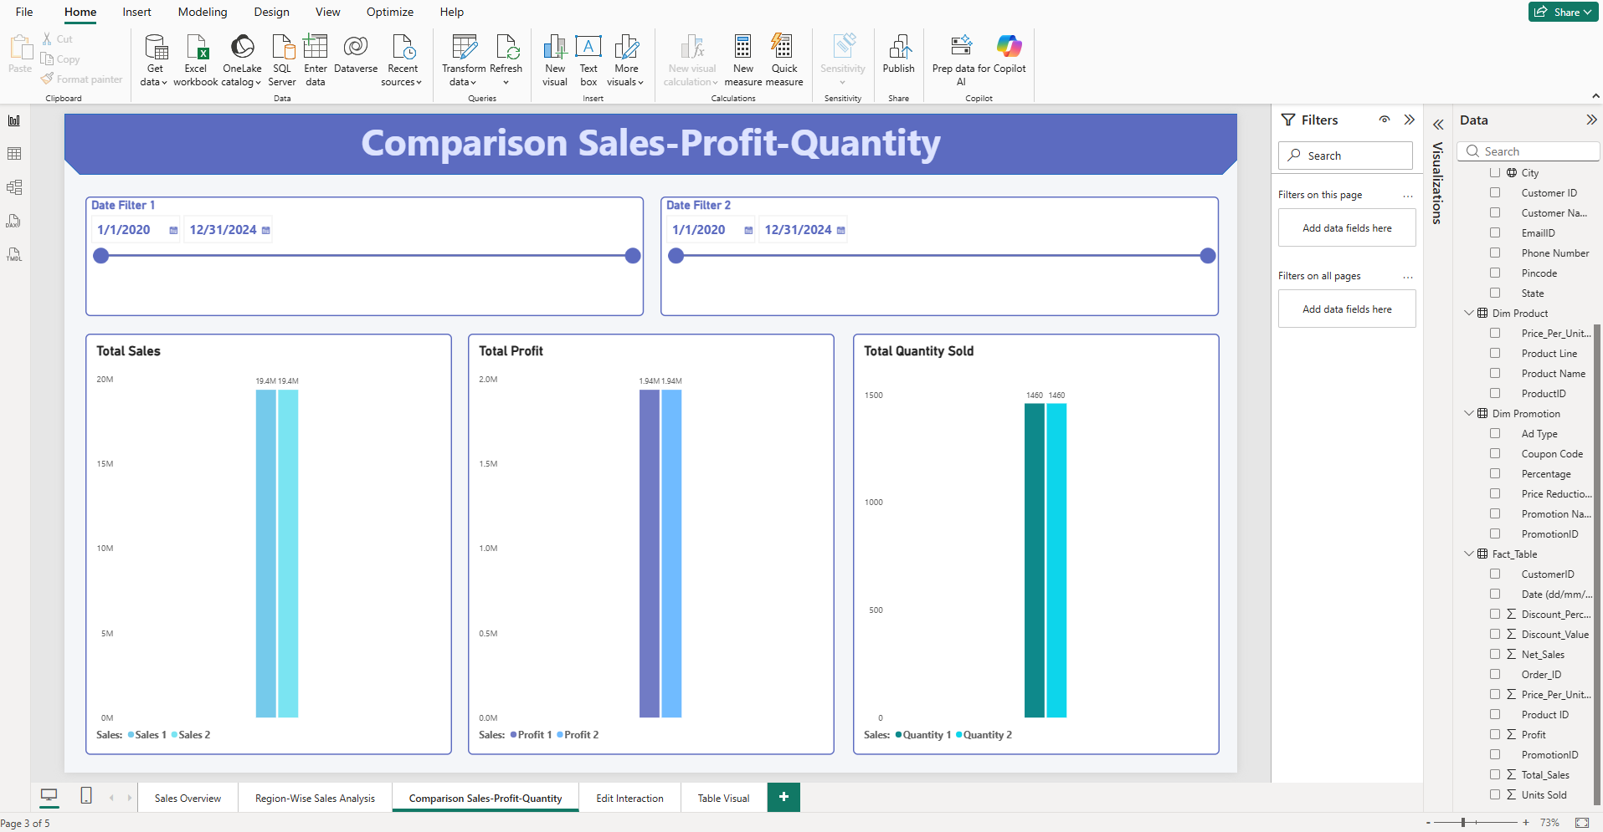
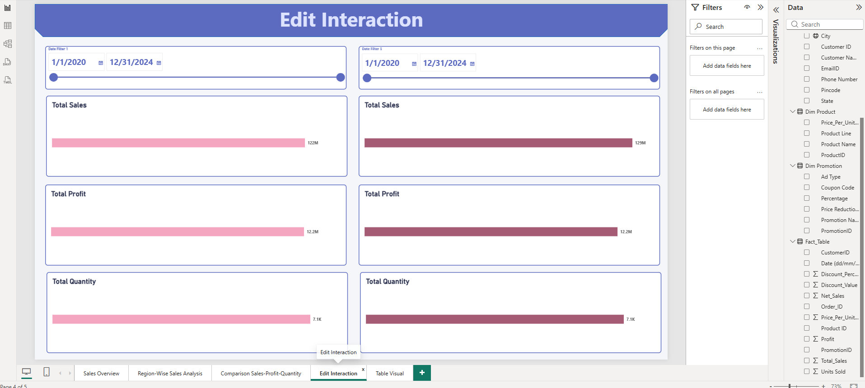
Pages 3 and 4: compare date ranges
Comparison: pick two date ranges and see sales, profit and units next to each other
Edit Interaction: each date slider controls only its own set of visuals
Notes:
Explain that Edit Interaction turns off cross-filtering so each slider only affects its own side.

Slide 7
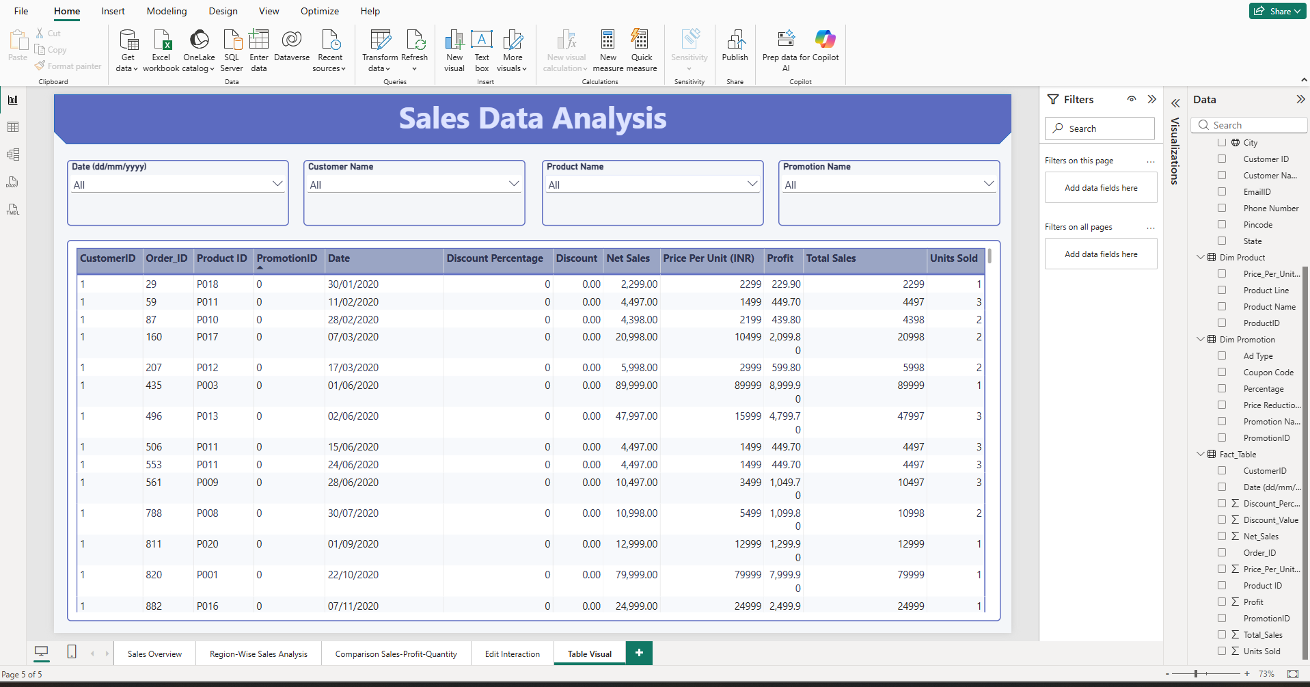
Page 5: table and how to use it
Use the four slicers: date, customer, product, promotion
Read order-level sales, discount and profit in the table
Notes:
This page is for checking the detail behind any number on the other pages.

Slide 8
Thank You
Umesh Sakpal
umeshsakpal14@gmail.com
github.com/Sakpal23

