Slide 1
UPI Transaction Analysis
Power BI dashboard · Year 2024
Umesh Sakpal | Power BI Developer & Data Analyst
github.com/Sakpal23

Slide 2
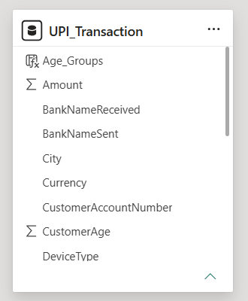
Project at a glance
Data
One table, UPI_Transaction. About 20,000 transactions in INR, USD, EUR and GBP.
Pages
Page 1: monthly trend views. Page 2: city, currency and month matrix.
Controls
10 slicers, 4 bookmark buttons to switch views, and a Currency filter on all pages.
Data model: one table

Slide 3
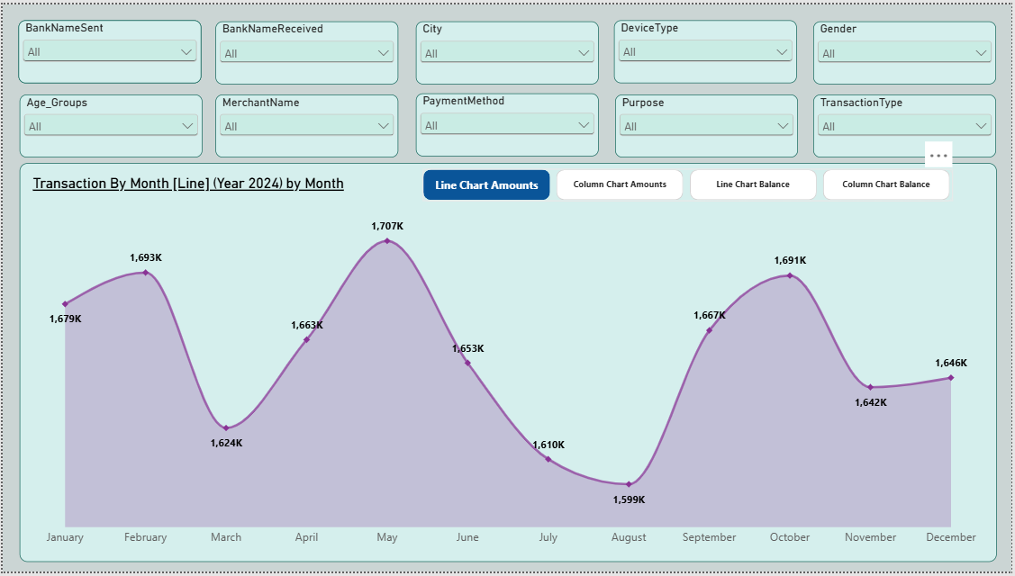
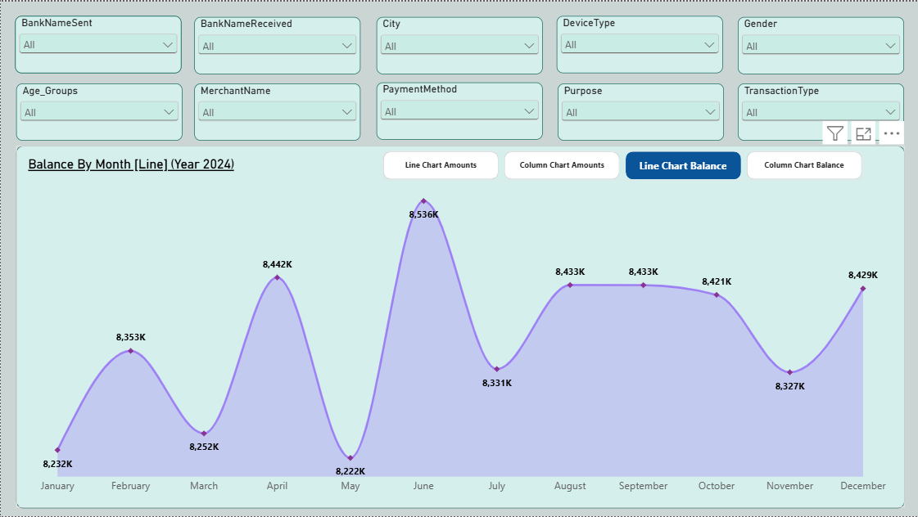
Page 1: Monthly trends
Transaction amount by month
Remaining balance by month
Bookmark buttons switch between line and column views of both measures. All 10 slicers filter every view.

Slide 4
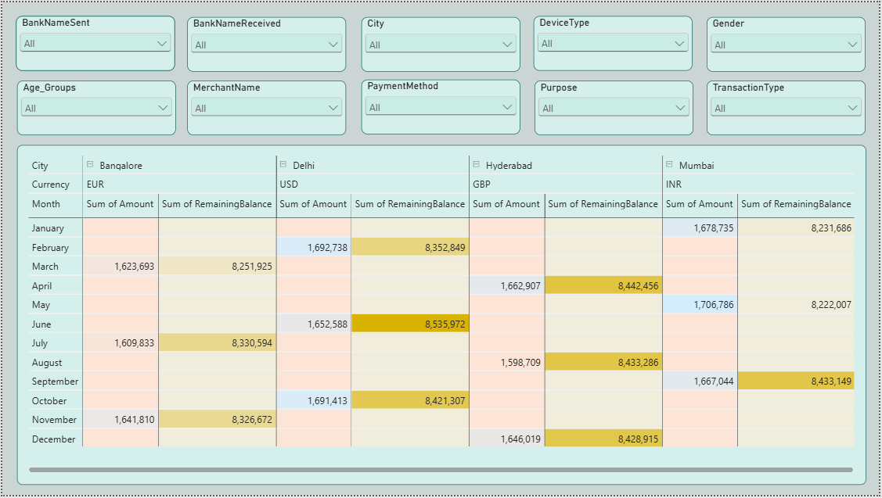
Page 2: City, currency and month
Matrix
Amount and remaining balance by month, grouped by city and currency.
Conditional colours
Darker cells show higher values at a glance.

Slide 5
Key findings
1.71M
1.60M
8.54M
8.22M
Highest monthly amount
Lowest monthly amount
Highest balance
Lowest balance
May
August
June
May
Monthly amounts stay in a narrow range of 1.60M to 1.71M across the year.

Slide 6
Thank you
Umesh Sakpal
umeshsakpal14@gmail.com | github.com/Sakpal23

