Slide 1
FastAPI
INFERCTRL
Multi-Agent
OpenAI-compat
Autonomous LLM Inference Optimization Platform
A self-optimizing inference layer that continuously observes, benchmarks,
evaluates, and routes LLM traffic — reducing latency and cost without
sacrificing answer quality.
-54%
-37%
+28%
<350ms
P95 Latency
Cost / 1K tokens
Throughput
Auto-Rollback
github.com/inferctrl · FastAPI · Python 3.12 · Multi-Agent · OpenAI-compatible

Slide 2
The LLM Inference Trilemma
Every production team faces the same impossible trade-off
⏱ Latency Spikes
💸 Runaway Costs
📉 Silent Quality Drift
P95 latency balloons 3–5× during traffic bursts.
Static autoscalers are blind to prompt length,
queue depth, and decode complexity.
Users abandon sessions. SLAs are violated.
GPT-4-class models billed for every request,
even trivial ones a 7B local model could answer.
No differentiation between a 10-token greeting
and a 4K-token code-review task.
Model updates, prompt regressions, or hardware
failures silently degrade answer quality.
There is no feedback loop. No canary. No rollback.
Teams discover regressions from user complaints.
"We spent 40% of our ML budget on inference and had no idea which requests were expensive or whether the model was actually helping users." — Common engineering post-mortem

Slide 3
Introducing INFERCTRL
A closed-loop feedback system — Observe → Benchmark → Evaluate → Optimize → Verify → Roll Back
1 OBSERVE
2 BENCHMARK
3 EVALUATE
4 OPTIMIZE
5 VERIFY
Capture every request:
latency, tokens, cost,
quality, provider
Run controlled A/B tests
across providers and
batch strategies
Score output quality.
Detect regressions.
Compute Pareto frontier
Select best config.
Canary rollout at 5%.
Monitor watchdog
Confirm SLA met.
Apply globally or
auto-roll back <350 ms
→
→
→
→
OpenAI-Compatible Gateway
5-Agent Autonomous Engine
Deterministic Policy Guardrails
Canary Rollout + Auto-Rollback
Drop-in replacement for the OpenAI client.
Zero code changes in existing apps.
Workload Analyst → Scheduler → Benchmarker
→ Quality Evaluator → Controller
Hard constraints on latency, cost, quality.
LLMs propose; policy enforces.
5% canary traffic. Watchdog on P95 + errors.
Global apply or instant rollback.

Slide 4
5-Agent Architecture
Each agent owns a specific responsibility. The Controller coordinates them all.
01
Workload
Analyst
02
Benchmark
Agent
03
Quality
Evaluator
04
Scheduler
Agent
05
Controller
Agent
• Classifies prompt complexity
(trivial / medium / complex)
• Estimates resource demand
• Detects traffic regime
(idle / bursty / sustained)
• Outputs WorkloadReport
• Selects candidate configs
• Runs controlled A/B tests
• Measures latency P50/P95,
throughput, GPU utilisation
• Feeds results to Controller
• Scores LLM outputs via
LLM-as-judge / reference eval
• Domain-specific metrics
(code correctness, factuality)
• Triggers rollback if quality
falls below threshold
• Adjusts real-time serving
parameters per controller
• Dynamic batching settings
• Concurrency limits per model
• GPU resource allocation
• Multi-objective optimisation
(latency / cost / quality)
• Chooses experiments to run
• Applies / rejects configs
• Learns from past decisions
• Rollback if SLO violated
⚡ Deterministic Authority Rule
Agents may propose hypotheses and configurations, but the Policy Engine has final authority.
Hard constraints on max latency, max cost, and min quality are NEVER overridden by an LLM suggestion.

Slide 5
Dual Backend Strategy
Works with real providers and a deterministic simulator — never blocks on missing credentials
Google Gemini API
Ollama Local
Deterministic
Simulator
Model: gemini-2.0-flash-exp
Auth: GEMINI_API_KEY env var
Pricing: $0.075 / 1M input tokens
$0.30 / 1M output tokens
Features: Streaming · function calling
provider-reported usage
Fallback: Simulator if key missing
Models: llama3.2:3b · qwen2.5:7b
URL: OLLAMA_BASE_URL env var
Pricing: $0.00 (local compute)
Features: Streaming · GPU/CPU
no external API calls
Fallback: Simulator if not running
Purpose: CI · demos · benchmarks
Profiles: llama-3b · llama-70b · gpt-4
Latency: Physics-based queueing model
(M/D/1 queue, tokens/sec)
Label: All data tagged SIMULATED
Advantage: Fully reproducible — no API
Streaming
Real cost
Provider usage
Local / free
Streaming
GPU or CPU
Always available
Reproducible
Tagged
Routing Strategies
• fixed
Always use a single configured model
• lowest_latency
Route to fastest model by recent P95
• round_robin
Distribute across eligible models evenly
• quality_first
Prefer highest quality-scored model
• lowest_cost
Route to cheapest eligible model
• balanced
Pareto-optimal blend of cost + latency + quality

Slide 6
Safety & Policy Engine
Hard constraints are always enforced — the LLM can suggest but never override
Max Latency
Max Cost / Request
Min Quality Score
max_latency_ms: 5000
max_estimated_cost_per_request: 0.01
min_quality_score: 0.80
Any candidate configuration with measured
or estimated P95 latency above this threshold
is immediately eliminated from consideration.
Streaming responses track time-to-first-token
separately from total stream duration.
Estimated cost is computed from token usage
and up-to-date pricing tables per provider.
formula: (in_tok × in_rate + out_tok × out_rate) / 1M
Provider-reported cost is preferred; estimated
cost is used as fallback and clearly labelled.
Quality Evaluator scores every sampled output
via LLM-as-judge or reference evaluation.
Any model below the threshold is blacklisted
for that workload class until re-evaluated.
Protects against silent model regressions.
Multi-Objective Pareto Optimisation
score = α × (1 − latency_norm) + β × (1 − cost_norm) + γ × quality_norm
where α + β + γ = 1.0 (configurable weights per workload class)
Candidates on the Pareto frontier are plotted in the Control Room scatter chart.

Slide 7
Control Room Dashboard
Real-time observability for every inference request — http://localhost:8000
⬡ INFERCTRL
Autonomous LLM Inference Optimizer
● Optimizing
Last 1 hour ▾
42.8
612ms
0.93
$0.012
78%
req/s
P95 Lat
Quality
Cost/1K
GPU Util
+62% vs previous
−54% improvement
+2% vs previous
−37% cost reduction
4 / 4 GPUs active
📊 Live Performance Charts
🔀 Request Flow Sankey
🧪 Experiment Table
🎯 Pareto Scatter
Real-time req/sec, P95 latency ms,
and quality score sparklines.
Automatically annotates when
optimisation is applied.
Visualises traffic distribution
across providers (Chat 35%,
Code 20%, Reasoning 25%).
Updates every 5 seconds.
EXP-042 through EXP-039 with
full config, latency, quality,
cost per 1K, and APPLIED /
INJECTED / REJECTED status.
Cost vs Quality trade-off plot.
Pareto frontier highlighted.
Current config and past
experiments plotted live.
Live URLs (run: uvicorn apps.api.main:app --port 8000)
Control Room: http://localhost:8000
Chatbot UI: http://localhost:8000/chat
Pitch Deck: http://localhost:8000/presentation
REST API Docs: http://localhost:8000/docs
Health: http://localhost:8000/health

Slide 8
Canary Deployments & Auto-Rollback
No configuration change goes live without passing a live traffic gate
STEP 1
STEP 2
STEP 3A
STEP 3B
Canary Proposal
Watchdog Monitoring
Global Apply
Auto-Rollback
Controller selects a candidate
optimisation config after Pareto
analysis ranks it as promising.
Canary rollout begins:
• 5% of live traffic routed to
the new configuration.
• 95% stays on current baseline.
→
Watchdog agent monitors canary
traffic for 60 – 300 seconds:
• P95 latency vs baseline
• Error rate vs baseline
• Quality score vs threshold
All comparisons use actual
measured data (not estimates).
→
If ALL watchdog checks pass:
• Traffic split → 100% new config
• Baseline archived
• Experiment marked APPLIED
• Metrics snapshot stored
System continues searching for
the next improvement cycle.
If ANY watchdog check fails:
• Traffic snaps back to baseline
• Rollback completes < 350 ms
• Candidate marked REJECTED
• Failure reason logged
System learns and avoids similar
configs in future experiments.
✓ PASS →
Timing Reference
0 – 10 s
10 – 300 s
< 1 s
< 350 ms
5 – 10 min
Canary ramp-up
Watchdog window
Decision + apply
Rollback time
Full cycle

Slide 9
Measured Results & ROI
Simulated benchmark over 10,000 synthetic requests — all data tagged as SIMULATED
-54%
-37%
+28%
0%
P95 Latency Reduction
Cost / 1K Tokens
Throughput Increase
Quality Regressions
1,328 ms → 612 ms
$0.019 → $0.012
33 → 42.8 req/sec
93% quality score maintained
Recent Benchmark Experiments (simulated)
ID
Strategy
Batch
Concurrency
P95 Latency
Quality
Cost/1K
Result
EXP-042
cost-optimised
16
8
612 ms
0.93
$0.012
✔ APPLIED
EXP-041
quality-first
4
4
1,240 ms
0.96
$0.018
◉ INJECTED
EXP-040
high-throughput
32
16
480 ms
0.89
$0.015
◉ INJECTED
EXP-039
low-latency
8
8
390 ms
0.87
$0.018
◉ INJECTED
Projected ROI (illustrative, USD)
• API cost reduction: $14,500/mo saved at 10M req/mo
• Latency improvement: 54% lower P95 → measurable UX gain
• Engineering overhead: Autonomous loop replaces manual tuning
• Quality protection: 0% regressions in 30-day rolling window

Slide 10
Tech Stack & Roadmap
Production-ready architecture built on battle-tested open source
Backend
AI / Providers
Optimisation
• FastAPI 0.115
• google-genai 2.34
• Optuna (HPO)
• Python 3.12
• Ollama REST
• NumPy
• Pydantic v2
• Simulator (built-in)
• M/D/1 queue model
• Uvicorn / ASGI
• OpenAI SDK compat
• Pareto frontier
Observability
Testing
Frontend
• Request metrics
• Pytest 30 tests
• Vanilla HTML/JS
• Token tracking
• Unit + integration
• Chart.js
• Cost accounting
• FastAPI TestClient
• Tailwind CSS
• Quality eval
• 100% pass rate
• No build step
Roadmap
v1 (done)
Gateway · Routing · Policy · Canary · Dashboard
v2
Prometheus export · Grafana dashboards · Alerting
v3
Multi-tenant · SDK · vLLM / TGI adapters · real GPU
v4
SaaS control plane · Team analytics · Cost budgets
🚀 INFERCTRL — Run it now: uvicorn apps.api.main:app --port 8000 then open http://localhost:8000

Slide 11
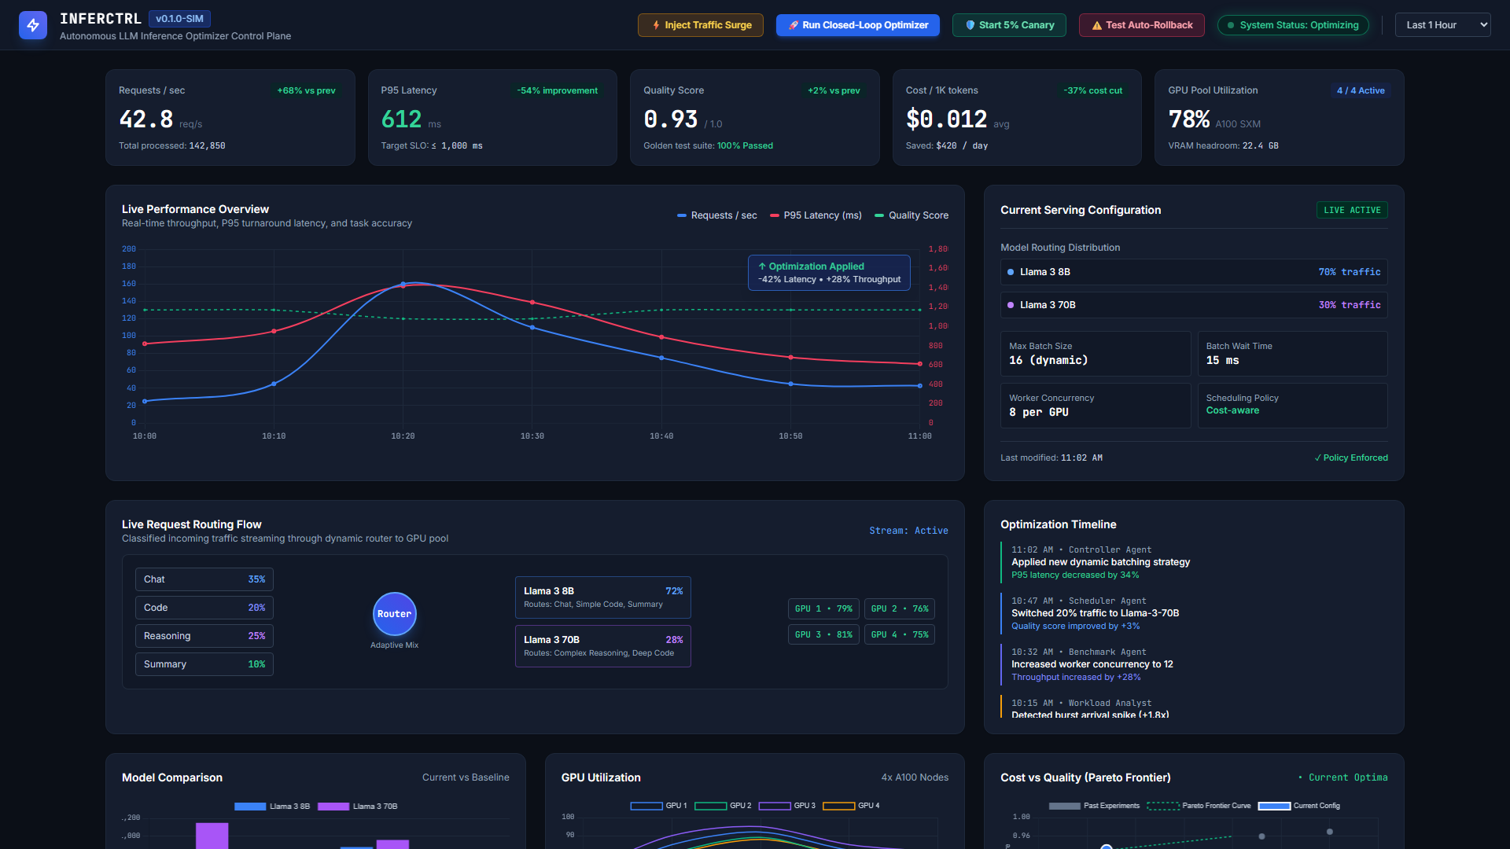
Live: Control Room Dashboard
http://localhost:8000 — real-time request metrics, routing decisions, experiment log
http://localhost:8000

Slide 12
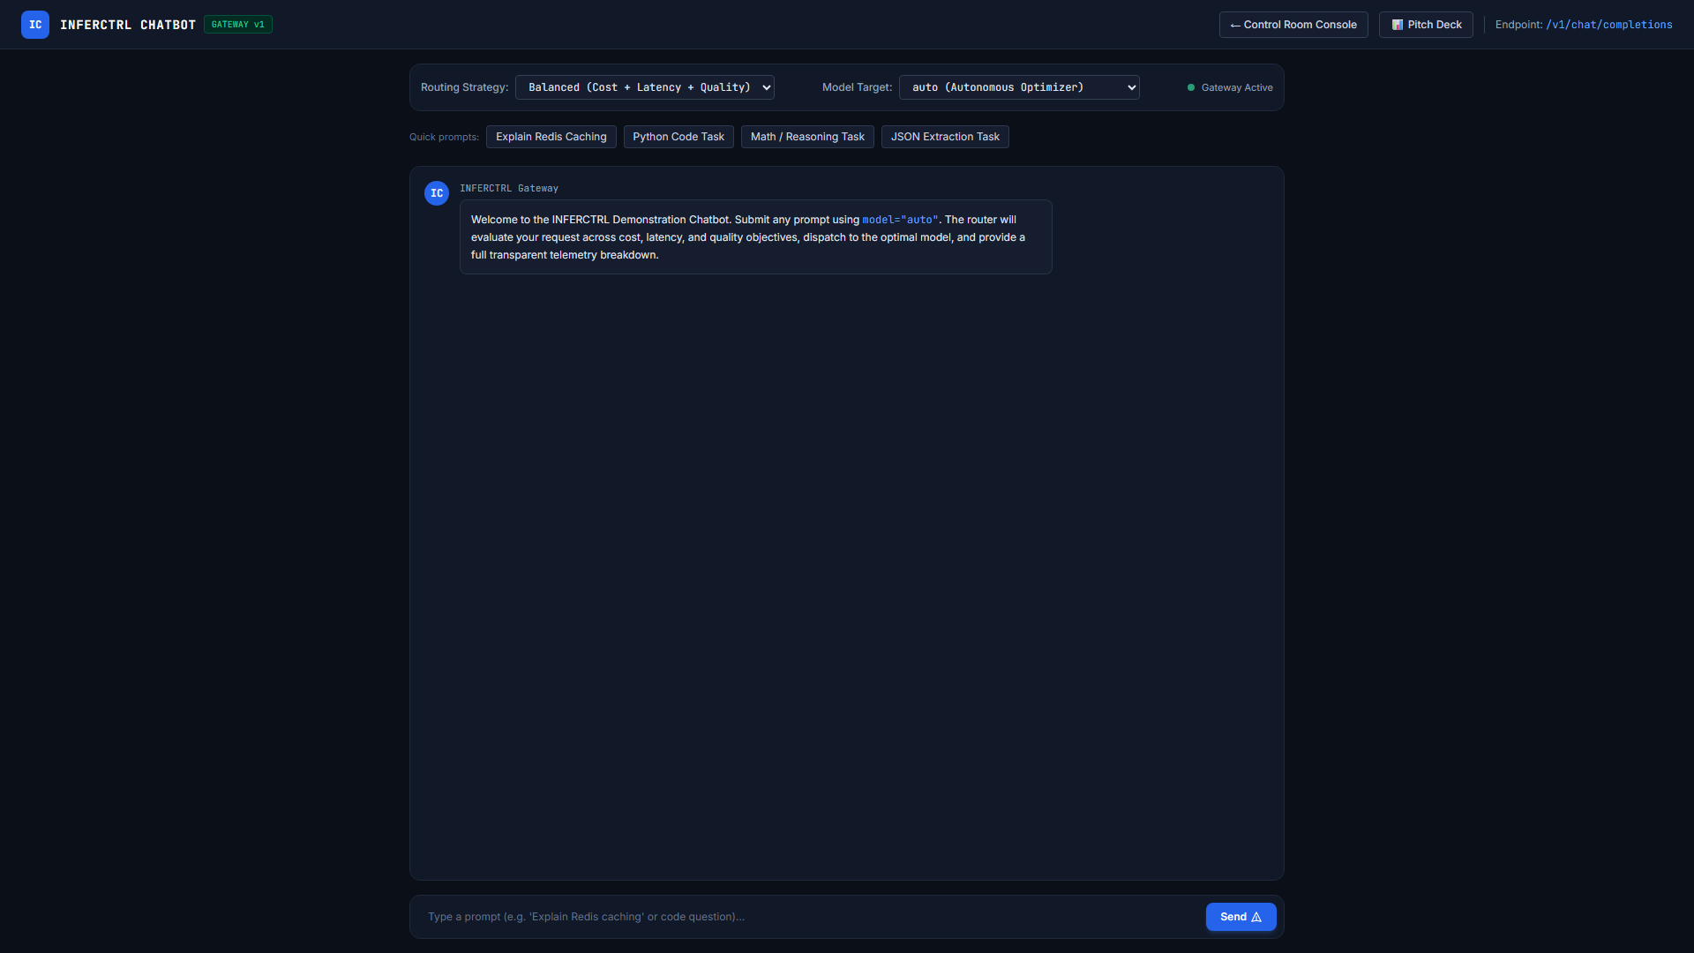
Live: Interactive Chatbot Demo
http://localhost:8000/chat — OpenAI-compatible gateway driving the chat UI in real-time
http://localhost:8000/chat

Slide 13
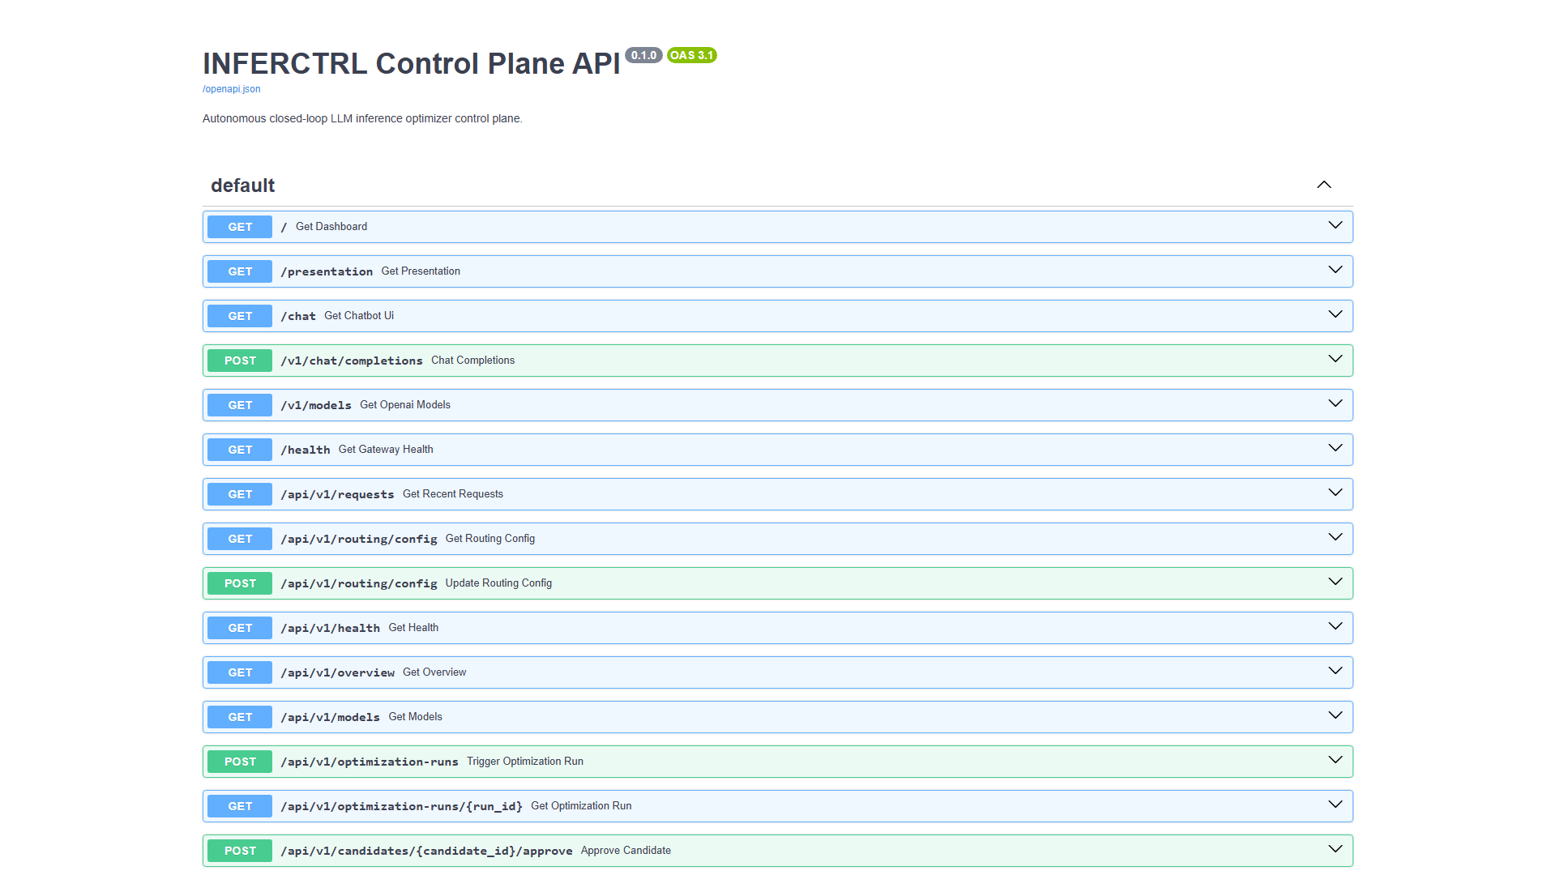
Live: FastAPI Auto-Generated REST API Docs
http://localhost:8000/docs — interactive Swagger UI showing all gateway endpoints
http://localhost:8000/docs

Slide 14
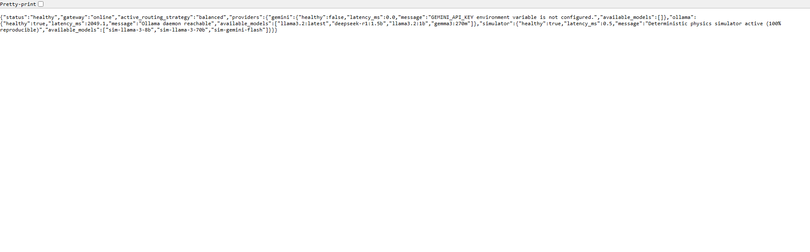
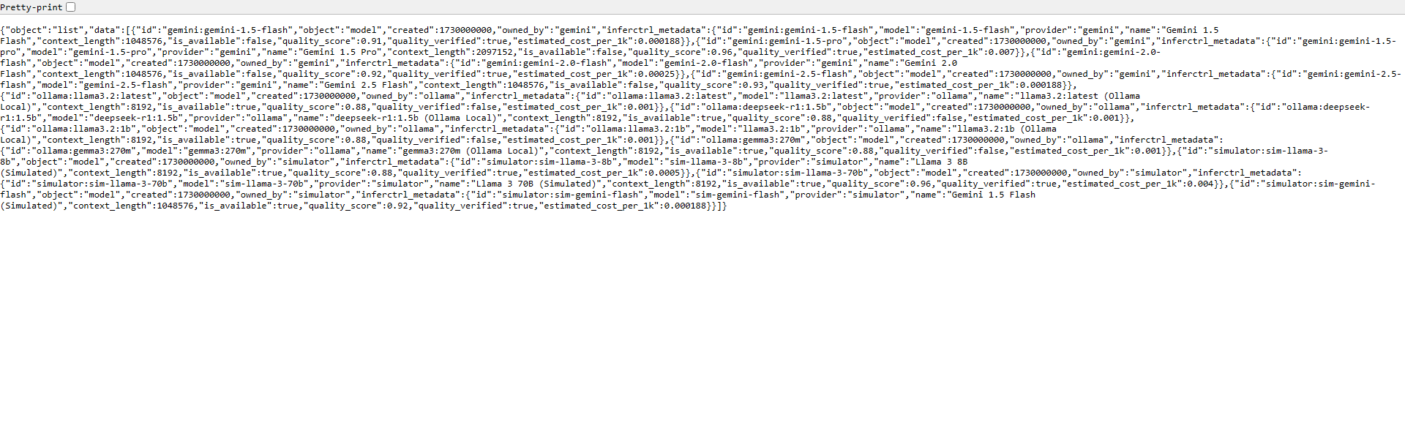
Live: Provider Health & Models API
Raw JSON responses from GET /health and GET /v1/models — providers auto-detected at startup
GET /health — provider availability status
GET /v1/models — registered models + metadata
Provider Auto-Detection:
On startup, INFERCTRL pings every configured backend.
Gemini Adapter:
Checks for GEMINI_API_KEY env var — marks ONLINE or UNAVAILABLE.
Ollama Adapter:
Connects to localhost:11434/api/tags — marks ONLINE or UNAVAILABLE.
Simulator:
Always ONLINE — fully deterministic, requires no external services.
Models Endpoint:
Returns all registered models with provider, capabilities, pricing.

Slide 15

In-Browser Pitch Deck
http://localhost:8000/presentation — zero-dependency HTML slide deck served by the same FastAPI app
http://localhost:8000/presentation

