Slide 1
Module-5

Slide 2
Quality management
Quality management is the act of overseeing different activities and tasks within an organization to ensure that products and services offered, as well as the means used to provide them, are consistent. It helps to achieve and maintain a desired level of quality within the organization.
Quality management consists of four key components, which include the following:
Quality Planning – The process of identifying the quality standards relevant to the project and deciding how to meet them.
Quality Improvement – The purposeful change of a process to improve the confidence or reliability of the outcome.
Quality Control – The continuing effort to uphold a process’s integrity and reliability in achieving an outcome.
Quality Assurance – The systematic or planned actions necessary to offer sufficient reliability so that a particular service or product will meet the specified requirements.

Slide 3
The aim of quality management is to ensure that all the organization’s stakeholders work together to improve the company’s processes, products, services, and culture to achieve the long-term success that stems from customer satisfaction.
The process of quality management involves a collection of guidelines that are developed by a team to ensure that the products and services that they produce are of the right standards or fit for a specified purpose.
The process starts when the organization sets quality targets to be met and which are agreed upon with the customer.
The organization then defines how the targets will be measured. It takes the actions that are required to measure quality.
It then identifies any quality issues that arise and initiates improvements.
The final step involves reporting the overall level of the quality achieved.

Slide 4
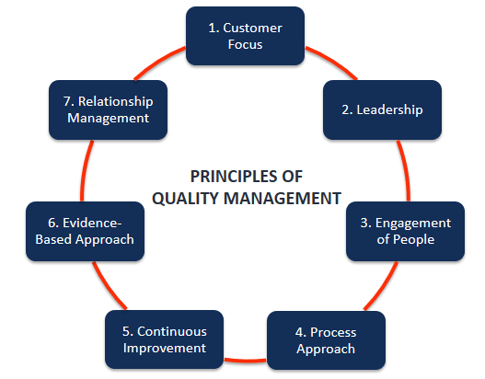
Principles of Quality Management

Slide 5
1. Customer Focus
The primary focus of any organization should be to meet and exceed the customers’ expectations and needs. When an organization can understand the customers’ current and future needs and cater to them, that results in customer loyalty, which in turn increases revenue.
2. Leadership
Leaders should involve the employees in setting clear organizational goals and objectives. This motivates employees, who may significantly improve their productivity and loyalty.
3. Engagement of People
Staff involvement is another fundamental principle. The management engages staff in creating and delivering value whether they are full-time, part-time, outsourced, or in-house.
An organization should encourage the employees to constantly improve their skills and maintain consistency.

Slide 6
4. Process Approach
The approach principle emphasizes achieving efficiency and effectiveness in the organizational processes.
The approach entails an understanding that good processes result in improved consistency, quicker activities, reduced costs, waste removal, and continuous improvement.
5. Continuous Improvement
Every organization should come up with an objective to be actively involved in continuous improvement.
Businesses that improve continually experience improved performance, organizational flexibility, and increased ability to embrace new opportunities.
Businesses should be able to create new processes continually and adapt to new market situations.

Slide 7
6. Evidence-based Decision Making
Businesses that make decisions based on verified and analyzed data have an improved understanding of the marketplace.
They are able to perform tasks that produce desired results and justify their past decisions.
Factual decision-making is vital to help understand the cause-and-effect relationships of different things and explain potential unintended results and consequences.
7. Relationship Management
Relationship management is about creating mutually beneficial relations with suppliers and retailers.
The organization should manage the supply chain process well and promote the relationship between the organization and its suppliers to optimize their impact on the company’s performance.

Slide 8
Benefits of Quality Management
It helps an organization achieve greater consistency in tasks and activities that are involved in the production of products and services.
It increases efficiency in processes, reduces wastage, and improves the use of time and other resources.
It helps improve customer satisfaction.
It enables businesses to market their business effectively and exploit new markets.
It makes it easier for businesses to integrate new employees, and thus helps businesses manage growth more seamlessly.
It enables a business to continuously improve its products, processes, and systems.

Slide 9
Risk management
Risk management is concerned with identifying risks and drawing up plans to minimize their effect on a project
A risk is some adverse circumstance that might occur
Categories of risks (based on what they affect primarily):
Project risks affect schedule or resources
Product risks affect the quality or performance of the software being developed
Business risks affect the organization developing or procuring the software

Slide 10
Examples of common project, product, and business risks
Risk | Affects | Description
Staff turnover | Project | Experienced staff will leave the project before it is finished.
Management change | Project | There will be a change of organizational management with different priorities.
Hardware unavailability | Project | Hardware that is essential for the project will not be delivered on schedule.
Requirements change | Project and product | There will be a larger number of changes to the requirements than anticipated.
Specification delays | Project and product | Specifications of essential interfaces are not available on schedule.
Size underestimate | Project and product | The size of the system has been underestimated.
CASE tool underperformance | Product | CASE tools, which support the project, do not perform as anticipated.
Technology change | Business | The underlying technology on which the system is built is superseded by new technology.
Product competition | Business | A competitive product is marketed before the system is completed.

Slide 11
The risk management process
Risk identification
Identify project, product and business risks
Risk analysis
Assess the likelihood and consequences of these risks
Risk planning
Draw up plans to avoid or minimize the effects of the risk
Risk monitoring
Monitor the risks throughout the project

Slide 12
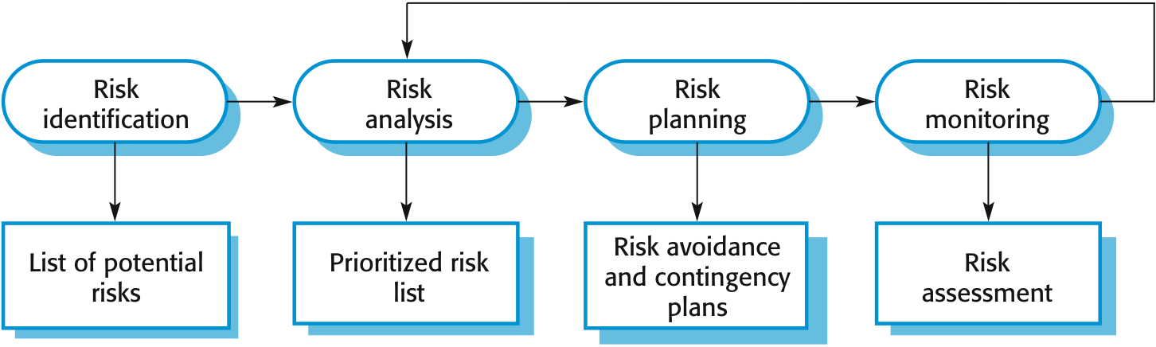
The risk management process

Slide 13
Risk identification
May be a team activities or based on the individual project manager’s experience.
A checklist of common risks may be used to identify risks in a project
Technology risks
People risks
Organizational risks
Tools risks
Requirements risks
Estimation risks

Slide 14
Examples of different risk types
Risk type | Possible risks
Technology | The database used in the system cannot process as many transactions per second as expected. (1) Reusable software components contain defects that mean they cannot be reused as planned. (2)
People | It is impossible to recruit staff with the skills required. (3) Key staff are ill and unavailable at critical times. (4) Required training for staff is not available. (5)
Organizational | The organization is restructured so that different management are responsible for the project. (6) Organizational financial problems force reductions in the project budget. (7)
Tools | The code generated by software code generation tools is inefficient. (8) Software tools cannot work together in an integrated way. (9)
Requirements | Changes to requirements that require major design rework are proposed. (10) Customers fail to understand the impact of requirements changes. (11)
Estimation | The time required to develop the software is underestimated. (12) The rate of defect repair is underestimated. (13) The size of the software is underestimated. (14)

Slide 15
Risk analysis
Assess probability and seriousness of each risk
Probability may be very low, low, moderate, high or very high
Risk consequences might be catastrophic, serious, tolerable or insignificant

Slide 16
Risk types and examples
Risk | Probability | Effects
Organizational financial problems force reductions in the project budget (7). | Low | Catastrophic
It is impossible to recruit staff with the skills required for the project (3). | High | Catastrophic
Key staff are ill at critical times in the project (4). | Moderate | Serious
Faults in reusable software components have to be repaired before these components are reused (2). | Moderate | Serious
Changes to requirements that require major design rework are proposed (10). | Moderate | Serious
The organization is restructured so that different management are responsible for the project (6). | High | Serious
The database used in the system cannot process as many transactions per second as expected (1). | Moderate | Serious

Slide 17
Risk types and examples
Risk | Probability | Effects
The time required to develop the software is underestimated (12). | High | Serious
Software tools cannot be integrated (9). | High | Tolerable
Customers fail to understand the impact of requirements changes (11). | Moderate | Tolerable
Required training for staff is not available (5). | Moderate | Tolerable
The rate of defect repair is underestimated (13). | Moderate | Tolerable
The size of the software is underestimated (14). | High | Tolerable
Code generated by code generation tools is inefficient (8). | Moderate | Insignificant

Slide 18
Risk planning
Consider each risk and develop a strategy to manage that risk
Avoidance strategies
The probability that the risk will arise is reduced
Minimization strategies
The impact of the risk on the project or product will be reduced
Contingency plans
If the risk arises, contingency plans are plans to deal with that risk

Slide 19
Strategies to help manage risk
Risk | Strategy
Organizational financial problems | Prepare a briefing document for senior management showing how the project is making a very important contribution to the goals of the business and presenting reasons why cuts to the project budget would not be cost-effective.
Recruitment problems | Alert customer to potential difficulties and the possibility of delays; investigate buying-in components.
Staff illness | Reorganize team so that there is more overlap of work and people therefore understand each other’s jobs.
Defective components | Replace potentially defective components with bought-in components of known reliability.
Requirements changes | Derive traceability information to assess requirements change impact; maximize information hiding in the design.

Slide 20
Strategies to help manage risk
Risk | Strategy
Organizational restructuring | Prepare a briefing document for senior management showing how the project is making a very important contribution to the goals of the business.
Database performance | Investigate the possibility of buying a higher-performance database.
Underestimated development time | Investigate buying-in components; investigate use of a program generator.

Slide 21
Risk monitoring
Assess each identified risks regularly to decide whether or not it is becoming less or more probable
Also assess whether the effects of the risk have changed
Each key risk should be discussed at management progress meetings

Slide 22
Risk indicators
Risk type | Potential indicators
Technology | Late delivery of hardware or support software; many reported technology problems.
People | Poor staff morale; poor relationships amongst team members; high staff turnover.
Organizational | Organizational gossip; lack of action by senior management.
Tools | Reluctance by team members to use tools; complaints about CASE tools; demands for higher-powered workstations.
Requirements | Many requirements change requests; customer complaints.
Estimation | Failure to meet agreed schedule; failure to clear reported defects.

Slide 24
Configuration Management
It is a process to systematically manage, organize, and control the changes in the documents, codes, and other entities during the Software Development Life Cycle.
The primary goal is to increase productivity with minimal mistakes. SCM is part of cross-disciplinary field of configuration management and it can accurately determine who made which revision.

Slide 25
Why do we need Configuration management?
There are multiple people working on software which is continually updating
It may be a case where multiple version, branches, authors are involved in a software config project, and the team is geographically distributed and works concurrently
Changes in user requirement, policy, budget, schedule need to be accommodated.
Software should able to run on various machines and Operating Systems
Helps to develop coordination among stakeholders
SCM process is also beneficial to control the costs involved in making changes to a system

Slide 26
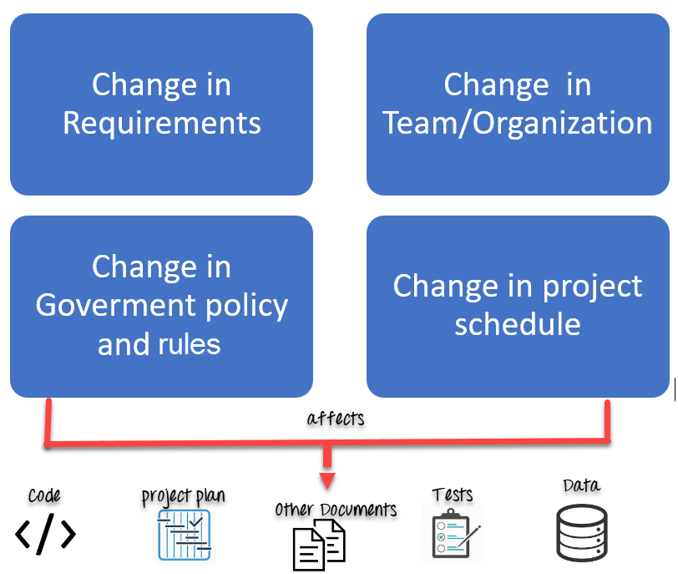
Any change in the software configuration Items will affect the final product. Therefore, changes to configuration items need to be controlled and managed.

Slide 27
Tasks in SCM process
Configuration Identification
Baselines
Change Control
Configuration Status Accounting
Configuration Audits and Reviews

Slide 28
Configuration Identification
Configuration identification is a method of determining the scope of the software system. With the help of this step, you can manage or control something even if you don’t know what it is. It is a description that contains the CSCI type (Computer Software Configuration Item), a project identifier and version information.
Activities during this process:
Identification of configuration Items like source code modules, test case, and requirements specification.
Identification of each CSCI in the SCM repository, by using an object-oriented approach
The process starts with basic objects which are grouped into aggregate objects. Details of what, why, when and by whom changes in the test are made
Every object has its own features that identify its name that is explicit to all other objects
List of resources required such as the document, the file, tools, etc.

Slide 29
Baseline:
A baseline is a formally accepted version of a software configuration item. It is designated and fixed at a specific time while conducting the SCM process. It can only be changed through formal change control procedures.
Activities during this process:
Facilitate construction of various versions of an application
Defining and determining mechanisms for managing various versions of these work products
The functional baseline corresponds to the reviewed system requirements
Widely used baselines include functional, developmental, and product baselines
In simple words, baseline means ready for release.

Slide 30
Change Control:
Change control is a procedural method which ensures quality and consistency when changes are made in the configuration object. In this step, the change request is submitted to software configuration manager.
Activities during this process:
Control ad-hoc change to build stable software development environment. Changes are committed to the repository
The request will be checked based on the technical merit, possible side effects and overall impact on other configuration objects.
It manages changes and making configuration items available during the software lifecycle

Slide 31
Configuration Status Accounting:
Configuration status accounting tracks each release during the SCM process. This stage involves tracking what each version has and the changes that lead to this version.
Activities during this process:
Keeps a record of all the changes made to the previous baseline to reach a new baseline
Identify all items to define the software configuration
Monitor status of change requests
Complete listing of all changes since the last baseline
Allows tracking of progress to next baseline
Allows to check previous releases/versions to be extracted for testing

Slide 32
Configuration Audits and Reviews:
Software Configuration audits verify that all the software product satisfies the baseline needs. It ensures that what is built is what is delivered.
Activities during this process:
Configuration auditing is conducted by auditors by checking that defined processes are being followed and ensuring that the SCM goals are satisfied.
To verify compliance with configuration control standards. auditing and reporting the changes made
SCM audits also ensure that traceability is maintained during the process.
Ensures that changes made to a baseline comply with the configuration status reports
Validation of completeness and consistency

Slide 33
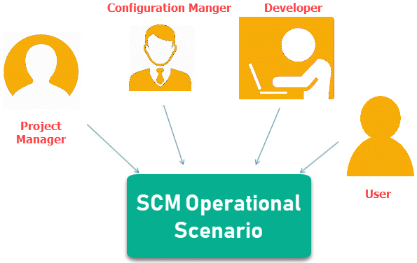
Participant of SCM process:
1.Configuration Manager
Configuration Manager is the head who is Responsible for identifying configuration items.
CM ensures team follows the SCM process
He/She needs to approve or reject change requests
2. Developer
The developer needs to change the code as per standard development activities or change requests. He is responsible for maintaining configuration of code.
The developer should check the changes and resolves conflicts

Slide 34
3. Auditor
The auditor is responsible for SCM audits and reviews.
Need to ensure the consistency and completeness of release.
4. Project Manager:
Ensure that the product is developed within a certain time frame
Monitors the progress of development and recognizes issues in the SCM process
Generate reports about the status of the software system
Make sure that processes and policies are followed for creating, changing, and testing
5. User
The end user should understand the key SCM terms to ensure he has the latest version of the software

Slide 35
Software Configuration Management Plan
The SCMP (Software Configuration management planning) process planning begins at the early coding phases of a project. The outcome of the planning phase is the SCM plan which might be stretched or revised during the project.
The SCMP can follow a public standard like the IEEE 828 or organization specific standard
It defines the types of documents to be management and a document naming. Example Test_v1
SCMP defines the person who will be responsible for the entire SCM process and creation of baselines.
Fix policies for version management & change control
Define tools which can be used during the SCM process
Configuration management database for recording configuration information.

Slide 36
Software Configuration Management Tools
Concurrency Management:
When two or more tasks are happening at the same time, it is known as concurrent operation. Concurrency in context to SCM means that the same file being edited by multiple persons at the same time.
If concurrency is not managed correctly with SCM tools, then it may create many pressing issues.
Version Control:
SCM uses archiving method or saves every change made to file. With the help of archiving or save feature, it is possible to roll back to the previous version in case of issues.
Synchronization:
Users can checkout more than one files or an entire copy of the repository. The user then works on the needed file and checks in the changes back to the repository. They can synchronize their local copy to stay updated with the changes made by other team members.

Slide 37
1. Git: Git is a free and open source tool which helps version control. It is designed to handle all types of projects with speed and efficiency.
Download link: https://git-scm.com/
2. Team Foundation Server: Team Foundation is a group of tools and technologies that enable the team to collaborate and coordinate for building a product.
Download link: https://azure.microsoft.com/en-us/services/devops/server/
3. Ansible: It is an open source Software configuration management tool. Apart from configuration management it also offers application deployment & task automation.
Download link: https://www.ansible.com/

Slide 38
Summary:
Configuration Management best practices helps organizations to systematically manage, organize, and control the changes in the documents, codes, and other entities during the Software Development Life Cycle.
The primary goal of the SCM process is to increase productivity with minimal mistakes
The main reason behind configuration management process is that there are multiple people working on software which is continually updating. SCM helps establish concurrency, synchronization, and version control.
A baseline is a formally accepted version of a software configuration item
Change control is a procedural method which ensures quality and consistency when changes are made in the configuration object.
Configuration status accounting tracks each release during the SCM process
Software Configuration audits verify that all the software product satisfies the baseline needs
Project manager, Configuration manager, Developer, Auditor, and user are participants in SCM process
The SCM process planning begins at the early phases of a project.
Git, Team foundation Sever and Ansible are few popular SCM tools.

