Slide 1

Design and Development of a Railway Support Chatbot
Leveraging IBM Watsonx for Intelligent Passenger Assistance

Slide 2

Need for AI in Railways
24/7 Operations
High Volume
Railways operate continuously with passengers requiring assistance at any time
Thousands of inquiries daily overwhelm traditional customer service channels
Language Diversity
Instant Response
Support needed across multiple languages and dialects for diverse passenger base
Real-time information on schedules, delays, and platform changes is critical

Slide 3

Problem Statement
Service Bottlenecks
Limited staff capacity creates long wait times during peak hours and delays
Information Gaps
Passengers lack real-time access to accurate train status and platform information
Inconsistent Answers
Different agents provide varying responses leading to confusion and frustration
Scalability Issues
Traditional systems cannot scale efficiently to meet growing passenger demands

Slide 4
Proposed AI Solution
01
02
Intelligent Chatbot Platform
Multi-Channel Access
IBM Watsonx-powered conversational AI for natural language understanding
Deploy across web, mobile apps, kiosks, and messaging platforms
03
04
Real-Time Integration
Learning System
Connect to railway systems for live schedule, delay, and platform data
Continuous improvement through passenger interactions and feedback

Slide 5
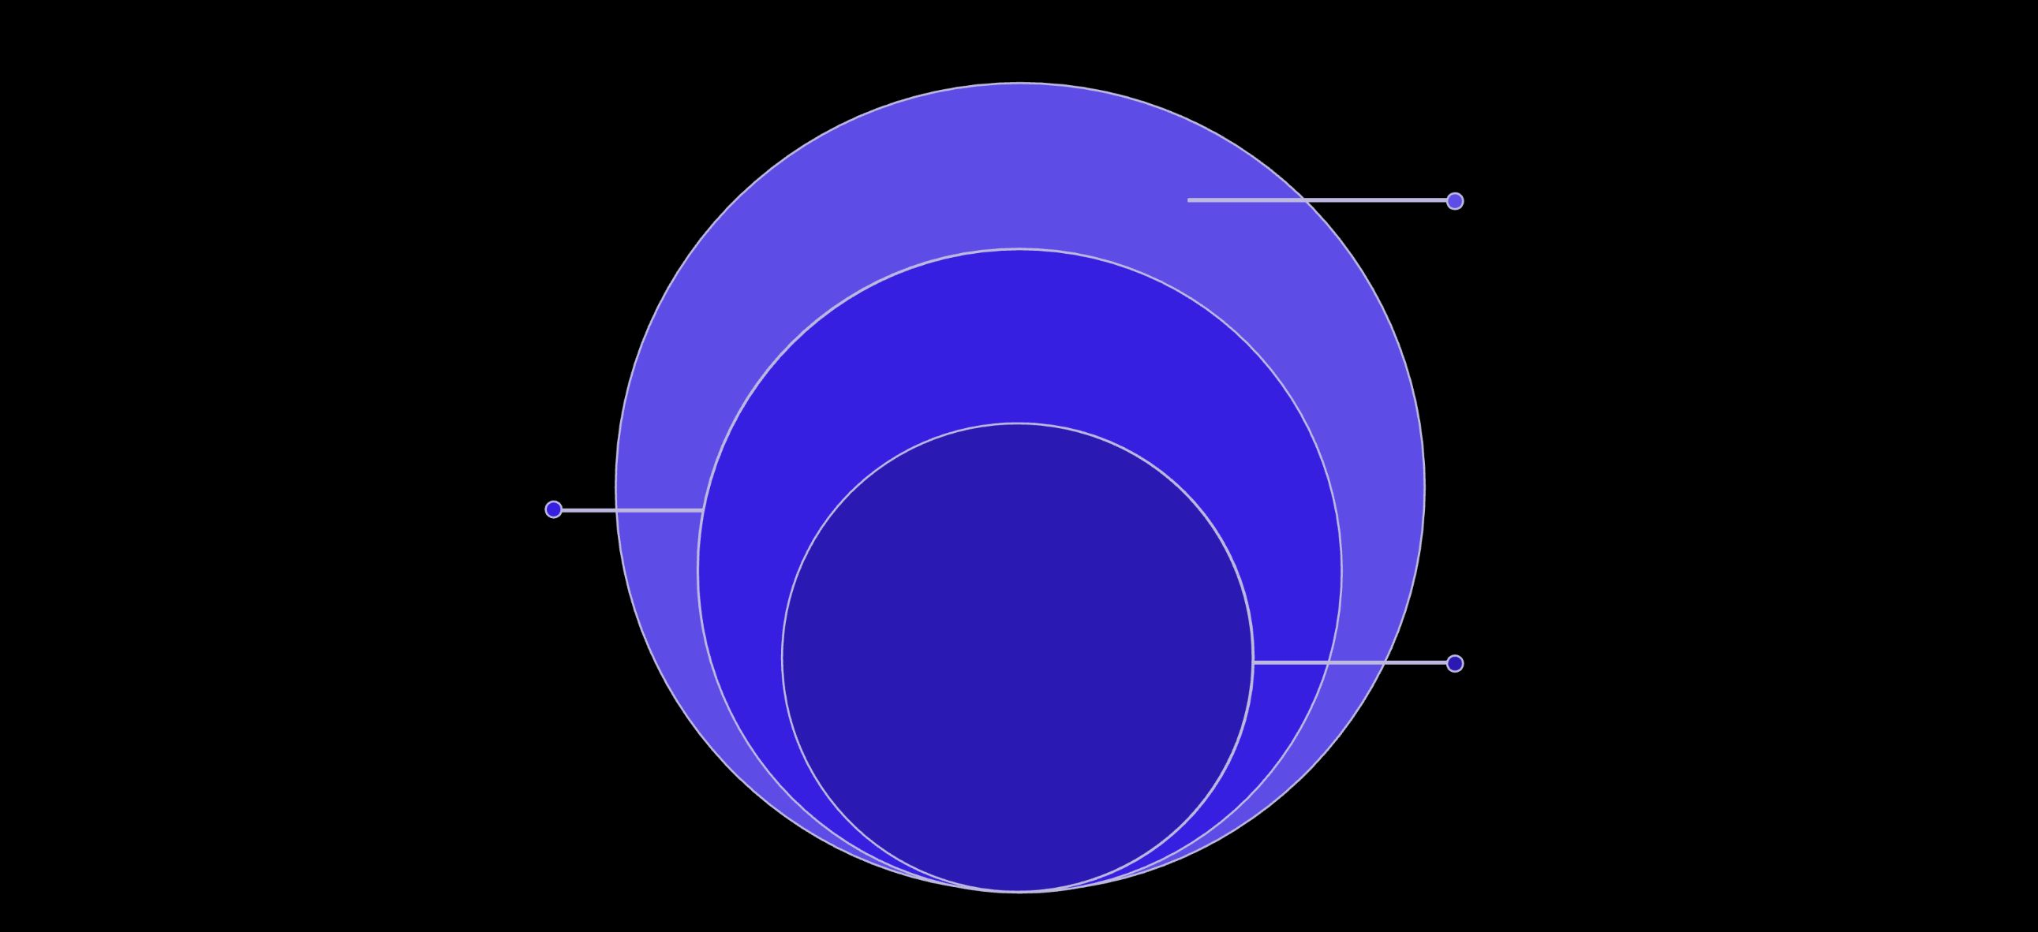
System Overview
Railway Data Systems
Real-time databases for trains and delays
Watsonx AI Engine
NLP core for intent, context, and routing
Chatbot Interface
User-facing chat for schedules and updates

Slide 6
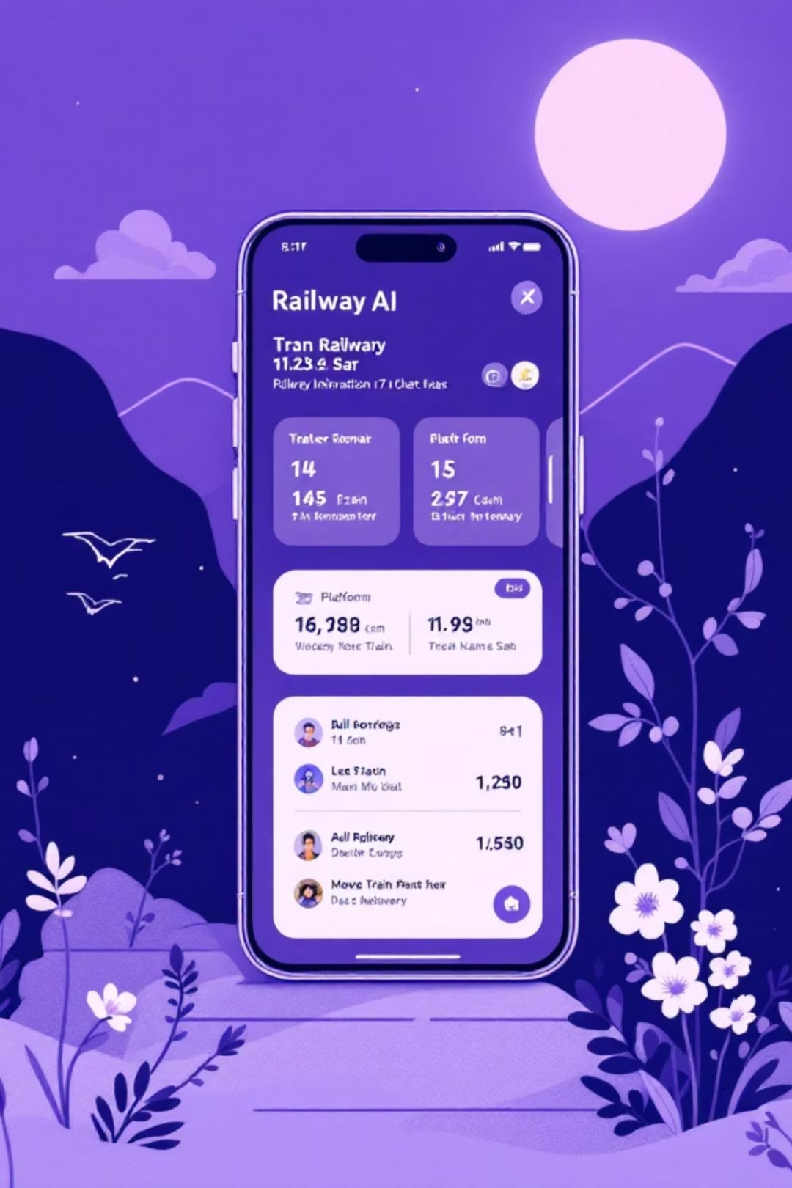
Core Capabilities
Natural Language Processing
Understands passenger queries in conversational language and multiple dialects
Context-Aware Responses
Maintains conversation context across multiple interactions for coherent dialogue
Real-Time Data Access
Retrieves live train status, platform assignments, and delay information instantly
Multi-Turn Conversations
Handles complex queries requiring multiple exchanges and follow-up questions

Slide 7
Technologies Used
IBM Watsonx
REST APIs
AI and machine learning platform for natural language understanding and generation
Integration layer connecting chatbot to railway scheduling and ticketing systems
Data Infrastructure
Cloud Platform
Real-time databases storing train schedules, delays, and passenger information
Scalable cloud infrastructure ensuring high availability and performance during peak loads

Slide 8





Development Process
Requirements Analysis
Identified use cases and passenger needs
System Design
Architectured data flows and integrations
Implementation
Built NLP models and API connections
Testing
Validated accuracy and response times
Deployment
Launched across channels

Slide 9
Benefits and Impact
85%
24/7
60%
3X
Query Resolution
Availability
Cost Reduction
Scalability
Automated handling of routine passenger inquiries without human intervention
Continuous support across all operating hours and time zones
Lower operational costs compared to traditional call center operations
Handles triple the passenger volume during peak periods without additional resources

Slide 10

Future Scope
Voice-Enabled Interface
Voice assistants for hands-free operation at stations and on trains
Predictive Assistance
Proactive notifications about delays, gate changes, and alternative routes
Personalized Services
Learning passenger preferences for customized travel recommendations
Expanded Languages
Additional language support for international travelers and tourists

