Slide 1
GROUP 1 BATCH B1
Team members:
Tushar Kant
Kurai Saksham Vinod
Siddharth Kumar Bhagat
Kalkar Tejas Prasad
Ayush Gupta
Chirag Saxena
Maulik Dave
Remote Operated Self-Folding Study Table
Introducing the innovative Remote Operated Self-Folding Study Table, a revolutionary space-saving solution that seamlessly integrates into any modern home or office. Crafted from beautiful maple wood, this wall-mounted design offers a stylish and eco-friendly alternative to traditional fixed furniture, providing a practical workspace that can be easily tucked away when not in use. It also has ventilation holes enhance airflow, preventing laptop overheating

Slide 2




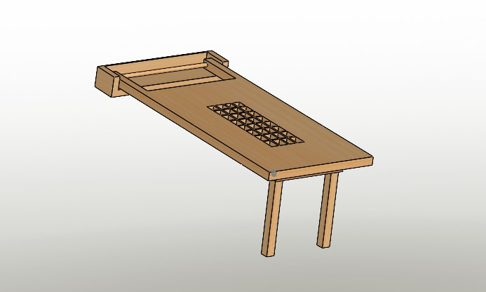
Wall-Mounted Design
Space-Saving
The wall-mounted design of the study table maximizes floor space, making it an ideal solution for small or cramped rooms where traditional furniture may not fit.
Maple Wood Construction
Convenient Access
Durability
With the touch of a button, the table can be easily deployed, providing a functional work surface when needed, and then seamlessly folded away when not in use.
The maple wood construction ensures the table's longevity, withstanding the wear and tear of everyday use while maintaining its elegant appearance
.
Versatile Placement
The versatile wall-mounted design allows the table to be installed in a variety of locations, from bedrooms and home offices to shared living spaces, making it a versatile solution for any room.
Natural Beauty
Maple wood's distinctive grain pattern and warm, natural tones add a touch of organic elegance to any workspace, seamlessly blending with a variety of interior styles.
Eco-Friendly
As a renewable and biodegradable resource, the use of wood in this design aligns with the table's environmentally conscious approach, promoting sustainability.

Slide 3


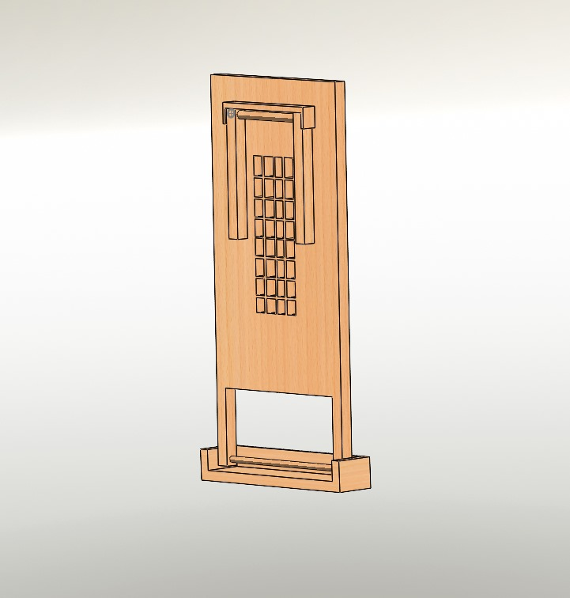
Space-Saving Solution
Clutter-Free Living
Multifunctional Design
Compact Footprint
By tucking the table away when not in use, you can maintain a clean, uncluttered aesthetic in your living environment, promoting a sense of balance and tranquility.
The self-folding mechanism allows the table to seamlessly transition between a functional work surface and a discreet, space-saving wall decoration, adapting to your needs.
When folded, the study table takes up minimal wall space, making it an ideal choice for small living spaces where every square inch counts.
Remote Control
Automated Folding
The study table's innovative folding mechanism can be seamlessly operated with the included remote control, allowing for effortless deployment and storage with the touch of a button.
The table's motorized folding system enables a smooth and efficient transformation, ensuring a hassle-free experience when transitioning between its open and closed positions.

Slide 4
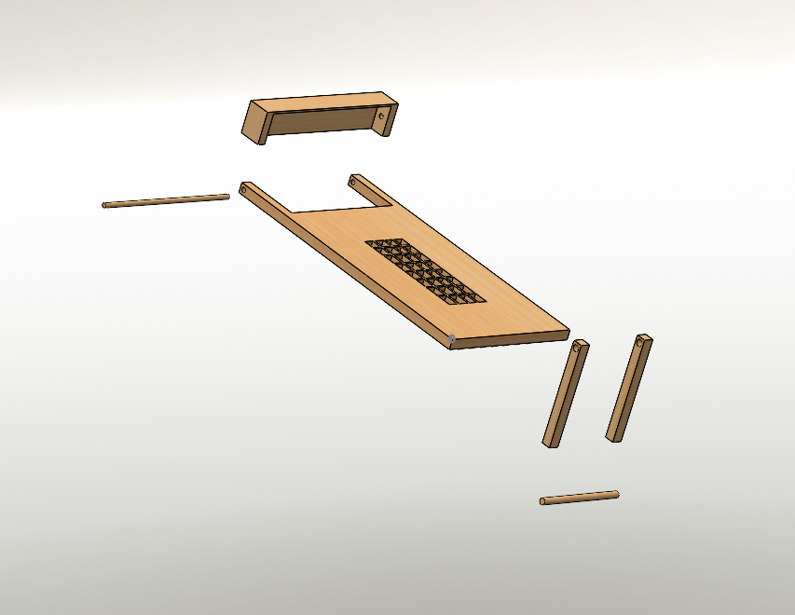

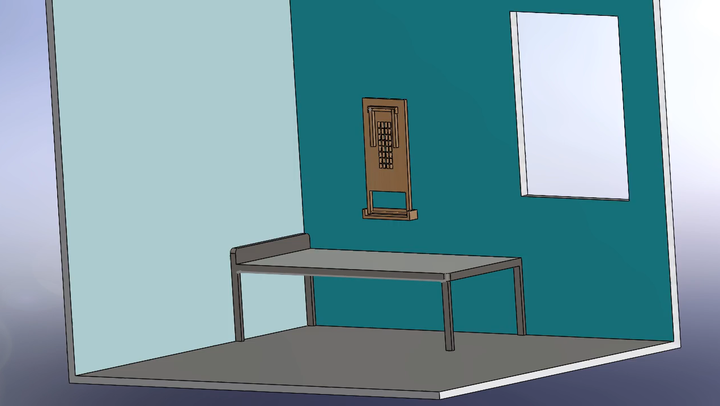
FINAL PRODUCT
CAD model made using solidworks
Wall Mount
Cooling Outlet
Table Base
Stand
Rotating Rod

Slide 5
Contribution :
Kurai Saksham Vinod : Cad model designing
Ayush Gupta : Material Selection
Siddharth Kumar Bhagat : Ideology (product convenience)
Chirag Saxena : Ideology (product uses )
Tushar Kant : Motor Selection
Kalkar Tejas Prasad : ppt making
Maulik Dave : ppt video making

