Slide 1
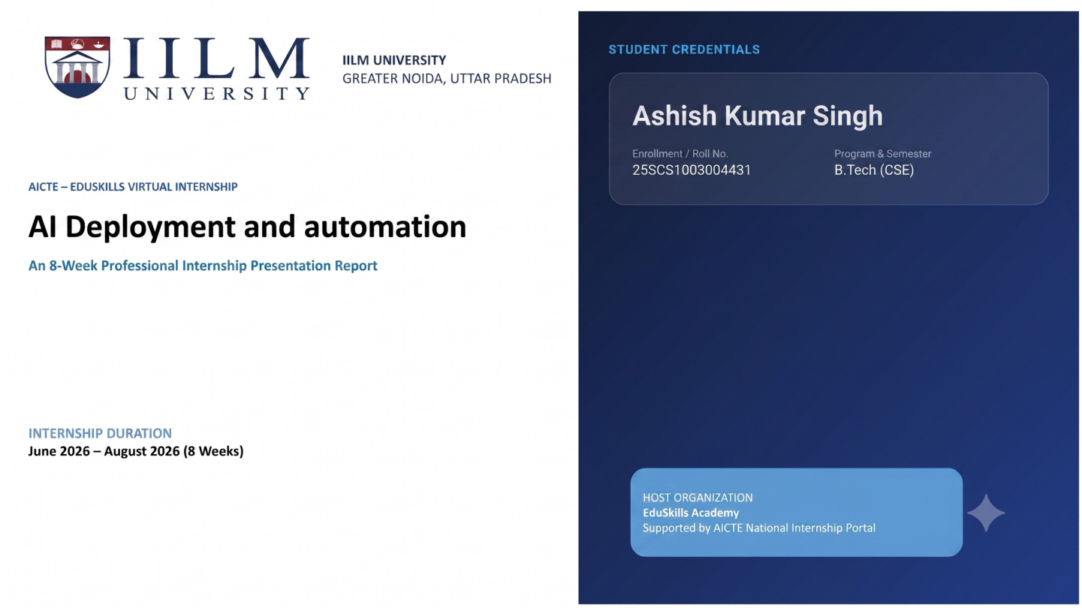
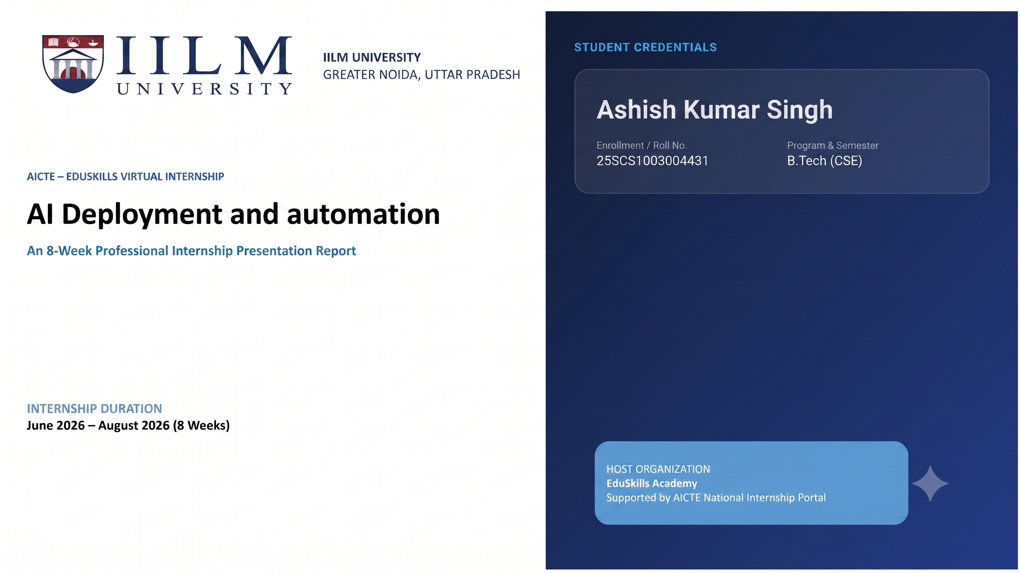
AICTE – EDUSKILLS VIRTUAL INTERNSHIP
Ethical Hacking
STUDENT CREDENTIALS
Saksham Singh
An 8-Week Professional Internship Presentation Report
Enrollment / Roll No.
Program & Semester
2410030795
B.Tech (CSE)
INTERNSHIP DURATION
April 2026 – June 2026 (8 Weeks)
HOST ORGANIZATION
EduSkills Academy
Supported by AICTE National Internship Portal

Slide 2


Candidate & Program Overview
Candidate Details
Internship Profile
SAKSHAM SINGH
Program Name: AICTE – EduSkills Virtual Internship
2410030795
Ethical Hacking
Degree: B.Tech (Computer Science & Engineering)
April 2026 – June 2026
Academic Batch: 2026-2027
2026-5338B2C69D
University: IILM University, Greater Noida, U.P.
C16Y2026M081399492

Slide 3


Organization Profile: EduSkills Academy
EduSkills Academy delivered the 8-week AICTE–EduSkills Virtual Internship in Ethical Hacking.
AICTE Association: The internship offer states that the program is under the patronage of the AICTE National Internship Portal.
Program Structure: The internship combined structured learning, weekly assessments, practical exposure, assignments and a final assessment.
Internship Domain: Ethical Hacking, with practical coverage of cybersecurity and security-testing fundamentals.

Slide 4

Problem Statement & Industry Context
The Learning Need
The Internship Scope
Cybersecurity learning benefits from practical exposure to threats, security practices and controlled security-testing activities.
The eight-week program covered ethical hacking, security fundamentals, social engineering, malware, networking, Kali Linux, web application vulnerability assessment and penetration testing.
The final stage included a capstone project and reporting of security-testing findings in a controlled, authorized context.
The internship provided a structured path from security fundamentals to Kali Linux, vulnerability assessment and penetration testing.

Slide 5








Core Project Objectives
Ethical Hacking Foundations
Security Fundamentals
Web Security Testing
Practical Security Skills
Develop familiarity with Kali Linux, networking, social engineering and malware-related security concepts.
Understand the purpose, legality, tools and techniques of ethical hacking.
Understand cybersecurity principles, common threat types and protection practices.
Learn basic web application vulnerability assessment and penetration-testing concepts.

Slide 6





Technologies & MLOps Toolchain
Security Environment
Networking
Web Application Security
Security Awareness
Kali Linux: security-testing environment and tools.
Networking: protocols, IP addressing and basic device concepts.
Vulnerability Assessment: identify and understand basic web application weaknesses.
Social Engineering: phishing, impersonation and human security risks.
Penetration Testing: controlled validation and reporting of vulnerabilities.
Malware: types, behaviour, impact and mitigation concepts.
Ethical Hacking: authorized security-testing concepts.
Network Security: foundations of secure communication.

Slide 7
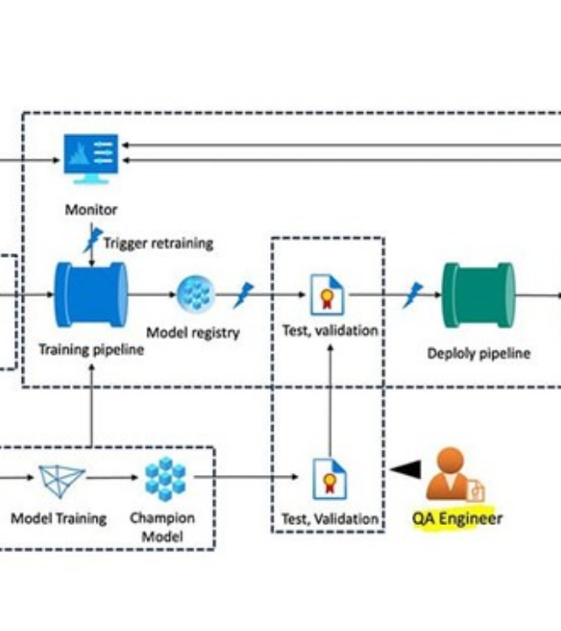
Ethical Hacking Learning Architecture
Security Fundamentals: Understand threats, risks and protection practices.
Reconnaissance / Understanding: Learn the target, services and attack surface in an authorized lab.
Vulnerability Assessment: Identify potential weaknesses in a controlled web application.
Penetration Testing: Validate selected vulnerabilities using ethical and authorized techniques.
Reporting & Mitigation: Document findings and recommend protective measures.

Slide 8




Curriculum Timeline (Weeks 1 to 4)
Week 2
Week 4
Fundamentals of Security Cybersecurity principles, threat types and protection practices for systems and data.
Malware and Their Types Learn different malware types and how to identify, analyze and mitigate their effects.
Week 1
Week 3
Introduction to Ethical Hacking Purpose, legality, tools and techniques of ethical hacking.
Social Engineering Identify and prevent social engineering attacks like phishing and impersonation.

Slide 9
Curriculum Timeline (Weeks 5 to 8)
Week 6
Week 8
Introduction to Kali Linux Learn Kali Linux basics, navigation and tools for ethical hacking and penetration testing.
Penetration Testing (Using Kali Linux) Perform hands-on penetration testing using Kali Linux tools and report vulnerabilities.
Week 5
Week 7
Networking Essentials Understand networks, protocols, IP addressing and basic device configurations.
Basic Web Application with Capstone Projects Build simple web apps and assess vulnerabilities through practical projects.

Slide 10
Key Projects & Demonstrated Skills
Ethical Hacking Fundamentals: Understood the purpose, legality, tools and techniques of ethical hacking.
Security Fundamentals: Studied cybersecurity principles, threat types and protection practices.
Social Engineering & Malware: Learned phishing, impersonation, malware types, behaviour, impact and mitigation.
Kali Linux & Networking: Developed foundational knowledge of Kali Linux, networking, protocols and IP addressing.
Web Security Testing: Gained exposure to vulnerability assessment, basic web application penetration testing and the capstone project.

Slide 11

Certification & Official Verification
Verification Metric | Official Record / Credential Details
Internship Title | AICTE – EduSkills Virtual Internship — Ethical Hacking
Issuing Organization | EduSkills Academy
Academic Patronage | AICTE National Internship Portal & EduSkills
Certificate ID | 2026-5338B2C69D (Issued: Jul 14, 2026)
Offer Letter Ref | C16Y2026M081399492
Internship Duration | 8 Weeks (April 2026 – June 2026)

Slide 12
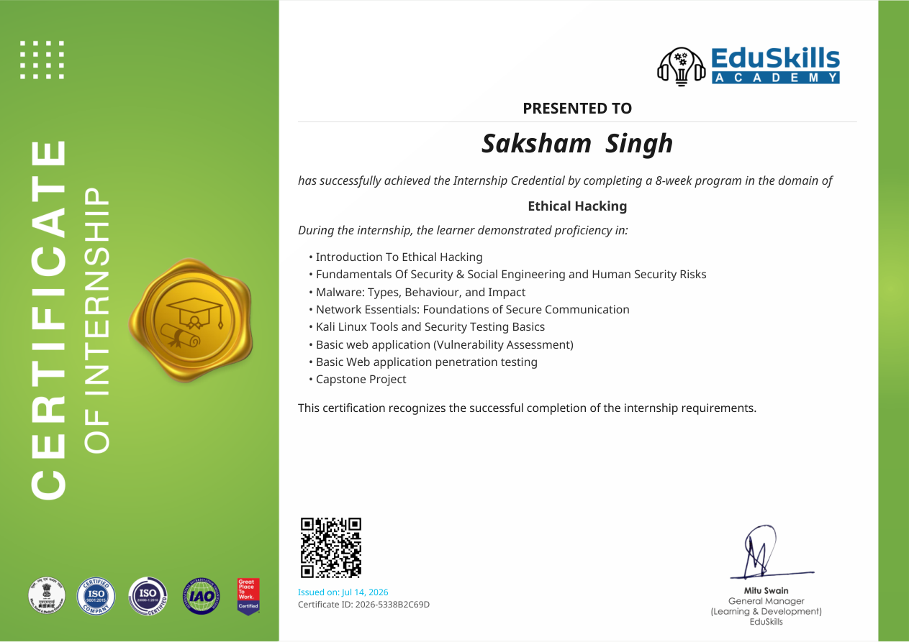
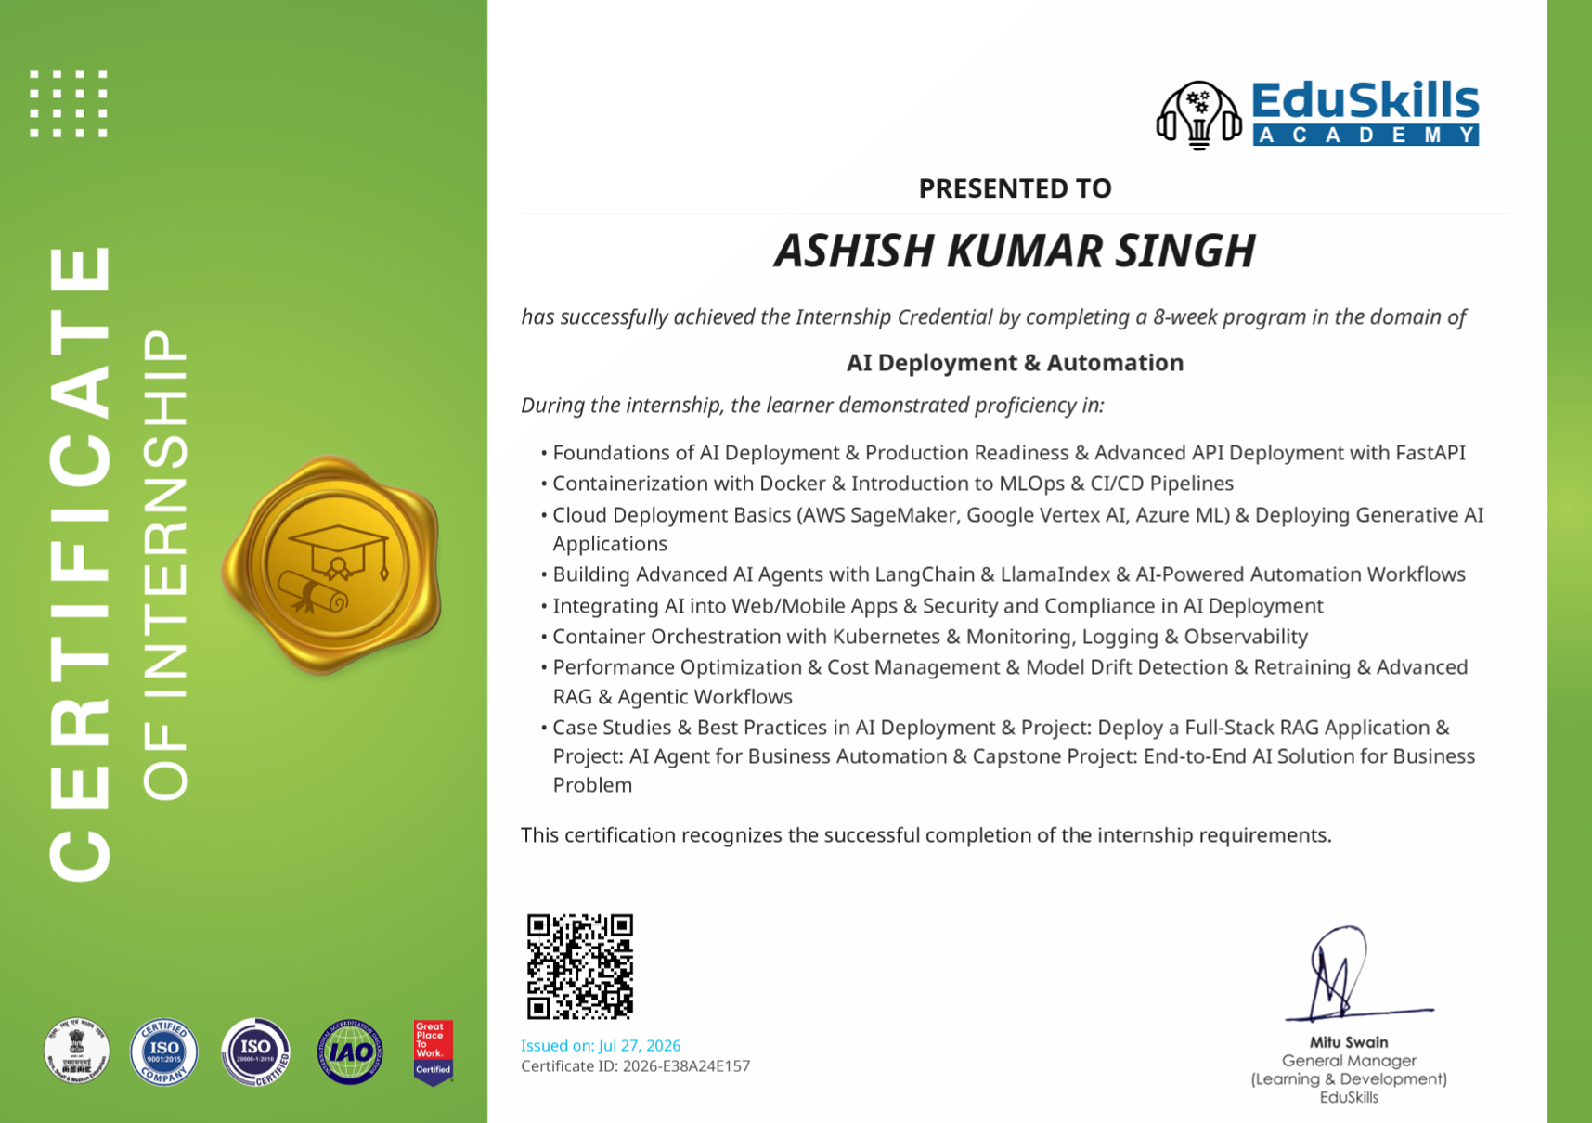
Certification & Official Verification
12

Slide 13

Thank You!
Saksham Singh
School of Computer Science & Engineering
2410030795
IILM University, Greater Noida, U.P.

