Slide 1

Vehicle Rental Management System
A Java & MySQL Based Desktop Application for Automated Fleet Booking and Billing
Presented By: Saksham Dogra
Apurv Kumar
Anirudh Sharma
Guided by: Dr Amit Kumar

Slide 2




OVERVIEW
Introduction
Vehicle rental businesses — local car & bike rentals, driving schools, campus rental counters — depend on smooth day-to-day tracking of vehicles, customers and payments. This project builds a Java desktop application, backed by a MySQL database, that digitizes the complete rental lifecycle from customer registration to final billing.
6
Core Modules
Two user roles
Dedicated Admin and Customer login with role-based access
4
Java OOP Pillars Used
End-to-end workflow
Registration → Booking → Billing → Reporting, all in one system
100%
Digitized Rental Flow
Strong Java foundation
Demonstrates OOP, JDBC, Collections, Exceptions and GUI design
Vehicle Rental Management System
2

Slide 3





THE CHALLENGE
Problem Statement
Double-bookings
No real-time availability
Paper registers and spreadsheets can't prevent the same vehicle being booked twice.
Staff have no quick way to check which vehicles are free right now.
Manual, error-prone billing
No centralized history
Rental charges and late-return fees are calculated by hand, causing mistakes and delays.
Customer and rental records are scattered, making lookups slow and unreliable.
Costly commercial software
Enterprise fleet-management platforms are subscription-based and overkill for a single small outlet.
Vehicle Rental Management System
3

Slide 4



GOALS OF THE PROJECT
Objectives
Build secure Admin & Customer login with role-based access
Manage the vehicle fleet with live availability status
Register customers and maintain complete rental history
Automate booking with real-time rental cost calculation
Auto-generate bills, including late-return charges
Provide instant reports on availability, rentals & revenue
Vehicle Rental Management System
4

Slide 5

WHERE THIS FITS
Literature Review
Manual Registers / Excel
Commercial Fleet SaaS
Proposed System (This Project)
Low upfront cost
Feature-rich, cloud based
One-time, affordable desktop app
No availability tracking
Recurring subscription cost
Works fully offline (local MySQL)
High risk of human error
Built for large multi-branch fleets
Tailored to a single rental branch
No structured reporting
Overkill for a single small outlet
Automatic billing & instant reports
Vehicle Rental Management System
5

Slide 6
HOW WE'LL BUILD IT
Proposed Methodology
1
Step 1
Requirement Analysis & Database Design (ER diagram, schema)
2
Step 2
Login & Vehicle Management module (add/update/delete, availability)
3
Step 3
Customer Management module (registration, rental history)
4
Step 4
Booking module (select vehicle & dates, auto cost calculation)
5
Step 5
Billing module (auto bill generation incl. late-return charges)
6
Step 6
Reports module, integration testing & final documentation
Vehicle Rental Management System
6

Slide 7





THE STACK
Tools & Technologies Used
Java (Core)
Java Swing
MySQL
Application logic, OOP design
Desktop GUI for all modules
Relational database backend
JDBC
Eclipse / NetBeans
Git & GitHub
Java-to-MySQL connectivity
IDE for development & debugging
Version control & collaboration
Vehicle Rental Management System
7

Slide 8
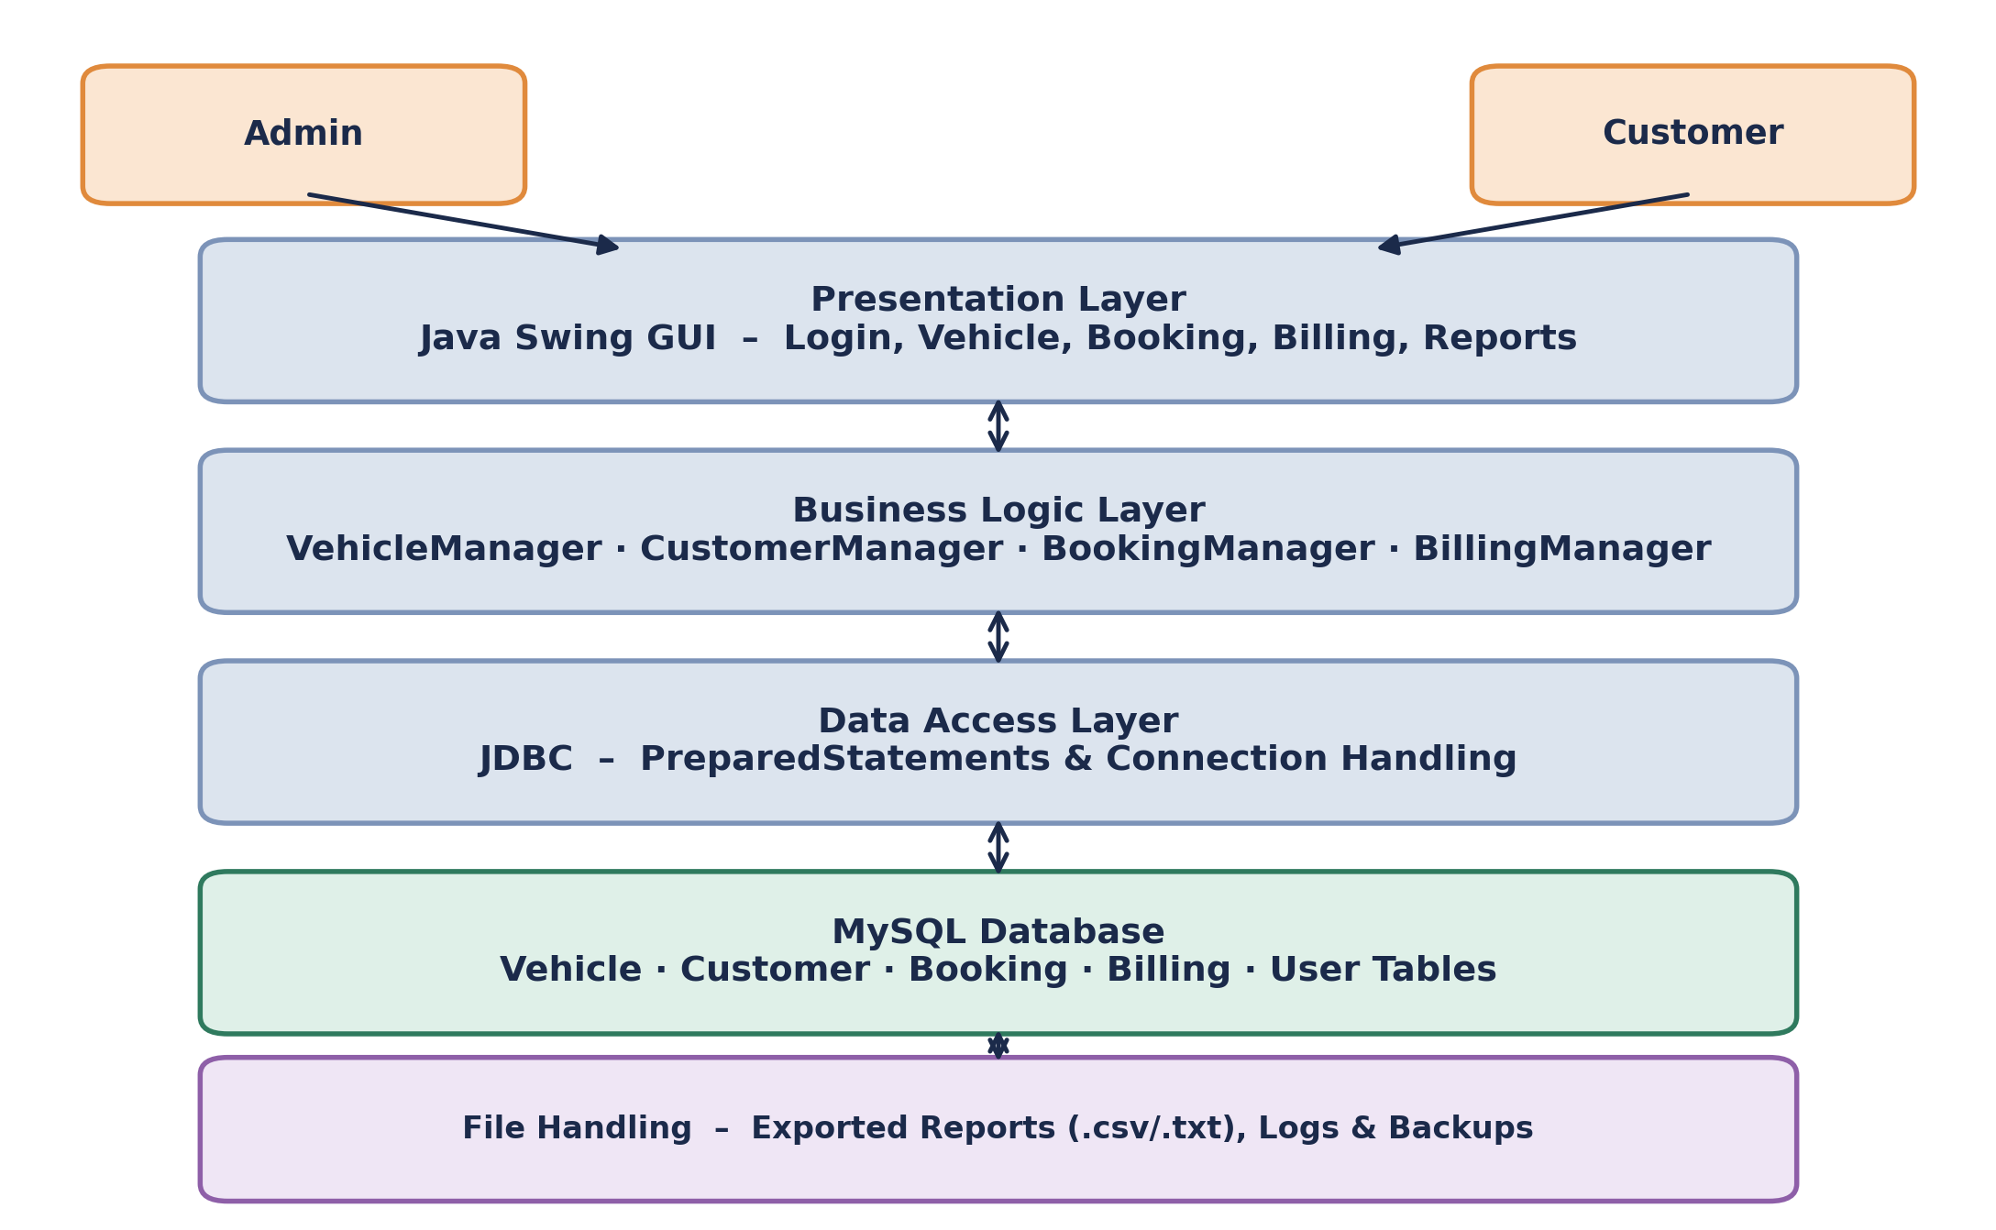
UNDER THE HOOD
System Architecture
Layered design
Presentation, Business Logic and Data Access are kept separate for clean, maintainable code.
JDBC bridge
PreparedStatements connect the Business Logic layer to MySQL securely.
File support
Reports and logs are additionally exported outside the database.
Vehicle Rental Management System
8

Slide 9

WHAT WE'LL DELIVER
Expected Outcomes
A fully working desktop app covering all 6 modules end to end
A centralized MySQL database replacing manual registers
Accurate, automatic bill generation, including late fees
Real-time reports: availability, active & completed rentals, revenue
Practical demonstration of OOP, JDBC, Collections, Exceptions, File I/O & GUI
Vehicle Rental Management System
9

Slide 10





LOOKING AHEAD
Future Scope
Android companion app for customers
Online payment gateway integration
Multi-branch support with a centralized cloud database
GPS-based live vehicle tracking
SMS / email reminders for bookings & due dates
Migration to a web app (Spring Boot + REST APIs)
Vehicle Rental Management System
10

Slide 11
SOURCES
References
Oracle Java Documentation – docs.oracle.com/en/java/
MySQL 8.0 Reference Manual – dev.mysql.com/doc/
Java JDBC API Documentation – docs.oracle.com/javase/tutorial/jdbc/
Java Swing Tutorial (Oracle) – docs.oracle.com/javase/tutorial/uiswing/
GeeksforGeeks – OOP Concepts in Java
GeeksforGeeks – Exception Handling & Collections Framework in Java
Vehicle Rental Management System
11

