Slide 1
Boundary Scan on Croc
Reading and driving every signal pin over five JTAG wires
TDI
TDO
Notes:
Boundary scan is the part of our DFT work that sits at the edge of the chip, between the pads and the core. This section shows what it is, where it sits in Croc, what each instruction is for, and how we verified it.

Slide 2
Why we need access at the pins
1
Is it the chip or the board?
Boundary scan
UART prints nothing on the first board. A bad solder joint, a wrong pin map and a broken core all look the same from the outside.
A scan cell sits between every signal pad and the core. From 5 JTAG pins we can:
read every pin while the chip runs
drive every output pin ourselves
feed the core any input pattern
do all of it without firmware
2
Pins we cannot probe
48 signal pins on a fine-pitch package. There is no room for a probe on each one, and a probe only sees, it cannot drive.
3
A core we cannot fully trust
Thomy (IIS, IHP130): synthesis flipped the reset values of array-assigned control signals. The team needed scan access to force the right values.
Notes:
Three situations we will face after tape-out. First, when something does not work on the board we must separate chip faults from board faults. Second, we cannot probe 48 pins, and a probe cannot drive anything. Third, the Thomy chip from IIS showed that silicon can come back in a state we did not intend: synthesis in IHP130 flipped the init values of control signals assigned through an array, and they needed scan access to set them. Boundary scan answers the pin-level part of all three: from the five JTAG pins we can observe and control every signal pin, without any firmware.

Slide 3
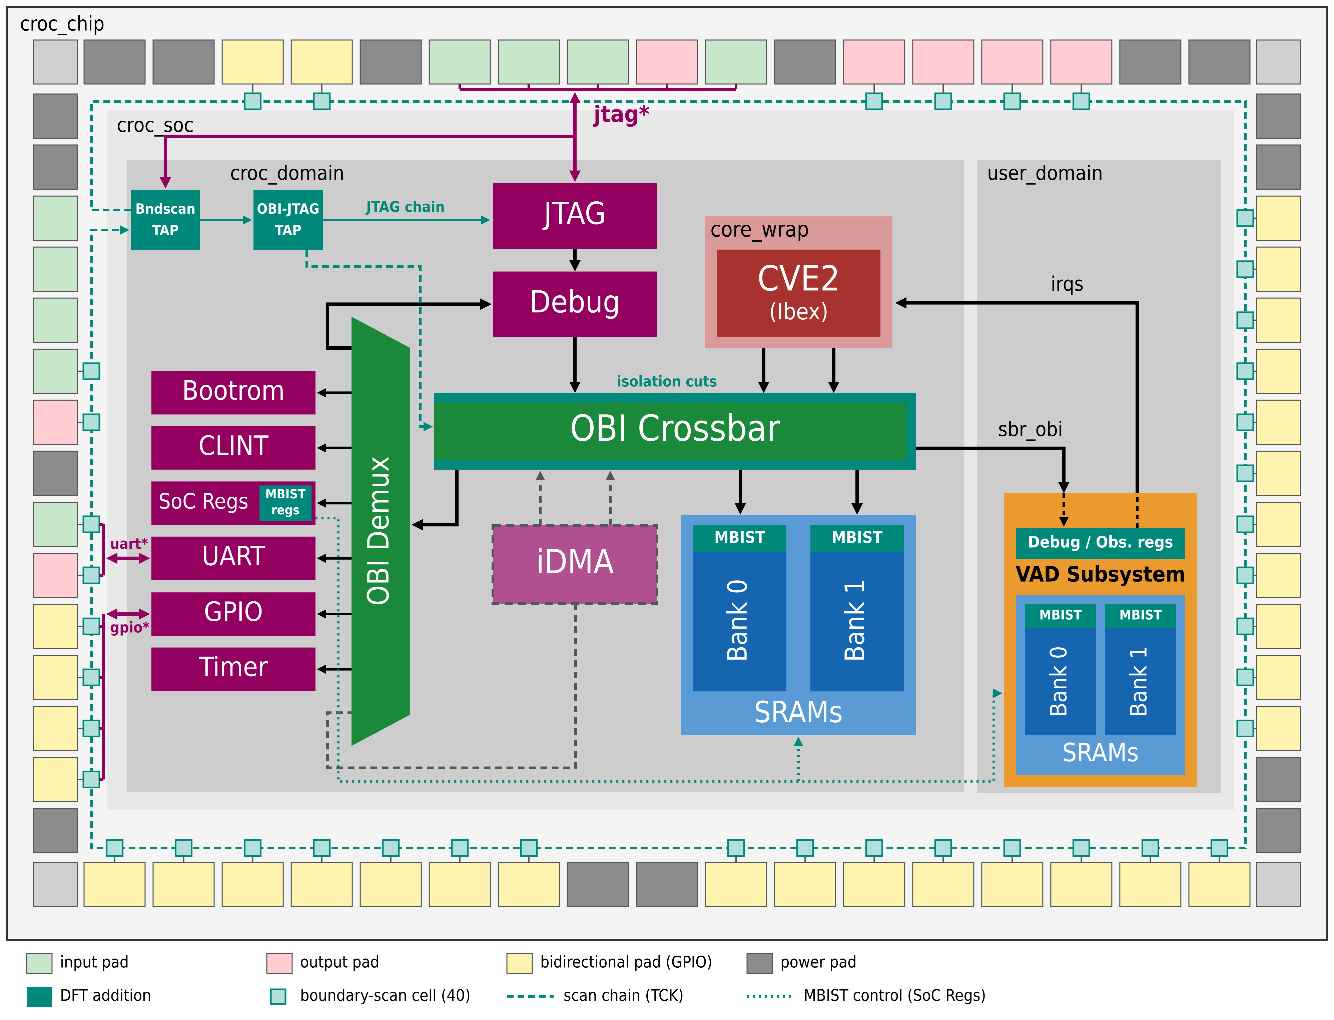
Where it sits in Croc
1
40 cells
uart_rx, testmode, uart_tx, status, unused0–3, gpio0–31. Bit 0 (uart_rx) is shifted out first.
2
No cell on
clk, rst_n, ref_clk and the five JTAG pins themselves.
3
Own TAP
First in the JTAG chain: TDI → Bndscan TAP → OBI-JTAG TAP → debug TAP → TDO.
4
4-bit IR
0 BYPASS, 1 SAMPLE/PRELOAD, 2 EXTEST, 3 INTEST. Unused opcodes select BYPASS.
Notes:
The teal squares around the edge are the 40 boundary-scan cells, one per signal pin except the clocks, reset and JTAG pins. They form one shift register, driven by its own TAP, which is the first TAP after TDI. The other two TAPs, for crossbar isolation and for debug, follow it in the same chain. The instruction register is 4 bits wide; we implement the four standard instructions and every unused opcode falls back to BYPASS.

Slide 4
One cell, three steps
TDI (from previous cell)
Boundary-scan cell
functional path
Pad
MUX
Core
Shift FF
Update FF
mode (from IR)
TDO (to next cell)
1
Capture
2
Shift
3
Update
The pin value (or the core output) is copied into the shift FF.
One bit per TCK: a new pattern goes in at TDI while the captured values come out at TDO.
The shifted-in value moves to the update FF and, in EXTEST/INTEST, drives the pin or the core.
Notes:
Each cell has a shift flip-flop and an update flip-flop. Capture copies what is on the pin into the shift flip-flop. Shift moves the whole chain one bit per TCK, so we read the captured values out at TDO while the next pattern goes in at TDI. Update copies the new pattern into the update flip-flops at once, and the mux, controlled by the instruction, decides whether the pin or the core sees the functional value or the scanned value. In normal operation the functional path is untouched.

Slide 5
Watching: BYPASS and SAMPLE / PRELOAD
BYPASS
SAMPLE / PRELOAD
Boundary scan steps aside
Look at every pin while the chip runs
transparent
records the pin
Input pin
cell
Core
Input pin
cell
Core
Output pin
cell
Output pin
cell
transparent
records the core output
JTAG TDI → one 1-bit register → TDO
JTAG the snapshot shifts out at TDO
JTAG PRELOAD: new values shift in and wait in the cells
Every pin works normally and the cells are transparent. Between TDI and TDO there is only one bit, so the other JTAG blocks in the chain are reached with one extra shift.
SAMPLE: the chip keeps running. Each input cell records its pin, each output cell records what the core drives, and the snapshot is shifted out.
PRELOAD: values shifted in are stored in the cells but not applied yet, so EXTEST or INTEST starts from safe, known values instead of random ones.
Use it for: normal operation (the default after reset) and talking to the other JTAG blocks.
Use it for: watching the pins live while firmware runs.
Use it for: loading safe values before taking control of the pins or the core.
teal = the cell drives amber = the cell records it grey = normal path ✕ = cut
Notes:
Click 1, BYPASS: boundary scan is out of the way. All pins and the core work normally, and the only thing between TDI and TDO is a single bit, so reaching the other TAPs behind it costs one extra shift. This is the state after reset. Click 2, SAMPLE: the chip still runs normally, nothing is changed on any pin. On Capture, every input cell records the value on its pin and every output cell records what the core is driving; Shift moves that snapshot out at TDO. Click 3, PRELOAD: it is the same instruction, used the other way round. The values we shift in are stored in the cells on Update but not applied, so when we then switch to EXTEST or INTEST, the pins or the core start from values we chose.

Slide 6
Taking control: EXTEST and INTEST
EXTEST
INTEST
Take over the output pins to test the board
Take over the core's inputs to test the core
records the pin
drives the core
Input pin
cell
Core
Input pin
✕
cell
Core
Output pin
cell
Output pin
cell
drives the pin
records the core output
JTAG shifted-in values drive the pins; recorded inputs shift out
JTAG shifted-in values drive the core; its answers shift out
The cells drive every output pin; the core's output stops at its cell. Input cells record what the board drives, and the core still sees its inputs.
The cells drive the core's inputs; the real input pins are ignored. Output cells record the core's answer, and the core keeps driving its pins.
Use it for: board test: walk a 1 across the outputs and read it back to find shorts, opens or a wrong pin map.
Use it for: testing the core with known inputs, whatever the board around it does.
teal = the cell drives amber = the cell records it grey = normal path ✕ = cut
Notes:
Click 1, EXTEST: now boundary scan takes control of the outputs. Every output pin is driven by its cell, so the core cannot disturb the board test; what the core wanted to drive is still recorded in the cell. Input cells record what arrives on the input pins, and in our design the core still sees those inputs. Typical use: walk a single 1 across the output pins and read the input pins back to find shorts, opens or a wrong pin map. Click 2, INTEST: the mirror image. The cells drive the core's inputs and the real input pins are ignored, so the core sees exactly the pattern we shifted in. The output cells record the core's answer, and in our design the core keeps driving its output pins. Typical use: test the core with known inputs even if the board is broken; our testbench does this with a program that echoes inputs to outputs.

Slide 7
How it helps: four examples
1
UART prints nothing
SAMPLE
2
GPIO short on the board
EXTEST
Sample uart_tx while the firmware runs. If the cell toggles, the core works and the fault is on the board. If it is stuck, look at the core. EXTEST can then toggle the pin directly for the scope.
Walk a single 1 across the GPIO outputs and read the pins back through the input cells. A short shows the 1 on two pins; an open never shows it at all.
3
Core needs known inputs
PRELOAD+INTEST
4
Is the core alive?
INTEST
Like Thomy's scan fix, but at the chip boundary: force testmode or the GPIO inputs to known values from JTAG, whatever the board drives.
Our test: the core echoes gpio[23:16] onto gpio[15:8]. Under INTEST the echo returns the BSR pattern, not the pin values, so the core works with nothing on the pins.
Notes:
Four concrete cases. One: the classic bring-up problem, UART silent. SAMPLE tells us in one scan whether the core is driving the pin. Two: board shorts and opens, found with a walking one under EXTEST, with no firmware and no probes. Three: the Thomy lesson. Boundary scan cannot reach internal registers, but it does give us control over every input the core sees from outside, for example testmode. Four: this is exactly what our testbench does, the core echoes GPIO inputs to outputs, and under INTEST it echoes the pattern we scanned in, which proves the core path works independently of the pins.

Slide 8
Verification at the pins
tb_croc_chip +bscan_test: the testbench drives only the chip pins and JTAG, like a tester
Part A: pins only, core idle
Part B: core running test_bscan.c
Chain length per instruction: BYPASS 5 bits, SAMPLE / EXTEST / INTEST 44
Unused opcodes select BYPASS
SAMPLE: walking 1/0 on all 32 GPIO pins is captured
SAMPLE: shifting all 1s leaves the outputs alone
EXTEST: walking 1/0 on uart_tx, status, unused0–3
EXTEST: input pads are not driven, still captured
TMS reset, TRST and BYPASS give the pins back to the core
SAMPLE sees the core's outputs on gpio[15:8]
EXTEST: the BSR overrides the core on gpio[15:8]
INTEST: the core reads the BSR, not the pins (echo shows the BSR pattern)
BYPASS: the core drives and reads the pins again
Result: all 34 checks pass · RTL simulation, QuestaSim
Notes:
We verified boundary scan from the outside only: the testbench drives the JTAG pins and the chip pins, exactly as a tester would. Part A runs with the core idle and checks the chain lengths, every instruction, and that a TAP reset or TRST always gives the pins back to the core. Part B runs a small program on the core so we can see SAMPLE, EXTEST and INTEST interact with real core activity. All 34 checks pass (QuestaSim, 31 October).

Slide 9
Takeaways
40 cells and one TAP buy control over the whole chip boundary
Chip or board?
Every pin
Core in isolation
SAMPLE and EXTEST answer it without firmware
readable and drivable from 5 JTAG pins
INTEST tests it with nothing on the pins
Notes:
To sum up: for the cost of 40 scan cells and one small TAP, we can tell chip faults from board faults, observe and drive every signal pin, and test the core on its own. Area numbers are in the evaluation slide.

