Slide 1
How crossbar isolation helps debugging
JTAG instructions wrap the OBI crossbar in scan registers (4 manager-side cuts, 5 subordinate-side cuts, a loadable address map); sub access also reads and writes the subordinates.
1
Is it the crossbar?
Verified: 8 transfers
2
Freeze and look
Not yet tested in sim
What you do
Send a real transfer through the crossbar from JTAG: req + payload in at any manager, rvalid + response back from the subordinate side. No core, software or memory has to work.
What you do
Entering isolation stalls every manager (no gnt, no rvalid) and keeps req away from every subordinate. Capture snapshots payload + valid at all 9 boundaries.
What it tells you
Separates a decode / arbitration / response-routing bug in the crossbar from a fault outside it.
What it tells you
After a hang: which request was waiting at each port. Transfers in flight are dropped on entry.
3
What-if address map
Verified: banks swapped
4
Clean exit
Verified: read-back + program run
What you do
Load a different address map from JTAG, then re-run the routing test.
What you do
BYPASS (or TAP reset) puts the cuts and crossbar back on the system clock, clears the cuts and restores the hard-wired map.
What it tells you
Checks a suspected decode bug, or a remap (e.g. swap two memory ranges), without new silicon. Only while isolated.
What it tells you
The debug session leaves no trace: the core boots and runs afterwards.
Notes:
4 clicks, one card each. Card 1: each cut register cell holds the payload plus one valid bit (req on the A channel, rvalid on the R channel); Update drives it for one TCK cycle (a step) and the subordinate-side cuts grant during every step. Card 2 (freeze and look) follows from the RTL: with isol_en the cuts drive gnt/rvalid = 0 to managers and req = 0 to subordinates and Capture loads the cut inputs, but it was not exercised in simulation, and the cut full flags are cleared on entry. Card 3: the JTAG address map is used only while XcnctIsolation is selected; outside isolation the register follows the hard-wired CrocAddrMap, so it cannot repair a chip at run time.

Slide 2
Crossbar isolation in action
TDI
Address map: built in
Sub 4 got it ✓
Address map: from JTAG (changed)
TDO
Crossbar
routes each request by its address
Mode
Normal
Crossbar driven by
the managers
Mode
Isolated
Crossbar driven by
JTAG
Sub 0
Mode
Normal
Crossbar driven by
the managers
Manager 0
nothing
waits
Sub 1
Manager 1
JTAG step
nothing
Shift-DR
bits move along the chain
Shift-DR
bits move along the chain
Shift-DR
bits move along the chain
Shift-DR
bits move along the chain
Shift-DR
bits move along the chain
waits
Sub 2
Manager 2
Update-DR
a cut drives the bus, 1 TCK
Update-DR
a cut drives the bus, 1 TCK
Update-DR
a cut drives the bus, 1 TCK
nothing
Update-DR
a cut drives the bus, 1 TCK
Sub 3
waits
Capture-DR
cuts record what arrived
Capture-DR
cuts record what arrived
Capture-DR
cuts record what arrived
Capture-DR
cuts record what arrived
nothing
Manager 3
captured ✓
Sub 4
waits
captured
request loaded
response
response ✓
same request
The crossbar connects managers (core, debug, …) to subordinates (memories, peripherals).
Each link has a cut register (teal). Click to follow a transaction.
Normal mode: manager 2 reads from subordinate 3 through the crossbar.
If this fails on silicon: is the bug in the manager, the crossbar or the memory?
Isolation instruction: managers wait, subordinates see nothing, the crossbar runs on the JTAG clock.
The address-map register and all cut registers are daisy-chained from TDI to TDO.
Shift-DR: a bit pattern moves through every register in the chain, one bit per TCK.
When it stops, manager 3's cut holds a request (valid + address + data); the others hold 0.
Update-DR: manager 3's cut drives the request into the crossbar for exactly one TCK.
The crossbar routes it by its address toward subordinate 4.
Capture-DR: every subordinate-side cut records what reached it in that cycle.
Only subordinate 4's cut holds the request; the other cuts saw nothing.
Shift-DR again: the captured bits come out at TDO (while the next pattern goes in at TDI).
JTAG reads: the request reached subordinate 4, the one its address belongs to.
The response is tested the same way: shift it into subordinate 4's cut, update, then capture.
It returns only to manager 3's cut, the manager that asked. No core, software or memory involved.
The address map is the first register in the chain. Shift in a changed map and the same request
now goes where the new map says: check a suspected decoding error without new silicon.
Leaving isolation (BYPASS) reopens the cuts and restores the built-in map.
The system runs as before; the test leaves nothing behind.
Notes:
9 clicks. Croc mapping: managers 0-3 = user, debug, core data, core instruction; subordinates 0-4 = error, peripherals, user/VAD, SRAM bank 0, SRAM bank 1. Isolation instruction = XcnctIsolation on the obi_jtag TAP: the cuts and the crossbar run on TCK, managers get no gnt/rvalid, subordinates no req. Chain (1284 bits TDI to TDO): address-map register, then the manager-side cuts, then the subordinate-side cuts; drawn simplified here. Each cut holds an A cell and an R cell, each payload plus one valid bit. In practice one scan does Capture + Shift + Update together: it reads the last step and loads the next. The JTAG register also holds a default index per manager (where unmapped addresses go), verified in simulation but left off the slide. tb_croc_chip +obi_jtag_test: 23 of 23 checks pass (18 isolation + 5 sub access, see the sub access slide).

Slide 3
Scan cells: shift, update, capture
TCK 1 / 8
TCK 2 / 8
TCK 3 / 8
TCK 4 / 8
TCK 5 / 8
TCK 6 / 8
TCK 7 / 8
TCK 8 / 8
TCK 1 / 8
TCK 2 / 8
TCK 3 / 8
TCK 4 / 8
TCK 5 / 8
TCK 6 / 8
TCK 7 / 8
TCK 8 / 8
scan chain
valid
p2
p1
p0
valid
p2
p1
p0
Manager-side cut
Crossbar
routes by address
Subordinate-side cut
sub-side cut: 1101
request arrived ✓
input (from the bus)
input (from the bus)
Manager
stalled
0
0
0
0
0
1
0
1
0
0
0
1
read out
1
01
001
1001
0100 1
1010 01
1101 001
0110 1001
1
01
101
1101
0110 1
0011 01
0001 101
shift stage (on the scan chain)
0000 1101
shift stage (on the scan chain)
shift stage (on the scan chain)
shift stage (on the scan chain)
0
0
0
0
0
1
0
1
1
0
0
0
0
0
0
0
0
0
1
0
0
0
0
0
1
0
1
0
0
0
0
0
0
0
0
0
1
1
0
0
0
0
0
1
0
0
0
0
0
0
0
0
0
0
0
1
1
0
0
0
0
0
1
0
0
0
0
0
0
0
0
0
1
0
1
1
0
0
0
0
0
1
0
0
0
0
0
0
0
0
0
1
0
1
1
0
0
0
0
1
1
0
0
0
0
0
0
0
0
0
1
0
1
1
0
0
0
0
1
1
0
0
0
0
0
0
1
0
0
1
0
1
1
0
0
1
0
1
1
0
0
0
0
TDI
0
TDO
req = 1 for one TCK
still to shift in
next cycle: req = 0
update stage (drives the bus)
update stage (drives the bus)
update stage (drives the bus)
1101 0000
update stage (drives the bus)
1101 000
1101 00
1101 0
1101
110
11
1
0000 0000
0000 000
0000 00
0000 0
0000
000
00
0
Subordinate
req held at 0
0
1
0
1
0
0
0
1
0
0
0
0
0
0
0
0
Capture-DR
input → shift stage
all bits at once
Capture-DR
input → shift stage
all bits at once
Shift-DR
TDI → … → TDO
one bit per TCK
Shift-DR
TDI → … → TDO
one bit per TCK
Shift-DR
TDI → … → TDO
one bit per TCK
Update-DR
shift → update stage
all bits at once
Update-DR
shift → update stage
all bits at once
Step
update stage drives
the bus for 1 TCK
Step
update stage drives
the bus for 1 TCK
Every cut register is one scan cell: a shift stage on the JTAG chain and an update stage
that drives the bus. Here: two cuts with a valid bit and a 3-bit payload. Click to step through.
Shift-DR: one bit moves one place per TCK, from TDI toward TDO. The manager-side cut gets
valid = 1 and a payload; the old contents leave at TDO. The bus sees none of this.
Update-DR copies every shift-stage bit into the update stage at the same moment.
Only now does the new request appear at the cut's output.
The step: for exactly one TCK cycle the update stage drives req + payload. The crossbar routes it
and the subordinate-side cut samples what arrives. Then req drops, so it is sent only once.
Capture-DR copies every input into the shift stage at the same moment. The subordinate-side cut
now holds the request that crossed the crossbar; the idle manager side holds 0.
Shift-DR again: the captured bits leave at TDO, and the next pattern goes in at TDI
at the same time. One scan reads the last step and loads the next one.
Notes:
5 clicks. Simplified: two cut registers, each a valid bit plus a 3-bit payload. In the RTL (spill_register_flushable_mod) the shift stage is {valid_q, a_data_q}, the update stage is b_data_q plus valid_upd_q, and the step is step_q, set by Update-DR for the next TCK cycle. Each OBI cut has an A cell (request: valid = req) and an R cell (response: valid = rvalid). Subordinate-side A cells never drive req to the real subordinate, manager-side R cells never drive rvalid to the real manager. The cells sample their inputs in the step cycle; Capture-DR keeps that sample (or loads the live inputs if no step happened since the last Update). In Croc the chain is 1284 bits from chip TDI to TDO: the address-map register and 9 cuts, so each scan takes about 1,300 TCK cycles.

Slide 4
How req / gnt work during isolation
cuts + crossbar clock: system clock
cuts + crossbar clock: TCK (JTAG)
Crossbar
Manager
core, debug, …
cut
cut (scan)
cut
req
req = 1
cut (scan)
Subordinate
memory, peripheral, …
req = 0
req = 1
req
A cell
valid | payload
req = 0
A cell (loaded)
1 | request
A cell
valid | payload
A cell (captured)
1 | request
gnt
gnt = 0
gnt = 1
gnt = 1
gnt
rvalid
rvalid = 0
R cell
valid | payload
R cell (captured)
1 | response
rvalid = 1
rvalid = 1
R cell
valid | payload
R cell (loaded)
1 | response
rvalid
ID FIFO: empty
ID FIFO: manager
ID FIFO: empty
in flight: 0
in flight: 1
in flight: 0
waits, req held
idle, never sees req
JTAG TAP state
Shift-DR
Shift-DR
Shift-DR · Update-DR · Step: 1 TCK
Why exactly one cycle?
A scan takes as many TCK cycles as the chain is long. If req and gnt stayed high for all of them,
the crossbar would accept the same request on every cycle. One step = one transaction.
Update-DR
Update-DR · Step: 1 TCK
Step: 1 TCK
Capture-DR
Capture-DR · Shift-DR
Shift-DR
req / rvalid into crossbar
0
0
0
1 (req)
1 (rvalid)
0
0
gnt into crossbar
0
0
0
1
1 (unused)
0
0
One transfer through the isolated crossbar, step by step.
Click to start in normal mode.
Normal mode: each cut is a small pipeline register. It does its own req / gnt handshake
with the side before it and the side after it; responses (rvalid) flow back.
Isolation: cuts and crossbar move to the JTAG clock. Toward the real manager gnt and rvalid
are held at 0, toward the real subordinate req is held at 0. The manager simply waits.
Shift-DR: a request is loaded into the manager-side A cell: one valid bit
(it becomes req) plus the payload. Nothing is driven yet.
Update-DR, then exactly one TCK cycle (the step): the cell drives req, and the subordinate-side
cut grants every request in that cycle. req and gnt meet: the crossbar records one transfer.
Next cycle req drops. It was granted in the same cycle, so no request is withdrawn ungranted
and the transfer happens once. Capture-DR stores what arrived; the next shift reads it out.
A second step sends the response from the subordinate-side R cell. The crossbar looks up who
asked and returns it only to that manager's cut, where it is captured. Nothing is left in flight.
The real manager and subordinate never take part: every handshake happens between
two scan cells, inside the isolated crossbar.
Notes:
7 clicks. Each cut register's scan cell holds the payload plus one valid bit (req on the A channel, rvalid on the R channel). Update-DR starts a step: for exactly one TCK cycle the cells drive their valid bit into the crossbar, and the subordinate-side cuts drive gnt = 1. The crossbar runs on the same TCK, so its arbiter, ID FIFO and in-flight counter see one handshake per step. The cells sample their inputs in the step cycle; Capture-DR keeps that sample. Toward the real managers gnt and rvalid stay 0, toward the real subordinates req stays 0, and the cut full flags are cleared on entry, so nothing is replayed on exit. gnt itself is not captured: it is proven by the response, which the crossbar only returns for a granted request.

Slide 5
Sub access: JTAG reads and writes a subordinate
Verified in simulation
JTAG clock (TCK)
subordinate's own clock
Crossbar
isolated,
not needed here
subordinate-side cut
access engine
one per cut
Subordinate
e.g. a memory
A cell (request)
valid = 0
A cell (request)
valid = 1 · write
A cell (request)
valid = 1 · read
req
send request
gnt
R cell (reply)
valid = 0
rvalid
written ✓
R cell (reply)
valid = 1 · OK · same ID
R cell (reply)
valid = 1 · data
reply stored
write accepted ✓
TDI
TDO
read = written data ✓
+2.3 kGE
on top of isolation: engines + synchronisers
synchronisers
Shift-DR
Shift-DR
Update-DR
Update-DR
wait a few TCK
wait a few TCK
Capture-DR
Capture-DR
Shift-DR
Shift-DR
A second JTAG instruction, sub access: isolation as before, and each subordinate-side cut
can also run a real transfer to its subordinate, the same way a core would.
Shift-DR: a write request (valid = 1, address, data) is shifted straight into the cut
in front of the subordinate. The crossbar is skipped.
Update-DR: the request crosses into the subordinate's clock. The engine raises req
and holds the address and data steady, exactly like a manager.
The subordinate grants, does the write and answers with rvalid and a reply, all on its own
clock. JTAG just waits a few TCK cycles meanwhile.
Capture-DR: the reply crosses back to TCK and the cut's R cell records it
(valid, error flag, ID and, for a read, the data).
Shift-DR: the reply comes out at TDO while the next request goes in.
One transfer = two scans with a short wait in between.
The same two scans with a read return the data just written. A request to the error
subordinate returns a bus error: JTAG sees exactly what a core would see.
Memories and peripherals can be read and written over JTAG even if the core or the
debug path is broken. Cost: +2.3 kGE on top of isolation.
Notes:
7 clicks. Instruction XcnctSubAccess on the obi_jtag TAP (JtagSubAccess = 1 in obi_xbar): the same isolation and scan chain as XcnctIsolation, plus one access engine (obi_cut_sub_access) per subordinate-side cut. A Shift-DR + Update-DR with the A cell valid bit set toggles a TCK flop; a 2-flop synchroniser carries the toggle into the subordinate's clock, where the engine raises req with the A cell payload (stable until the next Update), holds it until gnt, waits for rvalid and stores the reply. done is synchronised back to TCK; the next Capture-DR loads the reply into the cut's R cell and Shift-DR reads it out. The testbench waits 20 TCK in Run-Test/Idle between the two scans. tb_croc_chip +obi_jtag_test: write 0x5AB1C0DE to SRAM bank 0, read it back, the error subordinate answers err = 1, each transaction reaches its subordinate exactly once, and after leaving isolation the value is read over the normal debug path (5 extra checks, 23 in total). Area: +2.32 kGE vs isolation only (13,109 um2: ~215 flops, ~15 synchronisers, reply muxes).

Slide 6
Verification and cost
tb_croc_chip +obi_jtag_test: 23 of 23 checks pass
1 chain
address map + all 9 cuts
payload + 1 valid bit per cut register
✓ Scan chain integrity
a pattern comes out after exactly the chain length
✓ Requests (5)
from every manager, each reaches only the decoded subordinate
including an unmapped address → error subordinate
2 scans
per step
one to drive, one to capture; a transfer is 2 steps
✓ Address map from JTAG (2)
two ranges swapped: requests follow the new map
✓ Default index from JTAG
unmapped address redirected away from the error subordinate
✓ Responses (8)
rvalid + rdata return only to the requesting manager, rid = aid
✓ No leaks
never gnt / rvalid to a manager or req to a subordinate
+10.7 kGE
isolation + sub access vs the plain cuts
isolation 8.4 (scan muxes, JTAG control, flops) + sub access 2.3
✓ Sub access (5)
write + read-back of a memory, error subordinate, each exactly once
✓ After isolation (extra)
sub-access write seen over debug, program runs
Not covered yet: snapshot of live traffic (card 2); transfers in flight on entry are dropped; a subordinate's own gnt is not observed (the cuts grant during every step).
+39 %
of the original interconnect
crossbar + cuts were 27.6 kGE; +7.2 % of the chip
cd vsim
./run_vsim.sh --tb tb_croc_chip --plusarg +obi_jtag_test \
--run ../sw/bin/helloworld.hex
The crossbar can be tested, re-mapped, its subordinates read and written, all over the JTAG port.
Cost: +10.7 kGE over the original cuts: 8.4 for isolation, 2.3 for sub access.
Notes:
2 clicks: checks, then cost. 23 checks = 1 chain + 8 request routes + 8 responses + 1 leak monitor + 5 sub access. Area (Yosys, IHP 130 nm, 1 GE = NAND2X1 = 5.65 um2): obi_jtag_top block incl. JTAG wrapper and TAP 141,119 um2 (25.0 kGE); NORMAL obi_xbar_multicut 93,812 um2 (16.6 kGE); difference 47,306 um2 = 8.4 kGE for isolation. Of that: extra flops ~1.5 kGE (mostly the 288-bit address-map shadow register), scan muxes ~4.6 kGE, JTAG control (TAP, IR, 288-bit address-map shift register, clock mux) 2.3 kGE. Dropping the JTAG-loadable address map would save roughly 2.5-3 kGE. Sub access (JtagSubAccess = 1): block 154,227 um2, +13,109 um2 = +2.3 kGE more (access engines, synchronisers, reply muxes); total +10.7 kGE.

Slide 7
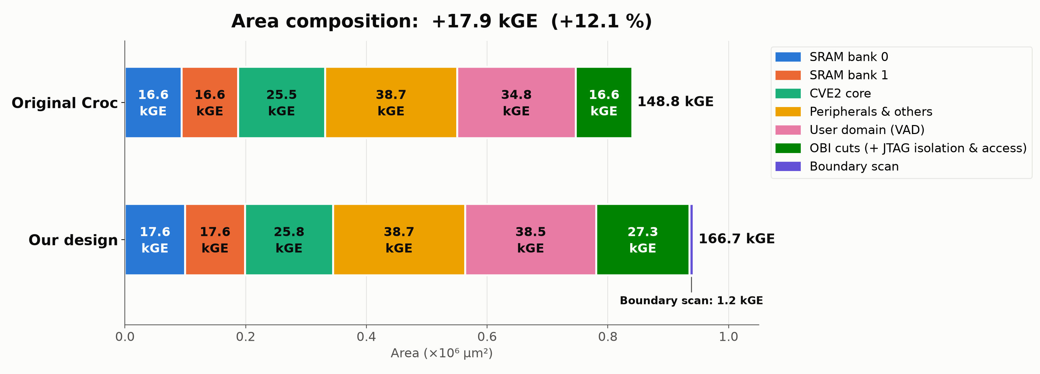
Area: original Croc vs our design
+17.9 kGE (+12.1 %). Each BIST controller is counted in the memory it tests; the core and
peripherals are unchanged. Standard cells + SRAM macros, IO pads excluded. 1 GE = NAND2X1.
Notes:
Standard cells + SRAM macros, IO pads excluded. 1 GE = NAND2X1 = 5.65 um2. Each March BIST controller is counted in the memory it tests. Our design: the VAD 512x32 SRAM macros are black boxes in its Yosys run; their liberty area (2 x 79,720 um2, from the NORMAL technology library) is added. Original Croc: NORMAL/yosys/reports/croc_area.rpt; our design: yosys/reports/croc_dft_sub_area.rpt (JtagSubAccess = 1).

Slide 8
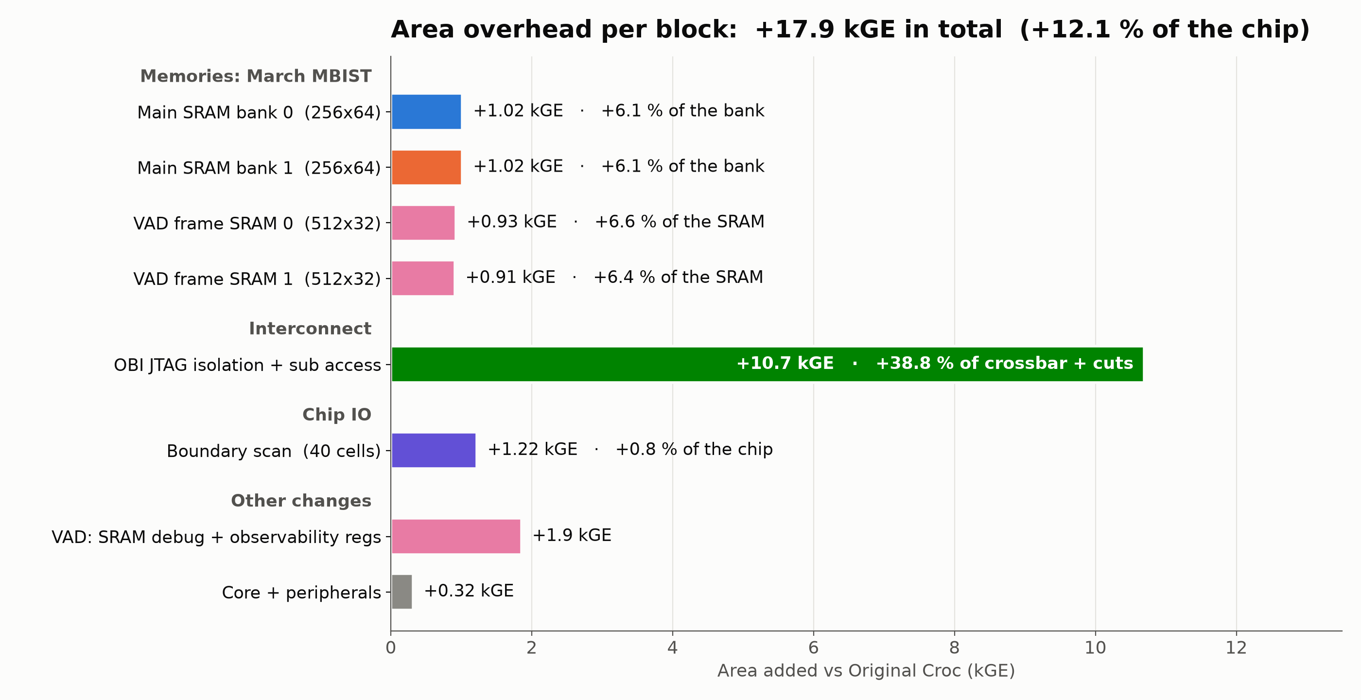
Area overhead per block
Each memory pays about 1 kGE for its March BIST (6–7 % of that memory).
Crossbar isolation + sub access is the largest single cost: +10.7 kGE, 39 % of the original interconnect.
Notes:
Main SRAM banks: BIST controller 0.93 kGE + 0.09 kGE interface logic in the bank wrapper. VAD frame SRAMs: BIST controller only, relative to the 512x32 macro. OBI isolation: scan cuts + JTAG control minus the plain cuts the original already had (60,415 um2); relative to the original crossbar + cuts (27.6 kGE). Of the 10.7 kGE: isolation 8.4 (scan muxes ~4.6, JTAG control ~2.3, extra flops ~1.5, mostly the 288-bit address-map shadow register) and sub access 2.3 (access engines, synchronisers, reply muxes). VAD +1.9 kGE: SRAM debug access and observability registers in the VAD wrapper (the BIST uses the macro's own BIST port, so hooking it up costs no extra muxes). Core + peripherals: SoC control registers for MBIST (+0.3 kGE) and synthesis noise. Chip = Original Croc, 148.8 kGE, standard cells + SRAM macros, IO pads excluded. 1 GE = NAND2X1 = 5.65 um2.

Slide 9
Proposal: memory bank repair
Proposal · not implemented
Crossbar decode
Bank A
memory
Bank A ✗
stuck cell found
March BIST
one per bank, run after reset
lower half of the RAM range
→ bank A
lower half of the RAM range
→ bank B
Core
runs the program
bank A: FAIL
bank B: pass
Bank B
memory
upper half of the RAM range
→ bank B
upper half of the RAM range
→ error subordinate
same start address,
half the RAM ✓
Error subordinate
answers with a bus error
stray access → bus error,
never silent corruption
remap register: bank A bad = 0 · bank B bad = 0
remap register: bank A bad = 1 · bank B bad = 0
If BIST finds a broken memory bank, the same decode mechanism can steer around it.
Click to step through.
Today the decode is fixed: the lower half of the RAM range goes to bank A,
the upper half to bank B.
After reset, March BIST tests every bank. Here bank A has a stuck cell:
without repair, any program using the RAM would fail.
Boot code or the debugger sets one bit. The decode now sends the lower half to the good bank
and the upper half to the error subordinate. Set it before the program is loaded.
Software keeps its start address and sees half the RAM. An access to the missing half
returns a bus error instead of silently overwriting good data. Cost: two register bits.
Notes:
Proposal, not implemented. Differences to the isolation map: the remap is active in normal operation, it is set from a register (soc_ctrl), not over JTAG isolation, and it only changes the target index of the two memory rules (two control bits: bank A bad, bank B bad). The missing half maps to the error subordinate rather than aliasing onto the good bank, so a stray access is reported instead of overwriting live data. Sequence: reset, run March BIST, read the status, set the remap, then load and start a program linked for half the RAM. Hardware cost is a two-bit register and a few muxes on the index fields, about 0.1 kGE. A finer-grained alternative uses the failing word addresses that the BIST already logs to replace single words with spare flip-flops, keeping the full RAM.

