Slide 1


KisanSetu
Farm to Consumer Digital Marketplace
Smart India Hackathon 2026
Problem Statement ID: SIH26033
Ministry of Consumer Affairs, Food & Public Distribution
Problem Statement ID – SIH25010
Problem Statement Title- Smart Crop Advisory System for Small and Marginal Farmers
Theme- Agriculture, FoodTech & Rural Development
PS Category- Software
Team ID-
Team Name (Registered on portal)- CodeCatalyst 6.0

Slide 2
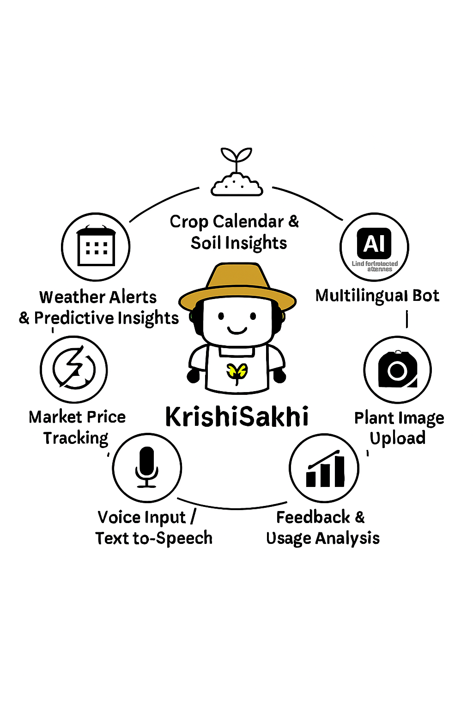
Problem Statement (SIH26033)
Code Catalyst
6.0
Proposed Solution : KrishiSakhi App
KrishiSakhi, a simple app and website that gives farmers advice in their own language. It helps with crops, soil, pests, fertilizers, weather and market prices.
Key Features:
AgroBot: Chatbot for crop advice in local language.
KisanVoice: Farmers can talk and get answers by voice.
MittiMitra: Soil and fertilizer tips.
Disease check: Framers can upload crop photos to find diseases.
Alerts: Live weather and market price updates.
Easy to use for farmers with low literacy, support local languages, save money and increases crop productivity, scalable, affordable, and helps millions of small farmers.
Work flow:
Choose the requirement
App analysis the requirement
Gives the advice by text, voice, or image
Farmer Login

Slide 3




















Our Solution: KisanSetu
Code Catalyst 6.0
Frontend
APIs
Frontend: Flutter, React.js
Programing Languages: Python, Dart, Javascript , Typescript
Backend & Database: Firebase (Auth, Firestore, Cloud Function, ML Kit, Cloud Storage, Messaging), Next.js, Express
APIs: OpenWeatherMap(Weather), Government Market Price APIs(Price Tracking)
AI/ML: Firebase ML Kit, Google Vision API, TensorFlow Model (Disease Detection), RASA, PyTorch, Transformer, XGBoost
Voice & Language: Google Cloud Translator API, Google Speech-to-text API
DevOps/Collaboration: GitHub
DevOps
AI / ML
Backend

Slide 4
Technical Approach
Code
Catalyst6.0
Feasibility
Cloud backend (Firebase/Firestore, Express) for scalability.
APIs for weather, market prices, and translation.
Pre-trained AI/ML models (TensorFlow, PyTorch).
Multilingual support via Google APIs.
Cross-platform app with Flutter.
Challenges
Poor internet in rural areas.
Inconsistent agri-data quality.
Scalability for millions of users.
Diverse languages/dialects.
Low digital literacy among farmers.
Strategies
Offline-first design (caching/SMS fallback).
Partnerships with ICAR, Govt., FPOs.
Model optimization & caching.
Regional dialect support with NLP.
Farmer training & awareness drives.
Business Idea
Subscription-based premium advisory services with voice call support.
Collaboration with government & NGOs for large-scale adoption.
Marketplace feature to connect farmers directly with buyers.

Slide 5
Feasibility and Viability
Code
Catalyst
6.0
Impact
Economic Upliftment Enhances income and livelihoods of small and marginal farmers through better returns.
Sustainability Promotes reduced chemical overuse, ensuring healthier soil, water, and long-term crop productivity.
Food Security Contributes to higher and more reliable crop production, strengthening national food supply.
Digital Inclusion Bridges the digital divide by enabling rural communities to adopt agri-tech solutions effectively.
Policy and Scalability Provides actionable data insights for government/NGO planning, with strong potential to scale across regions and diverse crops.
Benefits
Yield Improvement ICT-based advisories can enhance crop yields by 20–30% (NABARD, FAO reports).
Cost Savings Smart fertilizer management reduces input costs by 15–20% (ICAR study).
Wider Farmer Coverage The solution directly benefits 86% of Indian farmers, especially small and marginal farmers (NABARD, 2022).
Time Efficiency Farmers save time through quick access to reliable information instead of depending on middlemen.
Income Growth Digital advisory platforms have been shown to increase farmer incomes by 25% on average (World Bank AgriTech study).

Slide 6
Impact and Benefits
Code
Catalyst
6.0
Refrences:
Comparision with Existing Systems:
Features | KrishiSakhi | AgroStar | Plantix | Kisan Suvidha
Multilingual AI ChatBot | ✅ | ✅(Limited) | ❌ | ✅(Partial)
Crop Calender | ✅ | ❌ | ❌ | ❌
Pest / Disease Image Upload | ✅ | ❌ | ✅ | ❌
Market Price Tracking | ✅ | ❌ | ❌ | ❌
Voice support for literacy | ✅ | ❌ | ❌ | ❌
Direct Local Shop Linkage | ✅ | ❌ | ❌ | ❌
Alert | ✅ | ❌ | ❌ | ✅
Feedback | ✅ | ✅(Limited) | ❌ | ❌
Existing Website & App:
AgroStar: https://agrostar.in/shop?language=hi&state=uttar-pradesh
Plantix: https://plantix.net/
Kisan Suvidha: https://secure.mygov.in/group-issue/kisan-suvidha-smart-mobile-app-farmers/
Cropin Grow: https://www.cropin.com/
Research Innovation :
Farmer.chat: https://arxiv.org/abs/2409.08916
PlantNet: https://plantnet.org/en/
Krishi Sathi: https://www.linkedin.com/pulse/krishi-saathi-ai-powered-agricultural-advisory-indias-yfznc/

Slide 7
Future Scope & Thank You
Phase 2 Enhancements:
• Mobile app (React Native)
• Payment gateway integration (Razorpay)
• Multi-language support (Hindi, Tamil, etc.)
• GPS-based farmer discovery
Phase 3 Enhancements:
• IoT integration for crop monitoring
• Blockchain for supply chain transparency
• AI chatbot for farmer support
References:
• BigHaat, DeHaat, AgroStar (Existing platforms)
• FAO & NABARD reports on digital agriculture
Thank You!
KisanSetu - Bridging Farmers Directly to Consumers

