Slide 1


KISANSETU
Farm to Consumer Digital Marketplace
Problem Statement ID - SIH26033
Problem Statement Title - Digital Marketplace for Farmers
Theme - Agriculture, FoodTech & Rural Development
PS Category - Software
Team Name - KisanSetu Team

Slide 2
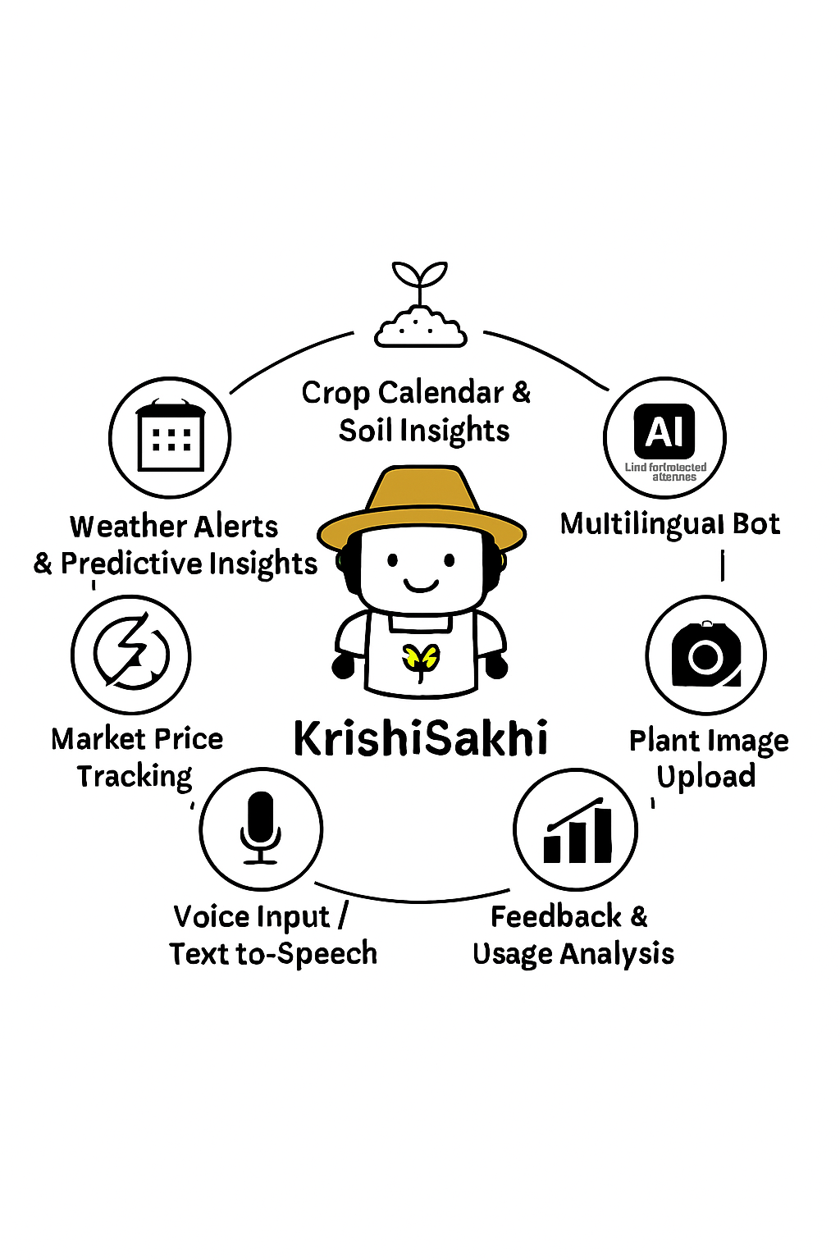
Problem & Solution
Code Catalyst
6.0
Our Solution: KisanSetu App
THE PROBLEM:
Multiple intermediaries reduce farmers earnings
and increase consumer prices.
Key Issues:
• Farmer gets only 30-40% of final price
• Consumer pays 40-50% more
• No direct farmer-consumer communication
• No demand visibility for farmers
• Supply chain causes food waste
OUR SOLUTION: KisanSetu
✓ Direct farmer-to-consumer marketplace
✓ AI-powered demand forecasting
✓ Smart logistics with route optimization
✓ Real-time chat communication
Lists Products
Consumer Buys
Direct Delivery
Farmer Registers

Slide 3




















TECHNICAL APPROACH
Code Catalyst 6.0
React.js + Tailwind
REST API
TECHNOLOGY STACK (MERN)
Frontend: React.js 18, Tailwind CSS, Framer Motion
Backend: Node.js, Express.js, Socket.io
Database: MongoDB Atlas (Cloud NoSQL)
Auth: JWT tokens, bcrypt hashing
Deployment: Vercel (Frontend), Render (Backend)
KEY FEATURES:
• Multi-role Auth (Farmer/Consumer/FPO)
• Product Marketplace with search & filters
• AI Demand Forecasting & price suggestions
• Smart Route Optimization (Nearest Neighbor)
• Real-time Chat via Socket.io
• Analytics Dashboard with Chart.js
Vercel + Render
AI Analytics
Node.js + Express

Slide 4
FEASIBILITY AND VIABILITY
Code
Catalyst6.0
Feasibility
• MERN stack mature & widely used
• MongoDB Atlas free tier
• Render & Vercel free hosting
• AI built with proven algorithms
Challenges
• Internet in rural areas
• Building user trust
• Scaling to millions
• Low digital literacy
Strategies
• Offline-first design
• Rating system for trust
• Cloud-native scaling
• Multi-language support
Business Model
→ Commission on transactions
→ Premium analytics subscription
→ Logistics partnerships
→ Government scheme integration

Slide 5
IMPACT AND BENEFITS
Code
Catalyst
6.0
Impact
✓ Economic: Higher farmer income
✓ Social: Digital empowerment
✓ Environmental: Less food waste
✓ Market: Transparent pricing
✓ Scalable across India
Benefits
✓ Farmer Income: +30-40% increase
✓ Consumer Savings: 20-30% lower prices
✓ Food Waste: 25-30% reduction
✓ Delivery: 35% time saved
✓ Direct connection, no middlemen

Slide 6
RESEARCH AND REFERENCES
Code
Catalyst
6.0
Thank You! | KisanSetu
References:
Features | KrishiSakhi | AgroStar | Plantix | Kisan Suvidha
Multilingual AI ChatBot | ✅ | ✅(Limited) | ❌ | ✅(Partial)
Crop Calender | ✅ | ❌ | ❌ | ❌
Pest / Disease Image Upload | ✅ | ❌ | ✅ | ❌
Market Price Tracking | ✅ | ❌ | ❌ | ❌
Voice support for literacy | ✅ | ❌ | ❌ | ❌
Direct Local Shop Linkage | ✅ | ❌ | ❌ | ❌
Alert | ✅ | ❌ | ❌ | ✅
Feedback | ✅ | ✅(Limited) | ❌ | ❌
Existing Platforms:
Existing Platforms:
• BigHaat: Agricultural e-commerce
• DeHaat: Farm-to-market platform
• AgroStar: Farm input marketplace
• Ninjacart: B2B produce supply
Our Differentiation:
Our Differentiation:
★ Direct F2C model (no B2B layer)
★ AI demand forecasting built-in
★ Smart logistics & route optimization
★ Multi-role support system
★ Real-time chat communication

