Slide 1
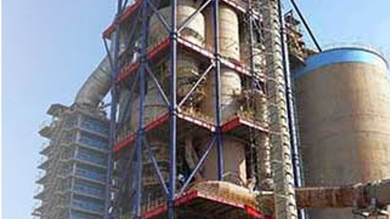
Introduction
Detecting anomalies form a cyclone preheater which is part of an industrial process In the duration of via using various Anomaly detection technique
19MID0023 SAKSHAM VERMA

Slide 2
Data preparation
data.shape
Get to know about the size of the data
data.sample(5)
Random sampling helps avoid any bias that might be present in the initial rows or at the end of the dataframe which lags in head() and tail()
data.isnull().sum()
Checking null values
data.info()
knowing about dtypes, not null values
Converting each data value to float from object
data.corr()
Correlation between columns and try solving multicollinearity
PCA
Solve multicollinearity

Slide 3
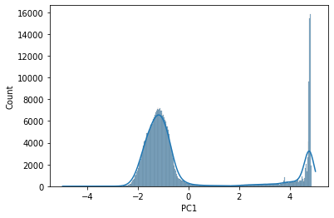
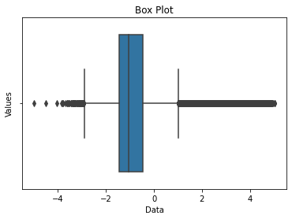
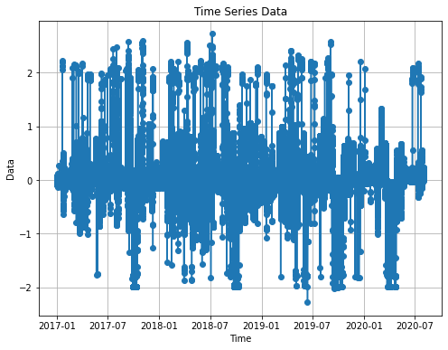
Analysis strategy
This data is an example of Unsupervised Anomaly detection in Timeseries data
Here I tried seeing the info pf the data using
line chart
Will help with analysis of threshold for each column as a time series data
Boxplot
Gives a good idea of median and outliers and distribution and here outliers are some of the main things to consider
Histogram
Gives a good idea of the distribution

Slide 4
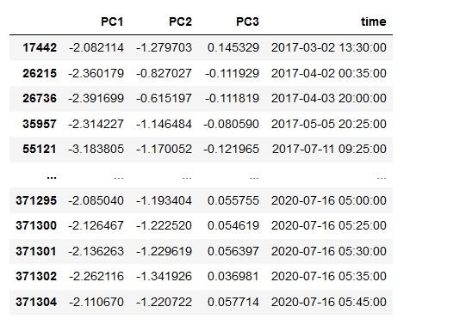
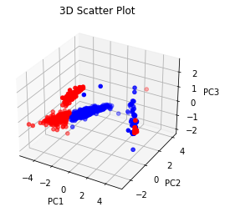
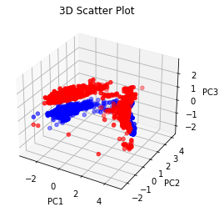
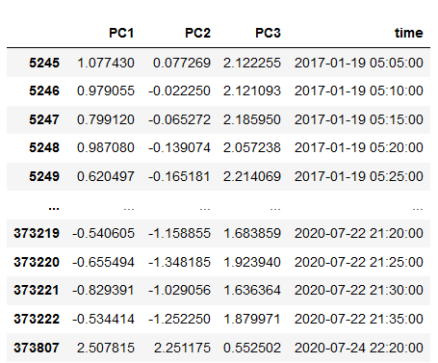
Insights
Kmeans
Used grid search cv to find the most appropriate cluster
Tried finding distance of every point wrt the avg_centre of all the all the clusters formed
Kmeans
Isolated Forest Anamoly Detection
Isolation Forest is a popular anomaly detection algorithm that is particularly effective in detecting outliers or anomalies in a dataset. It works by isolating anomalies in the data using a tree-based approach.
Isolated Forest Anamoly Detection

Slide 5
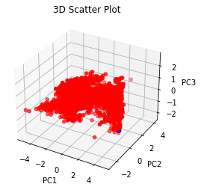
KNN
Found avg distance of the point wrt 10 of its neighbour.
Then took the starting 99 percentile as Normal and rest as anaomaly
DBSCAN
Arima

