Slide 1
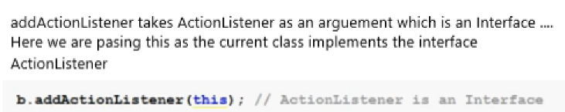
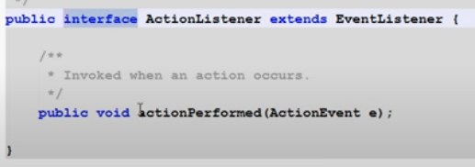

Slide 2
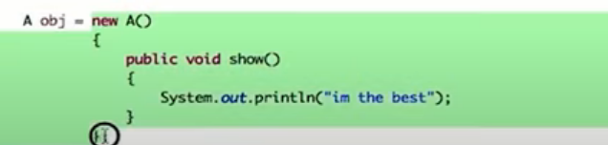
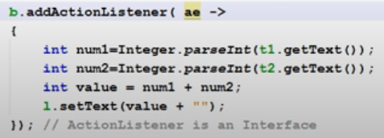

Class without name → Anonymous class
Functional interface
Creating an object of interface
Here we can create an object of the interface as it already known that it will accept object of that interface

Slide 3

JTextField t1 = new JTextField(20);
JButton b = new JButton("OK");
JLabel l = new JLabel("Result");
add(t1);

Slide 4
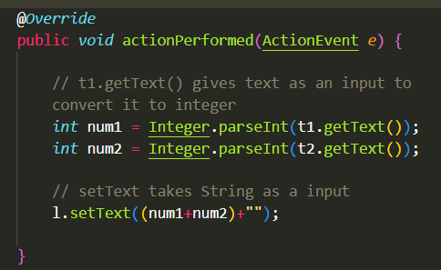


Button
// inside the addActionListener we pass an object of type ActionListener
// ActionListener is an interface
// Thus needs to implement ActionListener
// ActionListener contains a method by the name of actionPerformed

Slide 5
