Slide 1
Hotel Booking Cancellation Predictor
AI101 MINI-PROJECT PRESENTATION
Predicting booking cancellations to optimize revenue and inventory management using Logistic Regression.
Repository link: https://github.com/SakshamYadav601/hotel-booking-cancellation-predictor
PROJECT TEAM & ROLES
DOCUMENTATION LEAD
VIDEO LEAD
PPT LEAD
RUN & EXECUTION LEAD
Saksham Yadav
Chandan Kumar
Sejpal Aum
Malavath Yasvanth
2026MCB1562
2026EEB1337
2026AIB1079
2026AIB1054

Slide 2
Problem Statement & Kaggle Dataset
BACKGROUND & CONTEXT
The Challenge
Kaggle Dataset Specs
Last-minute hotel cancellations leave rooms unexpectedly vacant, directly impacting revenue, staffing accuracy, and operations. Predicting cancellations in advance empowers hotel management to optimize booking policies and dynamic pricing.
Source
Jesse Mostipak / Kaggle
Total Bookings
119,390 records
Features
32 variables
Key Predictors
lead_time, adr, deposit_type

Slide 3
Machine Learning Pipeline
METHODOLOGY
1. Ingestion & Validation
2. Data Preprocessing
3. Model Training
4. Model Evaluation
5. Output
→
→
→
→
Relative pathing via `pathlib` & Data Quality Checks
pd.get_dummies, StandardScaler, leakage removal & 80/20 split
Logistic Regression classifier
Accuracy, ROC-AUC & Recall performance metrics
Output evaluation metrics in terminal and saved graphs in output directory
Libraries Used:
pandas
numpy
pathlib
os
scikit-learn
matplotlib
seaborn

Slide 4
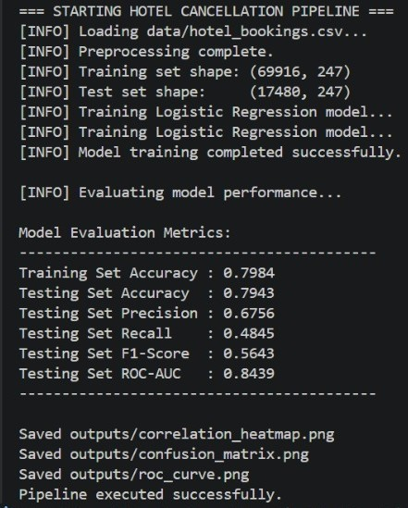
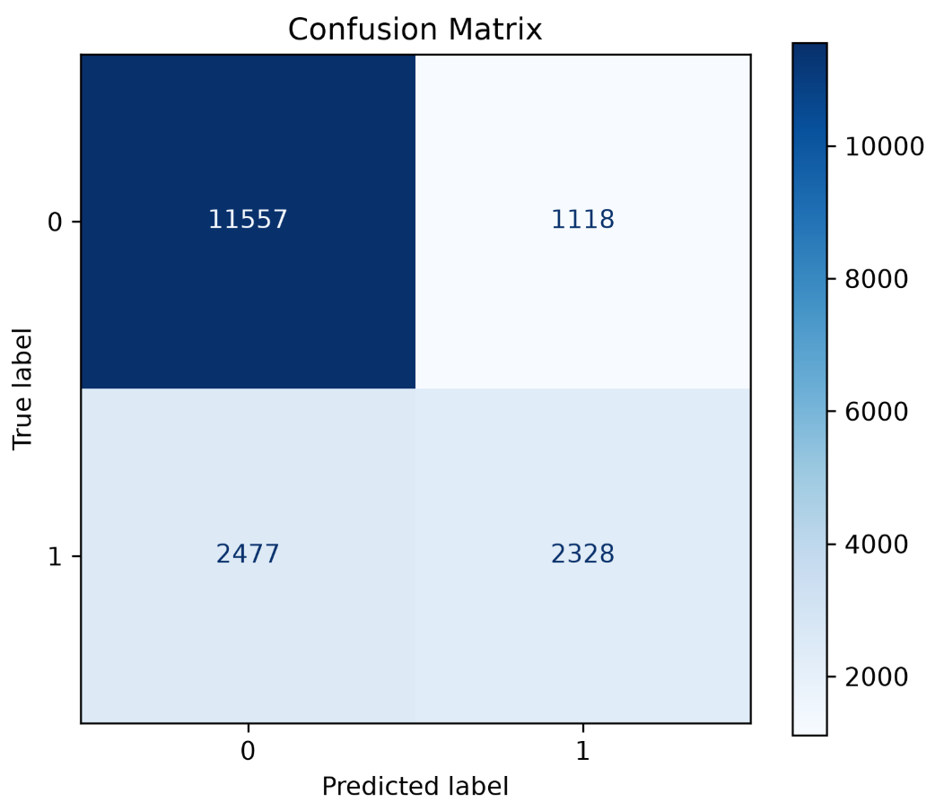
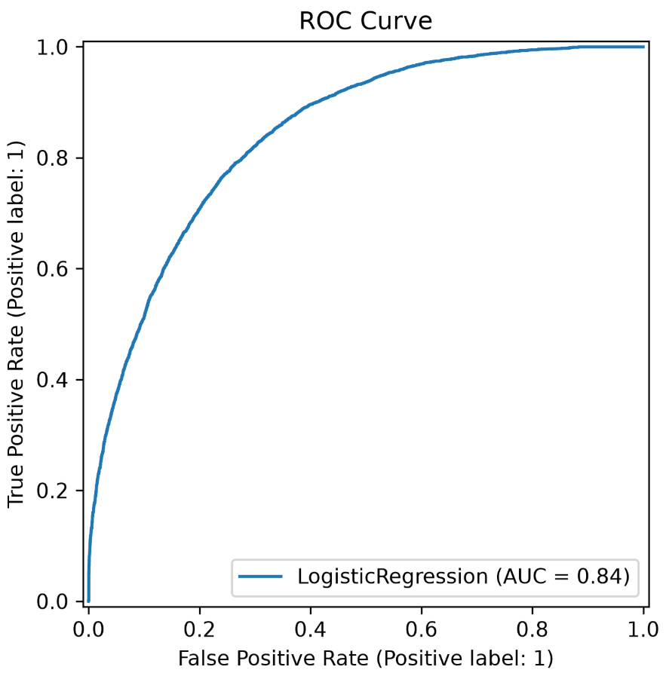
Logistic Regression Performance
RESULTS & ANALYSIS
Output
~80%
Model Accuracy
Overall correct predictions on test set
0.84
ROC-AUC Score
Strong class separation capacity

Slide 5
Learnings & AI Disclosure
04. PROJECT WRAP-UP
Key Learnings
Contributions
AI Use Disclosure
Leakage Prevention: Essential to drop columns like reservation_status before training.
Feature Scaling: Fitting StandardScaler strictly on training data prevents data leakage.
Class Balance: Stratified 80/20 train-test splits maintain baseline class distributions.
Saksham Yadav - Documentation Lead +
Data Understanding
Chandan Kumar - Video Lead +
Model Evaluation
Aum Sejpal - PPT Lead +
Model Development
Malavath Yasvanth - Execution Lead +
Data Preprocessing
AI tools (ChatGPT / Gemini/ Claude) were utilized for code debugging, structural code refactoring, and generating the template for PPT .
All data preprocessing logic, model execution, and performance evaluation were verified and executed by the team.
Thank You!

