Slide 1
🌿
EcoRoute AI
Sustainable fleet routing that runs 100% on CPU
Low-carbon route optimization grounded in a local RAG knowledge base.
Every query runs on-device — no data leaves the host, no cloud bill.
ZIROH Build Next 2026 · Sustainable AI Challenge

Slide 2
THE PROBLEM
Fleet routing is stuck between two bad options
Cloud LLM routing
Classic heuristics
▸ Privacy route + cargo data shipped to third-party APIs
▸ Cost per-token billing at fleet scale is unsustainable
▸ Latency network round-trips on every decision
▸ Distance-only ignores payload, idle time, congestion
▸ No grounding no regulatory/emission context, no citations
▸ Opaque operators can't audit why a route was chosen
Logistics drives ~10% of global CO₂ emissions.
The industry needs routing that is low-carbon, auditable, private, and cheap enough to run on every trip — not just in the cloud.
EcoRoute AI · ZIROH Build Next 2026
2

Slide 3
THE SOLUTION
One API call → the lowest-carbon route, with proof
EcoRoute AI recommends the best route for any origin / destination / vehicle / payload — grounded in real emission & regulation documents, with a citation-backed reasoning trace.
Local RAG grounding
Physical carbon model
FAISS dense + BM25 sparse retrieval (RRF fusion) over 16 real emission & regulation documents — BS-VI, Euro VI.
distance × payload-adjusted factor + idle-time burn, over real Haversine road distances for 29 Indian cities.
Citation-backed reasoning
CPU-native & private
every recommendation ships with a 5-step trace and the exact documents it relied on. Auditable by design.
all inference on-device. Zero external calls — data never leaves the host, and the compute bill is near zero.
EcoRoute AI · ZIROH Build Next 2026
3

Slide 4
HOW IT WORKS
A deterministic, explainable pipeline
1 · Retrieve
Hybrid dense + sparse search over the local knowledge base for the vehicle class
2 · Compute
Resolve real road distance; generate 3 candidates (direct / off-peak eco / consolidated)
3 · Select
Pick the lowest-carbon route; baseline = worst alternative for the savings number
4 · Synthesize
Citation-backed reasoning via a pluggable inference provider
5 · Report
Route + carbon + reasoning + measured compute cost; update the impact ledger
EcoRoute AI · ZIROH Build Next 2026
4

Slide 5
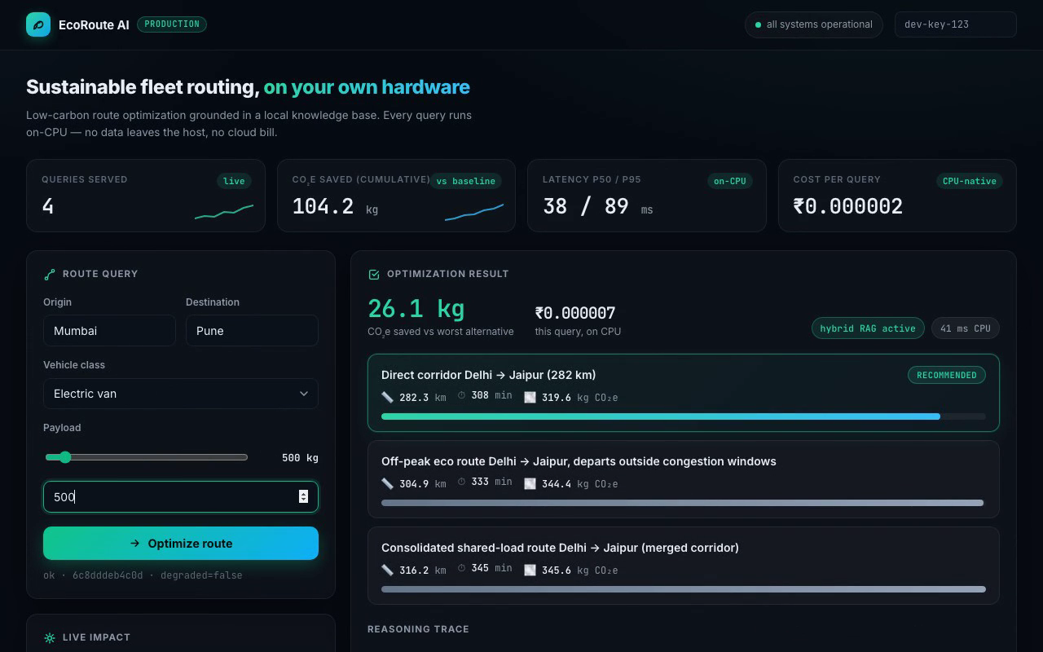
PRODUCT
A production dashboard, not a notebook
▸ Live KPIs queries, cumulative CO₂e saved, latency, cost per query
▸ Route comparison carbon bars across all candidates
▸ Reasoning trace animated timeline with source citations
▸ Impact ledger persistent across restarts
EcoRoute AI · ZIROH Build Next 2026
5

Slide 6
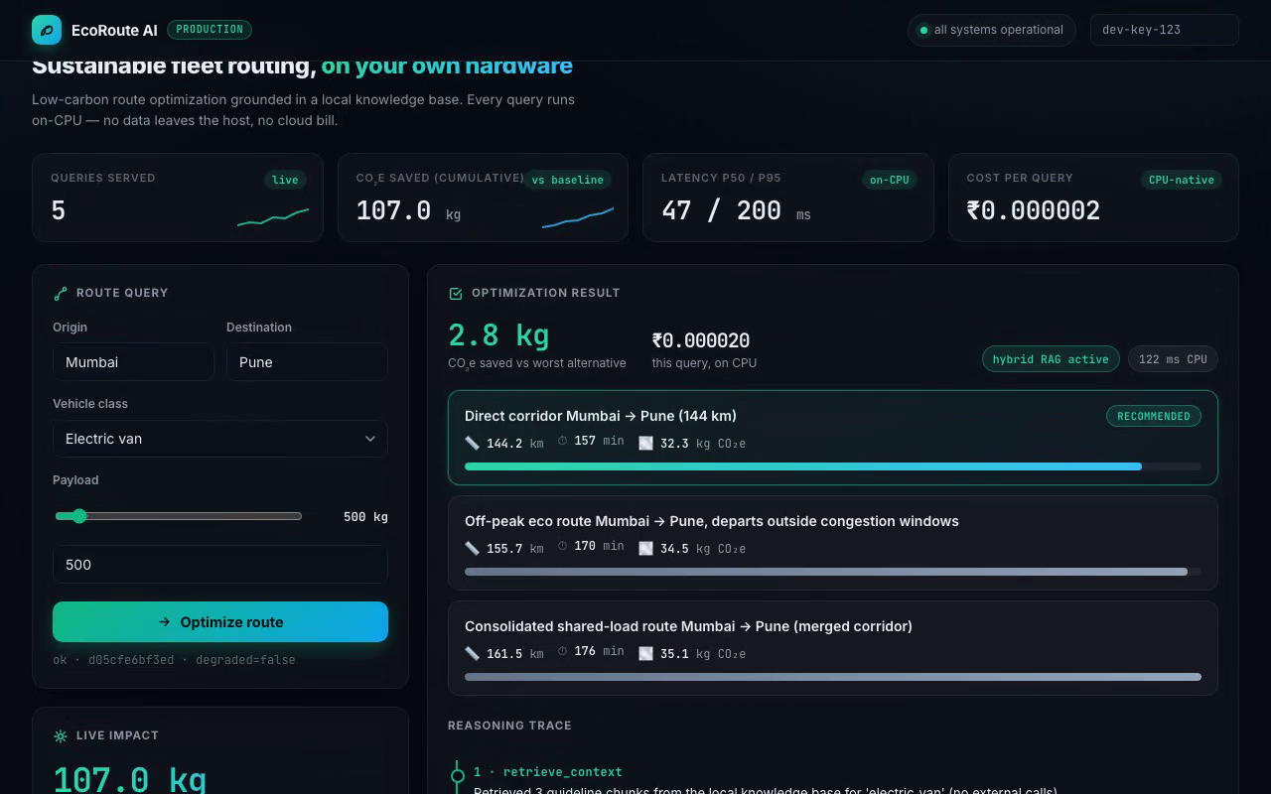
COST-EFFECTIVENESS
The money shot: ₹0.01 vs ₹498 per 10,000 queries
₹0.01
Local CPU stack · 10k queries (measured)
₹498
Cloud LLM API · 10k queries
₹497.99
Saved per 10k queries — on a 65W CPU
EcoRoute AI · ZIROH Build Next 2026
6

Slide 7
EFFICIENCY & ACCURACY
Measured, reproducible, in CI
~82 req/s
p95 155 ms
recall@3 = 1.00
single worker, concurrent load test
end-to-end query latency
retrieval quality on golden set
MRR = 1.00
77 tests
0 CVEs
mean reciprocal rank, 8/8 perfect
unit + integration + eval, all green
pip-audit clean, scanned in CI
Every number above is reproducible: make loadtest · make retrieval-report · make test
EcoRoute AI · ZIROH Build Next 2026
7

Slide 8
SECURITY & PRIVACY
Privacy-first is an architecture decision, not a slogan
Zero external calls
RAG, routing, and inference all run on-device. Customer data never leaves the host — the core privacy guarantee.
API-key auth + rate limiting
per-key sliding-window limits, bounded payloads, strict Pydantic validation on every field.
Production hardening
non-root container, multi-stage Dockerfile, health checks, structured JSON logs with request-id correlation.
Supply-chain security
pip-audit CVE scanning in CI; pinned dependencies; deterministic builds.
EcoRoute AI · ZIROH Build Next 2026
8

Slide 9
ARCHITECTURE
Modular by design — every layer is swappable
API layer
FastAPI · Pydantic v2 · middleware (auth, rate-limit, request-id, error envelope)
Stack
Python 3.11 · FastAPI · Uvicorn
faiss-cpu · sentence-transformers
Pydantic v2 · pydantic-settings
SQLite · psutil · Prometheus metrics
Docker (multi-stage, non-root)
GitHub Actions: ruff → mypy → pytest → pip-audit → docker build
Agent orchestrator
retrieve → compute → select → synthesize → report; per-query CPU/energy measurement
Local RAG engine
FAISS (all-MiniLM-L6-v2) + custom BM25 + Reciprocal Rank Fusion; graceful BM25-only degradation
Domain engines
deterministic carbon model · Haversine road distances (29 cities) · SQLite impact ledger
Inference provider
protocol-based: heuristic (default) ⇄ Kompact AI runtime — one env var, zero upstream changes
EcoRoute AI · ZIROH Build Next 2026
9

Slide 10
PHASE 2 & WHY WE WIN
Built to grow into the Kompact AI runtime
Kompact AI readiness
Why this wins
Inference sits behind an InferenceProvider protocol.
INFERENCE_PROVIDER=kompact
swaps the heuristic synthesizer for the Kompact runtime with zero changes to the agent, API, or RAG layers.
▸ Sustainability per-query + cumulative CO₂e, grounded in real norms
▸ Cost ₹0.01 vs ₹498 per 10k queries, measured
▸ Efficiency 82 req/s, p95 155 ms, recall@3 1.00
Try it in 30 seconds
make install && make index && make dev → http://localhost:8000
github.com/Sakshambh09/ecoroute-ai · 77 tests · green CI · Docker · one-command setup
EcoRoute AI · ZIROH Build Next 2026
10

