Slide 1
AIRDASHER
ANALYTICAL INTELLIGENCE IN ROUTE DEVELOPMENT AND STRATEGIC HANDLING OF ECONOMIC RESOURCES
SUBMISSION FOR THE R² DATA LABS RESPONSIBLE GROWTH HACKATHON
TEAM: π-thon (Sakshat Rao)
Notes:
Title

Slide 2



WHAT IS THE PROBLEM HERE?
DEMAND FOR AIR TRAVEL IS EXPECTED TO RAPIDLY INCREASE FOR THE NEXT FEW YEARS DUE TO -
FOR LOW-COST U.S. CARRIERS, AS LOW AS 50% OF NEWLY DEVELOPED ROUTES REMAINED IN SERVICE TWO YEARS AFTER INAUGURATION. HOW TO INCREASE THE SUCCESS RATE OF SUCH NEW ROUTES?
GROWING ECONOMIES ACROSS INDIA INCREASE DEMAND FOR INTER-CITY AIR TRAVEL
DIRECT CUSTOMER FEEDBACK IS USEFUL BUT DIFFICULT, TIME-CONSUMING & EXPENSIVE TO COLLECT. CAN CITY-WISE MACRO-ECONOMIC FACTORS BE USED TO PREDICT DEMAND FOR NEW ROUTES?
LOWER FLIGHT FARES HAVE BRIDGED THE INCOME GAP, ESPECIALLY FOR THE MIDDLE-CLASS
CIVIL AVIATION INDUSTRY IS EXPECTED TO RECOVER & GROW FOR POST-PANDEMIC PERIODS
NEW ROUTE DEVELOPMENT HAS SEVERAL COMPLEXITIES INVOLVED IN TERMS OF BUSINESS MODEL, STRATEGIES & PARAMETERS. CAN A SYSTEM BE BUILT TO PROVIDE PARAMETERIZED COST ANALYSIS?
THIS HAS PROVIDED AIRPORTS WITH AN OPPORTUNITY TO EXPAND THEIR NETWORK & CAPITALIZE ON THE INCREASING DEMAND.
Notes:
Problem

Slide 3


APPLICATIONS OF AIRDASHER
NEW ROUTE DEVELOPMENT
NEW AIRPORTS
DATA-DRIVEN SUGGESTIONS FOR CREATION OF NEW AIRPORTS IN CITIES
CITY SELECTION
ROUTE SELECTION
COST AND RESOURCE ANALYSIS
HAVING HIGH DEMAND AND FUTURE GROWTH IN AIR TRAFFIC
CIVIL AVIATION ANALYTICS
Identify cities having high demand & growth in air travel
Identify best routes to integrate city into airline’s network
Perform highly parameterized cost & resource analysis
STATISTICS & INSIGHTS ABOUT INDIAN/APAC CIVIL AVIATION SECTOR
Notes:
Applications

Slide 4
MARKET SIZE & COMPETITION
APPLICATIONS | TARGETED MARKET | COMPETITION
Route Opportunity Analysis | Airlines | Jeppesen Aircraft Routing, ASM Passenger Route Forecast
Route Cost Analysis & Optimizations | Airlines | ASM Passenger Route Forecast Tool
New Route/Airport Development | Airports | Avia Solutions’ Route Development, ASM Airport Long Term Passenger Forecast
New Route/Airport Development | Regional Governments / Tourism Boards | Avia Solutions’ Route Development
Aviation Analytics | Aircraft Lessors & Manufacturers/OEMs | Cirium Airline Routes
MARKET | MARKET SIZE | MARKET GROWTH
Indian Airlines | 8 Major + 6 Scheduled Commuter Airlines with total of 700+ operating fleet size | India is the 3rd largest & fastest growing aviation sector in the world. Among 14 main Indian airlines, 1400+ new orders have been made to increase total fleet by ~200%.
Route Development Analytics | Global Aviation Analytics market worth ~$2 billion dollars while Route Profitability Software market worth ~$10 billion | Global Aviation Analytics market expected to grow to ~$5 billion by 2028 at CAGR of 12% while Route Profitability Software market expected to grow to $27 billion by 2030 at CAGR of 10%.
Notes:
Market & Competition

Slide 5
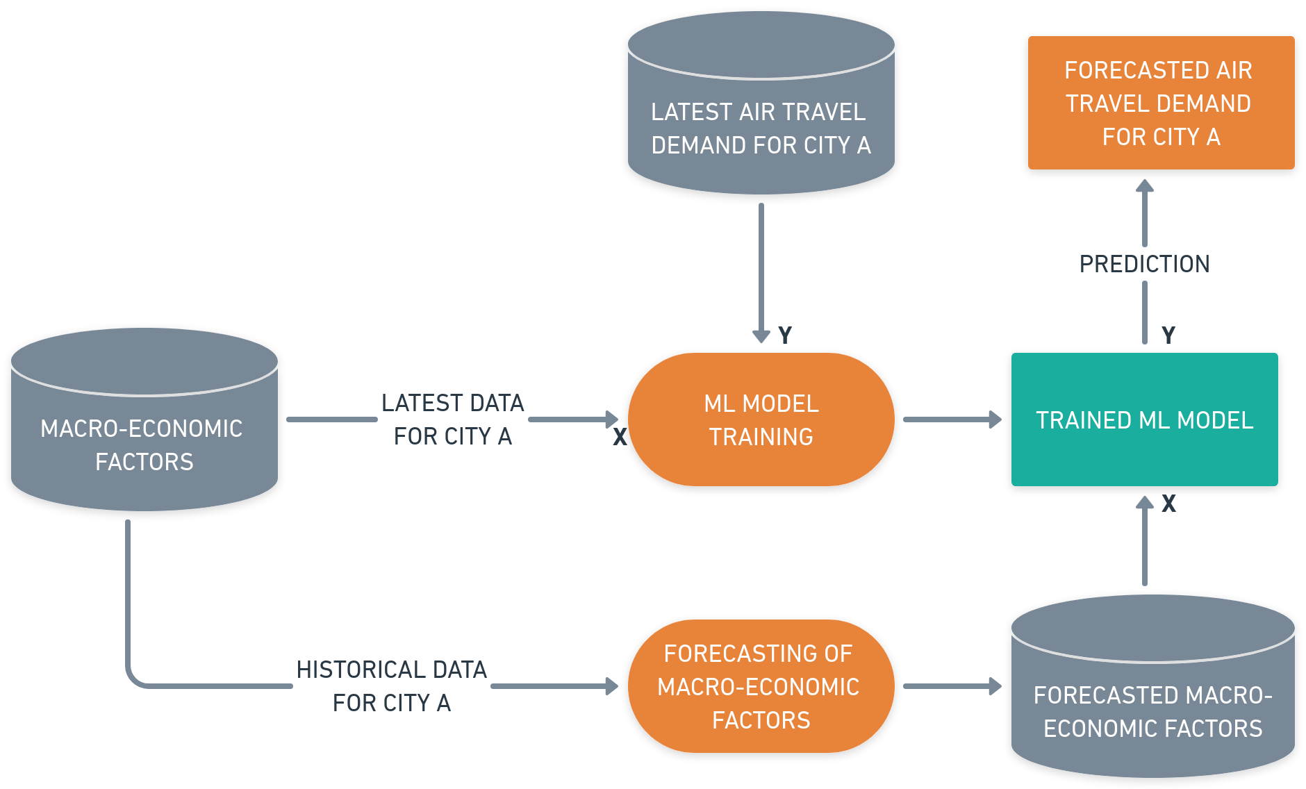
ROUTE DEVELOPMENT:
STEP 1 - CITY SELECTION
USE MACRO-ECONOMIC FACTORS TO TRAIN A MODEL. THEN FORECAST THESE MACRO-ECONOMIC FACTORS, APPLY THEM TO THE TRAINED MODEL TO GET FORECASTS
Notes:
City Selection

Slide 6
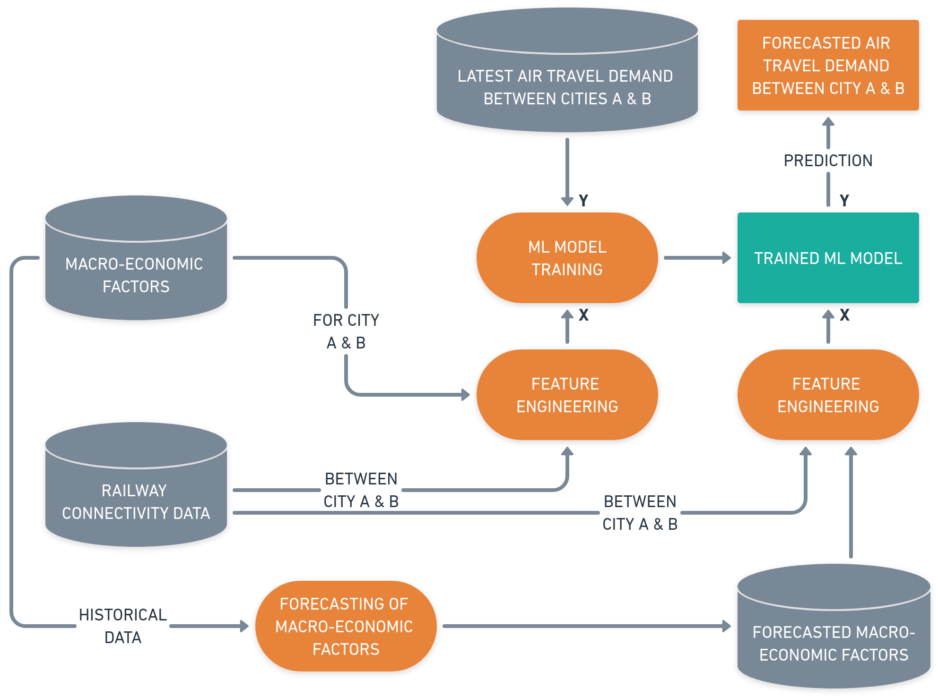
ROUTE DEVELOPMENT:
STEP 2 - ROUTE SELECTION
USE MACRO-ECONOMIC FACTORS OF SOURCE & DESTINATION CITIES ALONG WITH RAILWAY CONNECTIVITY DATA TO TRAIN A MODEL. THEN FORECAST THE MACRO-ECONOMIC FACTORS, APPLY THEM FOR SOURCE & DESTINATION CITIES ALONG WITH RAILWAY CONNECTIVITY DATA TO THE TRAINED MODEL TO GET FORECASTS
Notes:
Route Selection

Slide 7
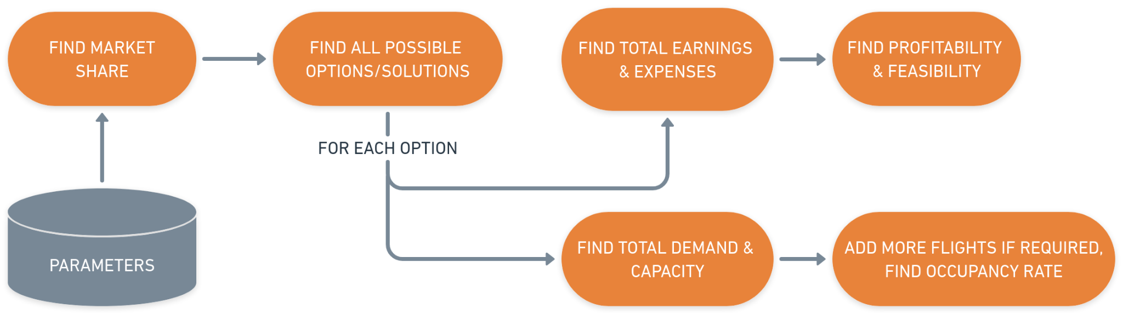
ROUTE DEVELOPMENT:
STEP 3 - COST/RESOURCE ANALYSIS
FOR A GIVEN ROUTE, FIND MARKET SHARE BASED ON PRICING & NO. OF FLIGHTS. THEN FOR DIFFERENT COMBINATIONS/OPTIONS OF FREQUENCIES & AIRCRAFT TYPES, CALCULATE THE TOTAL EARNINGS, EXPENSES, DEMAND & CAPACITIES TO JUDGE AN OPTION’S FEASIBILITY
Notes:
Cost & Resource analysis

Slide 8
OTHER APPLICATIONS
NEW AIRPORTS
CIVIL AVIATION ANALYTICS
USE THE TRAINED MODEL IN ‘CITY SELECTION’ STEP TO PREDICT CURRENT AIR TRAVEL DEMAND FOR A CITY WITH NO AIRPORT
FIND INSIGHTS & STATISTICS FROM A COMPREHENSIVE MANUALLY-BUILT DATASET COMPRISING INFORMATION OF 850+ FLIGHTS CONNECTING 125+ INDIAN TIER-I/II CITIES AS WELL AS ASIA-PACIFIC REGIONS
FORECAST THE MACRO-ECONOMIC FACTORS OF CITY, APPLY IT TO THE MODEL AGAIN TO GET FORECASTED AIR TRAVEL DEMAND
Notes:
Other applications

Slide 9
BUSINESS MODEL
END-TO-END ROUTE DEVELOPMENT TOOL FOR AIRLINES
CIVIL AVIATION SECTOR
ANALYTICS TOOL
Targeted towards Airlines
Application includes Air Travel Demand Analysis along with Parameterized Cost & Resource Analysis
Targeted towards Airports, Regional Governments / Tourism Boards, Aircraft Manufacturers & OEMs
Application includes Air Travel Demand Analysis of India/APAC civil aviation sector
BUSINESS FEATURE | OPEX
WEB SERVER (RENT), DOMAIN NAME, SSL CERTIFICATES, WEB DESIGN | $100 / MONTH
MARKETING & SEO | $5000 / MONTH
BUSINESS CLOUD STORAGE | $25 / MONTH
TIMELINE:
STAGE | DURATION
MINIMUM VIABLE PRODUCT | 3 MONTHS
PRODUCT OFFERING | 9 MONTHS
Notes:
Business model

Slide 10



KEY SUCCESS FACTORS
QUICK ENTRY INTO MARKET TO CAPITALIZE ON POST-PANDEMIC REVIVAL & GROWTH OF AIR TRAVEL ACROSS INDIA
BEST FORECASTS COULD BE OBTAINED BY COMBINING DIRECT CUSTOMER FEEDBACK WITH MACRO-ECONOMIC INFO
EXPERT KNOWLEDGE ON AIRLINE OPERATIONS, COSTS, RISKS & STRATEGIES WILL HELP IN SETTING CORE BUSINESS DIRECTION
Notes:
Key Success Factors

