Slide 1
Data Analytics & R
Topic : Application Of Multiple Regression In Fashion Industry
Submitted To : Submitted By:
Prof. J.P. Behera Sakshee Sree
BFT/18/202
Sem-6

Slide 2
Objective
R programming helps us to analyze a given set of data.
Case study on Multiple Regression in fashion industry - Using an equation which has two independent variable to predict a dependent variable.

Slide 3
Case Study : Multiple Regression
In this I have used multiple regression to calculate the worker efficiency.
I have done this on the basis of rework and the no of pieces that has been produced. (Considering the number of pieces given to each worker is the same).
Independent variables :
Rework.pieces
Number of pieces produced
Dependent variable :
Workereff

Slide 4
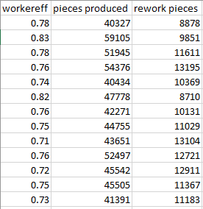
CSV Data

Slide 5
R Code
data1 <- read.csv(file.choose(), sep = ',')
View(data1)
model <- lm(workereff~pieces.produced+rework.pieces, data = data1[,c("workereff","pieces.produced","rework.pieces")])
model
a <- coef(model)[1]
a
b1 <- coef(model)[2]
b2 <- coef(model)[3]
b1
b2
newdata <- data.frame(pieces.produced = 120, rework.pieces = 10)
workereff <- predict(model,newdata)
workereff

Slide 6
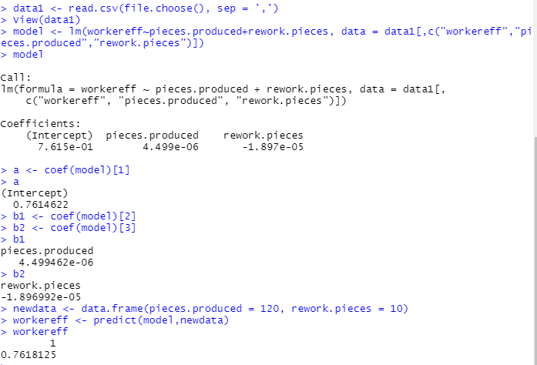
Output

Slide 7
THANK YOU!

