Slide 1

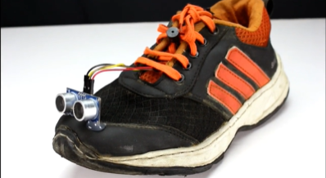
Internet Of Things Jury Assignment
Smart Shoes For Blind People Using Ultrasonic Sensor And Vibration Motor
Submitted To : Prof. Jyoti Prakash Behera
Submitted By :
Sakshee Sree(BFT/18/202)

Slide 2
Working Of Smart Shoes
The main objective is to help visually challenged people to navigate with ease using advance technology. In this technology controlled world, where people strive to live independently, this project proposes an ultrasonic shoe for blind people to help them gain personal independence. Since this is economical and not bulky, one can make use of it easily.
This shoe is especially designed for blind people that allows them to sense objects before their shoes touch them.
Our proposed project first uses ultrasonic sensor to detect obstacles without touching it using ultrasonic waves. On sensing obstacles the sensor passes this data to the microcontroller.
The microcontroller then processes this data and calculates if the obstacle is close enough. If the obstacle is far the circuit does nothing but If the obstacle is close the microcontroller sends a signal to sound a buzzer and a LED Light turns red and the vibration motor starts vibrating .
Ultrasonic sensor is used to detect any obstacle in front of blind person. It has Detection Distance of 2cm-50cm so whenever there is some obstacle in this range it will alert the blind person.

Slide 3
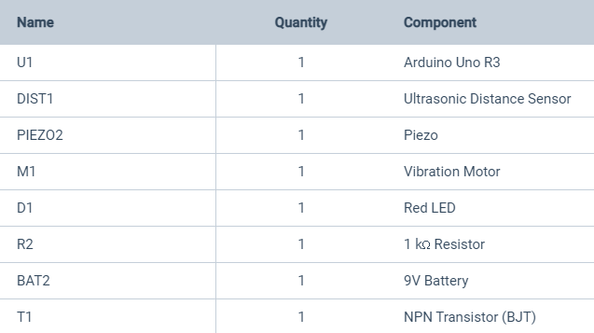
Components Used

Slide 4
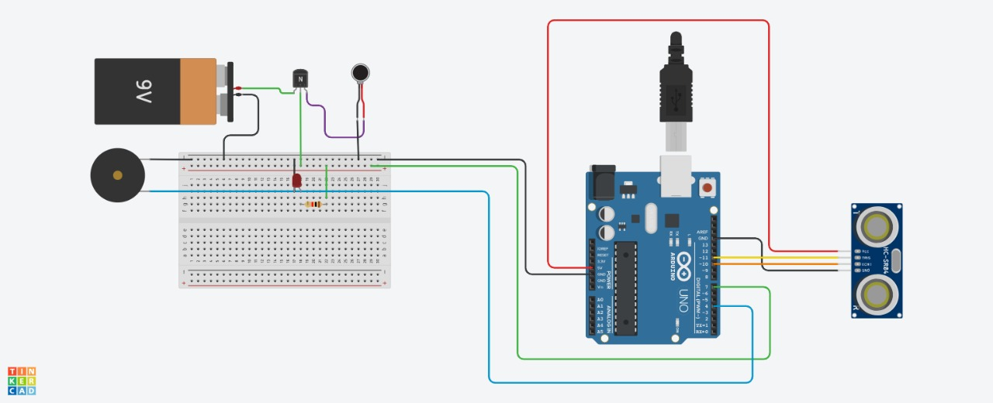
Circuit Diagram Before Stimulation

Slide 5
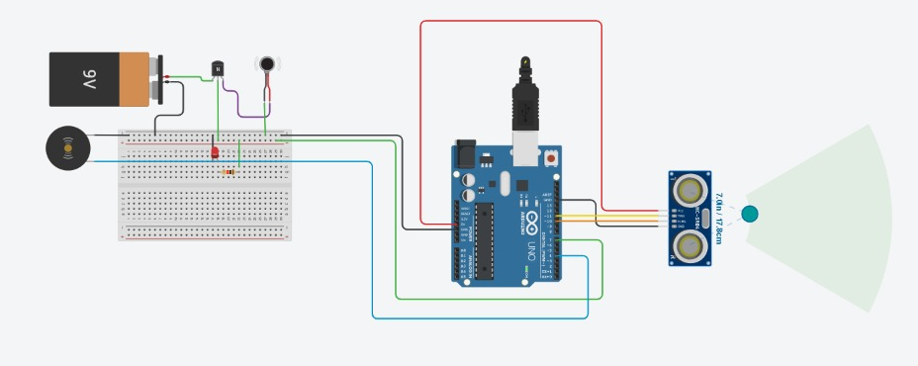
Circuit Diagram After Stimulation
Tinkercad Link : https://www.tinkercad.com/things/kphJv35rcWZ-brilliant-albar/editel?sharecode=TFWGJZjtA3dCoDMPepYKy24H65zizRmIi0OmsGXRies

Slide 6
Coding
#define trigPin 11
#define echoPin 10
#define motor 7
#define buzzer 4
void setup()
{
pinMode(trigPin, OUTPUT);
pinMode(echoPin, INPUT);
pinMode(motor, OUTPUT);
pinMode(buzzer, OUTPUT);
}
void loop()
{
long duration, distance;
digitalWrite(trigPin, LOW);
delayMicroseconds(2);
digitalWrite(trigPin, HIGH);
delayMicroseconds(10);
digitalWrite(trigPin, LOW);
duration = pulseIn(echoPin, HIGH);
distance = (duration/2) / 29.1;
if (distance <= 50)
{
digitalWrite(motor, HIGH);
digitalWrite(buzzer, HIGH);
}
else
{
digitalWrite(motor, LOW);
digitalWrite(buzzer, LOW);
}
delay(500);
}

Slide 7
Tinkercad Link
https://www.tinkercad.com/things/kphJv35rcWZ-brilliant-albar/editel?sharecode=TFWGJZjtA3dCoDMPepYKy24H65zizRmIi0OmsGXRies

