Slide 1
Submitted By : Team- 5709 Sakshee Suryawanshi Akash Kaushik
“Driving Revenue, Unlocking Ride Potential: Technical Insights from Namma Yatri”

Slide 2
Agenda :
Objective
Background
Data Preparation and Cleaning
Pipeline Complexity Breakdown
Key DAX Measures and Calculations
Analytical Insights
Optimization Actions
Appendix:
PowerBI Dashboards and Visuals
Data Dictionary
Data Methodology

Slide 3
Objective
Our Goal is to :
Improve model relationships and data pipeline quality.
Provide robust calculated fields to track KPIs.
Deliver scalable insights with dynamic filtering and performance-based visualization.

Slide 4
Background:
Namma Yatri provided Raw ride data includes: trip duration, fare, cancellation flags, zones, payment methods.
Data Tables included: Trips, Trip Details, Drivers, Customers, Zones and spread across multiple Excel tables.
No timestamps present; only duration in hours available for time-based analysis.

Slide 5
Data Preparation and Cleaning:
Key Tables Used: ‘Trips’, ‘Trip_Details’, ‘Assembly’, ‘Payment’ and ‘Duration’
Relationships:
Imported and Joined all tables using tripid, Payment id, duration id and Assembly id .
Cleaned data using Power Query (nulls, duplicates, flag correction)
DAX Measures used to drive calculated fields: Total revenue, trip success rates, Time_Period and many more.

Slide 6
Pipeline Complexity Breakdown:
No explicit timestamps, Used Duration to create Time Buckets i.e. “Time _Period”
Flag Logic Complexity :Ride completion based on multiple binary flags: end_ride, otp_entered.
No direct linkage between quote search and trip success without logical conditions.

Slide 7
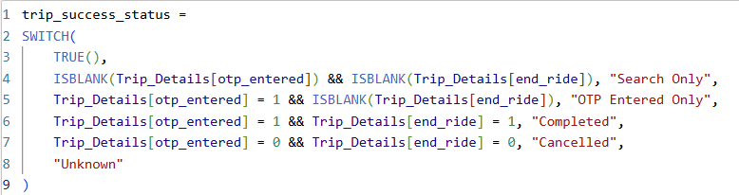
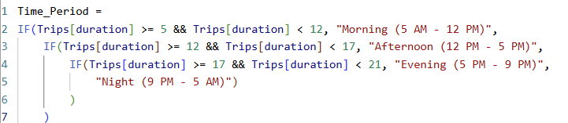

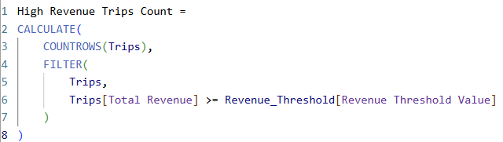
Key DAX Measures and Calculations:
The Key DAX Measures used for Namma Yatri Analysis :
Trip_success_status
Time_Periods
Total Revenue
High Revenue Trip Counts
Conversion QuoteTripCompletion %
Successful Ride Completion %
Total Quote Searches and many more..

Slide 8
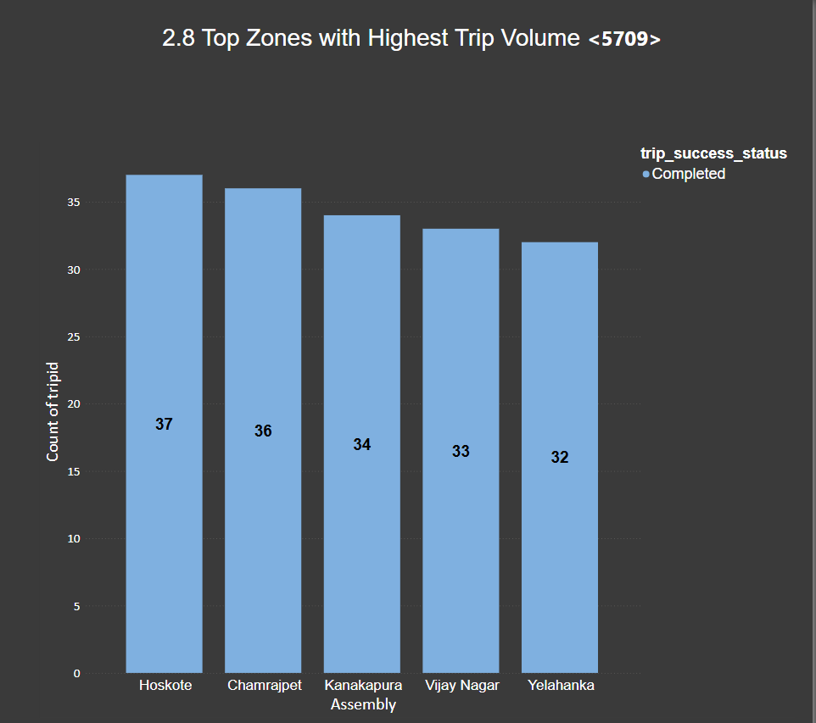
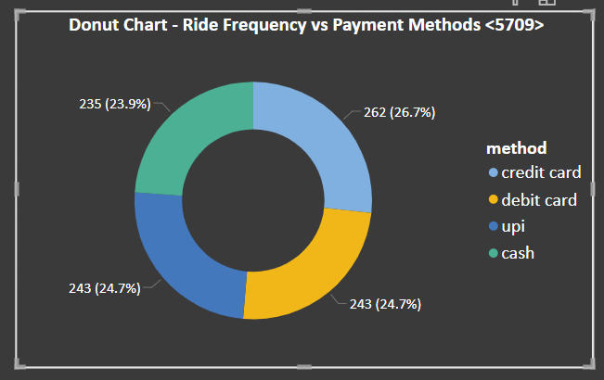
Analytical Insights:
Payment Preference Patterns:
Card/UPI payments correlated with higher fare rides
High Revenue Zones:
Focus promotions and incentives in Top 5 Zones
Peak Demand Hours:
Highest rides at 12 AM–1 AM (Night) and 1 PM–2 PM (Afternoon)
Resource realignment needed to match driver availability.

Slide 9
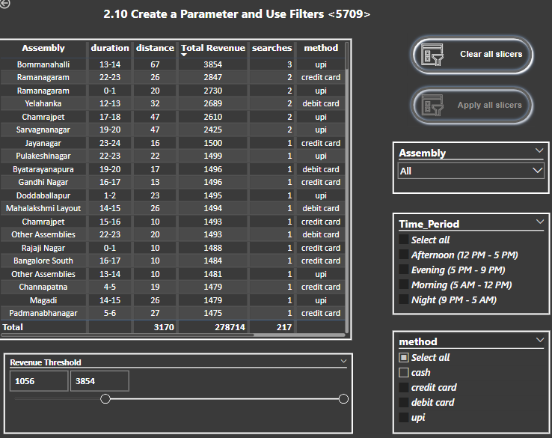
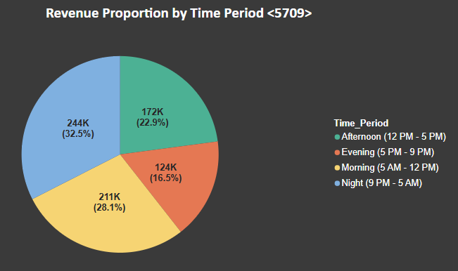
Appendix:
Power BI Features Used:
Slicers : Payment Methods, Assembly(Zones), Time_Periods.
Parameters: Revenue thresholds
Visuals: funnel drop chart, high-revenue zone treemap etc.

Slide 10
Appendix : Data Dictionary
Here is a snapshot of our data dictionary:
Trips Table: distance, customer details, fare, duration information
Trip_Details Table: search intent, quotes, estimates, Flags (end_ride, otp_entered).
Duration Table : Hours of Trip details.
Assembly Table: Pickup and drop zone mapping.
Payments Table: Payment Method status.
Data Source : From Excel Workbook Namma Yatri Dataset

Slide 11
Appendix : Data Methodology
Imported and Cleaned all tables using Power Query (null checks, column types).
Joined tables on keys (trip ID, zone ID) and Created DAX logic for revenue, status, and conversions.
Visualized using maps, bar charts, slicers & cards and Validated insights against KPIs and business objectives.

