Slide 1
Submitted By : Team- 5709 Sakshee Suryawanshi Akash Kaushik
“Driving Revenue, Unlocking Ride Potential: Business Insights from Namma Yatri”

Slide 2
Agenda :
Objective : “Analytical and Engineering Objective”
Background
Key Findings: “Pipeline Gaps: Where Are We Losing Potential Riders ”
Strategic Action Plan
Appendix:
Dashboards and Visuals
Data Sources
Data Methodology

Slide 3
Objective
Our Goal is to :
Improve ride completion by optimizing trip success and reduce operational inefficiencies.
Provide targeted strategies to optimize ride demands, driver-customer experience and revenue trends.
Detail actionable insights for resource allocation, zone-based performances and market strategies.

Slide 4
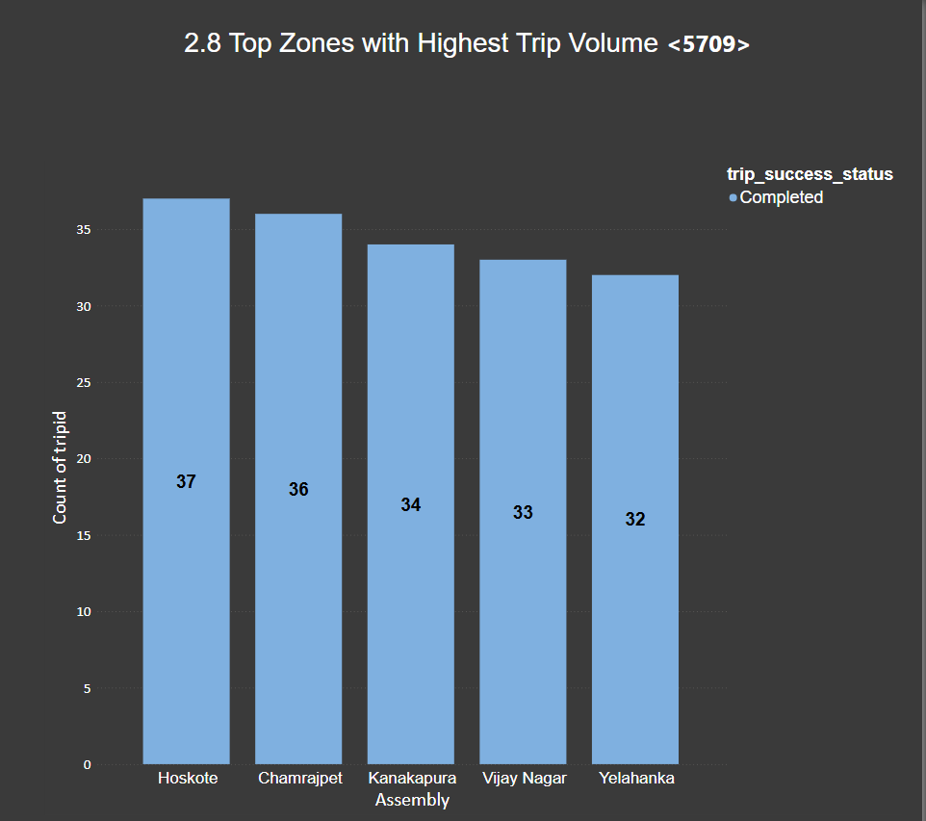
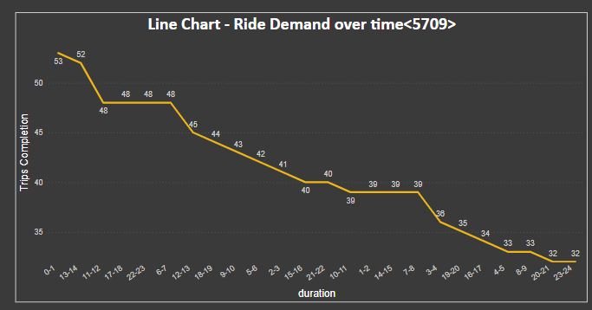
Background:
Namma Yatri is a city-based, ride-hailing platform seeking profitability and improve service efficiency.
Few zones dominated trip volume and revenue, while others underperform.
High variability in demand across zones, trip success, time periods and revenue generation.

Slide 5
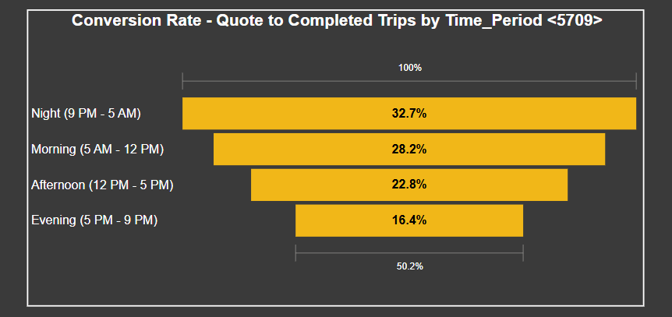
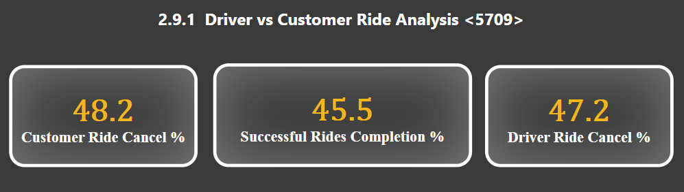
“Pipeline Gaps: Where Are We Losing Potential Riders?”
High Ride cancellation rates for Driver – 47.2 % and Customer – 48.2% .
Demand fluctuations and inconsistent revenue across various pickup zones and time periods.
Low Conversion from Quote to Completed Trips in some time zones.

Slide 6
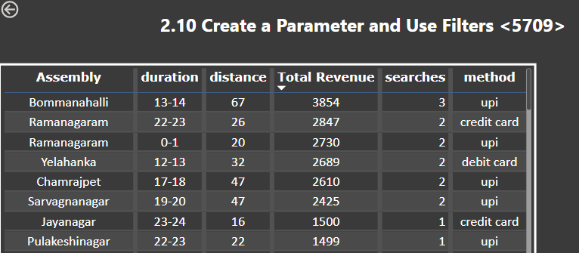
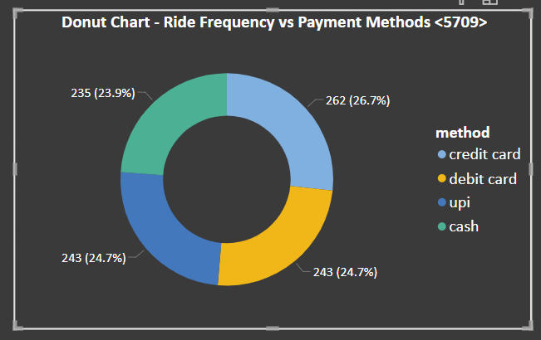
“Online Payments & Reward Offers –> High Opportunity of Conversion”
Around 75.3% of Customer prefers online payment methods like UPI, Wallet(Credit/Debit Cars).
Customers from all top revenue generating zones prefers online more than cash.
Earning cashback/ride points using online payment encourages customers to ride more with savings.

Slide 7
Strategic Action Plans:
Marketing : Geo-targeted Ads for low demand zones and Introduce Referral Programs for user growths.
Cancellation Mitigation : Strict Cancellation policies with real-time alerts and offer bonus and rewards for successful Ride Completions.
Digital Payment Adoption : Promote Cashback or loyalty offers for paying online for Rides.

Slide 8
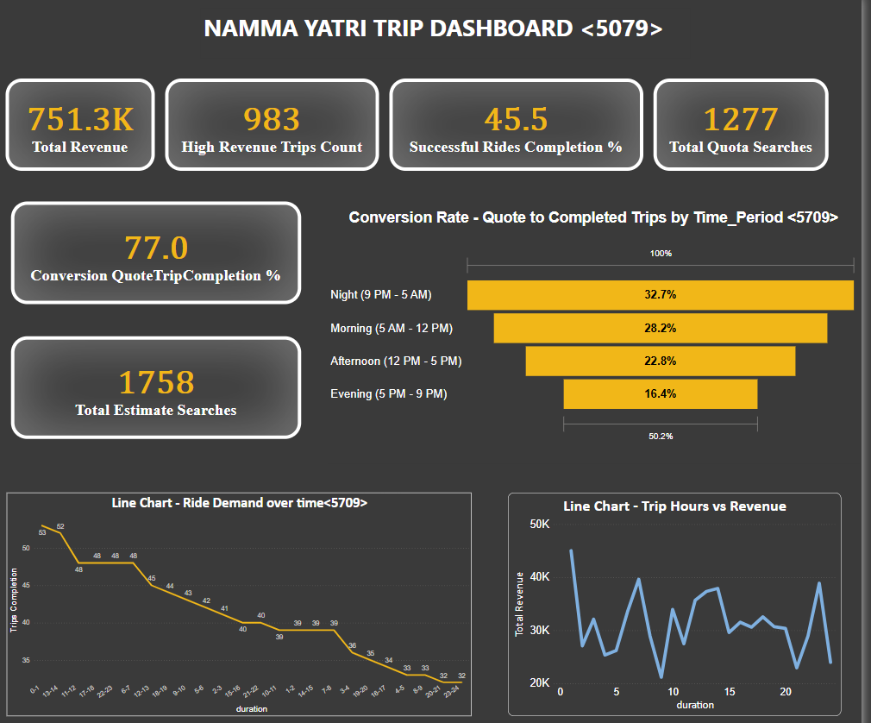
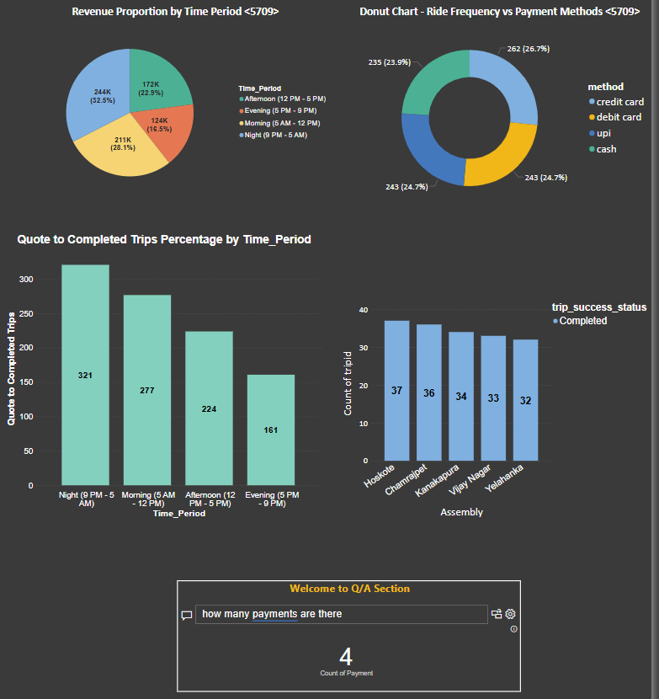
Appendix: Dashboards and Visuals

Slide 9
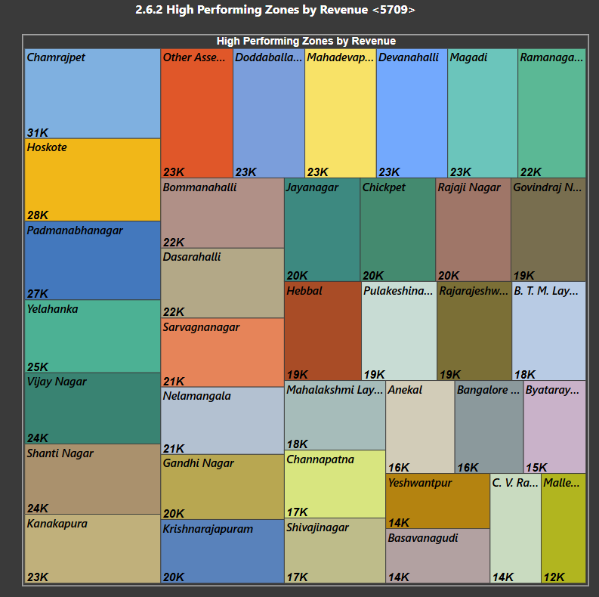
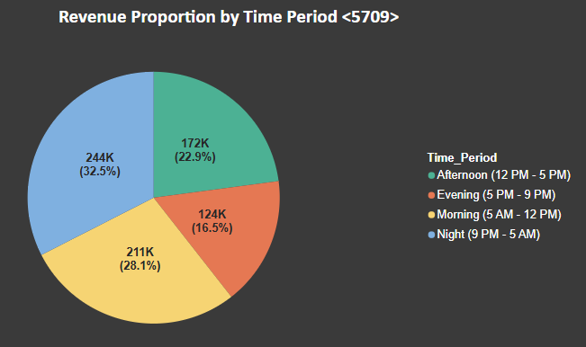
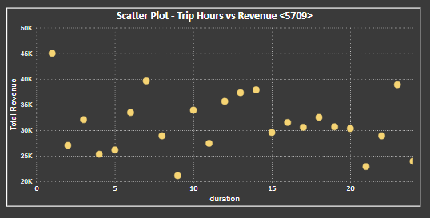
Appendix: Dashboards and Visuals

Slide 10
Appendix : Data Sources
Here is a snapshot of our data dictionary:
Trips Table: distance, customer details, fare, duration information
Trip_Details Table: search intent, quotes, estimates, Flags (end_ride, otp_entered).
Duration Table : Hours of Trip details.
Assembly Table: Pickup and drop zone mapping.
Payments Table: Payment Method status.
The team used cleaned Excel sheets provided by Namma Yatri for Power BI modeling.

Slide 11
Appendix : Data Methodology
Joined relevant tables, cleaned and created calculated columns and parameters (Trip Status, Revenue Thresholds)
Built Final dashboards filtered by zone, time period, payment type, and revenue thresholds visual using slicers, filters, and DAX.
Focused on visualizing key performance indicators with minimal clutter

