Slide 1


Topic: Water Resource Management
Sub-Topic: Rainfall Analysis and Prediction using Python
Presenting by: Sakshi B K

Slide 2

Learning Objectives
Understand and analyze long-term rainfall trends in India
Perform data preprocessing and exploratory data analysis (EDA)
Build a machine learning model for rainfall prediction
Interpret model accuracy using R² score and Mean Squared Error (MSE)
Use visualizations for better decision-making in water planning
GOAL
Source :
www.freepik.com/

Slide 3
Tools and Technology used :
1.Platform: Google Colab – for cloud-based coding and execution
2. Language: Python – used for data handling and machine learning
3. Libraries:
Pandas – for data manipulation
Matplotlib & Seaborn – for data visualization
scikit-learn – for building and evaluating the ML mode
4. Version Control: GitHub – for storing and sharing project files
These tools enabled efficient data analysis, model development, visualization, and collaboration.

Slide 4
Methodology
Data Collection & Cleaning: The project begins by using a historical rainfall dataset spanning from 1901 to 2015. Missing values were removed to ensure accurate analysis.
Annual Rainfall Calculation: Monthly rainfall data was aggregated to calculate the total annual rainfall for each year, which served as the main feature for trend analysis and prediction.
Exploratory Data Analysis (EDA): Various visualizations such as line graphs were created to explore patterns, fluctuations, and long-term trends in annual rainfall across India.
Model Building – Linear Regression: A Linear Regression model was trained to learn the relationship between time (year) and rainfall, aiming to predict future rainfall based on historical trends.
Model Evaluation: The model’s performance was assessed using metrics like R² Score (to measure accuracy) and Mean Squared Error (MSE) (to measure prediction error).

Slide 5
Problem Statement:
Rainfall plays a vital role in agriculture, water supply, and disaster preparedness. However, in recent years, rainfall patterns have become increasingly unpredictable, affecting planning and resource management.
The lack of reliable prediction tools makes it difficult to manage water resources effectively. This project uses historical rainfall data to analyze trends and build a predictive model that can support better decision-making in water resource planning.

Slide 6
Solution:
1. Used Python to clean and process historical rainfall data (1901–2015)
2. Performed trend analysis to identify patterns in annual rainfall
3. Applied a Linear Regression model to predict future rainfall
4. Evaluated model using R² Score and Mean Squared Error (MSE)
5. Created visualizations to support easy interpretation of data and predictions
6. Provides a data-driven solution to assist in water planning and climate decision-making

Slide 7
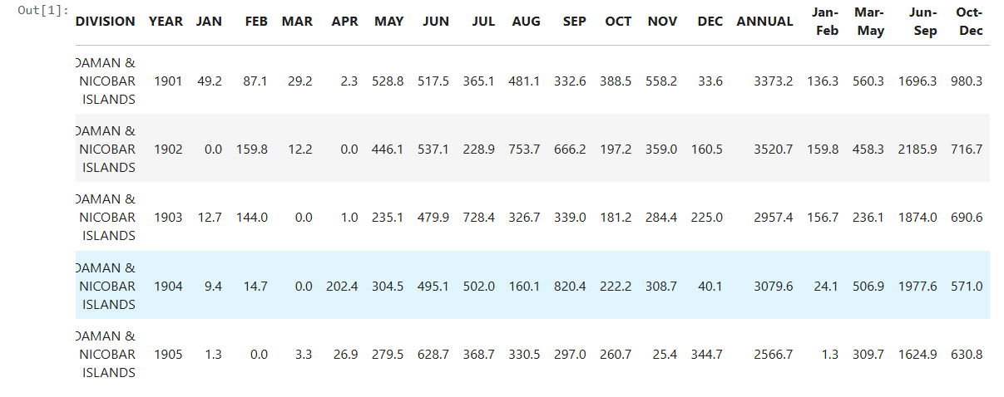
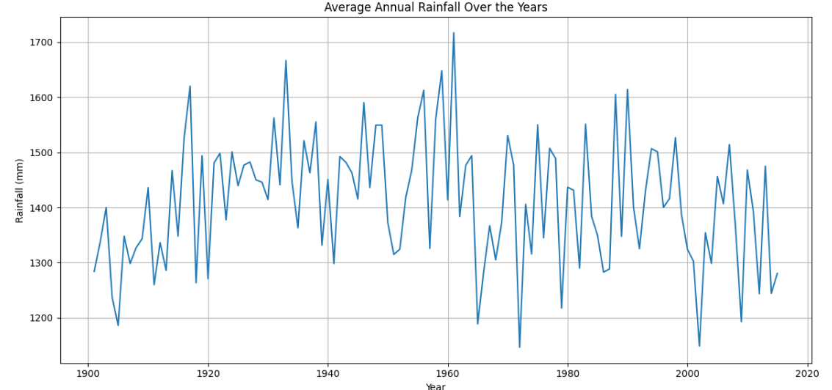
Screenshot of Output:
1.Week-1 Output:

Slide 8
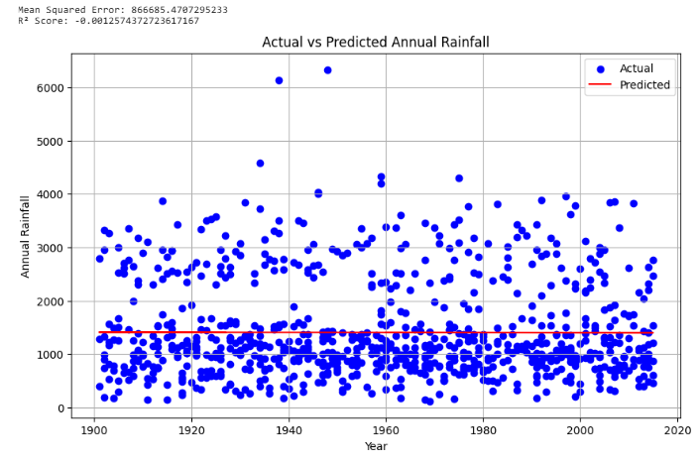
Screenshot of Output:
2.Week-2 Output:

Slide 9
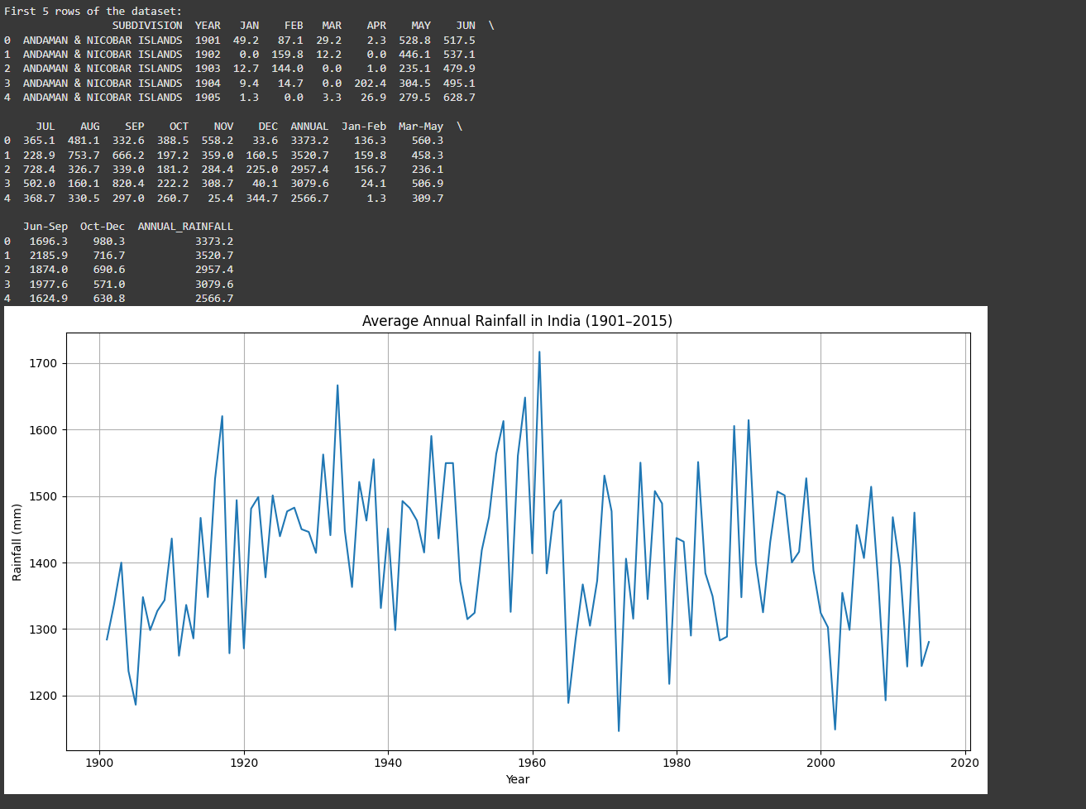
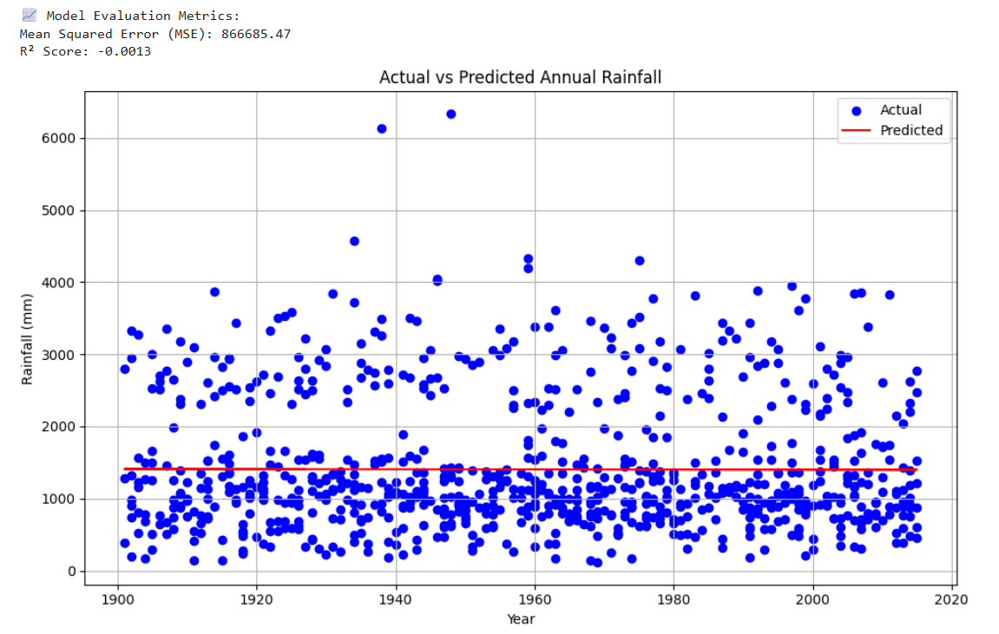
Screenshot of Output:
2.Week-3 Output:

Slide 10
Conclusion:
Rainfall data shows high year-to-year variability
EDA helps reveal useful long-term insights
Linear Regression gives a basic prediction model
The project lays a foundation for further improvements using advanced ML techniques (e.g., Random Forest, LSTM)

